Slide 1
Channel Access for Multi-link Operation
Date: 2019-07-15
Authors:
Name | Affiliation | Address | Phone | Email
Insun Jang | LG Electronics | 19, Yangjae-daero 11gil, Seocho-gu, Seoul 137-130, Korea |  | insun.jang@lge.com
Jinsoo Choi |  |  |  | js.choi@lge.com
Jeongki Kim |  |  |  | jeongki.kim@lge.com
Suhwook Kim |  |  |  | suhwook.kim@lge.com
Sungjin Park |  |  |  | allean.park@lge.com
Taewon Song |  |  |  | taewon.song@lge.com

Slide 2
Introduction
In the last meeting, Asynchronous (or independent) operation and Synchronous (or simultaneous) operation were addressed as modes of multi-link aggregation/operation [1]-[6]
In this contribution, we discuss channel access for those operations

Slide 3
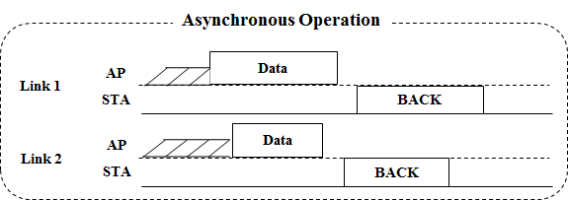
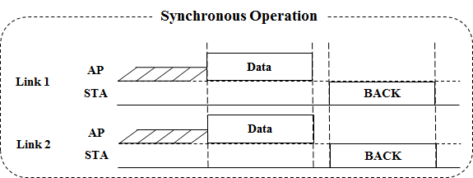
Modes of Multi-link Operation
Both of Asynchronous (Async.) mode and Synchronous (Sync.) mode are proper multi-link operations to increase the peak throughput by aggregating multi-links
Basically, we need to consider channel access for (re)transmission using multi-link operation

Slide 4
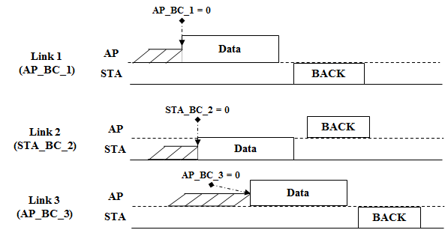
Channel Access in Asynchronous Mode
In Async. mode, an 11be STA (re)transmits and receives frames on each link independently
To support Async. Mode, it is straightforward that EDCA with its parameters (e.g., contention window (CW), backoff counter (BC)) should be performed on a primary channel of each link, independently

Slide 5
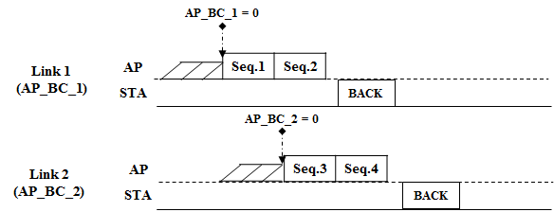
Channel Access in Asynchronous Mode with Common TID
In Async. mode, a common TID over multi-link may be supported, which means traffic flow with a common TID can be transmitted on multi-link
Independent EDCA on each link can support the transmission on multi-link with a common TID without any problems

Slide 6
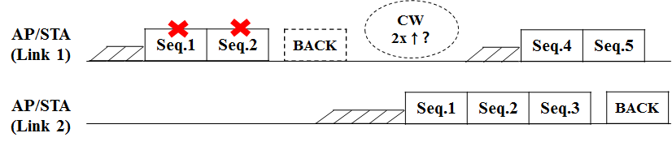
Channel Access in Asynchronous Mode with Common TID (Cont’d)
Especially, support of a common TID over multi-link enables a retransmission in other links on behalf of a link that an initial transmission is performed for the quick re-ordering
In this case, we could consider a CW adjustment for the link (e.g., Link 1) that the initial transmission is performed
  11be can apply the original rule, i.e., CW for link 1 is doubled
  11be may apply a different rule, e.g., CW for link 1 is not doubled because a new data instead of the initial data is transmitted on link 1

Slide 7
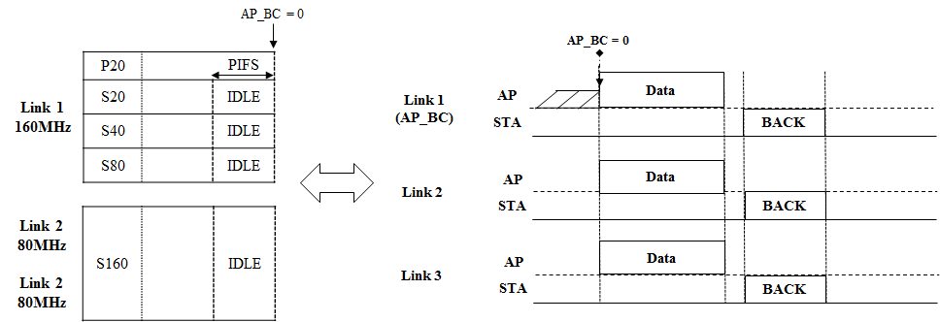
Channel Access in Synchronous Mode with Single Primary
Sync. mode with a single primary channel would use the original EDCA channel access over all of links to aggregate links as in the single-link
For more than 160MHz, an additional rule might be needed (e.g., Secondary160)

Slide 8
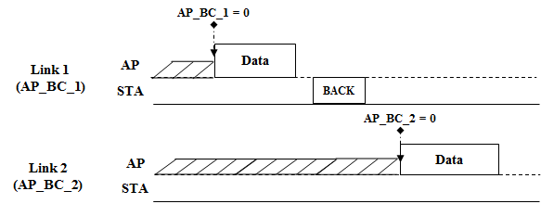
Channel Access in Synchronous Mode with Multiple Primary
Sync. mode with multiple primary channels would use the original EDCA channel access in each link
To aggregate links for transmitting a frame, the start of TXOP in each link shall be aligned; however, the alignment case that BC of each link becomes 0, simultaneously may not be frequent

Slide 9
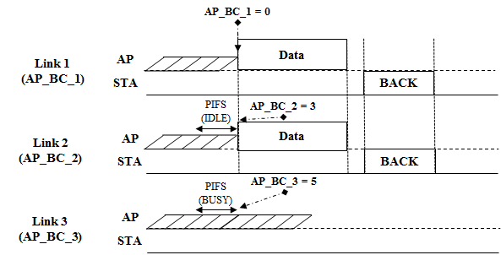
Channel Access in Synchronous Mode with Multiple Primary (Cont’d)
To facilitate the multi-link aggregation, it would be better to design an efficient channel access over multi-link
  For example, if BC of a link becomes zero and the channel states of other links during a certain period are idle, frames can be transmitted by using the links
    A certain period can be PIFS for the priority or AIFS for the fairness

Slide 10
Summary
We have discussed the channel access in both of Asynchronous mode operation and Synchronous mode operation
Asynchronous mode can perform the independent EDCA channel access on each link even in case of a common TID
Synchronous mode with multiple primary can perform an efficient channel access to facilitate multi-link aggregation while Synchronous mode with a single primary would perform the original channel access used in a single link

Slide 11
References
[1] 802.11-19/0731r0 EHT Multi-link Operation
[2] 802.11-19/0766r1 Enhanced Multi-band/Multi-channel Operation
[3] 802.11-19/0764r0 Multi-Link Aggregation: Gain Analysis
[4] 802.11-19/0823r0 Multi-Link Aggregation
[5] 802.11-19/0821r0 Multiple Band Operation Discussion
[6] 802.11-18/1908r0 Overview of Full Duplex over Multi- Band (FD-MB) for EHT

