Slide 1
Some results on HARQ performance in dense deployments
Date: 2019-07-15
Authors:

Slide 2
Abstract
HARQ is a one of the features considered for EHT in order to enhance the performance
In this contribution we present a slightly different way to introduce HARQ, by using a multi-layer approach [1]. Multi-layer transmission allows for a more opportunistic use of the channel and considerably reduces the need for link adaptation. Both these properties are advantages when the signal-to-interference at the receiver is highly unpredictable as e.g. in dense deployments

Slide 3
Outline
Background/Motivation
Basic idea
Simulation results
Straw Poll

Slide 4
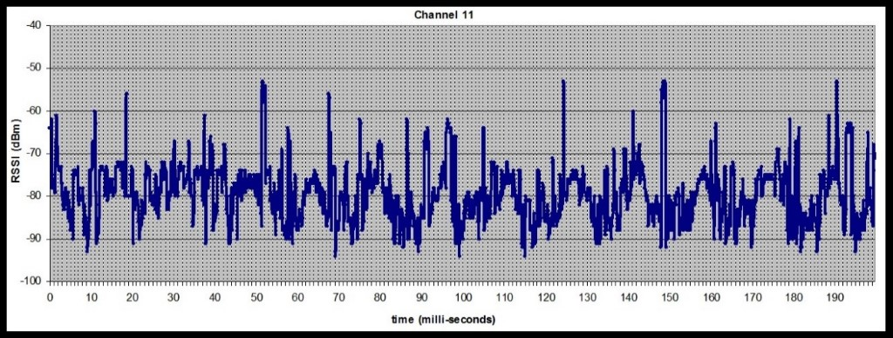
Background/Motivation
To make effective use of the channel, a proper MCS must be used
  This assumes knowledge of the channel
  In dense deployments where the link is interference limited, this is not possible as the experienced interference is essentially random (uncorrelated from one time instant to the next)

Slide 5
Background/Motivation
If the MCS is too low, the channel is not efficiently used
If the MCS is too high, a retransmission is needed
  With HARQ, this is less of a problem since still some information is extracted and can be used for successive transmissions
  However, it comes at the expense of increased delay/jitter
In an ideal case, one should use a high MCS in an opportunistic way
  If the channel is good this can be explored
  If the channel is poor, one should still be able to extract as much information as the channel allows for…

Slide 6
Basic idea – Multi-layer modulation
The problem of unknown channel conditions for the receiver resemble that of broadcast communication in that the channel may be very different for different for different receivers => Not possible for the transmitter to optimize for a specific receiver, but a receiver should do the best out of the situation…
In [1], the broadcasting problem is analyzed theoretically. Motivated by the need to obtain high efficiency at low latency
Here a very pragmatic approach is taken to improve performance with a minimum of changes

Slide 7
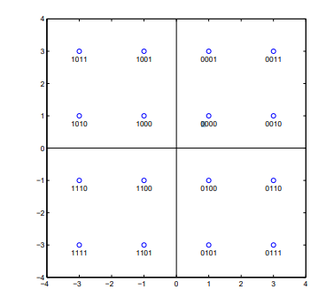
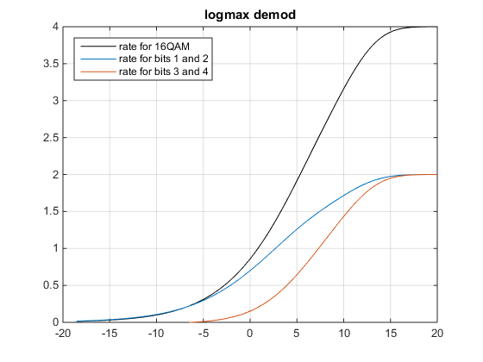
Basic idea – Multi-layer modulation
The different bits in a received symbol carry different amount of information[2]
Normally the ”average conditions” of the received bits determines whether the decoding is successful
In multi-layer transmission, the difference in relibility is instead exploited

Slide 8
Multi-layer modulation – Example 1
Codeword 1,
using b1- b4
Codeword 2,
using b1-b4
Interleaved
Codeword 1, using b1 and b2
Codeword 2, using b3 and b4
Layer 1&2
Layer 3&4
Example (ideal decoding): With a rate ½ code and ideal decoding, one must extract 1 bit of information for every 2 codebits. Then the coding will succeed, otherwise not
In the example above, this means
  5 dB needed when the bits are interleaved
  2.5 dB and 7 dB are needed for respective layer if not interleaved
Multi-layer means no interleaving of bit with different reliability

Slide 9
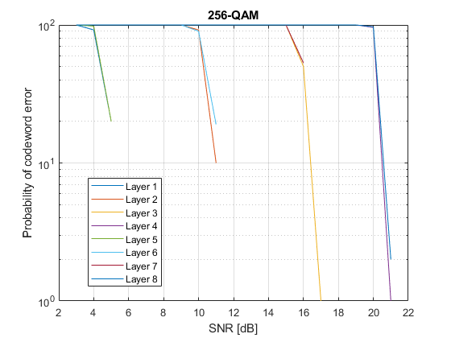
Multi-layer modulation – Example 2
Rather than looking at the information rate, one may look at the codeword error probability
The figure above shows simulation results for a LDPC code with H matrix (1944,972) in combination with 256-QAM
There are 8 layers, two at each robustness level

Slide 10
Simulation results – Simulation set-up
To benchmark multi-layer HARQ with the ”standard approach”, the following approach was taken:
  16/64/256-QAM and (1944,972) LDPC was used
  In each transmission 4/6/8 codewords are transmitted using 1944 symbols. For multi-layer, these are sent in parallel. For the standard approach the codewords are sent one after the other
  In both cases 1944 symbols are used. The channel is static for the 1944 symbols, then possibly varied in between each transmission
  HARQ with Chase combining is used. For multi-layer, the same layer is used for retransmission
  The figure of merit is how many transmissions are needed to correctly receiver 1000 codewords…

Slide 11
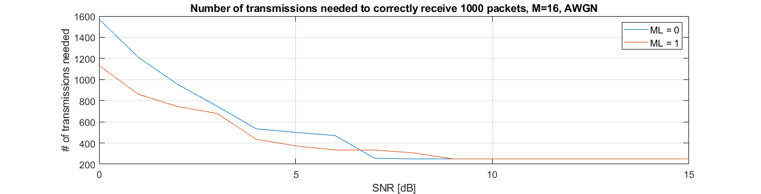
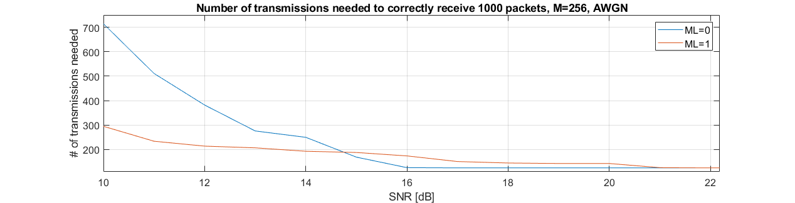
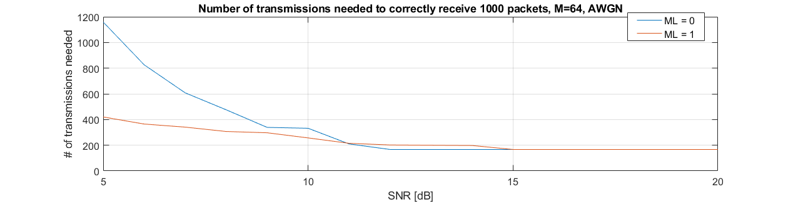
Simulation results - AWGN
For an AWGN channel, with the right SNR (perfect LA), the interleaved approach gives the best results. The reason is that the least robust layer for multi-layer transmission will fail
Noticible is that for lower SNR, the degradation is much more graceful. The degradation reflects worse channel conditions rather than a significant mismatch between channel and used MCS
Recall: If the channel is poor, one should still be able to extract as much information as the channel allows for…

Slide 12
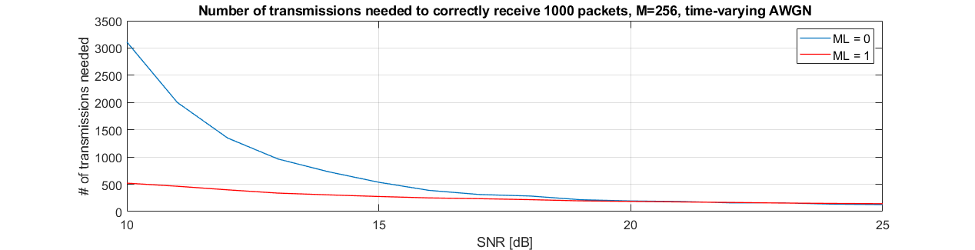
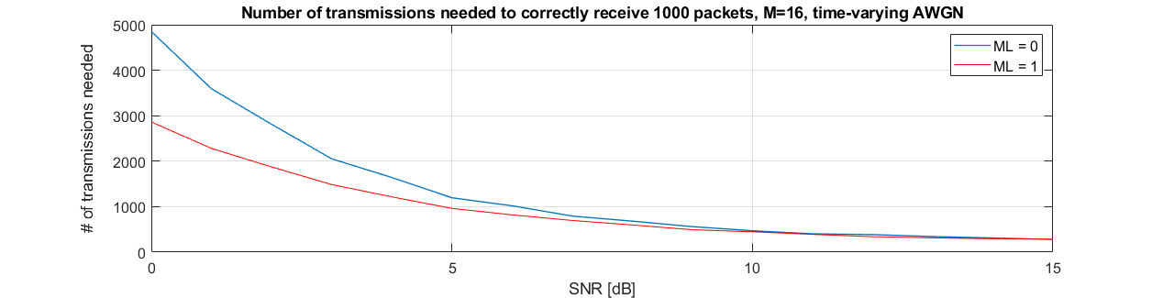
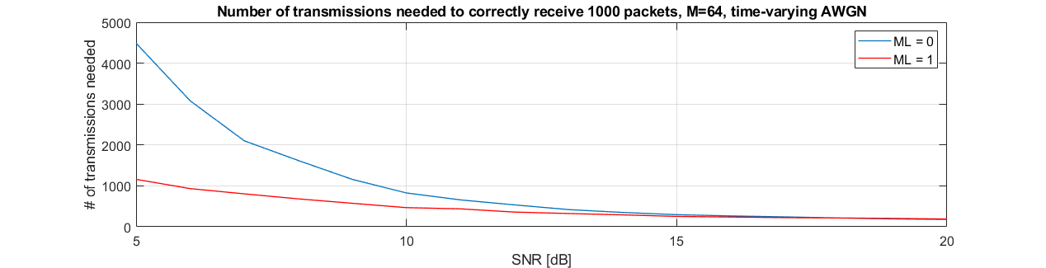
Simulation results – Varying channel (1)
Instead of an AWGN channel, where proper LA is feasible, a time-varying channel was considered
The effective SNR is uniformly distibuted between [SNR-10 SNR], i.e., it is assumed that random interference appears such that the effecive SNR is reduced by 0 and 10 dB in a uniform fashion.
=> There is no SNR where standard transmission outperforms multi-layer transmission

Slide 13
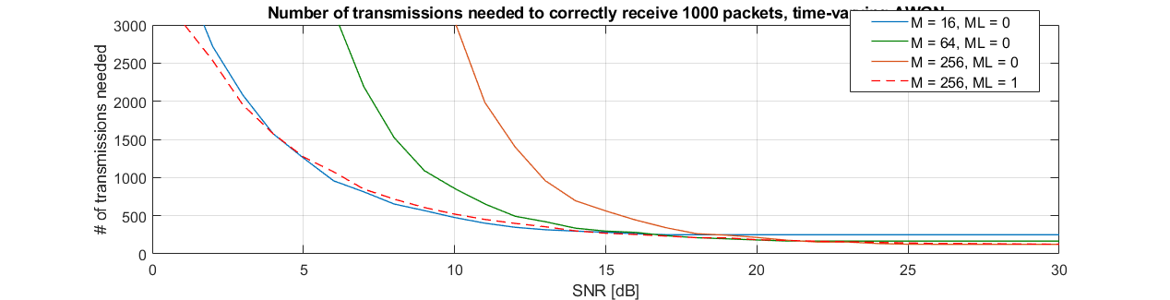
Simulation results – Varying channel (2) conditions
To see the robustness to multi-layer transmission, 256-QAM is compared to the best of 16/64/256 QAM standard transmission
Essentially, with multi-layer transmission, there is little need for link adaptation, 256-QAM works well independent of SNR

Slide 14
Straw Poll
Do you believe multi-layer transmission should be considered for EHT?
Y/N/A:

Slide 15
References
”Multi-layer broadcasting Hybrid-ARQ strategies for block fading channels”, A. Steiner and A. Shamai (Shitz), IEEE Trans. On Wireless Comm. July 2008.
”Coding performance of HARQ with BICM – Part I: Unified performance analysis”, J.-F. (T.) Cheng, PIMRC 2010

