Slide 1
Consideration on Multi-AP Coordination
Date: 2019-09-06
Authors:
Name | Affiliation | Address | Email
LiNan | ZTE Corporation | No.9 Wu Xing Section Xi Feng Road Xi’an, Shaanxi Province P.R.China | li.nan25@zte.com.cn
Sun Bo |  |  | sun.bo1@zte.com.cn
JiaQichen |  |  | jia.qichen@zte.com.cn
FangYonggang | ZTE(TX) |  | yfang@ztetx.com

Slide 2
Introduction
Multi-AP has been discussed in several contributions[1][2][3] as one of the key features for EHT.
  Discussed Multi-AP related topics in EHT include:
    Coordinated OFDMA, Coordinated Beamforming and nulling, Coordinated Spatial Reuse.etc.
    Joint transmission,joint distributed MU-MIMO[4],etc.
  Multi-AP is applied in EHT to achieve enhanced throughput, enhanced reliability , reduced latency and jitter.
In this contribution, we discuss a general multi-AP transmission procedure to be considered for EHT.

Slide 3
Multi-AP Operation in EHT
  Under typical multi-AP scenarios, such as enterprise network, home network and commercial network, a group of APs are connected by wired or wireless backhaul link. We can call it a multi-AP network or a multi-AP group.
  A multi-AP network may have a central node or not.
    A central node is helpful in multiple APs' management, resource scheduling and time synchronization. However, since all the management information is only kept in the central node, once the central node goes wrong, the whole network will break down.
    In a network without a central node, an AP has to communicate with each neighbor AP for coordination, which will result in signaling overhead and processing complexity.
  The multi-AP network may be variable to meet the requirements of typical use scenarios and market need. The multi-AP operation in EHT should be carefully designed to fully support the flexibility.

Slide 4
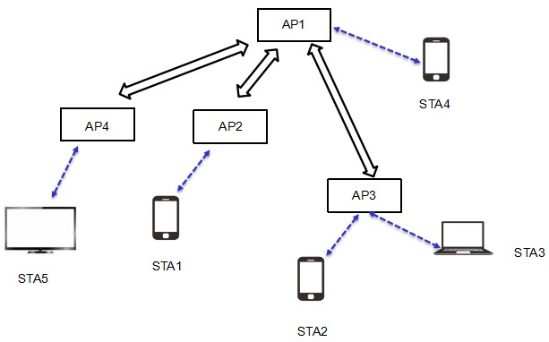
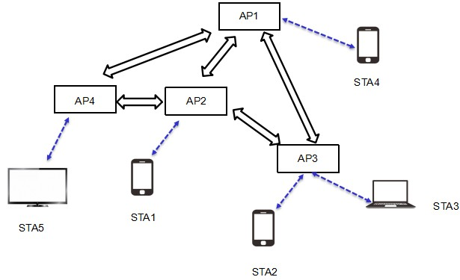
Examples of Multi-AP Network
Each of the two multi-AP networks/groups includes four APs.
In one example, AP1 is a central node of this multi-AP network; while in the other example, no central node exists.
Each AP in the multi-AP network/group announces its multi-AP capability in beacon frames, in both networks.
A STA(e.g. STA1) initiates association with one AP of this network (e.g. AP2 ) and declares its support of multi-AP operation.
Wired or wireless backhaul link
wireless link

Slide 5
Before A Multi-AP Transmission
A Multi-AP transmission is joint or coordinated,and could be initiated by AP or non-AP STA based on scenarios and/or QoS requirements.
Before multi-AP transmission, APs participating in a multi-AP transmission should be decided ,either by the associated AP, or by the central AP if there is one in the multi-AP network, or if needed .
  The AP knows the topology of the multi-AP network, load status information of each AP, link conditions between APs, measurements reports and capabilities information of the STAs.
However, a STA has better knowledge of air interface condition from the STA side, such as which AP could be heard. Besides, STA has the latest fronthaul link measurement results.
It's suggested that there is a "preparation stage" before multi-AP transmission in order that the STA could suggest a set of recommended APs for joint/coordinated transmission to the associated AP for reference.

Slide 6



An Example of Multi-AP Transmission Procedure
  Association stage
STA1 exchanges multi-AP capability with AP2, acquiring information about whether AP2 supports multi-AP capability and which multi-AP network it belongs to, the member information of the multi-AP network.
Preparation stage
AP2 or STA1 initiates a process for STA1 to decide to perform joint/ coordinated transmission, and which AP else will be involved in the following multi-AP transmission.
STA1 may send recommended APs (AP3 and AP4) to AP2 for multi-AP transmission suggestion.Recommended APs can be determined by front haul link metric collection, load and access control information, etc.
AP2 confirms the APs participating in the following transmission(AP2 , AP3) and related configurations for the transmission.
Transmission stage
Chosen APs of the multi-AP network perform DL/UL multi-AP transmission with STA1.
AP1
STA4
AP4
AP2
AP3
STA5
STA1
STA2
APs chosen
by STA1
APs participating in
multi-AP transmission
STA3

Slide 7
Summary
High level issues about multi-AP operation in EHT are discussed in this proposal.
  Multi-AP architecture
  Multi-AP transmission
Further study may include：
  Multi-AP architecture baseline
  Multi-AP transmission procedure optimization

Slide 8
Straw Poll
Do you agree that a STA may inform its associating AP a set of recommended APs for joint/coordinated transmission ?
  The detailed signaling is TBD.
Y:
N:
A:

Slide 9
Reference
[1]11-18-1509-00-0eht-features-for-multi-ap-coordination
[2]11-18-1926-00-0eht-terminology-for-ap-coordination
[3]11-18-1982-01-0eht-consideration-on-multi-ap-coordination-for-eht
[4]11-19-0800-00-00be-joint-processing-mu-mimo-update

