Slide 1
Enhancements for Time-Critical Data Transmission
Date: 2019-07-26
Authors:
Name | Affiliations | Address | Phone | email
Thomas Handte | Sony Corporation |  |  | thomas.handte (at) sony.com
Dana Ciochina |  |  |  | dana.ciochina (at) sony.com
Yusuke Tanaka |  |  |  | Yusuke.YT.Tanaka (at) sony.com
Kosuke Aio |  |  |  | Kosuke.Aio (at) sony.com
Ryuichi Hirata |  |  |  | Ryuichi.Hirata (at) sony.com

Slide 2
Introduction
Wireless data transmission for time sensitive applications needs improvements to Wireless LAN in terms of [1, 2]
Latency, jitter, reliability
Determinism
Need predictable performance (at least worst case bound) in key metrics
“TSN components for reliability and latency yet to be enabled over wireless” [2]
Keys to implement these features are [1, 2]
Diversity
Achieve high reliability
Efficient channel access
Eliminate congestion loss
Goal is to eliminate in managed networks, i.e. controlled interference [2]
Scheduled channel access

Slide 3
How to get there
How to achieve diversity
OFDMA and MU-MIMO are the basis to implement time, frequency, and spatial diversity
Any combination of diversity components feasible with 11ax
11be may bring enhanced spatial diversity by multi-AP in addition
How to achieve efficient channel access
Goal is to implement a type of scheduled access which is
Compliant with channel access regulations for unlicensed bands
Coexistent with legacy devices
Robust against interference
11ax is a good baseline to meet these goals
E.g. HE MU PPDU in downlink and HE TB PPDU in uplink

Slide 4
Baseline scenario under consideration
“RU hopping” is appropriate to exploit diversity
Goal is that a receiver may still retrieve user data although a few RUs have not been received
It’s favorable to perform RU hopping in multiple PPDUs
This is to avoid performance degradation due to preamble error
Example (single link, e.g. AP => STA)
User data is encoded in 4 data units (code rate ¼)
Each encoded data unit is assigned to mutually different RU
Receiver reconstructs MSDU after last PPDU has been received
It’s sufficient to receive only a few data units to retrieve the MSDU successfully.

Slide 5
Implementation example with 11ax
AP performs data exchange with 4 STAs
AP triggers STAs to transmit various TB PPDUs in uplink (UL)
STAs get different RUs assigned in each UL transmission (e.g. round robin RU allocation)
AP combines UL transmissions and provides a (multi-STA) BAck at the end
Downlink (DL) may resemble similar behavior as in UL (not shown in Fig)

Slide 6
What needs to be done on top of 11ax
Enhancements of 11ax facilitating such data exchanges
Enhancement of trigger-based access (=> Proposal 1)
Existing mechanism is inefficient when it comes to periodically data transmissions
same information is transmitted multiple times
Provide trigger-based channel access for periodically or persistently scheduled [3] data transmissions
Provide a mechanism to combine receptions (=> Proposal 2)
Provide an encoding/ decoding mechanism on low MAC or high PHY level
Encoding additionally safeguards MSDUs
Decoder may use redundancy to reconstruct MSDUs
Change of acknowledgement behavior
Acknowledgement of MSDU after combination/ decoding
One Acknowledgement for multiple encoded MPDUs transmitted in various PPDUs

Slide 7
Proposal 1
Trigger with schedule information
Schedule information includes various configurations of RU allocations
RU allocation in form of a table or function
UORA for asynchronous traffic (e.g. non-RTA traffic)
(Short) trigger to elicit a certain configuration
Corresponding RU allocation takes effect SIFS after that trigger

Slide 8
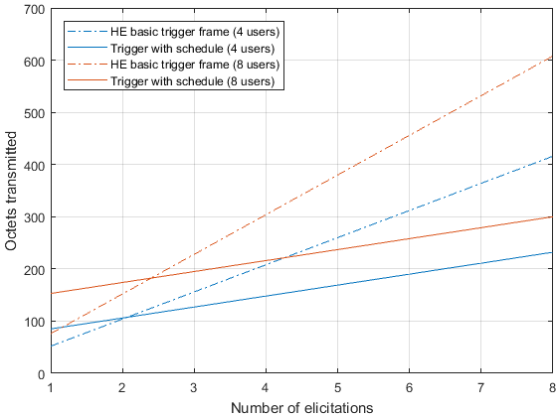
Benefit
Significant reduction of signaling overhead
Draft comparison
Exact signaling TBD, assumptions see Appendix
Octets transmitted for signaling vs. number of elicitations
HE basic trigger frame
low initial overhead, but high gradient
Trigger with schedule information
High initial overhead, but low gradient
High initial overhead can be reduced by using a function instead of a table to describe the RU allocations
Transmit time comparison see Appendix

Slide 9
Variant of Proposal 1
The trigger with schedule information also supports an extended baseline scenario
Some applications may benefit from different frame exchange sequences
E.g. applications with asymmetric traffic or reliability needs
A trigger with schedule information may thus configure a frame exchange sequence that has a DL time slot every $Q$ UL time slots
Example for $Q=2$

Slide 10
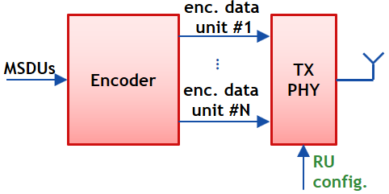
Proposal 2
Provide a mechanism to encode MSDUs in multiple data units
Addition of redundancy to protect MSDUs
MSDUs and redundancy contained in multiple encoded data units
Encoded data units may be transmitted in separate PPDUs on different RUs to exploit diversity
As a simple example, the encoder may perform duplication of MSDUs
Decoder combines encoded data units received and extracts MSDUs
Acknowledgement status is provided after decoding

Slide 11
Benefits
Exploit diversity provided by PPDUs transmitted over different RUs
Encoded data units (e.g. MPDUs) are transmitted over different RUs over time
Decoder combines receptions of encoded data units and reconstructs MSDUs
Likelihood of successful reconstruction is high due to coding and diversity gain
Retransmissions may be omitted
Residual error rate low due to redundancy and diversity
Ack may be provided but not necessarily used for (H)ARQ purposes
ARQ is often not desired for RTA due to its non-determinism [1]
Some applications may benefit from a combination with closed-loop (H)ARQ
Tradeoff throughput vs. determinism

Slide 12
Conclusion
Wireless LAN needs improvements to support real-time applications
Key areas of improvement are efficient channel access and reliability through diversity
11ax is good baseline, but needs add-ons to enable and simplify RTA data transmission via a wireless link
Two major enhancements are proposed
Trigger with schedule information
Mechanism for encoding of MSDUs to provide redundancy
Benefits
Low overhead channel access for periodic and persistent schedules
Robust data transmission even without retransmissions

Slide 13
References
[1] 11-18/1918r0: Bringing Determinism for IoT Wireless - sharing 802.15.4 experience –
[2] 11-19/0373r0: Time-Sensitive Applications Support in EHT
[3] 11-19/0806r1: Enabling persistent allocation for EHT
[4] 11ax D4.0

Slide 14
appendix

Slide 15
Octet count for draft comparison of trigger schemes
N users, M configurations, P elicitations
RU table transmitted as schedule information
HE basic trigger variant [4]
$P (28+6N)$ octets
Trigger with schedule information
$28+(5+M) N + 21P$ octets
Baseline is HE basic trigger variant
$1$ octet for each RU configuration and for each user
Short trigger to elicit a configuration: $21$ octets

Slide 16
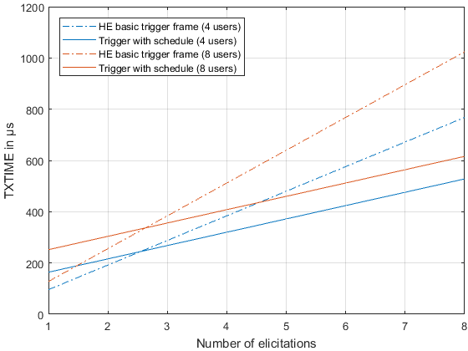
Transmit time for draft comparison of trigger schemes
Assumptions
Octet count as in slide 14
PHY configuration
non-HT duplicate, MCS0

