Slide 1
Enhancements for Time-Critical Data Transmission
Date: 2019-07-15
Authors:
Name | Affiliations | Address | Phone | email
Thomas Handte | Sony Europe B.V. | Hedelfinger Strasse 61, 70327 Stuttgart | +49 711 5858 236 | thomas.handte (at) sony.com
Dana Ciochina |  |  |  | dana.ciochina (at) sony.com
Yusuke Tanaka | Sony Corporation |  |  | Yusuke.YT.Tanaka (at) sony.com
Kosuke Aio |  |  |  | Kosuke.Aio (at) sony.com
Ryuichi Hirata |  |  |  | Ryuichi.Hirata (at) sony.com

Slide 2
Introduction
Wireless data transmission for time sensitive applications needs improvements to Wireless LAN in terms of [1, 2]
  Latency, jitter, reliability
  Determinism
    Need predictable performance (at least worst case bound) in key metrics
“TSN components for reliability and latency yet to be enabled over wireless” [2]
Keys to implement these features are [1, 2]
  Diversity
  Efficient channel access
    Eliminate congestion loss
      Goal is to eliminate in managed networks, i.e. controlled interference [2]
    Scheduled channel access

Slide 3
How to get there
How to achieve diversity
  OFDMA and MU-MIMO are the basis to implement time, frequency, and spatial diversity
  Any combination of diversity components feasible with 11ax
    11be may bring enhanced spatial diversity by multi-AP in addition
How to achieve efficient channel access
  Goal is to implement a type of scheduled access which is
    Compliant with channel access regulations for unlicensed bands
    Coexistent with legacy devices
    Robust against interference
  11ax is a good baseline to meet these goals
    E.g. HE MU PPDU in downlink and HE TB PPDU in uplink

Slide 4
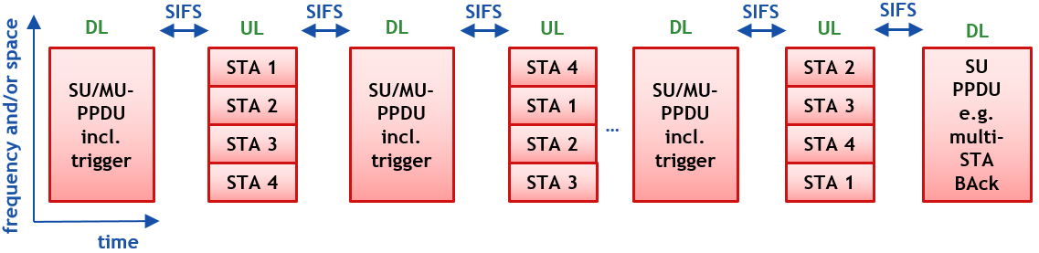
Scenario under consideration
AP performs data exchange with 4 STAs
  AP triggers STAs to transmit various TB PPDUs in uplink (UL)
    STAs get different RUs assigned in each UL transmission (e.g. round robin RU allocation)
    AP combines each UL transmission and provides a (multi-STA) BAck at the end
  Downlink (DL) may resemble similar behavior as in UL (not shown in Fig)

Slide 5
What needs to be done on top of 11ax
Enhancements of 11ax facilitating such data exchanges
Enhancement of trigger-based access
  Existing mechanism is inefficient when it comes to periodically data transmissions
    same information is transmitted multiple times
  Provide trigger-based channel access for periodically or persistently scheduled [3] data transmissions
Provide a mechanism to combine receptions
  Provide an encoding/ decoding on MAC level or some (preventive) HARQ mechanism
    Encoding additionally safeguards MSDUs
    Decoder may use redundancy to reconstruct MSDUs
  Change of acknowledgement behavior
    Acknowledgement of MSDU after combination/ decoding
      One Acknowledgement for multiple encoded MPDUs transmitted in various PPDUs

Slide 6
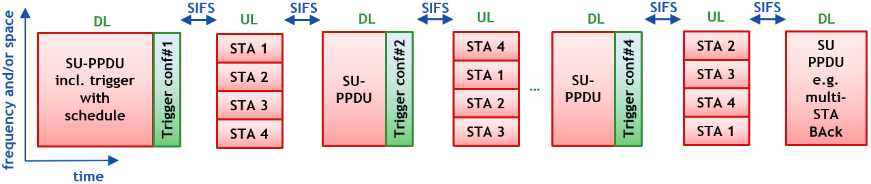
Proposal (1)
Trigger with schedule information
  Schedule information includes various configurations of RU allocations
    RU allocation in form of a table or function
    UORA for asynchronous traffic (e.g. non-RTA traffic)
  Trigger to elicit a certain configuration
    Corresponding RU allocation takes effect SIFS after that trigger

Slide 7
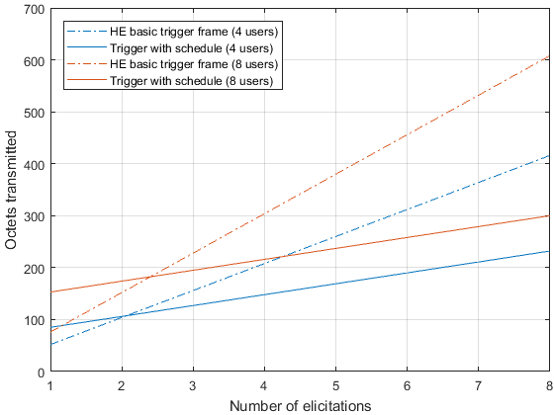
Benefit
Significant reduction of signaling overhead
  Draft comparison
    Exact signaling TBD, assumptions see Appendix
Octets transmitted for signaling vs.
number of elicitations
  HE basic trigger frame
    low initial overhead, but high gradient
  Trigger with schedule information
    High initial overhead, but low gradient
    High initial overhead can be reduced by using a
    function instead of a table to describe the RU
    allocations
Transmit time comparison see Appendix

Slide 8
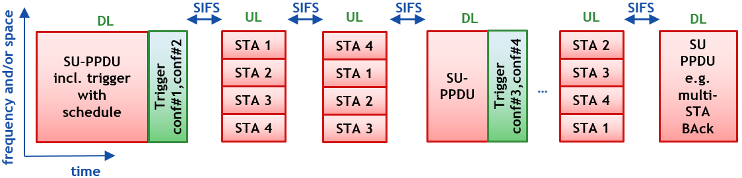

Variant of Proposal (1)
The trigger with schedule is not limited to the scenario on Slide #4
  Some applications may benefit from different frame exchange sequences
    E.g. applications with asymmetric traffic or reliability needs
  A Trigger with schedule information may thus configure a frame exchange sequence that has a DL time slot every $Q$ UL time slots
  Example for $Q=2$

Slide 9
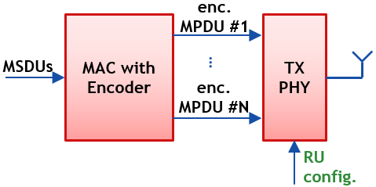
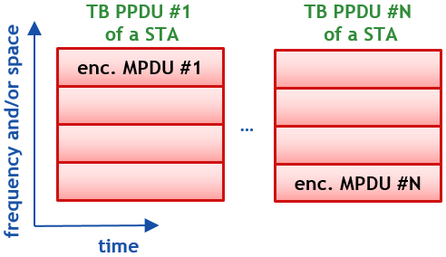
Proposal (2)
Provide a mechanism to encode MSDUs in multiple MPDUs
  Addition of redundancy to protect MSDUs
    MSDUs and redundancy contained in multiple encoded MPDUs
  Encoded MPDUs may be transmitted in separate PPDUs on different RUs to exploit diversity
  Decoder combines encoded MPDUs received and extracts MSDUs
    Acknowledgement status is provided after decoding

Slide 10
Benefits
Exploit diversity provided by PPDUs transmitted over different RUs
  Encoded MPDUs are transmitted over different RUs over time
  Decoder combines receptions of encoded MPDUs and reconstructs MSDUs
    Likelihood of successful reconstruction is high due to coding and diversity gain
Retransmissions may be omitted
  Residual error rate low due to redundancy and diversity
    Ack may be provided but not used for (H)ARQ purposes
  ARQ is often not desired for RTA due to its non-determinism [1]
  Some applications may benefit from a combination with closed-loop ARQ
    Tradeoff throughput vs. determinism

Slide 11
Conclusion
Wireless LAN needs improvements to support real-time applications
  Key areas of improvement are efficient channel access and diversity
  11ax is good baseline, but needs add-ons to enable and simplify RTA data transmission via a wireless link
Two major enhancements are proposed
  Trigger with schedule information
  Mechanism for encoding of MSDUs to provide redundancy
Benefits
  Low overhead channel access for periodic and persistent schedules
  Robust data transmission even without retransmissions

Slide 12
References
[1] 11-18/1918r0: Bringing Determinism for IoT Wireless - sharing 802.15.4 experience –
[2] 11-19/0373r0: Time-Sensitive Applications Support in EHT
[3] 11-19/0806r1: Enabling persistent allocation for EHT
[4] 11ax D4.0

Slide 13
appendix

Slide 14
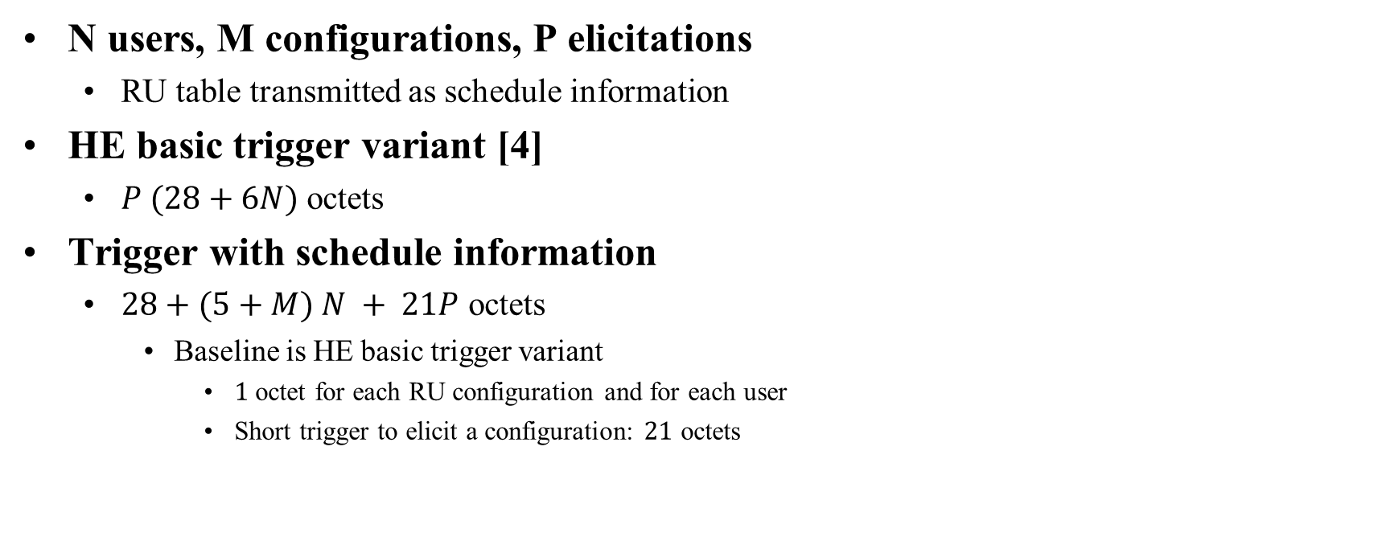
Octet count for draft comparison of trigger schemes
N users, M configurations, P elicitations
  RU table transmitted as schedule information
HE basic trigger variant [4]
  $P (28+6N)$ octets
Trigger with schedule information
  $28+(5+M) N + 21P$ octets
    Baseline is HE basic trigger variant
      $1$ octet for each RU configuration and for each user
      Short trigger to elicit a configuration: $21$ octets

Slide 15
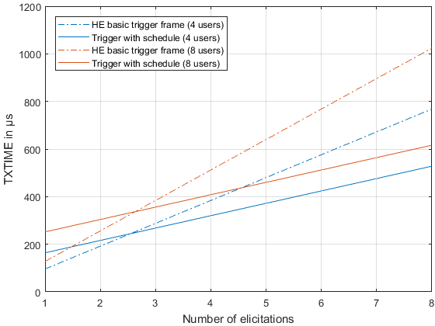
Transmit time for draft comparison of trigger schemes
Assumptions
  Octet count as in slide 14
  PHY configuration
    non-HT duplicate, MCS0

