Slide 1
Direct Link MU transmissions
Date: 2019-09-15
Authors:

Slide 2
Outline
Direct Link use cases for EHT
Benefits of the direct link for EHT applications
Direct Link issues with 11ax amendment
New feature: Mixed UL/DiL MU Triggered Transmissions
Next step

Slide 3

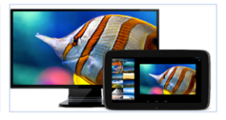

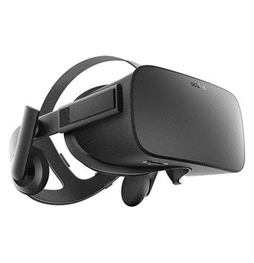
Direct Link Use Cases for 11be
Wireless control/operation of remote device
  Wireless tethered shooting for pro-photographer market
  Remote shooting (high quality selfie) for mass market
  Video surveillance (setup and control).
  …
Wireless display
Direct printing
  via smartphone, tablet, etc.
VR and AR applications [1],[2]

Slide 4
Benefits of the direct link for 11be applications
Efficient solution to carry large local traffics. A relay of the traffic by the AP is a waste of bandwidth in this case.
  More and more user devices are (2k, 4k) video content producers
  Large video streaming (AR, VR, or streaming from a local NAS ).
Direct link is a good solution for local interactive applications that require very low latency
  AR or VR applications
  Remote control,
  …
Direct link traffic is more easy to schedule than unpredictable traffic
  TDLS session is established by a STA for a given purpose (streaming, file transfer, etc.) that can be characterized.
  Usually non transient sessions

Slide 5
Direct Link issues with 11ax amendments
Direct link provides high “interferences” to the AP
  Direct link traffic carries large amount of data
    Large video transmission for VR, or video streaming.
  Direct link traffic often requires low latency thus frequently accesses the medium.
    Interactive applications (VR, visio conferences, etc.)
Direct link cannot be efficiently scheduled by an AP today
  AP cannot trigger the sending of direct link data, so fine scheduling is not possible.
    Direct link only relies on EDCA.
    Multi User OFDMA doesn’t support Direct link traffic.
  Quiet time period mechanism is not incentive enough
    Every station with direct link traffic will contend on the same period.
    Even if this period has been negotiated by a STA, the quiet time period is open for all direct link stations
    Other stations with uplink data may also contend during this period (Quiet time period is just intended to give a better priority of medium access for direct link traffic).
    No specific protection against legacy stations.

Slide 6
Mixed UL/DiL MU Triggered Transmissions
Enable triggered MU transmissions from any direction
Allocate dedicated RU for Uplink (UL) , and/or Direct link (DiL) transmissions.
All MU transmissions are scheduled by the AP
  RU allocations can be driven by the reported STAs needs (BSR)
All transmissions become controllable by the AP
  less collision on the medium
  more opportunities for the AP to access the medium for sending TF.
  Enhanced latency for the direct link Stations (reduction of the jitter).
Trigger
Frame
STA6 → STA3 (Direct Link)
BA from STA3
STA2 → STA4 (Direct link)
BA from STA4
STA1 → AP (Uplink)
Multi STA BA (3,5) from AP
STA5 → AP (Uplink)
SIFS
SIFS

Slide 7
Direct link MU transmission via Trigger frame
STA2
AP
STA4
1st solution: DiL AID based
  Compatible with 11ax TF format
  ID value (in the AID range) allocated by the AP for a DiL session
  Features to report needs to the AP (DiL BSR, TSPEC …)
TDLS setup request
DiL session establishment
TDLS setup response
TDLS setup confirm
DiL requirements collection
Trigger Frame (BSRP)
DiL BSR
DiL BSR
DiL session
Id Setup
DiL session Id setup
802.11ax Trigger frame
MU DiL transmissions using the assigned DiL session ID
DiL Data
802.11ax Trigger frame
DiL Data
DiL session ID Release
DiL session Id teardown

Slide 8
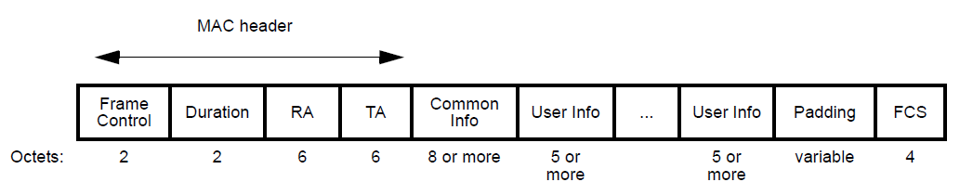
Direct link MU transmission via Trigger frame
2nd solution: new User Info field format
  No dedicated ID for DiL communications
  Features to report needs to the AP (DiL BSR, TSPEC …)
  New format of User Info field for the DiL RU:
    1 or 2 bit(s) to indicate Tx direction (DiL/DL)
    Additional field to indicate AID of the destination STA
    Extend Trigger Dependent User Info field to store these additional information
Trigger ControlID
AID12 Src
AID12 Dest
Reserved
Trigger ControlID | Value
0 | Identify a User Info filed for triggered Downlink MU transmission.
1 | Identify a triggered Direct Link MU transmission
2-15 | Reserved

Slide 9
Summary
Some 11be scenarios (low latency scenario) can benefit from the usage of the direct link.
Including the direct link traffic in the AP scheduling ensures a better medium access control.
Better direct link communication scheduling is required in 11be
  To increase global cell’s efficiency.
  To secure Peer to Peer transmission and offer a better user experience.

Slide 10
Straw Poll #1
Do you support that the 802.11be amendment shall define mechanism(s) for an AP to initiate a Direct Link (peer-to-peer) transmission ?
Results: Y/N/A

Slide 11
Reference
[1]. 11-18-1481-01: Technology for EHT

