Slide 1
Reduced Beamforming Feedback for 802.11be
Date: 2019-07-02
Authors:

Slide 2
Introduction
Beamforming is one of the key techniques used in wireless communication to achieve significant gain in terms of performance
Various feedback schemes were considered and supported by 802.11n; explicit compressed feedback was selected within 11ac/11ax
11be introduces new challenges [1] related to MIMO and beamforming, in particular supporting more spatial streams and larger MU-MIMO groups
Some contributions have already discussed the new challenges and what directions may be used for next generation beamforming schemes and procedures [2], [3]
In this contribution we want to study the impact of more spatial streams (and hence larger precoding matrix) on the existing beamforming scheme, and understand what can be done in terms of optimization with minimal impact on the basic building blocks

Slide 3
Beamforming Challenges in 802.11be
The main issue in 802.11be is related to the larger number of streams (16) that is being considered, which implies both larger MIMO schemes and larger MU-MIMO groups
The main impact on the beamforming procedure is a significant increase in precoder feedback size caused by the larger channel matrix, while backward compatibility requires to maintain SVD based beamforming
We believe that practical and theoretical experience achieved during the evolution of 802.11 standards should be considered in the design of the next generation schemes and procedures with minimal required changes to existing hardware designs
The currently adopted beamfoming procedure/mechanism is based on the following principles:
  Explicit Beamforming – precoder is obtained from estimated channel matrix, reflecting Tx and Rx chains that are used for data transmission
  SVD based precoder calculation – sounding procedure is based today on applying SVD on the channel matrix at the beamformee side
  Compressed feedback – precoder is transmitted in compressed manner, and different compression schemes are defined by the standard

Slide 4
Wideband Beamforming
SU MIMO, TGnD, Nss = 2, 8 Tx Ant, MCS4
Today the precoder is calculated in frequency domain
per tone (or per group of tones based on the Ng value)
However, in many scenarios a wideband precoder
(same for the large group of tones or entire BW, also
known as time-domain precoder) may be applied with
relatively small degradation in the performance
There are several techniques to obtain such a wideband
precoder (a simple example is averaging a channel/precoder
over all the tones, similar to large Ng value)
The main advantage of wideband precoding is the very
small size of feedback that is required to be transmitted
(can allow larger number of bits to be used in order to
preserve the accuracy)
The results (see on the right) show that wideband
precoding yields a reasonable degradation (~2dB) that
introduces a trade-off between feedback size overhead
and PER
~8dB
SU MIMO, TGnD, Nss = 2, 16 Tx Ant, MCS4
~10dB

Slide 5

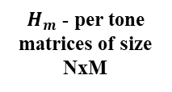

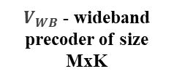
Mixed Beamforming
Though wideband precoding provides a very attractive solution in terms of feedback size, it leads to a degradation in case of large MIMO schemes and MU-MIMO
One possible solution is mixed beamforming
(digitally implemented hybrid beamforming)
where the narrowband precoder is calculated
on top of the wideband precoder
In the ensuing discussion we will use the term
“narrowband precoder “ only in connection with
mixed BF
Narrowband precoder matrix size is smaller than
the regular per-tone precoder (K < N)
This technique leads to smaller per-tone
precoders (more than 50% feedback size
reduction compared with regular per-tone precoder)
while all the basic building blocks of the
existing beamforming procedure are preserved
Channel Estimation
$H_{m}$ - per tone
matrices of size
NxM
Wideband Precoder Calculation
$V_{WB}$ - wideband precoder of size MxK
Narrowband Equivalent Matrix Calculation
${\tilde{H}}_{j}=H_{j}$ $V_{WB}$
  $V_{NB}$ of size $K×N_{SS}$ (smaller than regular per-tone precoder!)
Narrowband Precoder Calculation

Slide 6
Mixed BF Performance
MU-MIMO, TGnD, Nss = 2, 4 STA, 16 Tx Ant, MCS4
We look at the performance of MU-MIMO with
mixed BF for with 4 STAs and using different
values of K
The results show that we can adjust the
parameters of mixed beamforming in order to
produce a very small performance gap (less than
0.5dB for K > 8) compared with the regular
per-tone precoder
In the table below we present the gain in terms of reduced feedback size that can be achieved from mixed beamforming in some scenarios

Slide 7
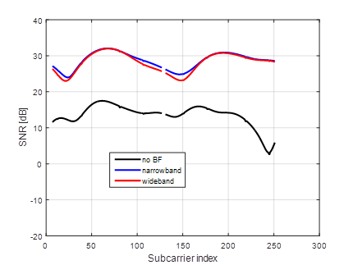
Mixed Beamforming Properties
Mixed beamforming yields performance almost identical to per-tone precoding, and leads to significant feedback size reduction
We want to investigate the properties of mixed beanforming and understand how efficient this method could be
The main intuition is that the wideband precoder addresses the directions of channel multipath and ‘creates’ the main beams while the narrowband precoder implements fine tuning of the beams with small changes
FFT
Wideband BF Beam
Narrowband Beam Correction

Slide 8
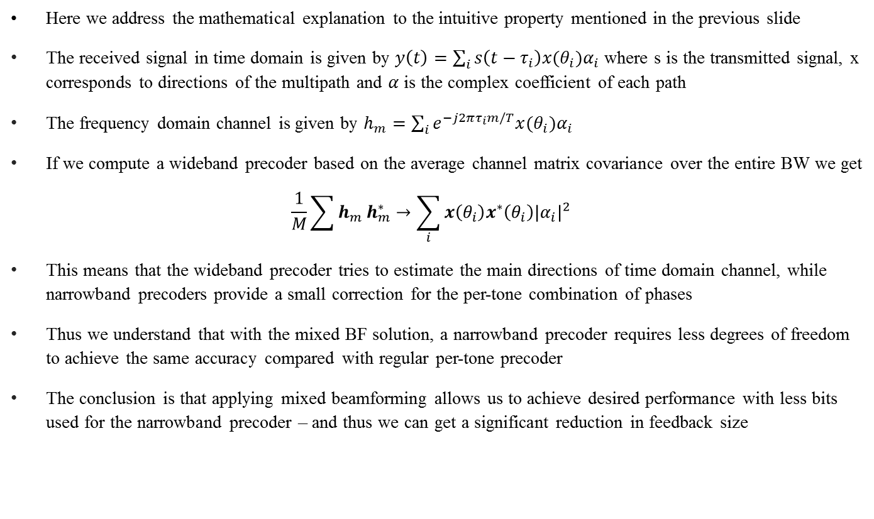
Mixed Beamforming Math
Here we address the mathematical explanation to the intuitive property mentioned in the previous slide
The received signal in time domain is given by $y\left(t\right)=\sum_{i}{s\left(t−τ_{i}\right)x(θ_{i})α_{i}}$ where s is the transmitted signal, x corresponds to directions of the multipath and $α$is the complex coefficient of each path
The frequency domain channel is given by $h_{m}=\sum_{i}{e^{−j2πτ_{i}m/T}x(θ_{i})α_{i}}$
If we compute a wideband precoder based on the average channel matrix covariance over the entire BW we get
$$\frac{1}{M}\sum{h_{m}}h_{m}^{∗}→\sum_{i}{x\left(θ_{i}\right)x^{∗}\left(θ_{i}\right){|α_{i}|}^{2}}$$
This means that the wideband precoder tries to estimate the main directions of time domain channel, while narrowband precoders provide a small correction for the per-tone combination of phases
Thus we understand that with the mixed BF solution, a narrowband precoder requires less degrees of freedom to achieve the same accuracy compared with regular per-tone precoder
The conclusion is that applying mixed beamforming allows us to achieve desired performance with less bits used for the narrowband precoder – and thus we can get a significant reduction in feedback size

Slide 9

Mixed Beamforming SNR Impact
Let us now analyze the impact of applying
mixed precoding on the SNR
The Zero-Forcing SNR of the post BF channel
is given by the covariance matrix of the
equivalent channel $\tilde{H}$ after applying
wideband precoding
We compared between the SNR after applying
per-tone precoding and the SNR after applying
wideband precoding with different K values
The figure on the right shows the CCDF of the
difference in dB between the two SNR results
  These results represent the impact that narrowband precoding may have on the total per-tone SNR
We can see, for example, that for K = 10 the maximum SNR correction that can be achieved by narrowband precoding is less than 0.15dB in 90% of the cases and is less than 0.35dB in 99% of the cases
0.15dB
0.35dB

Slide 10
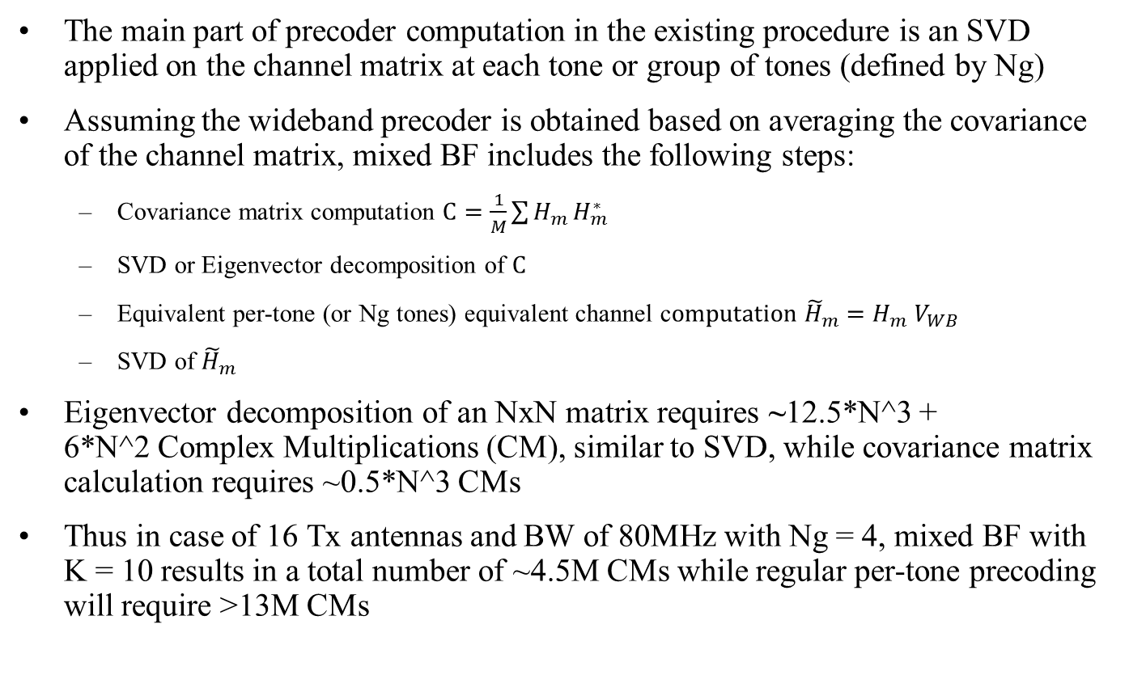
Complexity Aspects
The main part of precoder computation in the existing procedure is an SVD applied on the channel matrix at each tone or group of tones (defined by Ng)
Assuming the wideband precoder is obtained based on averaging the covariance of the channel matrix, mixed BF includes the following steps:
  Covariance matrix computation $C=\frac{1}{M}\sum{H_{m}}H_{m}^{∗}$
  SVD or Eigenvector decomposition of $C$
  Equivalent per-tone (or Ng tones) equivalent channel c$omputation {\tilde{H}}_{m}=H_{m}$ $V_{WB}$
  SVD of ${\tilde{H}}_{m}$
Eigenvector decomposition of an NxN matrix requires ~12.5*N^3 + 6*N^2 Complex Multiplications (CM), similar to SVD, while covariance matrix calculation requires ~0.5*N^3 CMs
Thus in case of 16 Tx antennas and BW of 80MHz with Ng = 4, mixed BF with K = 10 results in a total number of ~4.5M CMs while regular per-tone precoding will require >13M CMs

Slide 11
Conclusions
The new challenges for beamforming procedure introduced by 802.11be features can be addressed with reasonable overhead by wideband and mixed BF
Both wideband and narrowband precoders can be obtained using the same operations (e.g. SVD) – means minor changes in implementation and no increase in computational complexity
Wideband precoding is more robust to temporal changes in channel, thus allows to minimize the feedback overhead during updates
Mixed Beamforming implies very small impact on the gain compared with per-tone precoder, thus the overhead of feedback size can be managed with very small degradation to the performance

Slide 12
References
[1] 11-18/1231r6-0eht-eht-draft-proposed-par.
[2] 11-18-1184-01-0eht-eht-discussions-on-throughput-enhancement
[3] 03-19-0391 - Feedback Overhead Reduction in 802.11be

Slide 13
Straw Poll 1
Do you agree to increase value of Ng to support wideband precoder?
Y/N/A

Slide 14
Straw Poll 2
Do you think mixed beamforming should be used in 11be for reducing feedback size?
Y/N/A

