Slide 1
Agenda for IEEE 802.11 Coexistence Workshop in Vienna on 17 July 2019
17 July 2019
Authors:
Name | Company | Phone | email
Andrew Myles | Cisco | +61 418 656587 | amyles@cisco.com

Slide 2
Agenda for Coexistence Workshop
# | Topic | Chair
0 | Welcome & logistics | Andrew Myles (IEEE 802.11 Coexistence SC Chair, Cisco)
1 | Invited papers
2 | Deployment experience | Dorothy Stanley (IEEE 802.11 WG Chair, HPE)
3 | Coexistence topics

Slide 3
Welcome & logistics

Slide 4
Sponsors: a big thank you to the three major sponsors of today’s Coexistence Workshop
The
wireless bits

Slide 5
Goals: the Coexistence Workshop will focus on discussion of sharing by 802.11ax/be & NR-U
Coexistence Workshop goals
The primary objective of the Coexistence Workshop is to discuss issues related to fair and efficient shared operation in the 6 GHz band by:
IEEE 802.11ax High Efficiency WLAN)
IEEE 802.11be (Extremely High Throughput)
3GPP NR-U (New Radio Unlicensed)
It is hoped the primary objective will be achieved by:
Sharing information on plans for use of future technology standards (particularly IEEE 802.11 and 3GPP NR-U) in the 6 GHz band
Assessing coexistence issues and topics related to the simultaneous use of IEEE 802.11 and 3GPP NR-U technologies in the 6 GHz band, including coexistence criteria and mechanisms
Discussing related coexistence topics of interest, including deployment experience of 3GPP LAA/eLAA coexistence with IEEE 802.11ac in the 5 GHz band

Slide 6
Decisions: the Coexistence Workshop has no decision making authority
The Coexistence Workshop will focus on:
Sharing …
Assessing …
Discussing …
However, the Coexistence Workshop has no authority to make any decisions on behalf of:
IEEE 802.11 WG in relation to 802.11ax/be
3GPP RAN in relation to NR-U
… or anyone else!
Rather, it is hoped that today's workshop will help both 3GPP RAN & IEEE 802.11 WG to make decisions in the future that promote fair & efficient coexistence between 802.11ax/be & NR-U in the 5 & 6 GHz bands

Slide 7
Rules: normal IEEE-SA rules will be used as operating guidelines for the Coexistence Workshop
Advice has been received from IEEE-SA that normal IEEE-SA standards development rules do not apply to the Coexistence Workshop
However, it was suggested that the normal rules should be used as operating guidelines for the Coexistence Workshop
Important operating guidelines include:
Follow all applicable laws including anti-trust & competition laws
Don’t discuss the interpretation, validity or essentiality of patents
Don’t discuss licensing rates, terms or conditions
Don’t discuss or engage in the fixing of product prices, allocation of customers or division of sales markets
In addition, before speaking, participants are asked to identify any organizations to which they are affiliated
Note: participants are requested to not assert they are representing the position of any organization without authority from that organization

Slide 8
Rules: the Coexistence Workshop will operate using accepted principles of meeting etiquette
Meeting etiquette principles
The Coexistence Workshop will be conducted in an orderly & professional manner
Participants shall only address the “technical” content
Participants shall refrain from making personal comments to or about others

Slide 9
Materials: Coexistence Workshop agenda, presentations & papers are available on-line
All of the materials associated with today’s Coexistence Workshop, including agenda, presentation and attendance list, are available on-line:
Website
Agenda in ppt and xls
(Partial) registration list
Additional documents will be uploaded as soon as possible after the Coexistence Workshop, including:
Updates to presentations
Workshop minutes
The IEEE 802.11 Coexistence SC Chair will investigate having the material indexed by IEEE Xplore
Thank you to Guido Hiertz (Ericsson) who has agreed to act as the Recording Secretary for today’s Coexistence Workshop

Slide 10
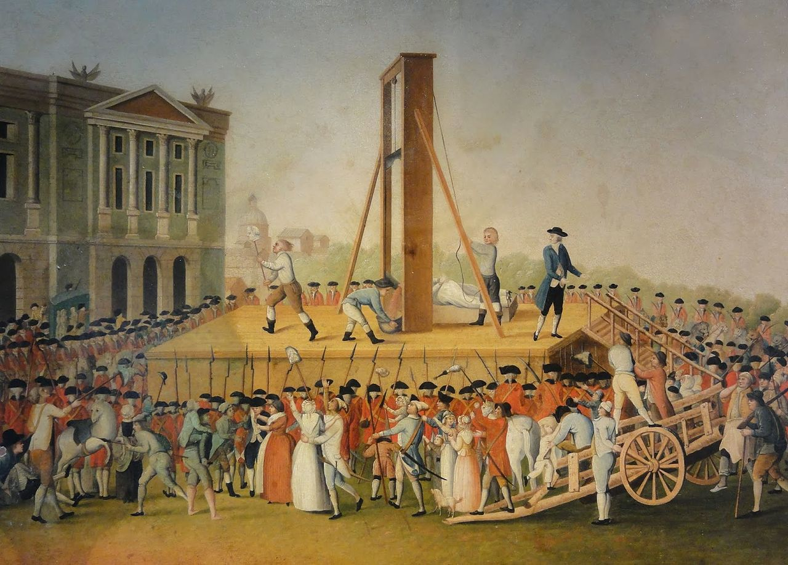
Schedule: timing will be strict … and speakers will be cut off if they speak beyond their allocated time!

Slide 11
Schedule: the Coexistence Workshop schedule includes 7.5 hours of meeting & 2 hours of eating/drinking
The meeting schedule details are as follows:
12:30 - 13:00: Welcome Break: Foyer Level 1 - Coffee Station
13:00 - 22:00: Workshop: The Golden Wave 1 - 1st Floor
15:30 - 16:00: Coffee Break: Foyer Level 1 - Coffee Station
19:00 - 20.00: Dinner: Level E: Flow Restaurant
The Workshop Dinner (buffet style), includes 1 water/soda per guest and will be served from 19:00 to 20:00 in the Flow Restaurant - Level E, Melia Vienna.
The Menu will be posted on the Coffee Station at the start of the Workshop.
**Additional beverage (wine and/or beer) is the cost of the meeting attendee
Note: all sessions will start promptly at the advertised time!

Slide 12
Coexistence Workshop
IEEE 802.11 Coexistence SC Chair’s remarks

Slide 13
The problem: a group of blindfolded people need to form a rope into an equilateral triangle
From this …
A team building exercise
To this …

Slide 14
The solution: various groups have different approaches … not all leading to success
Real solutions at a team building day … in 1989!
An alternative
Chaos 1
Chaos 2
Coordination
Directed
Chaos
Poor communication
Independent attempts to find solution
Ultimately failed
Chaos
Poor communication
Independent attempts to find solution
Got lucky!
Good coordination
Good communication
Careful consideration
Solved in one attempt
Rely on a third party for the answer
May not result in best solution for everyone
May take a long time
Failure
Success
Success
Success

Slide 15
IEEE 802.11 WG & 3GPP RAN are currently operating somewhere between the “chaos” & “directed” modes
Application to the coexistence problem
Blindfolded participants are:
IEEE 802.11 WG stakeholders
3GPP RAN stakeholders
Communications have been poor
Infrequent workshops
Ineffective “LS ping pong”
Insufficient common membership
Little active consensus building
Significant mistrust!
Mostly independent attempts to find solutions in the two SDOs
Result for coexistence between IEEE 802.11 & LAA/NR-U
We are probably operating in one of the two “chaos” categories …
… meaning there is significant risk of messing up 5 & 6 GHz unlicensed spectrum
Fortunately, we are operating in the “directed” mode too …
… with ETSI BRAN directing us
… but also limiting innovation
… and taking way too long!

Slide 16
The challenge for IEEE 802.11 WG & 3GPP RAN is better coordinate our coexistence activities
We could continue with the current hybrid “chaos/directed” model …
But “chaos” risks messing up 5 & 6 GHz
And “direction” from ETSI BRAN may limit innovation and slow us down
… or we could transition to the “coordination” model
This workshop could be the start
But it is almost certainly not enough
The challenge is that working together effectively will be hard
Difficult technical issues
EDCA based LBT is horrible in many ways, but the alternative is not obvious
Common preambles, no LBT, CW update, reservation signals, …
Cultural differences
802.11 WG has a long history of distributed operation in unlicensed spectrum
3GPP RAN’s history is scheduled operation in a licensed environment
Practical difficulties
It took many months to even schedule this workshop

Slide 17
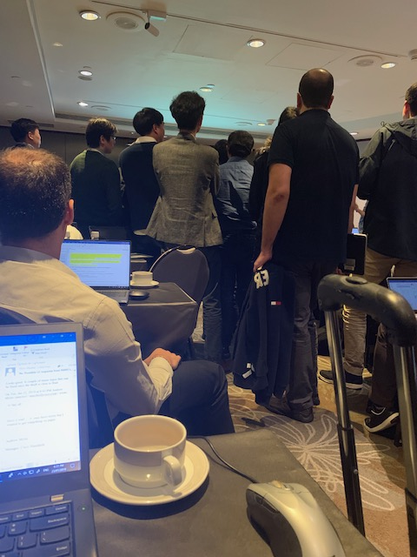
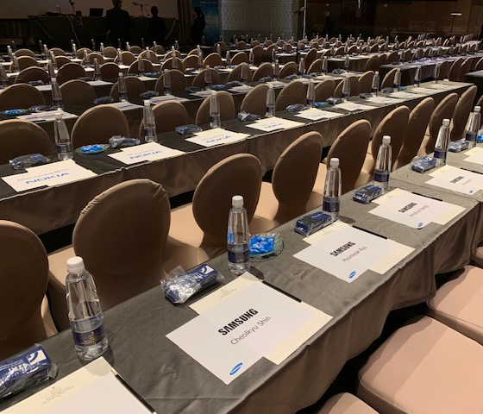
Humour: 3GPP RAN1 & IEEE 802.11 WG culturally seem to align with their protocols ☺
In RAN1, every single seat was reserved for the week …
… which is aligned with the scheduled philosophy of LTE/LAA/NR-U
In RAN1, the Chair is a technical decision maker rather than a process facilitator…
… which is aligned with the centralised control philosophy of LTE/LAA/NR-U
Reservations
Unseen Chair leading technical discussions
Whereas in the 802.11 WG seats are only reserved while they are occupied (for limited periods) …
… just like the 802.11 protocol!
Whereas the 802.11 WG distributes technical control with the Chair playing a coordinating role …
… just like the 802.11 protocol!

Slide 18
Coexistence Workshop
Chairs’ welcomes

Slide 19
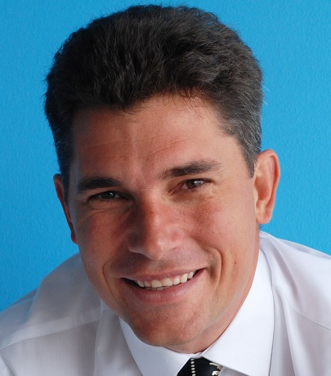
The Chairs of IEEE 802.11 WG & 3GPP RAN will welcome participants to the Coexistence Workshop
Dorothy Stanley
Chair of IEEE 802.11 WG
Balazs Bertenyi
Chair of 3GPP RAN

Slide 20
Agenda for Coexistence Workshop
# | Topic | Chair
0 | Welcome & logistics | Andrew Myles (IEEE 802.11 Coexistence SC Chair, Cisco)
1 | Invited papers
2 | Deployment experience | Dorothy Stanley (IEEE 802.11 WG Chair, HPE)
3 | Coexistence topics

Slide 21
Invited: 3GPP RAN will present “Status Report for Release 16 NR-U”
Title | 1-1: Status Report for Release 16 NR-U
Speakers | Jing Sun (Qualcomm), Balasz Bertenyi (Nokia) & Havish Koorapaty (Ericsson)
Timing | 40 min, including Q&A
Abstract | NR unlicensed is being standardized in 3GPP as a Release 16 work item since the beginning of 2019 and is expected to be completed by the end of the year. The paper provides a summary on the current status of development with emphasize on channel access aspect.
Links | Status Report for Release 16 NR-U

Slide 22
Invited: IEEE 802.11 TGax will present “High Efficiency WLAN (802.11ax) Overview”
Title | 1-2: High Efficiency WLAN (802.11ax) Overview
Speakers | Osama Aboul-Magd (Huawei)
Timing | 40 min, including Q&A
Abstract | The IEEE 802.11 WG has been working on a new amendment to its wireless LAN (WLAN) standard since May 2014. The new amendment is usually referred to as 802.11ax or High Efficiency WLAN (HEW). Since then task group (TG) AX has been working on the technical specification. This presentation provides the status of the standard development as well as its technical features. The proposed operation in the 6 GHz band is also included. Outline: • Project Scope and difference with previous amendments. • Timeline and Status • 802.11ax Numerology • 802.11ax Frame Formats (legacy preamble + HE preamble) • Tone Plans for 20, 40, and 80 MHz channels • Support for two NAVs and Spatial Reuse • Clear Channel Assessment (CCA) • Operation in 6 GHz band
Links | IEEE 802.11 WG: High Efficiency WLAN (802.11ax) Overview

Slide 23
Invited: IEEE 802.11 TGbe will present “IEEE 802.11be: Extremely High Throughput (EHT) WLAN”
Title | 1-3: IEEE 802.11be: Extremely High Throughput (EHT) WLAN
Speakers | Alfred Asterjadhi (Qualcomm)
Timing | 15 min, including Q&A
Abstract | IEEE 802.11 has recently approved the creation of a new task group to work on a major amendment, IEEE 802.11be, for next generation wireless LAN. The new amendment will define Extreme High Throughput (EHT) physical (PHY) and medium access control (PHYMAC) layers capable of supporting a maximum throughput of at least 30 Gbps. The amendment will also aim at reducing worst case latency and jitter to improve support for time sensitive applications such virtual reality, augmented reality, gaming, etc. The presentation will cover the scope of the IEEE 802.11be project, main use cases, candidate feature sets and projected timeline.
Links | Extremely High Throughput (EHT) WLAN

Slide 24
Invited: ETSI BRAN will present “ETSI BRAN Update”
Title | 1-4: ETSI BRAN Update
Speakers | David Boldy (Broadcom)
Timing | 15 min, including Q&A
Abstract | ETSI BRAN is the Technical Committee in Europe responsible for the existing 5GHz RLAN standard and where the new 6GHz standard for RLAN will be created. This update details the status of the 6GHz sharing and compatibility studies in Europe as well as the latest on the feasibility and development of regulations (in response to the EC 6GHz Mandate) and how this relates to the work that has been completed or is under way at ETSI. A history of the 5GHz Channel Access requirements, the lessons learned during development of the current harmonized standard and the status of draft EN 301 893 v2.2.1 are included to help promote discussion on what can be done better for 6GHz.
Links | ETSI BRAN Update

Slide 25
Invited: a regulator will present “A 6 GHz regulatory update”
Title | 1-5: A 6 GHz regulatory update
Speakers | Andy Gowans (OFCOM)
Timing | 15 min, including Q&A
Abstract | This presentation covers spectrum issues associated with possible opportunities and sharing issues for RLAN technologies in the 5GHz and 6GHz range
Links | A 6 GHz regulatory update

Slide 26
Coffee break

Slide 27
Agenda for Coexistence Workshop
# | Topic | Chair
0 | Welcome & logistics | Andrew Myles (IEEE 802.11 Coexistence SC Chair, Cisco)
1 | Invited papers
2 | Deployment experience | Dorothy Stanley (IEEE 802.11 WG Chair, HPE)
3 | Coexistence topics

Slide 28
Submitted: HPE will present “LAA/Wi-Fi coexistence evaluations with commercial hardware”
Title | 2-1: LAA/Wi-Fi coexistence evaluations with commercial hardware
Speakers | Stuart Strickland (HPE)
Timing | 15 min, including Q&A
Abstract | In this work, we first present extensive coexistence measurement results with enterprise-grade Wi-Fi AP and commercial LAA small cell (in 5 GHz), and then share our findings that are important to both 3GPP and IEEE community. Briefly, we investigate two important coexistence scenarios, where LAA strength is: Above; and Below Wi-Fi energy-detection (ED) thresholds. In the above-ED scenario, we found that when both Wi-Fi and LAA use considerably different maximum transmission durations (TXOP), there exist severe airtime unfairness. In the below-ED scenario, LAA and Wi-Fi have a 2-10x performance degradation, due to the absence of preamble detection or RTS/CTS by LAA. We argue that these findings should be discussed for the upcoming 6 GHz-based 5G-NR standard.
Links | LAA/Wi-Fi coexistence evaluations with commercial hardware

Slide 29
Submitted: Uni of Chicago will present “Coexistence of LTE-LAA and Wi-Fi: analysis, simulation & experiments”
Title | 2-2: Coexistence of LTE-LAA and Wi-Fi: analysis, simulation and experiments
Speakers | Monisha Ghosh (Uni of Chicago)
Timing | 15 min, including Q&A
Abstract | In this presentation, we will summarize our study into the issue of coexistence of LTE-LAA and Wi-Fi in the unlicensed bands. This project was funded by the National Science Foundation and is an objective analysis of the coexistence of these two systems. Via analysis, extensive simulations and experiments we have studied the performance in various coexistence scenarios. The two main conclusions from this work are: the two systems coexist best (in terms of throughput and latency for both systems) when the sensing levels used by each to protect against the other are symmetric, e.g. -82 dBm as currently used by Wi-Fi and the maximum TXOP size used by LTE-LAA has an effect on coexistence and 6 ms may be a better option than 8 ms. These insights can inform the design of the next generation of Wi-Fi and cellular systems for the 6 GHz band to ensure improved coexistence for both.
Links | Coexistence of LTE-LAA and Wi-Fi: analysis, simulation and experiments (update coming)

Slide 30
Agenda for Coexistence Workshop
# | Topic | Chair
0 | Welcome & logistics | Andrew Myles (IEEE 802.11 Coexistence SC Chair, Cisco)
1 | Invited papers
2 | Deployment experience | Dorothy Stanley (IEEE 802.11 WG Chair, HPE)
3 | Coexistence topics

Slide 31
Submitted: WBA will present “RAN and core convergence/coexistence in action”
Title | 3-1: RAN and core convergence/coexistence in action
Speakers | Tiago Rodrigues (WBA General Manager), Bruno Tomas (WBA Director Programs)
Timing | 15 min, including Q&A
Abstract | Abstract
Links | RAN.core convergence/coexistence in action: How the combination of Wi-Fi and cellular complements the 5G experience

Slide 32
Submitted: Ericsson will present “Coexistence in 6 GHz License-Exempt Spectrum”
Title | 3-2: Coexistence in 6 GHz License-Exempt Spectrum
Speakers | Sorour Falahati (Ericsson)
Timing | 15 min, including Q&A
Abstract | This paper discusses the principles and practical challenges for coexistence of RLAN technologies such as those developed by the IEEE and 3GPP applicable to 6 GHz license-exempt spectrum that is expected to be made available for RLANs in the near future. Both coexistence between RLANs and between RLANs and existing users (e.g., microwave/satellite services) of the spectrum are addressed. Experience from technology development and deployments in 5 GHz regarding important coexistence aspects and its applicability to 6 GHz is discussed. Regulatory aspects related to 6 GHz, similarities and differences from 5 GHz and the applicability of the experience from the 5 GHz regulatory framework to 6 GHz is also addressed.
Links | Coexistence in 6GHz License Exempt Spectrum

Slide 33
Submitted: Cisco will present on “LBT should remain the basis of fair & efficient coexistence …”
Title | 3-3: LBT should remain the basis of fair & efficient coexistence in 6 GHz unlicensed spectrum
Speakers | Andrew Myles (Cisco)
Timing | 15 min, including Q&A
Abstract | IEEE 802.11 WG & 3GPP RAN need to work together on LBT based & new rules for 6 GHz coexistence After 20 years, Wi-Fi in unlicensed spectrum is a wildly successful $2T pa socio-economic phenomenon New cellular derived technologies threatened the future success of Wi-Fi & 5 GHz unlicensed spectrum The threat to Wi-Fi & 5 GHz unlicensed spectrum was mitigated (a bit) by the use of LBT by LAA/NR-U There is now a good case for working together on both LBT based & new rules to achieve 6 GHz coexistence
Links | LBT should remain the basis of fair and efficient coexistence in 6 GHz spectrum

Slide 34
Submitted: Cablelabs will present “NR-U/Wi-Fi Coexistence in 5/6 GHz bands”
Title | 3-4: NR-U/Wi-Fi Coexistence in 5/6 GHz bands
Speakers | Dorin Viorel (Cablelabs)
Timing | 15 min, including Q&A
Abstract | IEEE and 3GPP are the major SDOs developing wireless standards for unlicensed spectra. Since the related access technologies (LAA LTE/NR and Wi-Fi) are intended for the same spectra, pro-active steps should be taken to optimize the coexistence of these technologies. The contribution represents the perspective of the major global MSOs (members of CableLabs) into the possible steps on optimizing the coexistences between Wi-Fi, LTE LAA and NR-U rolled out or intended to be rolled in the 5/6 GHz bands.
Links | NR-U/Wi-Fi Coexistence in 5/6 GHz bands

Slide 35
Submitted: Huawei will present “Performance evaluation of channel access mechanisms in 6 GHz spectrum”
Title | 3-5: Performance evaluation of channel access mechanisms in 6 GHz spectrum
Speakers | Jiayin Zhang (Huawei)
Timing | 15 min, including Q&A
Abstract | The authorities in US & EU are soon going to open 6 GHz for unlicensed usage. This has attracted interest from both IEEE802.11 and 3GPP NR-U. In NR-U Release 16 Study Item, the coexistence mechanisms between 802.11ax & NR-U in 6 GHz were evaluated. In this paper, we provide evaluation results for several channel access mechanisms in the coexistence scenarios, such as same or different ED threshold, with or without common preamble. In particular, this paper looks at the proposal discussed in 3GPP to adopt the same ED threshold for NR-U and Wi-Fi without common preamble from the perspective of user perceived throughput. Moreover, the channel access mechanism for wider operation bandwidth will also be discussed. Wideband LBT would be beneficial from implementation perspective considering the larger available bandwidth in 6 GHz band. Outline: Description of channel access mechanisms evaluated Evaluation assumptions and methodologies Results and conclusions Wideband LBT in 6 GHz
Links | Performance evaluation of channel acccess mechanisms in 6 GHz spectrum

Slide 36
Submitted: Ericsson will present “Coexistence Mechanisms”
Title | 3-6: Coexistence Mechanisms
Speakers | Sorour Falahati (Ericsson)
Timing | 15 min, including Q&A (part of panel session)
Abstract | This paper discusses specific coexistence mechanisms and their impact on system performance addressing the effects of technology choices, operation modes and system parameters on overall performance. Different deployment environments are considered. Test and field results are used wherever possible to inform the discussion. Both co-channel and adjacent channel coexistence aspects are discussed. Key factors such as deployment densities and reuse factors and their relation to the impact of various coexistence mechanisms on system performance is addressed. The paper also considers the design principles of different RLAN technologies and their use of the discussed coexistence mechanisms for sharing in license-exempt spectrum.
Links | Coexistence Mechanisms

Slide 37
Submitted: Quantenna will present “Efficient and Fair Medium Sharing Enabled by a Common Preamble”
Title | 3-7: Efficient and Fair Medium Sharing Enabled by a Common Preamble
Speakers | Imran Latif (Quantenna)
Timing | 12 min, no Q&A (part of panel session)
Abstract | A co-Existence mechanism between 3GPP (LTE) and IEEE (802.11) for the unlicensed 5GHz frequency band is currently defined in release 13 of 3GPP LTE standard. It utilizes listen-before-talk (LBT) access mechanism to gain the control of the medium before transmitting any data. The LBT mechanism uses energy detection (ED) to perform clear channel assessment (CCA) in order to avoid collisions and to fairly use the unlicensed wireless medium. FCC has recently issued an NPRM to make the 6 GHz band available for unlicensed use. With the opening of 6 GHz band in sight, it has become critical to address the co-existence issues between 3GPP and IEEE for this frequency band. …
Links | Efficient and Fair Medium Sharing Enabled by a Common Preamble Presentation and Paper

Slide 38
Submitted: Orange will present “Orange view on co-existence between NR-U and Wi-Fi”
Title | 3-8: Orange view on co-existence between NR-U and Wi-Fi
Speakers | Benoit Graves (Orange)
Timing | 12 min, no Q&A (part of panel session)
Abstract | This presentation will give an operator perspective on the interest to have a common pre-amble for NR-U and Wi-Fi. Orange is a convergent operator in a large number of countries, operating both mobile networks and Wi-Fi operations. Introduction of unlicensed 3GPP technologies is seen as an opportunity for an MNO, but a risk for legacy WLAN deployments. Optimized co-existence between the two systems is critical to the success of both technologies, the use of a common pre-amble for channel access (together with Energy detection) is the best solution to secure fairness between the systems in any deployment scenario
Links | On the interest of a common preamble between NR-U and Wi-Fi

Slide 39
Submitted: Broadcom will present “On a common preamble between Wi-Fi and NR-U”
Title | 3-9: On a common preamble between Wi-Fi and NR-U
Speakers | Sindhu Verma (Broadcom)
Timing | 12 min, no Q&A (part of panel session)
Abstract | Wi-Fi and NR-U may be deployed in close proximity. So, it is important that they coexist well. Similarity in channel access is critical for good coexistence. A basic step in channel access is for a device to determine if the channel is idle i.e. there are no ongoing transmissions, before it decides to transmit. Wi-Fi checks this by looking for a known signature (called a “preamble”) that is prefixed to all Wi-Fi transmissions. This procedure is referred to as Preamble Detection. NR-U checks for an idle channel by measuring the total received energy in the channel and comparing it to a predetermined threshold. This is known as Energy Detection. We discuss the merits and feasibility of both these schemes.
Links | On a common preamble between Wi-Fi and NR-U

Slide 40
Submitted: IITP RAS will present “Collision Detection for Fair LAA/Wi-Fi Coexistence”
Title | 3-10: Collision Detection for Fair LAA/Wi-Fi Coexistence
Speakers | Vyacheslav Loginov (IITP RAS)
Timing | 12 min, no Q&A (part of panel session)
Abstract | A LAA eNB performs the backoff procedure before every tx attempt. However, it only starts data tx at slot boundaries, which results in an extremely long vulnerable period from the end of the backoff procedure until the slot boundary. To protect LAA tx’s, many developers propose sending a reservation signal (RS) during the vulnerable period. However, there are several disadvantages concerning the RS use, especially when Wi-Fi STAs uses RTS/CTS. In particular, RS leads to asymmetric collisions: if a Wi-Fi STA transmits an RTS & a collision with the LAA eNB occurs, the duration of the RS may be longer than the collided Wi-Fi frame, so LAA payload is not affected, while Wi-Fi STAs need to increase their contention window. To solve this problem, we propose a novel wireless collision detection mechanism. After performing the backoff procedure, the LAA eNB sends a short RS, defined as Pre-RS, and then it senses the channel for SIFS. If the channel is idle, there are no Wi-Fi transmissions, and the LAA BS continues the RS transmission. Otherwise, if the channel is busy, the LAA BS postpones its tx and repeats the backoff procedure. We show that the proposed mechanism improves significantly both Wi-Fi performance & fairness of channel resource sharing between LAA & Wi-Fi devices.
Links | Collision Detection for Fair LAA/Wi-Fi Coexistence

Slide 41
Submitted: AT&T will present “Common Preamble Design in the 6 GHz Band – Merits and Challenges”
Title | 3-11: Common Preamble Design in the 6 GHz Band – Merits and Challenges
Speakers | Arun Ghosh (AT&T)
Timing | 12 min, no Q&A (part of panel session)
Abstract | This paper proposes a common channel access procedure, and specifically a common preamble design for 3GPP and IEEE 802.11 technologies in the 6 GHz band. This paper also discusses benefits and challenges of a common preamble including designs based on the IEEE 802.11ax preamble or a common new preamble. Special emphasis will be given to the fact that these are different radio technologies under the umbrella of different standards developing organizations (SDOs). While the paper focuses on the 6 GHz band, remedies for the 5 GHz band are addressed including adoption of the legacy Wi-Fi preamble by NR-U (New Radio – Unlicensed) with the dual ED/PD (Energy Detection/ Preamble Detection) mechanism as an option. In case the preamble detection is optional, the paper addresses the use of the same threshold for ED only channel access procedures.
Links | Common Preamble Design in the 6 GHz Band – Merits and Challenges

Slide 42
Dinner break

Slide 43
Agenda for Coexistence Workshop
# | Topic | Chair
0 | Welcome & logistics | Andrew Myles (IEEE 802.11 Coexistence SC Chair, Cisco)
1 | Invited papers
2 | Deployment experience | Dorothy Stanley (IEEE 802.11 WG Chair, HPE)
3 | Coexistence topics

Slide 44
3-P1: Panel on “common preambles”
Chair
Dorothy Stanley (HP Enterprise)
Participants
Monisha Ghosh (Uni of Chicago)
Sorour Falahati (Ericsson)
Imran Latif (Quantenna)
Benoit Graves (Orange)
Sindhu Verma (Broadcom)
Vyacheslav Loginov (IITP RAS)
Arun Ghosh (AT&T)

Slide 45
Submitted: Cisco will present “The use of no LBT for DRS is not justified by history”
Title | 3-12: The use of no LBT for DRS is not justified by history
Speakers | Andrew Myles (Cisco)
Timing | 10 min, no Q&A (part of panel session)
Abstract | The history of Short Control Signalling supports proposals to ban no LBT & restrict short LBT Today’s workshop will hear multiple presentations related to the use of short LBT access by LAA/NR-U This presentation examines the history of no LBT access for short control signalling in EN 301 893 by LAA/NR-U The history of Short Control Signalling supports the proposal to ban no LBT & restrict short LBT in the future
Links | The use of no LBT for DRS is not justified by history

Slide 46
Submitted: Huawei will present “LBT for short control messages”
Title | 3-13: LBT for short control messages
Speakers | David Mazzarese (Huawei)
Timing | 10 min, no Q&A (part of panel session)
Abstract | NR-U support the deployment of standalone (SA), dual connectivity (DC) and licensed assisted access (LAA). DRS is more critical for NR-U system than for LTE-LAA, as it is required by UE to acquire and maintain timing/frequency synchronization, system information and to perform RRM/RLM measurements. LBT types for DRS transmission was discussed for NR-U in 3GPP Release 16. It was agreed in 3GPP to use LBT CAT2 if the duration of DRS is smaller than 1ms and duty cycle is smaller than 1/20, i.e. the same as for DRS in LTE LAA. Otherwise, LBT CAT4 will be used. In this paper, we provide coexistence and performance evaluations for the case of standalone operation, looking at various channel access schemes for the DRS according to the communication that took place by LS between 3GPP, ETSI BRAN and IEEE802.11. Outline: Description of DRS in NR-U Description of channel access mechanisms investigated for DRS transmission Assumptions and methodologies of system level evaluation Results and conclusions
Links | LBT for short control messages

Slide 47
Submitted: Broadcom will present “On standalone transmissions with short-LBT”
Title | 3-14: On standalone transmissions with short-LBT
Speakers | Sindhu Verma (Broadcom)
Timing | 10 min, no Q&A (part of panel session)
Abstract | Listen Before Talk or LBT is the procedure by which a device confirms the absence of other transmissions in the channel before starting its own transmission. LBT is a key procedure for transmission on an unlicensed channel. In NR-U/LAA/Wi-Fi, independent transmissions use the following types of LBT: CAT2 LBT where a device that intends to transmit checks the channel for a short fixed duration of time and CAT4 LBT where a device that intends to transmit checks the channel for a random duration of time. This presentation discusses the performance of both these LBT schemes.
Links | On standalone transmissions with short-LBT

Slide 48
3-P2: Panel on “short/no LBT”
Chair
Dorothy Stanley
Participants
Sindhu Verma (Broadcom)
David Mazzarese (Huawei)
Andrew Myles (Cisco)

Slide 49
Submitted: Mediatek will present “Coex simulation and analysis”
Title | 3-15: Coex Simulation and Analysis
Speakers | James Wang (Mediatek), with six Mediatek co-authors
Timing | 15 min, including Q&A
Abstract | This contribution provides the system level simulation to evaluate 802.11 and ETSI LBE channel access engine and parameters which can impact fairness for medium occupancy Some challenges are observed and identified.
Links | 11-19-1230-00

Slide 50
Submitted: CONNECT Centre will present “An experimental evaluation of coexistence challenges … “
Title | 3-16: An Experimental Evaluation of Coexistence Challenges of Wi-Fi & LTE in the unlicensed band
Speakers | Jerome A. Arokkiam (CONNECT Centre, Trinity College Dublin)
Timing | 15 min, including Q&A
Abstract | Wi-Fi & LTE, evolving from different techno-socio-economic perspectives, face challenges when coexisting in unlicensed spectrum. In this paper, we use COTS hw/sw to evaluate coexistence between Wi-Fi data & LTE control/data, by emulating practical coexistence scenarios with varying tx power levels, tx bandwidths & channel selections, and by measuring throughput at the respective clients. Our results provide three major conclusions: While low-powered LTE control tx’s act appear as a hidden-terminal to Wi-Fi, the relatively higher-powered tx’s of Wi-Fi or LTE causes significant interference to the other technology, regardless of the tx bandwidth or mode (either control or data) being used by LTE When a 5MHz LTE tx coexists with a 20MHz Wi-Fi tx in different co-channels, the Wi-Fi client experiences significant degradation in throughput, regardless of the relative tx power levels During adjacent-channel tx’s of 20MHz LTE & 20MHz Wi-Fi, LTE tx’s causes significant interference to Wi-Fi due to out-of-band emissions from LTE In this work, we present LTE/Wi-Fi coexistence problems at 2.4 GHz with the legacy LTE Release 8/9 and Wi-Fi but the results are applicable for the LAA/Wi-Fi coexistence at 5GHz under the conditions 1) adjacent channel operation, 2) hidden terminal problem.
Links | An experimental Evaluation of Coexistence Challenges of Wi-Fi & LTE in the unlicensed band

Slide 51
Submitted: Octoscope will present “A testbed architecture for 6 GHz Wi-Fi/NR-U Coexistence Testing”
Title | 3-17: A testbed architecture for 6 GHz Wi-Fi/NR-U Coexistence Testing
Speakers | Leigh Chinitz (Octoscope)
Timing | 15 min, including Q&A
Abstract | As the wireless industry prepares for the potential of 1.2 GHz of unlicensed spectrum to become available in the 6 GHz band, organizations such as IEEE and 3GPP are anticipating how some of the latest wireless technologies will be able to coexist in that band. The technologies of most interest are Wi-Fi 6, based on the IEEE 802.11ax standard, and NR-U, the unlicensed spectrum version of 3GPP’s 5G New Radio standard. In this paper we discuss the important attributes the testbeds used to test the coexistence of, in particular, these two technologies will need to have, and we propose an architecture to meet those requirements.
Links | A testbed architecture for 6 GHz Wi-Fi/NR-U Coexistence Testing and Paper

Slide 52
Submitted: Cisco will present on NR-U’s definition of success for LBT
Title | 3-18: NR-U’s definition of success for LBT needs to be realigned with 802.11 and European rules
Speakers | Andrew Myles (Cisco)
Timing | 0 min, reserve topic
Abstract | NR-U’s definition of success for LBT needs to be realigned with 802.11 and European rules European rules & IEEE 802.11 base Contention Window updates in LBT on the success of transmissions at the start of a COT … … because only the success (or lack thereof) at the start of COT is relevant to collision detection for LBT Whereas, LAA/NR-U bases Contention Window updates on information later in COT, contrary to the European rules It is time to align NR-U to focus success on start of transmission to enable compliance & fairness
Links | NR-U’s definition of success for LBT needs to be realigned with 802.11 and European rules

Slide 53
The (second) Coexistence Workshop in Vienna in July 2019 is adjourned …
… but let’s hope it represents a new beginning for better coexistence between Wi-Fi & LAA/NR-U

