Slide 1
Agenda for
IEEE 802.11 Coexistence Workshop in Vienna on 17 July 2019
5 July 2019
Authors:
Draft
Name | Company | Phone | email
Andrew Myles | Cisco | +61 418 656587 | amyles@cisco.com

Slide 2
Agenda for Coexistence Workshop
# | Topic | Chair
0 | Welcome & logistics | Andrew Myles (IEEE 802.11 Coexistence SC Chair, Cisco)
1 | Invited papers
2 | Deployment experience | Dorothy Stanley (IEEE 802.11 WG Chair, HPE)
3 | Coexistence topics

Slide 3
Welcome & logistics

Slide 4



Sponsors: a big thank you to the three major sponsors of today’s Coexistence Workshop
The
wireless
bits

Slide 5
Goals: the Coexistence Workshop will focus on discussion of sharing by 802.11ax/be & NR-U
Coexistence Workshop goals
  The primary objective of the Coexistence Workshop is to discuss issues related to fair and efficient shared operation in the 6 GHz band by:
    IEEE 802.11ax High Efficiency WLAN)
    IEEE 802.11be (Extremely High Throughput)
    3GPP NR-U (New Radio Unlicensed)
  It is hoped the primary objective will be achieved by:
    Sharing information on plans for use of future technology standards (particularly IEEE 802.11 and 3GPP NR-U) in the 6 GHz band
    Assessing coexistence issues and topics related to the simultaneous use of IEEE 802.11 and 3GPP NR-U technologies in the 6 GHz band, including coexistence criteria and mechanisms
    Discussing related coexistence topics of interest, including deployment experience of 3GPP LAA/eLAA coexistence with IEEE 802.11ac in the 5 GHz band

Slide 6
Decisions: the Coexistence Workshop has no decision making authority
  The Coexistence Workshop will focus on:
    Sharing …
    Assessing …
    Discussing …
  However, the Coexistence Workshop has no authority to make any decisions on behalf of:
    IEEE 802.11 WG in relation to 802.11ax/be
    3GPP RAN in relation to NR-U
    … or anyone else!
  Rather, it is hoped that today's workshop will help both 3GPP RAN & IEEE 802.11 WG to make decisions in the future that promote fair & efficient coexistence between 802.11ax/be & NR-U in the 5 & 6 GHz bands

Slide 7
Rules: normal IEEE-SA rules will be used as operating guidelines for the Coexistence Workshop
  Advice has been received from IEEE-SA that normal IEEE-SA standards development rules do not apply to the Coexistence Workshop
  However, it was suggested that the normal rules should be used as operating guidelines for the Coexistence Workshop
  Important operating guidelines include:
    Follow all applicable laws including anti-trust & competition laws
    Don’t discuss the interpretation, validity or essentiality of patents
    Don’t discuss licensing rates, terms or conditions
    Don’t discuss or engage in the fixing of product prices, allocation of customers or division of sales markets
  In addition, before speaking, participants are asked to identify any organizations to which they are affiliated
    Note: participants are requested to not assert they are representing the position of any organization without authority from that organization

Slide 8
Rules: the Coexistence Workshop will operate using accepted principles of meeting etiquette
Principles
  The Coexistence Workshop will be conducted in an orderly & professional manner
  Participants shall only address the “technical” content
  Participants shall refrain from making personal comments to or about others

Slide 9
Materials: Coexistence Workshop agenda, presentations & papers are available on-line
  All of the materials associated with today’s Coexistence Workshop, including agenda, presentation and attendance list, are available on-line:
    See <website>
  Additional documents will be uploaded as soon as possible after the Coexistence Workshop, including:
    Updates to presentations
    Workshop minutes
  The IEEE 802.11 Coexistence SC Chair will investigate having the material indexed by IEEE Xplore
  Thank you to Guido Hiertz (Ericsson) who has agreed to act as the Recording Secretary for today’s Coexistence Workshop

Slide 10
Schedule: the Coexistence Workshop schedule includes 7.5 hours of meeting & 2 hours of eating/drinking
High level Coexistence Workshop schedule
  12:30 13:00 Welcome coffee station
  13:00-15:30 Meeting (2.5 hours)
  15:30-16:00 Coffee Break
  16:00-19:00 Meeting (3 hours)
  19:00-20.00 Dinner
  20:00-22:00 Meeting (2 hours)
  Note: all sessions will start promptly at the advertised time!

Slide 11
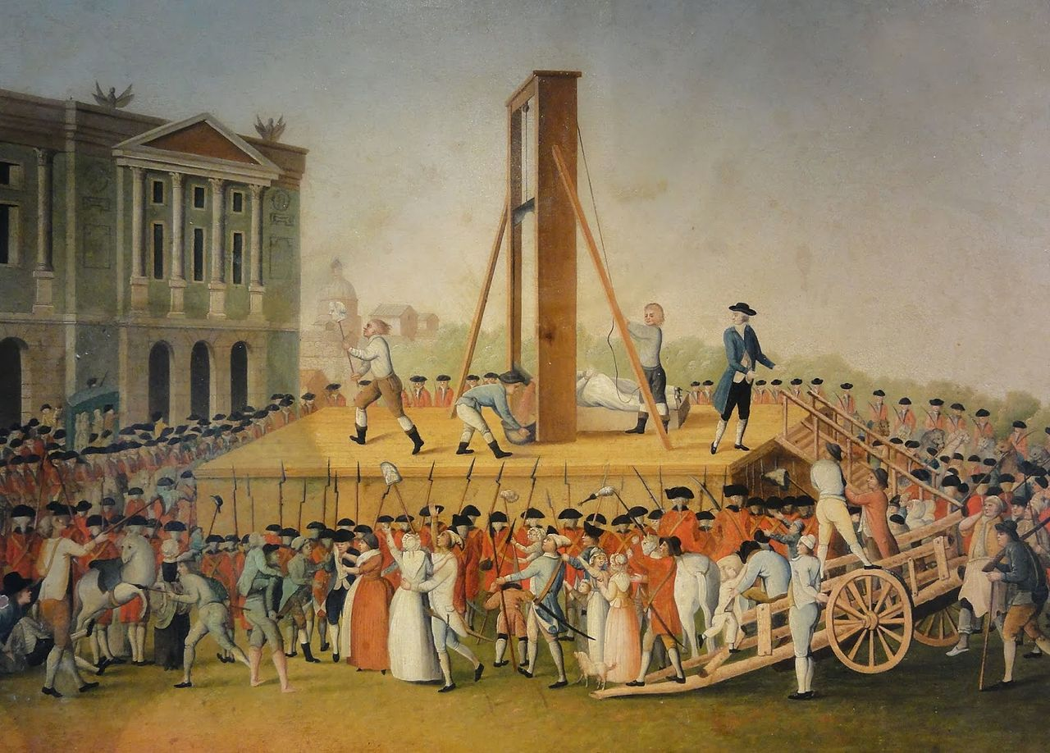
Schedule: timing will be strict … and speakers will be cut off!

Slide 12
Dinner: details
tbd

Slide 13
Coexistence Workshop
IEEE 802.11 Coexistence SC Chair’s remarks

Slide 14

The problem: a group of blindfolded people need to form a rope into an equilateral triangle
From this …
A team building exercise
To this …

Slide 15
The solution: various groups have different approaches … not all leading to success
Real solutions at a team building day … in 1989!
An alternative
Chaos 1
Chaos 2
Coordination
Directed
Chaos
Poor communication
Independent attempts to find solution
Ultimately failed
Chaos
Poor communication
Independent attempts to find solution
Got lucky!
Good coordination
Good communication
Careful consideration
Solved in one attempt
Rely on a third party for the answer
May not result in best solution for everyone
May take a long time
Failure
Success
Success
Success

Slide 16
IEEE 802.11 WG & 3GPP RAN are currently operating somewhere between the “chaos” & “directed” modes
Application to the
coexistence problem
  Blindfolded participants are:
    IEEE 802.11 WG
    3GPP RAN
  Communications are poor
    Infrequent workshops
    Ineffective “LS ping pong”
    Insufficient common members
    Little consensus building
    Significant mistrust!
  Mostly independent attempts to find solutions in the two SDOs
Result for coexistence between IEEE 802.11 & LAA/NR-U
  We are probably operating in one of the two “chaos” categories …
    … meaning significant risk of messing up 5 & 6 GHz unlicensed spectrum
  Fortunately, we are operating in the “directed” mode too …
    … with ETSI BRAN directing us
    … but also limiting innovation
    … and taking way too long!

Slide 17
The challenge for IEEE 802.11 WG & 3GPP RAN is better coordinate our coexistence activities
  We could continue with the current hybrid “chaos/directed” model …
    But “chaos” risks messing up 5 & 6 GHz
    And “direction” from ETSI BRAN may limit innovation and slow us down
  … or we could transition to the “coordination” model
    This workshop could be the start
    But it is almost certainly not enough
  Of course, working together effectively will be hard
    Difficult technical issues
      EDCA based LBT is horrible in many ways
      But the alternative is not obvious
    Cultural differences
      802.11 WG has a long history of distributed operation in unlicensed spectrum
      3GPP RAN’s history is scheduled operation in a licensed environment
    Practical difficulties
      It took many months to schedule this workshop

Slide 18
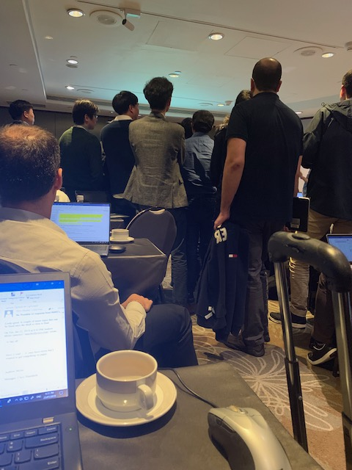
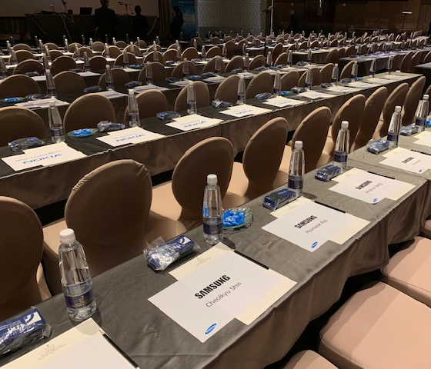
Humour: 3GPP RAN1 & IEEE 802.11 WG culturally seem to align with their protocols ☺
In RAN1, every single seat was reserved for the week …
… which is aligned with the scheduled philosophy of LTE/LAA/NR-U
In RAN1, the Chair is a technical decision maker rather than a process facilitator…
… which is aligned with the centralised control philosophy of LTE/LAA/NR-U
Reservations
Unseen Chair leading technical discussions
Whereas in the 802.11 WG seats are only reserved while they are occupied (for limited periods) …
… just like the 802.11 protocol!
Whereas the 802.11 WG distributes technical control with the Chair playing a coordinating role …
… just like the 802.11 protocol!

Slide 19
Coexistence Workshop
Chairs’ welcomes

Slide 20

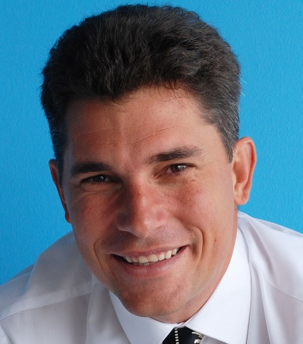
The Chairs of IEEE 802.11 WG & 3GPP RAN will welcome participants to the Coexistence Workshop
Dorothy Stanley
Chair of IEEE 802.11 WG
Balazs Bertenyi
Chair of 3GPP RAN

Slide 21
Agenda for Coexistence Workshop
# | Topic | Chair
0 | Welcome & logistics | Andrew Myles (IEEE 802.11 Coexistence SC Chair, Cisco)
1 | Invited papers
2 | Deployment experience | Dorothy Stanley (IEEE 802.11 WG Chair, HPE)
3 | Coexistence topics

Slide 22
Invited: 3GPP RAN will present “Status Report for Release 16 NR-U on Channel Access Related Design”
Title | Status Report for Release 16 NR-U on Channel Access Related Design
Speakers | Jing Sun (Qualcomm), Balasz Bertenyi (Nokia) & Havish Koorapaty (Ericsson)
Timing | 40 min, including Q&A
Abstract | Waiting for abstract
Links | Uploaded but waiting for link

Slide 23
Invited: IEEE 802.11 TGax will present “High Efficiency WLAN (802.11ax) Overview”
Title | High Efficiency WLAN (802.11ax) Overview
Speakers | Osama Aboul-Magd (Huawei)
Timing | 40 min, including Q&A
Abstract | The IEEE 802.11 WG has been working on a new amendment to its wireless LAN (WLAN) standard since May 2014. The new amendment is usually referred to as 802.11ax or High Efficiency WLAN (HEW). Since then task group (TG) AX has been working on the technical specification. This presentation provides the status of the standard development as well as its technical features. The proposed operation in the 6 GHz band is also included. Outline: • Project Scope and difference with previous amendments. • Timeline and Status • 802.11ax Numerology • 802.11ax Frame Formats (legacy preamble + HE preamble) • Tone Plans for 20, 40, and 80 MHz channels • Support for two NAVs and Spatial Reuse • Clear Channel Assessment (CCA) • Operation in 6 GHz band
Links | TBD

Slide 24
Invited: IEEE 802.11 TGbe will present “Enhancements for extremely high throughput (EHT) Wi-Fi”
Title | Enhancements for extremely high throughput (EHT) Wi-Fi
Speakers | Alfred Asterjadhi (Qualcomm) will confirm on 1 July 2019
Timing | 15 min, including Q&A
Abstract | IEEE 802.11 has recently approved the creation of a new task group to work on a major amendment, IEEE 802.11be, for next generation wireless LAN. The new amendment will define Extreme High Throughput (EHT) physical (PHY) and medium access control (PHY) layers capable of supporting a maximum throughput of at least 30 Gbps. The amendment will also aim at reducing worst case latency and jitter to improve support for time sensitive applications such virtual reality, augmented reality, gaming, etc. The presentation will cover the scope of the IEEE 802.11be project, main use cases, candidate feature sets and projected timeline
Links | TBD

Slide 25
Invited: ETSI BRAN will present “ETSI BRAN Update”
Title | ETSI BRAN Update
Speakers | David Boldy (Broadcom)
Timing | 15 min, including Q&A
Abstract | Waiting for abstract
Links | ETSI BRAN Update

Slide 26
Invited: a regulator will present “A 6 GHz regulatory update”
Title | A 6 GHz regulatory update
Speakers | Andy Gowans (OFCOM)
Timing | 15 min, including Q&A
Abstract | A brief summary of the situation for access to 6 GHz globally and any likely associated rules
Links | TBD

Slide 27

Coffee break

Slide 28
Agenda for Coexistence Workshop
# | Topic | Chair
0 | Welcome & logistics | Andrew Myles (IEEE 802.11 Coexistence SC Chair, Cisco)
1 | Invited papers
2 | Deployment experience | Dorothy Stanley (IEEE 802.11 WG Chair, HPE)
3 | Coexistence topics

Slide 29
Submitted: HPE will present “LAA/Wi-Fi coexistence evaluations with commercial hardware”
Title | LAA/Wi-Fi coexistence evaluations with commercial hardware
Speakers | Stuart Strickland (HPE)
Timing | 15 min, including Q&A
Abstract | In this work, we first present extensive coexistence measurement results with enterprise-grade Wi-Fi AP and commercial LAA small cell (in 5 GHz), and then share our findings that are important to both 3GPP and IEEE community. Briefly, we investigate two important coexistence scenarios, where LAA strength is: Above; and Below Wi-Fi energy-detection (ED) thresholds. In the above-ED scenario, we found that when both Wi-Fi and LAA use considerably different maximum transmission durations (TXOP), there exist severe airtime unfairness. In the below-ED scenario, LAA and Wi-Fi have a 2-10x performance degradation, due to the absence of preamble detection or RTS/CTS by LAA. We argue that these findings should be discussed for the upcoming 6 GHz-based 5G-NR standard.
Links | LAA/Wi-Fi coexistence evaluations with commercial hardware

Slide 30
Submitted: Uni of Chicago will present “Coexistence of LTE-LAA and Wi-Fi: analysis, simulation & experiments”
Title | Coexistence of LTE-LAA and Wi-Fi: analysis, simulation and experiments
Speakers | Monisha Ghosh (Uni of Chicago)
Timing | 15 min, including Q&A
Abstract | In this presentation, we will summarize our study into the issue of coexistence of LTE-LAA and Wi-Fi in the unlicensed bands. This project was funded by the National Science Foundation and is an objective analysis of the coexistence of these two systems. Via analysis, extensive simulations and experiments we have studied the performance in various coexistence scenarios. The two main conclusions from this work are: the two systems coexist best (in terms of throughput and latency for both systems) when the sensing levels used by each to protect against the other are symmetric, e.g. -82 dBm as currently used by Wi-Fi and the maximum TXOP size used by LTE-LAA has an effect on coexistence and 6 ms may be a better option than 8 ms. These insights can inform the design of the next generation of Wi-Fi and cellular systems for the 6 GHz band to ensure improved coexistence for both.
Links | tbd

Slide 31
Agenda for Coexistence Workshop
# | Topic | Chair
0 | Welcome & logistics | Andrew Myles (IEEE 802.11 Coexistence SC Chair, Cisco)
1 | Invited papers
2 | Deployment experience | Dorothy Stanley (IEEE 802.11 WG Chair, HPE)
3 | Coexistence topics

Slide 32
Submitted: WBA will present “How the combination of Wi-Fi & cellular complements the 5G experience”
Title | RAN and core convergence/coexistence in action: How the combination of Wi-Fi & cellular complements the 5G experience
Speakers | Tiago Rodrigues (WBA General Manager), Bruno Tomas (WBA Director Programs)
Timing | 15 min, including Q&A
Abstract | In this session, Tiago Rodrigues, WBA General Manager, will share the results of (WBA) work streams and advocate a future of collaboration and integration between Wi-Fi and cellular technologies From a WBA standpoint we have decided to work on a global industry survey to also complement our presentation and raise key data points on 6 GHz band utilization plans. Asked for updated abstract on 24 June and reminded of deadline
Links | TBD

Slide 33
Submitted: Ericsson will present “Coexistence in 6 GHz License-Exempt Spectrum”
Title | Coexistence in 6 GHz License-Exempt Spectrum
Speakers | Sorour Falahati (Ericsson)
Timing | 15 min, including Q&A
Abstract | This paper discusses the principles and practical challenges for coexistence of RLAN technologies such as those developed by the IEEE and 3GPP applicable to 6 GHz license-exempt spectrum that is expected to be made available for RLANs in the near future. Both coexistence between RLANs and between RLANs and existing users (e.g., microwave/satellite services) of the spectrum are addressed. Experience from technology development and deployments in 5 GHz regarding important coexistence aspects and its applicability to 6 GHz is discussed. Regulatory aspects related to 6 GHz, similarities and differences from 5 GHz and the applicability of the experience from the 5 GHz regulatory framework to 6 GHz is also addressed.
Links | Coexistence in 6GHz License Exempt Spectrum

Slide 34
Submitted: Cisco will present on “LBT should remain the basis of fair & efficient coexistence …”
Title | LBT should remain the basis of fair & efficient coexistence in 6 GHz unlicensed spectrum
Speakers | Andrew Myles (Cisco)
Timing | 15 min, including Q&A
Abstract | IEEE 802.11 WG & 3GPP RAN need to work together on LBT based & new rules for 6 GHz coexistence After 20 years, Wi-Fi in unlicensed spectrum is a wildly successful $2T pa socio-economic phenomenon New cellular derived technologies threatened the future success of Wi-Fi & 5 GHz unlicensed spectrum The threat to Wi-Fi & 5 GHz unlicensed spectrum was mitigated (a bit) by the use of LBT by LAA/NR-U There is now a good case for working together on both LBT based & new rules to achieve 6 GHz coexistence
Links | LBT should remain the basis of fair and efficient coexistence in 6 GHz spectrum

Slide 35
Submitted: Cablelabs will present “NR-U/Wi-Fi Coexistence in 5/6 GHz bands”
Title | NR-U/Wi-Fi Coexistence in 5/6 GHz bands
Speakers | Dorin Viorel (Cablelabs)
Timing | 15 min, including Q&A
Abstract | IEEE and 3GPP are the major SDOs developing wireless standards for unlicensed spectra. Since the related access technologies (LAA LTE/NR and Wi-Fi) are intended for the same spectra, pro-active steps should be taken to optimize the coexistence of these technologies. The contribution represents the perspective of the major global MSOs (members of CableLabs) into the possible steps on optimizing the coexistences between Wi-Fi, LTE LAA and NR-U rolled out or intended to be rolled in the 5/6 GHz bands.
Links | NR-U/Wi-Fi Coexistence in 5/6 GHz bands

Slide 36
Submitted: Huawei will present “Performance evaluation of channel access mechanisms in 6 GHz spectrum”
Title | Performance evaluation of channel access mechanisms in 6 GHz spectrum
Speakers | Jiayin Zhang (Huawei)
Timing | 15 min, including Q&A
Abstract | The authorities in US & EU are soon going to open 6 GHz for unlicensed usage. This has attracted interest from both IEEE802.11 and 3GPP NR-U. In NR-U Release 16 Study Item, the coexistence mechanisms between 802.11ax & NR-U in 6 GHz were evaluated. In this paper, we provide evaluation results for several channel access mechanisms in the coexistence scenarios, such as same or different ED threshold, with or without common preamble. In particular, this paper looks at the proposal discussed in 3GPP to adopt the same ED threshold for NR-U and Wi-Fi without common preamble from the perspective of user perceived throughput. Moreover, the channel access mechanism for wider operation bandwidth will also be discussed. Wideband LBT would be beneficial from implementation perspective considering the larger available bandwidth in 6 GHz band. Outline: Description of channel access mechanisms evaluated Evaluation assumptions and methodologies Results and conclusions Wideband LBT in 6 GHz
Links | Performance evaluation of channel acccess mechanisms in 6 GHz spectrum

Slide 37
Submitted: Ericsson will present “Coexistence Mechanisms”
Title | Coexistence Mechanisms
Speakers | Sorour Falahati (Ericsson)
Timing | 15 min, including Q&A (part of panel session)
Abstract | This paper discusses specific coexistence mechanisms and their impact on system performance addressing the effects of technology choices, operation modes and system parameters on overall performance. Different deployment environments are considered. Test and field results are used wherever possible to inform the discussion. Both co-channel and adjacent channel coexistence aspects are discussed. Key factors such as deployment densities and reuse factors and their relation to the impact of various coexistence mechanisms on system performance is addressed. The paper also considers the design principles of different RLAN technologies and their use of the discussed coexistence mechanisms for sharing in license-exempt spectrum.
Links | Coexistence Mechanisms

Slide 38
Submitted: Quantenna will present “Efficient and Fair Medium Sharing Enabled by a Common Preamble”
Title | Efficient and Fair Medium Sharing Enabled by a Common Preamble
Speakers | Imran Latif (Quantenna)
Timing | 12 min, no Q&A (part of panel session)
Abstract | A co-Existence mechanism between 3GPP (LTE) and IEEE (802.11) for the unlicensed 5GHz frequency band is currently defined in release 13 of 3GPP LTE standard. It utilizes listen-before-talk (LBT) access mechanism to gain the control of the medium before transmitting any data. The LBT mechanism uses energy detection (ED) to perform clear channel assessment (CCA) in order to avoid collisions and to fairly use the unlicensed wireless medium. FCC has recently issued an NPRM to make the 6 GHz band available for unlicensed use. With the opening of 6 GHz band in sight, it has become critical to address the co-existence issues between 3GPP and IEEE for this frequency band. …
Links | Efficient and Fair Medium Sharing Enabled by a Common Preamble Presentation and Paper

Slide 39
Submitted: Orange will present “Orange view on co-existence between NR-U and Wi-Fi”
Title | Orange view on co-existence between NR-U and Wi-Fi
Speakers | Benoit Graves (Orange)
Timing | 12 min, no Q&A (part of panel session)
Abstract | This presentation will give an operator perspective on the interest to have a common pre-amble for NR-U and Wi-Fi. Orange is a convergent operator in a large number of countries, operating both mobile networks and Wi-Fi operations. Introduction of unlicensed 3GPP technologies is seen as an opportunity for an MNO, but a risk for legacy WLAN deployments. Optimized co-existence between the two systems is critical to the success of both technologies, the use of a common pre-amble for channel access (together with Energy detection) is the best solution to secure fairness between the systems in any deployment scenario
Links | On the interest of a common preamble between NR-U and Wi-Fi

Slide 40
Submitted: Broadcom will present “On a common preamble between Wi-Fi and NR-U”
Title | On a common preamble between Wi-Fi and NR-U
Speakers | Sindhu Verma (Broadcom)
Timing | 12 min, no Q&A (part of panel session)
Abstract | Wi-Fi and NR-U may be deployed in close proximity. So, it is important that they coexist well. Similarity in channel access is critical for good coexistence. A basic step in channel access is for a device to determine if the channel is idle i.e. there are no ongoing transmissions, before it decides to transmit. Wi-Fi checks this by looking for a known signature (called a “preamble”) that is prefixed to all Wi-Fi transmissions. This procedure is referred to as Preamble Detection. NR-U checks for an idle channel by measuring the total received energy in the channel and comparing it to a predetermined threshold. This is known as Energy Detection. We discuss the merits and feasibility of both these schemes.
Links | tbd

Slide 41
Submitted: IITP RAS will present “Collision Detection for Fair LAA/Wi-Fi Coexistence”
Title | Collision Detection for Fair LAA/Wi-Fi Coexistence
Speakers | Vyacheslav Loginov (IITP RAS)
Timing | 12 min, no Q&A (part of panel session)
Abstract | In our work, we propose a modification of channel access rules of LTE-LAA/NR-U in order to achieve fairness with Wi-Fi deployments. ... Asked to provide shorter abstract and reminded of deadline on 24 June
Links | tbd

Slide 42
Submitted: AT&T will present “Common Preamble Design in the 6 GHz Band – Merits and Challenges”
Title | Common Preamble Design in the 6 GHz Band – Merits and Challenges
Speakers | Arun Ghosh (AT&T)
Timing | 12 min, no Q&A (part of panel session)
Abstract | This paper proposes a common channel access procedure, and specifically a common preamble design for 3GPP and IEEE 802.11 technologies in the 6 GHz band. This paper also discusses benefits and challenges of a common preamble including designs based on the IEEE 802.11ax preamble or a common new preamble. Special emphasis will be given to the fact that these are different radio technologies under the umbrella of different standards developing organizations (SDOs). While the paper focuses on the 6 GHz band, remedies for the 5 GHz band are addressed including adoption of the legacy Wi-Fi preamble by NR-U (New Radio – Unlicensed) with the dual ED/PD (Energy Detection/ Preamble Detection) mechanism as an option. In case the preamble detection is optional, the paper addresses the use of the same threshold for ED only channel access procedures.
Links | Uploaded but waiting for link

Slide 43

Dinner break

Slide 44
Agenda for Coexistence Workshop
# | Topic | Chair
0 | Welcome & logistics | Andrew Myles (IEEE 802.11 Coexistence SC Chair, Cisco)
1 | Invited papers
2 | Deployment experience | Dorothy Stanley (IEEE 802.11 WG Chair, HPE)
3 | Coexistence topics

Slide 45
Panel on “common preambles”
Chair
  Dorothy Stanley (HP Enterprise)
Participants
  Sorour Falahati (Ericsson)
  Ralf Bendlin (AT&T)
  Vyacheslav Loginov (IITP RAS)
  Sindhu Verma (Broadcom)
  Benoit Graves (Orange)
  Imran Latif (Quantenna)

Slide 46
Submitted: Cisco will present “The use of no LBT for DRS is not justified by history”
Title | The use of no LBT for DRS is not justified by history
Speakers | Andrew Myles (Cisco)
Timing | 10 min, no Q&A (part of panel session)
Abstract | The history of Short Control Signalling supports proposals to ban no LBT & restrict short LBT Today’s workshop will hear multiple presentations related to the use of short LBT access by LAA/NR-U This presentation examines the history of no LBT access for short control signalling in EN 301 893 by LAA/NR-U The history of Short Control Signalling supports the proposal to ban no LBT & restrict short LBT in the future
Links | The use of no LBT for DRS is not justified by history

Slide 47
Submitted: Huawei will present “LBT for short control messages”
Title | LBT for short control messages
Speakers | David Mazzarese (Huawei)
Timing | 10 min, no Q&A (part of panel session)
Abstract | NR-U support the deployment of standalone (SA), dual connectivity (DC) and licensed assisted access (LAA). DRS is more critical for NR-U system than for LTE-LAA, as it is required by UE to acquire and maintain timing/frequency synchronization, system information and to perform RRM/RLM measurements. LBT types for DRS transmission was discussed for NR-U in 3GPP Release 16. It was agreed in 3GPP to use LBT CAT2 if the duration of DRS is smaller than 1ms and duty cycle is smaller than 1/20, i.e. the same as for DRS in LTE LAA. Otherwise, LBT CAT4 will be used. In this paper, we provide coexistence and performance evaluations for the case of standalone operation, looking at various channel access schemes for the DRS according to the communication that took place by LS between 3GPP, ETSI BRAN and IEEE802.11. Outline: Description of DRS in NR-U Description of channel access mechanisms investigated for DRS transmission Assumptions and methodologies of system level evaluation Results and conclusions
Links | LBT for short control messages

Slide 48
Submitted: Broadcom will present “On standalone transmissions with short-LBT”
Title | On standalone transmissions with short-LBT
Speakers | Sindhu Verma (Broadcom)
Timing | 10 min, no Q&A (part of panel session)
Abstract | Listen Before Talk or LBT is the procedure by which a device confirms the absence of other transmissions in the channel before starting its own transmission. LBT is a key procedure for transmission on an unlicensed channel. In NR-U/LAA/Wi-Fi, independent transmissions use the following types of LBT: CAT2 LBT where a device that intends to transmit checks the channel for a short fixed duration of time and CAT4 LBT where a device that intends to transmit checks the channel for a random duration of time. This presentation discusses the performance of both these LBT schemes.
Links | tbd

Slide 49
Panel on “short/no LBT”
Chair
  Dorothy Stanley
Participants
  Sindhu Verma (Broadcom)
  David Mazzarese (Huawei)
  Andrew Myles (Cisco)

Slide 50
Submitted: Mediatek will present “Coex simulation and analysis”
Title | Coex simulation and analysis
Speakers | James Wang (Mediatek), with six Mediatek co-authors
Timing | 15 min, including Q&A
Abstract | Proper setting of EDCA Parameters can be used to mitigate the effects of medium utilization (subject to further study) Due to the use of licensed channel, LAA has advantage in medium utilization in some cases
Links | TBD

Slide 51
Submitted: CONNECT Centre will present “An experimental evaluation of coexistence challenges … “
Title | An Experimental Evaluation of Coexistence Challenges of Wi-Fi and LTE in the unlicensed band
Speakers | Jerome A. Arokkiam (CONNECT Centre, Trinity College Dublin)
Timing | 15 min, including Q&A
Abstract | Wi-Fi and LTE technologies, which have traditionally evolved from different techno-socio-economic perspectives of data communication, face many challenges when coexisting in the unlicensed spectrum. In this paper, we experimentally evaluate the coexistence challenges using three deployment scenarios that: Have difference in relative transmission power levels Demonstrate impact of co-channel interference and adjacent channel interference Use different transmission bandwidths. Our experiments quantify the relative throughput performance of Wi-Fi and LTE clients for the three deployment scenarios. Our results will produce realistic insights for addressing the practical coexistence challenges faced by Wi-Fi and LTE technologies in the unlicensed spectrum
Links | An experimental Evaluation of Coexistence Challenges of Wi-Fi and LTE in the unlicensed band

Slide 52
Submitted: Octoscope will present “A testbed architecture for 6 GHz Wi-Fi/NR-U Coexistence Testing”
Title | A testbed architecture for 6 GHz Wi-Fi/NR-U Coexistence Testing
Speakers | Leigh Chinitz (Octoscope)
Timing | 15 min, including Q&A
Abstract | As the wireless industry prepares for the potential of 1.2 GHz of unlicensed spectrum to become available in the 6 GHz band, organizations such as IEEE and 3GPP are anticipating how some of the latest wireless technologies will be able to coexist in that band. The technologies of most interest are Wi-Fi 6, based on the IEEE 802.11ax standard, and NR-U, the unlicensed spectrum version of 3GPP’s 5G New Radio standard. In this paper we discuss the important attributes the testbeds used to test the coexistence of, in particular, these two technologies will need to have, and we propose an architecture to meet those requirements.
Links | A testbed architecture for 6 GHz Wi-Fi/NR-U Coexistence Testing and Paper

Slide 53
Submitted: Cisco will present on NR-U’s definition of success for LBT
Title | NR-U’s definition of success for LBT needs to be realigned with 802.11 and European rules
Speakers | Andrew Myles (Cisco)
Timing | 0 min, reserve topic
Abstract | NR-U’s definition of success for LBT needs to be realigned with 802.11 and European rules European rules & IEEE 802.11 base Contention Window updates in LBT on the success of transmissions at the start of a COT … … because only the success (or lack thereof) at the start of COT is relevant to collision detection for LBT Whereas, LAA/NR-U bases Contention Window updates on information later in COT, contrary to the European rules It is time to align NR-U to focus success on start of transmission to enable compliance & fairness
Links | NR-U’s definition of success for LBT needs to be realigned with 802.11 and European rules

Slide 54

The (second) Coexistence Workshop in Vienna in July 2019 is adjourned …
… but let’s hope it represents a new beginning for good coexistence between Wi-Fi & LAA/NR-U

