Slide 1
Study on 20MHz Channel Access Schemes
Date: 2019-07-15
Authors:

Slide 2
Introduction
In SFD[1], the format of 20MHz 11bd PPDU is defined, and the channel access procedure for 20MHz transmission has been discussed[2], [3], [4]
  The access mechanism has to consider the fairness with the traffic in the secondary channel
The discussed mechanism includes:
  Basic wide band channel access mechanism with (PIFS, AIFS, etc) sensing on the secondary channel
  Dual backoff mechanism in both channel
  Allowing 20MHz transmission only
In this contribution, we further discuss the channel access method and investigate the effects of secondary channel for each channel access methods

Slide 3
Recap: channel access methods for 20MHz
The baseline wide-band channel access
  Contention processed on the primary channel
  The CS for PIFS on the secondary channel
The channel access method based on baseline
As previously discussed, the fairness issue may occur
  The 20MHz enabled frame only senses for PIFS, when the traffic in secondary channel senses AIFS(+backoff when the busy channel detected)

Slide 4
Channel access with fairness: based on baseline
The baseline channel access method with AIFS sensing and same sensitivity level relieves the fairness problem
  For secondary channel,
    Channel is idle for AIFS from the start of CS: the 20MHz transmission
    Channel is busy in AIFS: 10MHz transmission applied, not using the secondary channel (no cease and resume procedure)
  The fairness issue only occurs for NAV protection

Slide 5
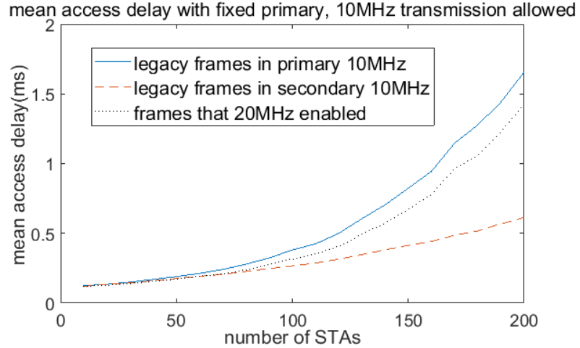
Channel access with fairness: based on baseline
The baseline approach with 10MHz fallback transmission may cause the strong adjacent channel interference problem[3]
Too many 10MHz fallback procedure may causes severe congestion in WBSS primary channel(e.g., channel that contention occurs)
  Assuming the large data for 20MHz transmission

Slide 6
20MHz only channel access: basic
As in the channel access procedure in baseline, the channel sensing processed in one channel, and the AIFS CS in the other channel
  The backoff counter is invoked in case of busy sensed during the AIFS sensing before the end of the backoff in one channel

Slide 7
20MHz only channel access with fairness
To alleviate the fairness issues on secondary channel, the following methods has been proposed
  Modified baseline channel access: Start AIFS for both channel & contention in one channel, AIFS CS for the other channel
  20MHz whole band channel access[3]: backoff procedure for all bands

Slide 8
Investigation on the effects on secondary channel
To investigate the effect of large number of nodes to the reliability, brief simulation is performed
  Assumes the perfect channel
  AC: BE assumed
  Packet length: (500) Bytes for normal packets on each 10MHz channel, (2000) Bytes for 20MHz-enabled packets
  Number of nodes: 10 legacy STA for contention performed channel, 10 to 200 STAs in the other channel and 20MHz traffic
  Traffic model: 100ms of average inter-arrival time in each channel(legacy) + 20MHz enabled traffic

Slide 9
Fairness Investigation results
The mean access delay for legacy devices in the channel that contention is not applied shows the effects to the secondary channel by the 20MHz transmission

Slide 10
Observation
For low traffic, the fairness problem is not shown well
  Because of low probability of interference
For high traffic, the effects to the mean access delay in secondary channel by 20MHz traffic is improved with modification
  For all 20MHz sensing and modified AIFS method
There might be trade offs between the fairness with WBSS secondary channel and the performance of 20MHz channel access.
  Further investigation is required

Slide 11
Conclusion
The effects on the mean access time for secondary channel is limited compared to the congestion effect, for 10MHz fallback transmission enabled
  Alleviates the fairness problem for AIFS sensing on the secondary channel
However, if we allow the 10MHz transmission, the following problem may happen
  Adjacent channel interference
  Congestion issue because of long airtime of packet with many fallbacks
If we allow only 20MHz transmission, the fairness issue occurs
  Need adjustment mechanism for fairness guarantee
For further investigation, the effects of the virtual sensing may be included

Slide 12
Reference
[1] IEEE 802.11-19/497r2, 802.11bd Specification Framework Document, Bahar Sadeghi (Intel)
[2] IEEE 802.11-19/366r5, 20MHz Channel Access in 11 bd, Insun Jang (LG electronics)
[3] IEEE 802.11-19/715r1, 20MHz channel usage, Onn Haran (Autotalks)
[4] IEEE 802.11-19/807r1, Consideration on 20MHz channel access in 11bd, Yongsu Gwak (KNUT)

Slide 13
Straw poll 1
Do you agree to consider only 20MHz channel transmission due to problems (e.g., heavy traffic load increment on WBSS primary channel and/or strong adjacent channel interference) with 10MHz fallback?
Y/N/A

Slide 14
Straw poll 2
Do you agree with followings?
  In order to consider the fairness and performance of 20MHz channel access, more investigation on various 20MHz channel access schemes is required
Y/N/A

Slide 15
backup

Slide 16
Fairness Investigation results: including low traffic
When it is applied for low traffic, fairness issue is not shown well
  Because of low traffic in all channel

