Slide 1
NGV PHY Performance Results
Date: 2019-07-16
Authors:

Slide 2
Abstract
This contribution presents an update to the open source 802.11p/bd simulation model which now includes some of the potential features of the NGV PHY. Additionally, results from performance investigations using this model are presented and discussed.
Open source 802.11p model [1] available at:
  https://github.com/u-blox/ubx-v2x/
Branch with potential NGV features available at:
  https://github.com/u-blox/ubx-v2x/tree/ngv

Slide 3
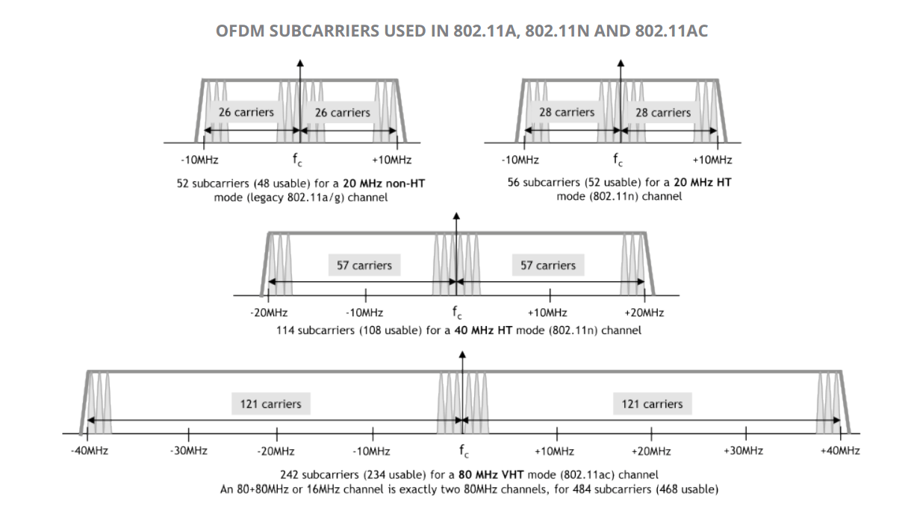
Introduction
The ubx-v2x model was updated with the following (potential) NGV features:
LDPC encoding / decoding
LDPC tone mapping / demapping
Midamble insertion / tracking
802.11ac DC2 20 MHz numerology
MCS8: 64-QAM 5/6
MCS9: 256-QAM 3/4

Slide 4
Performance investigations
Three PHY configurations:
  Standard 802.11p @ 10 MHz with DACE [2]
  NGV PHY* with BCC & DACE
  NGV PHY* with LDPC & MCE
  * NGV PHY assumptions:
    802.11ac, 20 MHz DC2 numerology
    MCS 0-7 (standard 802.11p)
    MCS8: 64-QAM 5/6
    MCS9: 256-QAM 3/4

Slide 5
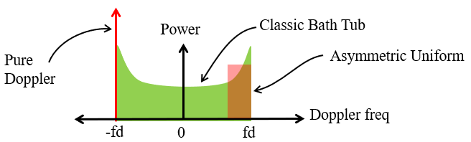
Simulation parameters
Payload length: 400 bytes
DACE (applicable to PHY #1 & PHY #2):
  Viterbi TB = 96 bits
  Latency = [5, 4, 3, 3, 2, 2, 2, 2, 2, 2] OFDM symbols for MCS 0 to 9 respectively
Channel models [3, 4]:
  Rural LoS (144 km/h, low frequency selectivity)
  Highway NLoS (252 km/h, high frequency selectivity)
  Doppler is Asymmetric Jakes (C2C definition)
Impairments:
  AWGN
  CFO: U(-5,5) ppm on both Tx and Rx

Slide 6
Rural LoS Performance
Low SNR (ρ < 10 dB) range
NGV BCC marginally better than legacy
NGV LDPC marginally worse than legacy
Mid SNR (10 dB < ρ < 20 dB) range
NGV BCC/LDPC better than legacy
High SNR (ρ > 20 dB) range
NGV BCC/LDPC significantly better than legacy
NGV LDPC would probably benefit from an even higher MCS (eg. QAM-256, 5/6)

Slide 7
Highway NLoS Performance
Low SNR (ρ < 10 dB) range
NGV BCC/LDPC similar performance to legacy
Mid SNR (10 dB < ρ < 20 dB) range
NGV BCC marginally better than legacy
NGV LDPC worse than legacy
High SNR (ρ > 20 dB) range
NGV BCC significantly better than legacy
NGV LDPC on average similar to legacy

Slide 8
Conclusions
An updated MATLAB model was presented which can be used as a basis for link-level NGV simulations
As in previous studies, performance studies showed that there are many cases where the (BCC + DACE) PHY provides significant gains against an (LDPC + MCE) PHY
Irrespective of the FEC / channel tracking method throughput improvements were confirmed for:
  higher modulation schemes (eg. 256-QAM)
  higher coding rates (eg. 5/6)
  extended numerology (eg. 11ac 10MHz DC2)

Slide 9
References
[1] I. Sarris, “V2X Simulation Model,” IEEE 802.11-18/1480r0.
[2] A. Agnoletto, “Data Decoding Aided Channel Estimation Techniques for OFDM Systems in Vehicular Environment,” March 2010.
[3] M. Kahn, "IEEE 802.11 Regulatory SC DSRC Coexistence Tiger Team V2V Radio Channel Models," IEEE 802.11-14/0259r0.
[4] I. Sarris, “Simulation of NGV PHY,” IEEE 802.11-19/0311r0.

Slide 10
Straw poll
Do you agree to add the following text into Section 3 of SFD?
  “11bd shall support a BCC mode with no Midamble insertion.”
Yes:
No:
Abstain:

Slide 11
Backup slides

Slide 12
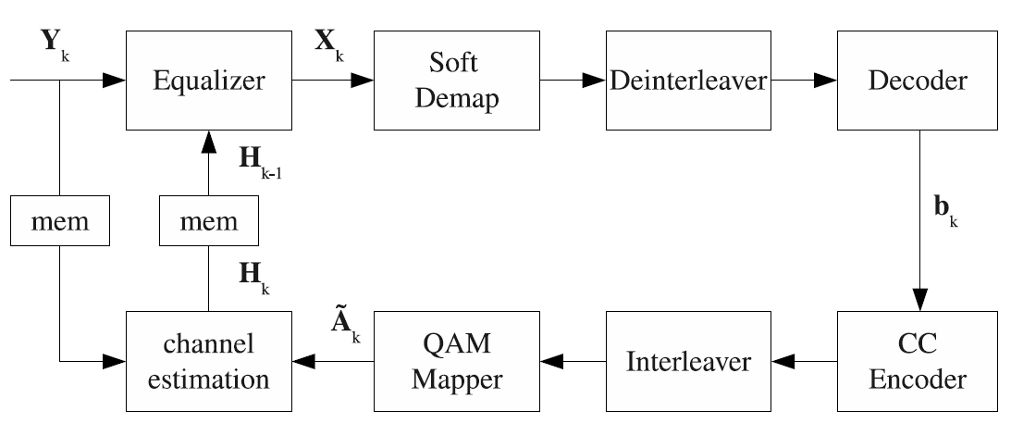
Data-Aided Channel Estimation (DACE)
Legacy frame format was designed assuming that the channel coherence time is greater than the maximum packet duration
This assumption is violated in most V2X scenarios even at moderate speeds
Current state-of-the-art V2X chipsets usually involve a Data-Aided Channel Estimation (DACE) scheme for tracking the wireless channel
Fig. Block diagram of DACE, taken from [2]

Slide 13
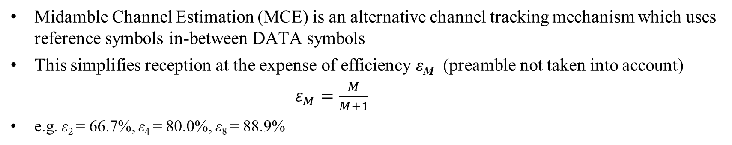
Midamble Channel Estimation (MCE)
Midamble Channel Estimation (MCE) is an alternative channel tracking mechanism which uses reference symbols in-between DATA symbols
This simplifies reception at the expense of efficiency ε_{M} (preamble not taken into account)
$ε_{Μ}=\frac{Μ}{Μ+1}$
e.g. ε₂ = 66.7%, ε₄ = 80.0%, ε₈ = 88.9%
802.11p
STF
LTF
SIG
DATA
DATA
DATA
DATA
DATA
DATA
DATA
DATA
DATA
DATA
Midamble format (e.g. M=4)
STF
LTF
SIG
DATA
DATA
DATA
MID
DATA
DATA
DATA
DATA
MID
DATA
M=4
M=4

