Slide 1
NGV PHY Performance Results
Date: 2019-07-15
Authors:

Slide 2
Abstract
This contribution presents an update to the open source 802.11p/bd simulation model which now includes some of the potential features of the NGV PHY. Additionally, results from performance investigations using this model are presented and discussed.
Open source 802.11p model [1] available at:
  https://github.com/u-blox/ubx-v2x/
Branch with potential NGV features available at:
  https://github.com/u-blox/ubx-v2x/tree/ngv

Slide 3
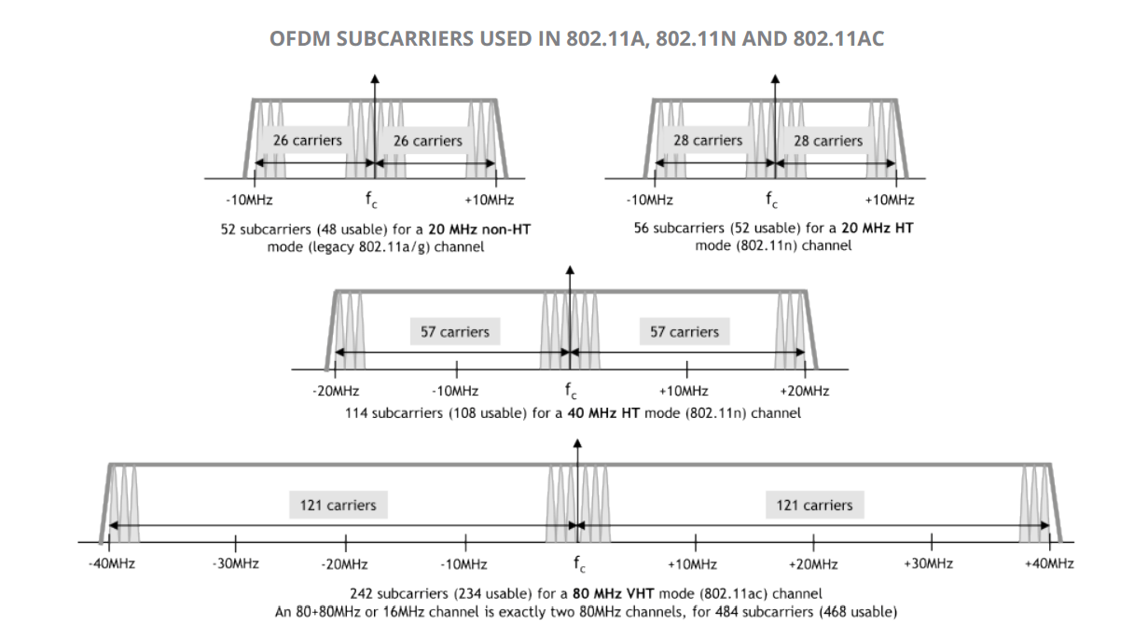
Introduction
The ubx-v2x model was updated with the following (potential) NGV features:
LDPC encoding / decoding
LDPC tone mapping / demapping
Midamble insertion / tracking
802.11ac DC2 20 MHz numerology
MCS8: 64-QAM 5/6
MCS9: 256-QAM 3/4

Slide 4
Performance investigations
Three PHY configurations:
  Standard 802.11p @ 10 MHz with DACE [2]
  NGV PHY* with BCC & DACE
  NGV PHY* with LDPC & MCE
  * NGV PHY assumptions:
    802.11ac, 20 MHz DC2 numerology
    MCS 0-7 (standard 802.11p)
    MCS8: 64-QAM 5/6
    MCS9: 256-QAM 3/4

Slide 5
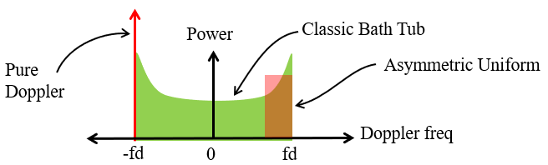
Simulation parameters
Payload length: 400 bytes
DACE (applicable to PHY #1 & PHY #2):
  Viterbi TB = 96 bits
  Latency = [5, 4, 3, 3, 2, 2, 2, 2, 2, 2] OFDM symbols for MCS 0 to 9 respectively
Channel models [3, 4]:
  Rural LoS (medium mobility, low frequency selectivity)
  Highway NLoS (high mobility & frequency selectivity)
  Doppler is Asymmetric Jakes (C2C definition)
Impairments:
  AWGN
  CFO: U(-5,5) ppm on both Tx and Rx

Slide 6
Rural LoS Performance
Low SNR (ρ < 10 dB) range
NGV BCC marginally better than legacy
NGV LDPC marginally worse than legacy
Mid SNR (10 dB < ρ < 20 dB) range
NGV BCC/LDPC better than legacy
High SNR (ρ > 20 dB) range
NGV BCC/LDPC significantly better than legacy

Slide 7
Highway NLoS Performance
Low SNR (ρ < 10 dB) range
NGV BCC/LDPC similar performance to legacy
Mid SNR (10 dB < ρ < 20 dB) range
NGV BCC marginally better than legacy
NGV LDPC worse than legacy
High SNR (ρ > 20 dB) range
NGV BCC significantly better than legacy
NGV LDPC on average similar to legacy

Slide 8
Conclusions
An updated MATLAB model was presented which can be used as a basis for link-level NGV simulations
As in previous studies, the impact of midamble insertion in the throughput efficiency resulted in an overall superior performance of (BCC + DACE) against (LDPC + MCE)
Irrespective of the FEC / channel tracking method throughput improvements were confirmed for:
  higher modulation schemes (eg. 256-QAM)
  higher coding rates (eg. 5/6)
  extended numerology (eg. 11ac 10MHz DC2)

Slide 9
References
[1] I. Sarris, “V2X Simulation Model,” IEEE 802.11-18/1480r0.
[2] A. Agnoletto, “Data Decoding Aided Channel Estimation Techniques for OFDM Systems in Vehicular Environment,” March 2010.
[3] M. Kahn, "IEEE 802.11 Regulatory SC DSRC Coexistence Tiger Team V2V Radio Channel Models," IEEE 802.11-14/0259r0.
[4] I. Sarris, “Simulation of NGV PHY,” IEEE 802.11-19/0311r0.

