Slide 1
20MHz Channel Access in 11bd: Follow-up
Date: 2019-07-15
Authors:
Name | Affiliation | Address | Phone | Email
Insun Jang | LG Electronics | 19, Yangjae-daero 11gil, Seocho-gu, Seoul 137-130, Korea |  | insun.jang@lge.com
Dongguk Lim |  |  |  | dongguk.lim@lge.com
Jinsoo Choi |  |  |  | js.choi@lge.com
Jeongki Kim |  |  |  | jeongki.kim@lge.com
Eunsung Park |  |  |  | esung.park@lge.com
Suhwook Kim |  |  |  | suhwook.kim@lge.com

Slide 2
Introduction
A way to access a 20MHz channel was proposed in May meeting [1]
In this contribution, we further elaborate the proposed 20MHz channel access by providing several clarifications

Slide 3
20MHz Channel Access Proposal: Recap
To improve the channel utilization in DSRC, the transmission of 10MHz PPDU should be supported in a 20MHz channel where more services can be served
It requires an 11bd STA to first contend for a 10MHz channel in the 20MHz channel to correctly sense and/or receive 10MHz PPDUs
To transmit 20MHz PPDU, when the back-off count of the 10MHz contention channel becomes zero, the 11bd STA has to check the state (i.e., IDLE/BUSY) of another 10MHz channel in the 20MHz
If IDLE, a 20MHz PPDU is transmitted. If not, a 10MHz PPDU is transmitted
The IDLE/BUSY condition for two 10MHz channels has not been specified yet

Slide 4
20MHz Channel Access Proposal: Recap
We need to consider the following aspects
Terminologies and roles of 10MHz channels in a 20MHz channel
Channel IDLE/BUSY conditions to transmit a 20MHz PPDU
In this contribution, we will
Define the role of each 10MHz in a 20MHz channel with proper terminologies
Specify the channel IDLE/BUSY conditions to transmit a 20MHz PPDU

Slide 5
Roles of 10MHz channels
A 20MHz channel consists of two 10MHz channels
A 10MHz channel is used for contending, i.e., performing the original EDCA mechanism
We call the 10MHz channel “OCB primary channel”
An 11bd STA operating in a 20MHz channel first sense and access OCB primary channel using EDCA
Another 10MHz channel is used for forming the 20MHz channel with OCB primary channel
We call the 10MHz channel “OCB secondary channel”
When the backoff count of the OCB primary channel becomes 0, the 11bd STA transmits
a 20MHz PPDU if state of OCB secondary channel is idle
otherwise a 10MHz PPDU

Slide 6
How to Set OCB Primary Channel and OCB Secondary Channel
According to 11p and IEEE 1609, operating channels for channel switching and data transmission are indicated from upper layer
Using the channel information (e.g., Channel identifier as a parameter which includes Country String, Operating class, Channel Number)
Based on the process, an 11bd STA can also set OCB primary channel and OCB secondary channel
Notes:
How does upper layer indicate? System-level?

Slide 7
How to Set OCB Primary Channel and OCB Secondary Channel (Cont’d)
An example of procedure
1) Upper layer first indicates an operating 20MHz channel and a 10MHz channel information
2) An 11bd STA sets the 20MHz channel indicated by the upper layer to the operating channel
3) An 11bd STA sets the 10MHz channel indicated by the upper layer to the OCB primary channel
Consequently, an 11bd STA sets OCB primary channel and OCB secondary channel upon request from upper layer
11bd STAs serving a common service (that will use the same 20MHz channel) would have the same OCB primary channel and the same OCB secondary channel based on the control of upper layer

Slide 8
OCB Primary Channel IDLE/BUSY Condition
TGbd already decided that an 11bd STA decodes 11p PPDUs with TBD receive sensitivity threshold (TBD value is -85dBm or lower) [2]
Likewise, it is straightforward for an 11bd STA to decode 11bd PPDUs in a 10MHz channel with TBD receive sensitivity threshold (TBD value is -85dBm or lower)
Therefore, OCB primary channel performs EDCA under IDLE/BUSY condition where TBD receive sensitivity threshold is used (TBD value is -85dBm or lower)

Slide 9
OCB Secondary Channel IDLE/BUSY Condition
The transmission of 20MHz PPDU depends on the state of OCB secondary channel (i.e., IDLE or BUSY) where the back-off is not performed
To determine the condition, we need to consider the following
Sensing Interval
Receive Sensitivity Threshold

Slide 10
Consideration for Condition
Some 11bd STAs operating in a 10MHz channel may contend for OCB secondary channel of some other STAs operating in 20MHz channel (e.g., ①)
Also, OCB primary channel of some STAs may be OCB secondary channel of some other STAs (e.g., ②)
According to the values of sensing interval and receive sensitivity threshold used in OCB Secondary channel, there can be unfairness

Slide 11
Design Aspect: Fairness
Fairness is an important requirement in 11bd which has to be considered in determining values
Therefore, we propose that to determine the state of OCB secondary channel, an 11bd STA uses the same Receive Sensitivity Threshold and Sensing Interval as those used in OCB Primary channel
Receive Sensitivity Threshold of OCB primary channel is TBD (TBD is -85dBm or lower)
OCB primary channel uses AIFS[AC] as sensing interval for EDCA
AC is the access category for data to be transmitted

Slide 12
Proposed 20MHz Channel Access in 11bd
An 11bd STA first senses and accesses OCB Primary Channel by means of the original EDCA
Receive sensitivity threshold is TBD (TBD value is -85dBm or lower)
Transmission
To extend to 20MHz and transmit 20MHz 11bd PPDU, when the back-off count of OCB primary channel becomes zero, the STA checks the state of OCB secondary channel
Specifically, if the OCB secondary channel were idle during AIFS[AC] with -TBD receive sensitivity threshold (TBD value is -85dBm or lower), 20MHz 11bd PPDU is transmitted. Otherwise (i.e., busy), 10MHz 11bd PPDU is transmitted

Slide 13
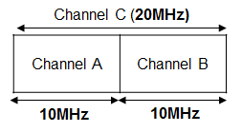
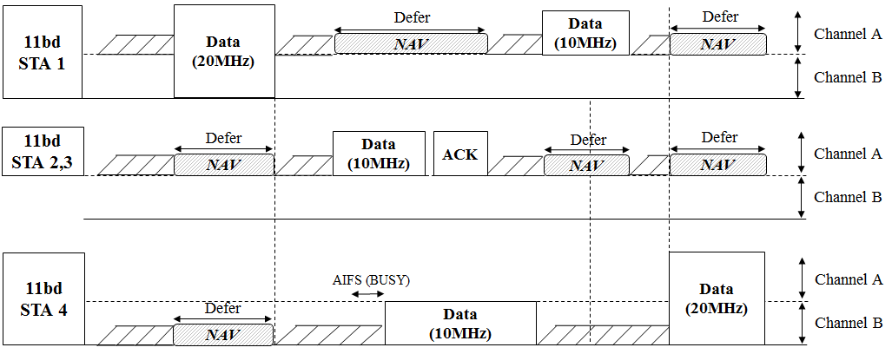
Channel Access Example (4 STAs)
Channelization
STA | Service | OCB Primary | OCB Secondary | Access Channel Width
1 | A (Broadcast) | Channel A | Channel B | 20MHz
2,3 | B (Unicast) | Channel A (10MHz access) |  | 10MHz
4 | C (Broadcast) | Channel B | Channel A | 20MHz

Slide 14
Discussion: Interoperability for 11p STA
TGbd already decided to transmit PPDU format up on request from upper layer, the PPDU format can be either 11p PPDU or 11bd PPDU [2]
Note that the proposed channel access is only for transmitting 11bd PPDUs in a 20MHz channel
Therefore, the proposed way of operation will be enabled only after detecting that there are no 11p devices depending on the decisions from upper layer
We believe the proposed channel access can operate without the impact on 11p STAs

Slide 15
Summary
In this contribution, we have further elaborated the 20MHz channel access in 11bd proposed in May meeting
Specifically, we defined terminology and role of each 10MHz in a 20MHz channel, i.e., OCB primary channel and OCB secondary channel and how to set the channels
In addition, we determined IDLE/BUSY conditions of OCB primary/secondary channel by considering the fairness

Slide 16
SP #1
Do you agree to add the following text into 11bd SFD?
The transmission of 10MHz PPDU shall be supported in a 20MHz channel
A 20MHz channel in 11bd consists of a 10MHz OCB primary channel and a 10MHz OCB secondary channel
OCB primary channel means a 10MHz channel for an 11bd STA to contend, i.e., perform EDCA
OCB secondary channel means a 10MHz channel for an 11bd STAs to form the 20MHz channel with OCB primary channel
An 11bd STA sets OCB primary channel and OCB secondary channel upon request from upper layer
Y/N/A

Slide 17
SP #2
Do you agree to add the following text into 11bd SFD?
To transmit 20MHz bandwidth PPDU, an 11bd STA shall perform the following actions,
Contends for OCB primary channel with TBD receive sensitivity threshold
TBD is -85dBm or lower
Transmit a 20 MHz PPDU on OCB primary channel and OCB secondary channel if OCB secondary channel was idle under during TBD interval immediately preceding the start of the TXOP with TBD receive sensitivity threshold
Transmit a 10 MHz PPDU on OCB primary channel if OCB secondary channel was busy during TBD interval immediately preceding the start of the TXOP with TBD receive sensitivity threshold
Y/N/A

Slide 18
SP #3
Do you agree to add the following text into 11bd SFD?
To determine the state of OCB secondary channel, an 11bd STA uses the same receive sensitivity threshold and sensing interval as those used in OCB primary channel
The sensing interval is AIFS[AC]
AC is the access category for data to be transmitted
Y/N/A

Slide 19
References
[1] 802.11-19/0366r6 20MHz Channel Access in 11bd
[2] 802.11-19/0497r1 802.11bd Specification Framework Document

