Slide 1
Coexistence Mechanisms
Date: 2019-07-17
Authors:

Slide 2
Coexistence Mechanisms
The key elements for coexistence are
  A calibrated sensing mechanism
    Listen for transmissions from other nodes
  A listen-before-talk (LBT) protocol
    A protocol to process the sensing results prior to transmission
  Maximum channel occupancy time (MCOT) limits
    Limits on transmit duration when transmitting
  Adjacent channel protection
    Requirements on protection of adjacent channels when transmitting

Slide 3
Sensing Threshold
IEEE 802.11a/n/ac use two thresholds, one for own technology, higher for other technologies
IEEE 802.11ax uses more than two thresholds depending on spatial reuse option
  Preambles are used to differentiate between own and other technology/network and choose a different threshold for them
3GPP technologies use a single threshold for all technologies

Slide 4
Sensing Threshold
IEEE 802.11ax devices defer to IEEE 802.11a/n/ac and ax (own network) devices at -82 dBm
802.11ax
802.11a/n/ac/ax_own_nwk
-62 dBm
-82 dBm

Slide 5
Sensing Threshold
IEEE 802.11ax devices defer to IEEE 802.11ax (other network) devices at threshold greater than -82 dBm (spatial reuse)
802.11ax
802.11ax
other_nwk
-62 dBm
-82 dBm

Slide 6
Sensing Threshold
IEEE 802.11ax devices defer to other technology devices at threshold -62 dBm
802.11ax
Other technology
-62 dBm
-82 dBm

Slide 7
Sensing Threshold
Sensing threshold determines the level of spatial reuse by determining the level at which a node defers to another node
  Trade-off between reuse (proportional to channel access opportunities) and SINR
The appropriate level of the sensing threshold to maximize system performance depends on
  Deployment density
  Radio environment
    Indoor residential
    Indoor office
    Outdoor urban
    Outdoor suburban
    …
The appropriate level sensing threshold should NOT depend on the characteristics of neighboring nodes
  Own or other network
  Own or other technology

Slide 8
Sensing Threshold for 6 GHz
A solution that satisfies the clear need for adaptation of sensing thresholds in the real world without violation of regulations is needed
A single common maximum energy detection threshold between all nodes and technologies is the only solution that is viable and future proof (addressed further in companion document)
For better alignment of different technologies in greenfield 6 GHz unlicensed spectrum, setting different sensing thresholds for different types of neighboring nodes is NOT the right solution
  If a particular technology or network implements different sensing thresholds to different types of nodes, the maximum sensing threshold used should be identical for all nodes and technologies

Slide 9
Adjacent Channel Protection
Adjacent channel leakage ratio is an important requirement for good coexistence of nodes operating in adjacent channels
3GPP standards require ~9 dB (35 dB vs. 26.3 dB) additional protection compared to IEEE 802.11
Carrier 1
Carrier 2
Power spectral
density

Slide 10
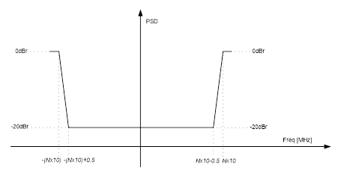
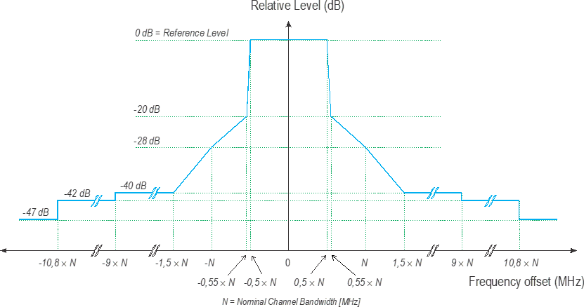
Adjacent Channel Protection with Wideband Carriers
IEEE 802.11 defines spectral emissions mask for transmissions on parts of wideband carriers (e.g. 80 MHz)
Spectral emission masks for Wi-Fi preamble puncturing where N is the number of contiguous punctured 20 MHz channels
Transmit spectral emission mask from the latest version of the ETSI BRAN Harmonized standard EN 301 893 v2.1.1

Slide 11
Adjacent Channel Protection with Wideband Carriers
The ETSI spectral mask requirements are not met for various cases
  Can cause harmful interference to already deployed LTE-LAA systems designed to meet ETSI masks
Comparison of the overall spectral emission masks for the [1 1 0 1] channel puncturing pattern
Comparison of the overall spectral emission masks for the [1 0 0 1] channel puncturing pattern

