Slide 1
Multi-Link Aggregation: Latency Gains
Date: 2019-08-22
Name | Affiliation | Address | Phone | Email
Abhishek Patil | Qualcomm Inc. |  |  | appatil@qti.qualcomm.com
George Cherian | Qualcomm Inc.
Alfred Asterjadhi | Qualcomm Inc.
Duncan Ho | Qualcomm Inc.

Slide 2
Overview
Multi-Link Aggregation (MLA) is expected to increase peak-throughput and reducing latency
In an earlier presentation [1], we have looked at the two schemes of packet-level aggregation: independent MLA and simultaneous MLA
We presented our analysis on the impact of independent and simultaneous MLA on peak throughput gains in [2].
In this document we investigate the impact of independent MLA on the latency

Slide 3
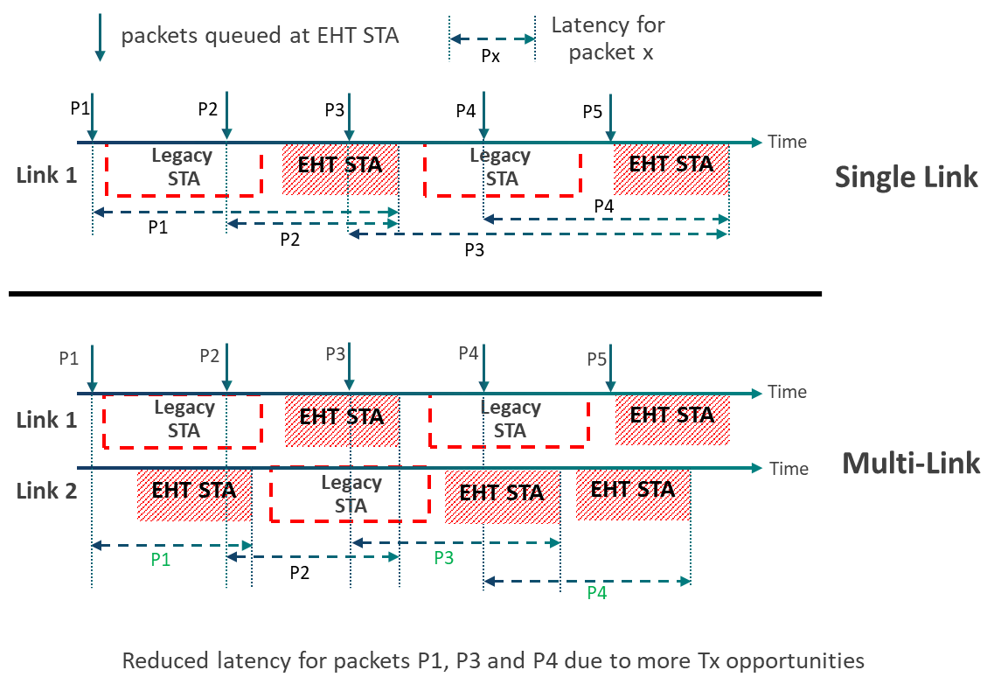
Multi-Link Aggregation Latency Benefits

Slide 4
Latency Analysis
Simulation Setup
  Traffic Model
    STAUT: CBR, 1000 bytes every 15ms
    Each link is loaded with variable number of full buffer STAs
      Fixed TXOP of 5 ms
  Emulate independent MLA between a 5GHz & 2.4GHz link:
    BW_{L1} = 80 MHz, BW_{L2} = 20 MHz
  Frame Aggregation on STAUT:
    Max TXOP of 5 ms
  Retransmission limit for STAUT = 8
    Packet dropped after retry limit
  PER = 0% on both links
Latency gains are compared between:
  Single link (no Aggregation)
  Independent MLA
Gains are expressed as 95% latency

Slide 5
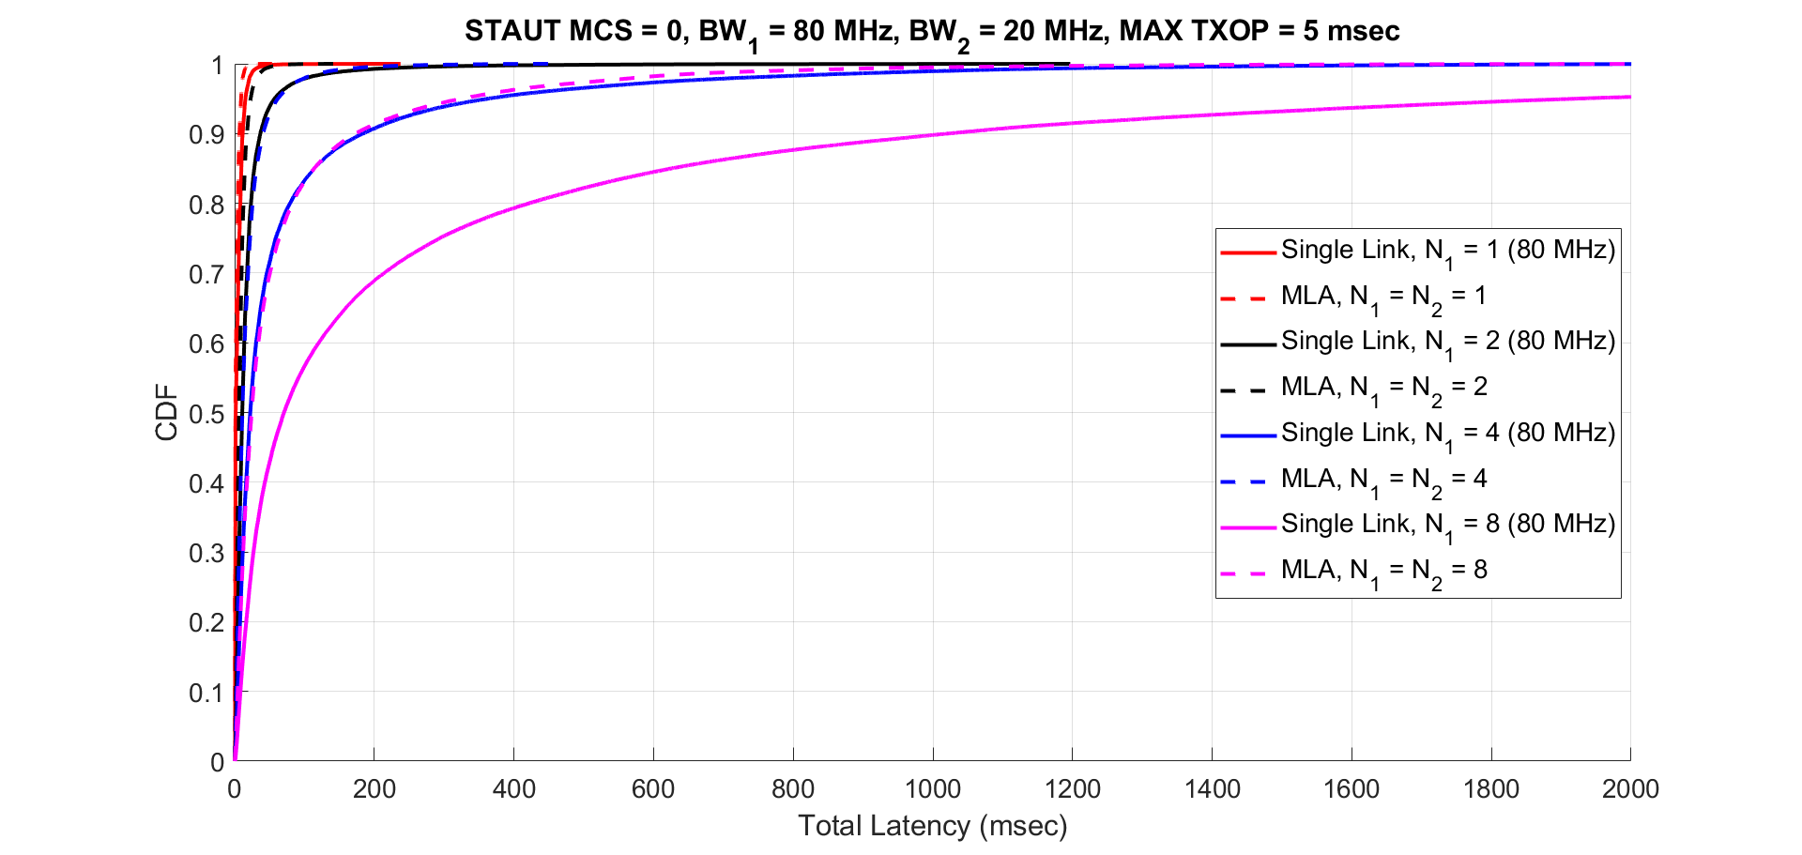
Single Link 80 MHz vs MLA (80+20) MHz
Latency CDF, MCS 0, 80+20
N1: Number of OBSS STAs on 1st link (80MHz)
N2: Number of OBSS STAs on 2nd link (20MHz)
  See appendix for access latency plot

Slide 6
95 percentile latency results (for 80+20)
MCS0 | 1 other STA per link | 2 other STAs per link | 4 other STAs per link | 8 other STAs per link
Single 20MHz Link | 15.98 | 58.27 | 594.0 | 2797*
Single 80MHz Link | 14.78 | 54.05 | 310.1 | 1322*
Multi Link (80MHz+20MHz) | 9.24 | 22.89 | 61.88 | 325.2
Latency in msec
* Unstable region
Observations and analysis:
  Channel access delay is the major contributor to the overall latency
    See appendix for an example
  Adding another link significantly improves the worst-case latency
    Increased access opportunities translates to reduction in channel access delay
    Increasing the MCS or link BW has little impact to improving the worst-case latency
      See appendix for impact of MCS and link BW on latency

Slide 7
95 percentile latency results (for 80+20)
Varying PER
Simulation setup
Traffic Model
  STAUT: CBR, 1000 Bytes every 15 ms
  Other STAs: Full buffer, TXOP = 5 ms
Emulate independent MLA with 5G & 2.4G:
  BW_{L1} = 80 MHz, BW_{L2} = 20 MHz
  MCS0 and MCS2
Frame Aggregation on STAUT
  Maximum TXOP = 5 ms
  Maximum aggregated packets = 64
Retransmission limit for STAUT = 8
  Packet dropped after retry limit
PER varied from 0 to 50 % on both links
Single 80 MHz Link (MCS0)
MLA 20 + 80 MHz (MCS0)
PER
PER
 | 0 % | 10 % | 20 % | 30 % | 40 % | 50 %
1 | 9.2 | 11.1 | 15.7 | 31.5 | 120 | 388
2 | 22.9 | 35.9 | 75.3 | 303 | 838 | 1804
4 | 61.9 | 136 | 427 | 1152 | N/A | N/A
8 | 325 | 892 | 1602 | N/A | N/A | N/A
 | 0 % | 10 % | 20 % | 30 % | 40 % | 50 %
1 | 14.8 | 21.6 | 52.4 | 165.1 | 626 | 969
2 | 54 | 133 | 598 | N/A | N/A | N/A
4 | 310 | 887 | N/A | N/A | N/A | N/A
8 | 1322 | N/A | N/A | N/A | N/A | N/A
 | 0 % | 10 % | 20 % | 30 % | 40 % | 50 %
1 | 9.2 | 11.1 | 15.7 | 31.5 | 120 | 388
2 | 22.9 | 35.9 | 75.3 | 303 | 838 | N/A
4 | 61.9 | 136 | 427 | N/A | N/A | N/A
8 | 325 | 892 | N/A | N/A | N/A | N/A
 | 0 % | 10 % | 20 % | 30 % | 40 % | 50 %
1 | 14.8 | 21.6 | 52.4 | 165.1 | 626 | 969
2 | 54 | 133 | 598 | 1255 | 1718 | N/A
4 | 310 | 887 | 1500 | N/A | N/A | N/A
8 | 1322 | N/A | N/A | N/A | N/A | N/A
# STAs
per link
# STAs
per link
95 percentile latency (msec)
N/A = unstable region (latency > 2sec)
95 percentile latency (msec)

Slide 8
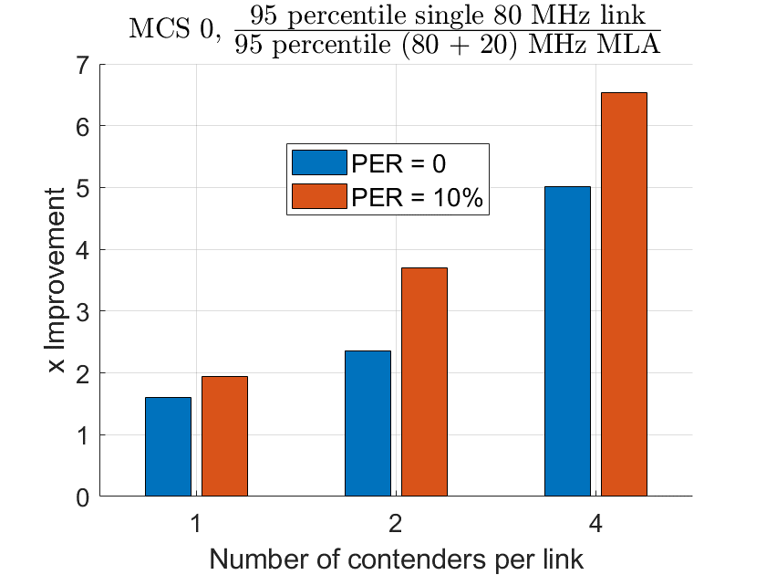
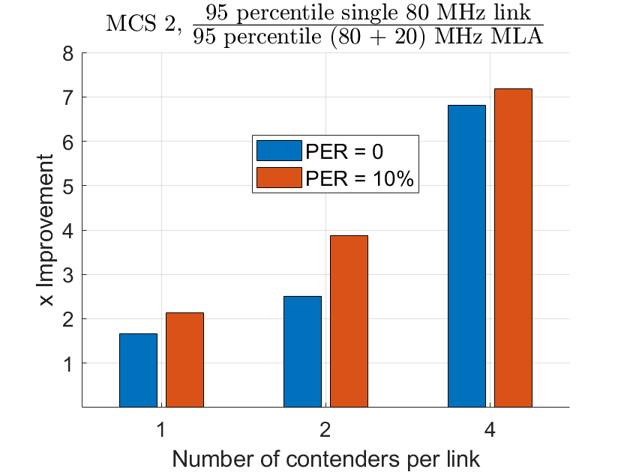
95 percentile latency results (for 80+20)
Latency Gains increase with
Increasing number of contenders for a given PER
Increasing PER for a given number of contenders
Increasing MCS for a given PER or number of contenders

Slide 9
Age-based dropping
If strict latency bounds are desired, age-based dropping of packets can be used
However, this comes at the cost of increase in the loss rate
MLA significantly brings down the loss rate if age-based dropping is used
  See appendix for results on age-based dropping

Slide 10
Summary
In this contribution, we present latency gains with multi-link aggregation (independent MLA).
  Adding an auxiliary link significantly improves the worst-case latency
  Channel access delay is the major contributor to the overall latency
    Increasing the MCS or BW has little impact to improving the worst-case latency
    Most of the gains come from increased access opportunities
      Which translates to reduction in access delay
    The auxiliary link can be of a much lower BW
      e.g., adding a 20MHz link to an 80MHz link provides similar gains
  Investigated latency gains for varying PER conditions
  Further, loss rate for MLA to meet a certain latency goal is much lower compared to a single link case

Slide 11
References
[1] 11-19/0823
[2] 11-19/0764

Slide 12
Appendix

Slide 13
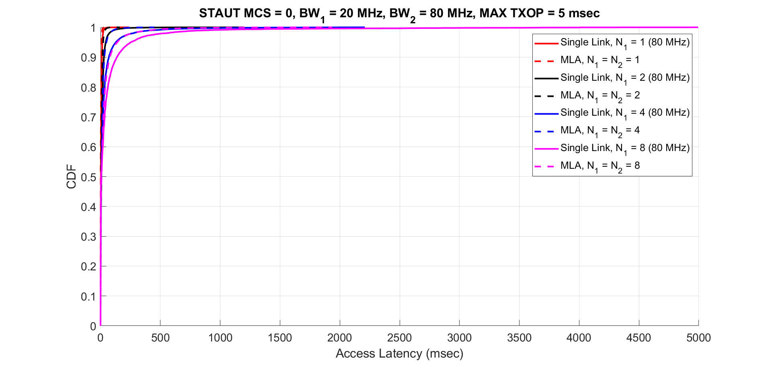
Single Link 80 MHz vs MLA (80+20) MHz
Access Latency CDF, MCS 0
N1: Number of OBSS STAs on 1st link (20MHz)
N2: Number of OBSS STAs on 2nd link (80MHz)
Back

Slide 14
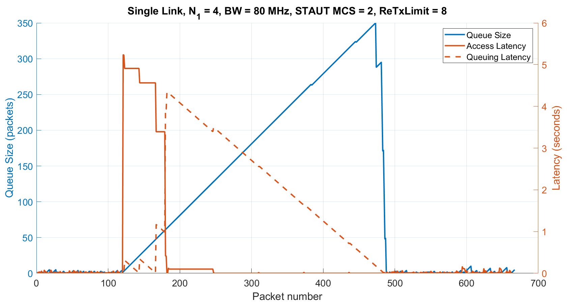
A single run showing impact of access delay
There are cases where, the STA under test (STAUT) suffers from multiple back-to-back collisions
  This results in the STAUT picking a very high back-off counter resulting in a large access latency
In the adjoining plot, each point on the x-axis corresponds to a packet – 15ms interval on the timeline.
  There are a total of 667 packets in a 10sec run.
The 120th packet experienced several retries which manifests as a spike in the access latency.
  This results in longer queuing latency for packets queued behind the 120th packet.
  By the time the 500th packet arrives, the queue size is 350 packets
The steps in the access latency (between 120-180) are the instances when the STAUT gained accessed and packets were getting flushed (aggregated in one A-MPDU).
  This helps reduce the queuing latency (downward trend after 180).
Back

Slide 15
A single run showing impact of access delay
Observation:
  BW/MCS has far less impact on the worst-case latency
  Worst-case latencies are dictated by randomness in the contention mechanism
    such random spikes contribute to the top 5 percentile worst case latencies
    Such scenarios are likely in dense deployments
  MLA performs better because STAUT had access opportunities on both links.
    Further, repeated simultaneous collisions on both links is much less likely
Back

Slide 16
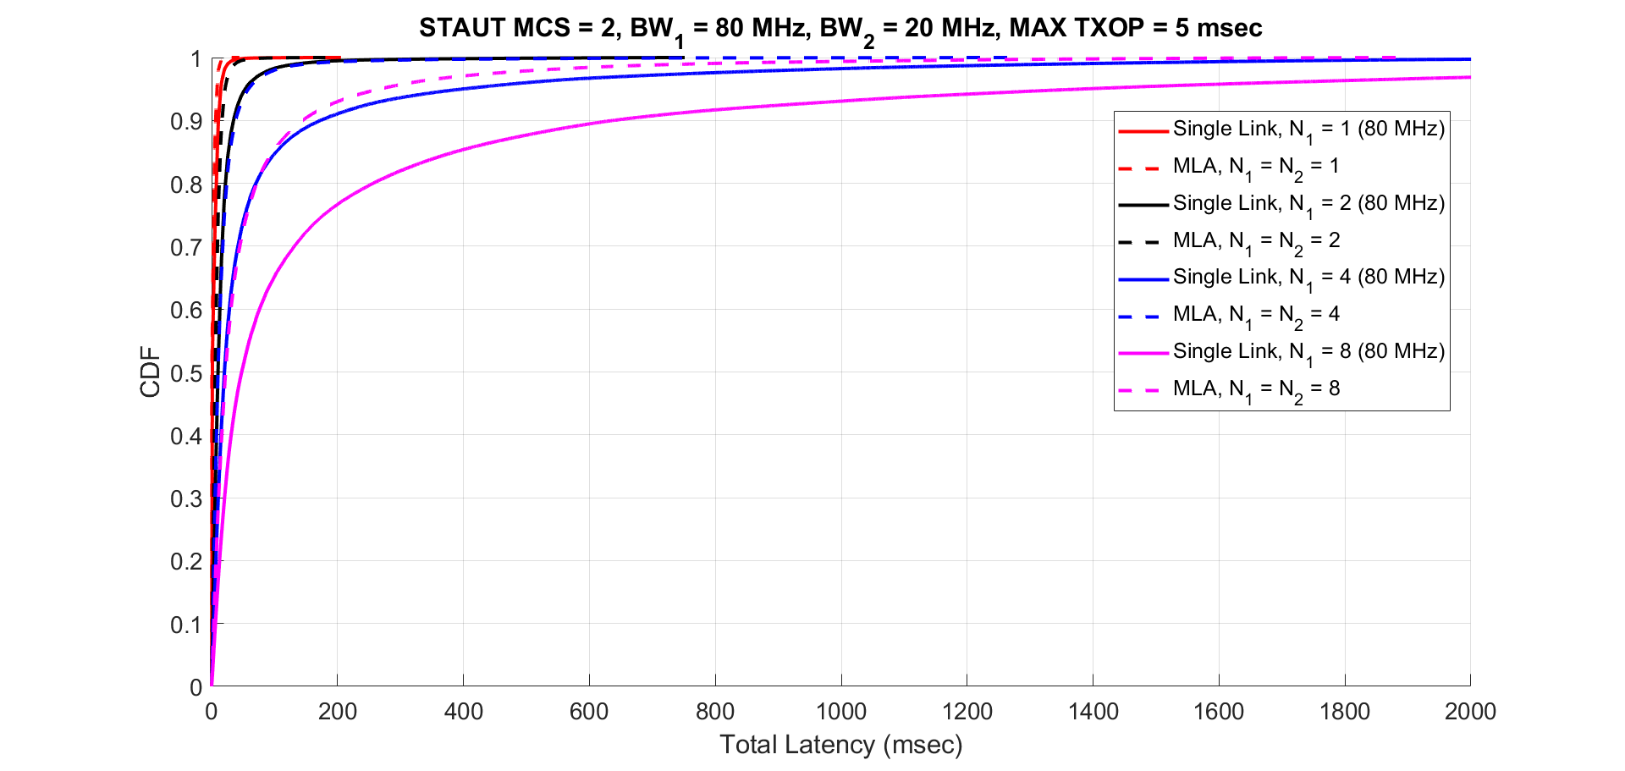
Impact of MCS
N1: Number of OBSS STAs on 1st link (80MHz)
N2: Number of OBSS STAs on 2nd link (20MHz)
95 percentile latency results (for 80+20) @MCS2
MCS2 | 1 OBSS STA per link | 2 OBSS STAs per link | 4 OBSS STAs per link | 8 OBSS STAs per link
Single 20MHz Link | 15.04 | 59.37 | 342.78 | 1759*
Single 80MHz Link | 14.60 | 53.37 | 337.19 | 1294*
Multi Link (80MHz+20MHz) | 8.74 | 21.26 | 58.47 | 266.9
Latency in msec
* Unstable region
Back

Slide 17
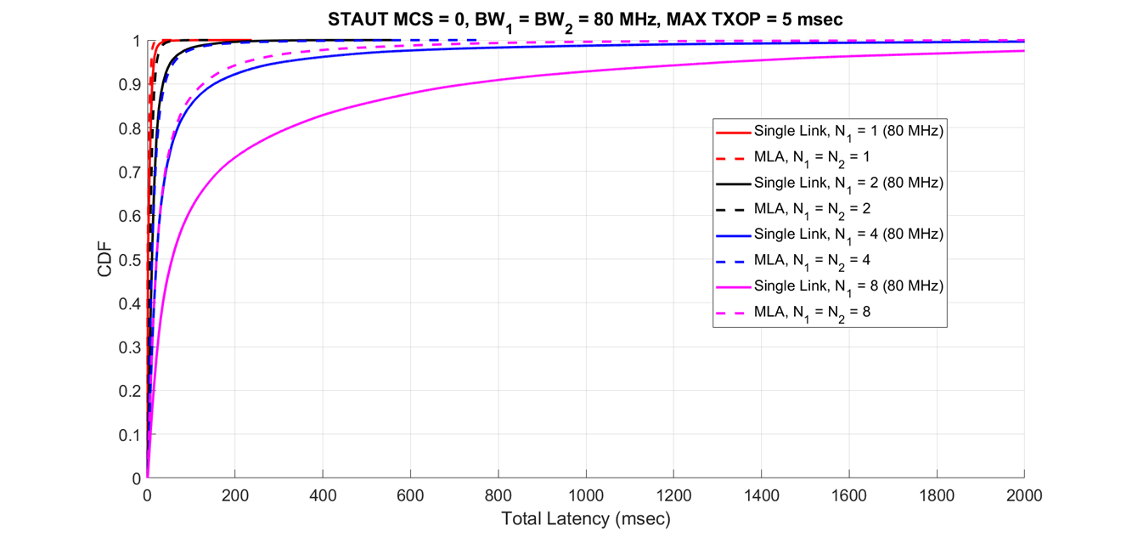
Impact of link BW
N1: Number of OBSS STAs on 1st link (80MHz)
N2: Number of OBSS STAs on 2nd link (80MHz)
95 percentile latency results (for 80+80)
MCS0 | 1 other STA per link | 2 other STAs per link | 4 other STAs per link | 8 other STAs per link
Single 80MHz Link | 14.78 | 54.05 | 310.1 | 1322*
Multi Link (80MHz+80MHz) | 9.09 | 21.13 | 60.87 | 223.36
Latency in msec
* Unstable region
Back

Slide 18
95 percentile latency with Age-based drop
Single Link (20 MHz)
Simulation Setup
  Traffic Model
    STAUT: CBR, 1000 Bytes every 15 ms
    Each link is loaded with variable number of full buffer STAs
      Fixed TXOP of 5 ms
  Single link
    N1 = # of other STAs on the link
  MLA
    N1 = # of other STAs on 1st link
    N2 = # of other STAs on 2nd link
  Emulate independent MLA with 5G & 2.4G:
    BW_{L1} = 80 MHz, BW_{L2} = 20 MHz
    MCS0
  Frame Aggregation on STAUT:
    Max TXOP of 5 ms
  Age-based packet dropping
    50, 100, 200 ms
  Retransmission limit for STAUT = 8
    Packet dropped after retry limit
  PER = 0% on both links
Age (msec) | N₁ = 1 | N₁ = 2 | N₁ = 4 | N₁ = 8
50 | 15.86 | 37.62 | 45.17 | 47.44
100 | 15.98 | 47.68 | 78.64 | 89.94
200 | 16.13 | 60.19 | 136.6 | 170.6
∞ | 15.98 | 58.27 | 594.0 | 2797
Single Link (80 MHz)
Age (msec) | N₁ = 1 | N₁ = 2 | N₁ = 4 | N₁ = 8
50 | 14.73 | 34.87 | 42.73 | 45.27
100 | 14.87 | 45.11 | 74.09 | 85.09
200 | 14.91 | 51.59 | 116.8 | 159.63
∞ | 14.78 | 54.05 | 310.1 | 1322
Multi Link (20 + 80)
Age (msec) | N₁ = N₂ = 1 | N₁ = N₂ = 2 | N₁ = N₂ = 4 | N₁ = N₂ = 8
50 | 9.23 | 22.04 | 37.95 | 44.24
100 | 9.23 | 22.6 | 52.34 | 79.50
200 | 9.23 | 22.7 | 58.96 | 135.17
∞ | 9.24 | 22.89 | 61.88 | 325.2
Notes:
STAUT: CBR, 1000 Bytes every 15 msec
STAUT MCSL1 = 0 (8 Mbps), MCSL2 = 0 (34 Mbps)
Tx. Time/packet = 1msec (20 MHz), 236 µsec (80 MHz)

Slide 19
Loss Rate with age-based dropping for MCS 0
Percentage of packets dropped
(due to age expiration)
Single Link (20 MHz)
Single Link (80 MHz)
Age (msec) | N₁ = 1 | N₁ = 2 | N₁ = 4 | N₁ = 8
50 | 0 | 5.6 | 24.7 | 48.5
100 | 0 | 1.9 | 13.3 | 35
200 | 0 | 0.9 | 7.8 | 27.1
Age (msec) | N₁ = 1 | N₁ = 2 | N₁ = 4 | N₁ = 8
50 | 0 | 5.4 | 24.4 | 50.6
100 | 0 | 2 | 12.8 | 34.2
200 | 0 | 0.6 | 6.5 | 25.7
Multi Link (20 + 80) MHz
Age (msec) | N₁ = N₂ = 1 | N₁ = N₂ = 2 | N₁ = N₂ = 4 | N₁ = N₂ = 8
50 | 0 | 0 | 6.4 | 24.8
100 | 0 | 0 | 1.6 | 13.3
200 | 0 | 0 | 0.4 | 6.1

