Slide 1
HARQ Complexity
Date: 2019-07-15
Authors:

Slide 2
Outline
Receiver LLR Memory Requirements
LDPC Codeword Processing
MAC Layer Processing

Slide 3
Receiver LLR Memory Requirements

Slide 4
Introduction
HARQ requires that the receiver save log likelihood ratio (LLR) values for code bits
Here we make some first order estimates of the required memory size, in terms of both MB and die area

Slide 5
Basic Assumptions
Terminology
  We use the term “HARQ Sequence” to indicate the initial HARQ transmission and any subsequent HARQ retransmissions, for a block of data (e.g. PSDU)
Assumptions
  A HARQ Sequence completes within a TXOP
  In this analysis, we assume there is only a single HARQ Sequence active at a time
  Memory is assumed to buffer LLRs for all codewords
    Greater than 10% probability that all codewords are in error on the first transmission (See backup)
    Selective codewords buffer is possible with degraded performance. That is not considered in this first order estimate
  We will allocate memory for LLRs for all code bits in the codeword. This is required for Chase Combining
    Incremental redundancy may require comparable or larger memory requirements, depending on the design. Here we will focus on Chase Combining.
  We will allocate 5 bits for an LLR

Slide 6
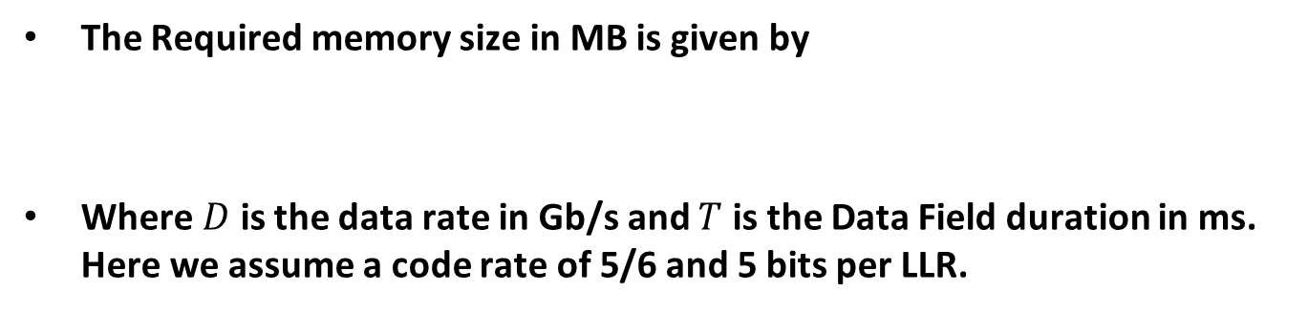
Rough Estimate of LLR Memory Size
The Required memory size in MB is given by
Where $D$ is the data rate in Gb/s and $T$ is the Data Field duration in ms. Here we assume a code rate of 5/6 and 5 bits per LLR.
$$Memory Size=D \left(\frac{6}{5}\right)\left(\frac{5 (bits per LLR)}{8 (bits per byte)}\right)\left(\frac{{10}^{6}}{{\left(1024\right)}^{2}}\right)T=0.715 D T$$
Data Rate (Gb/s) | Duration of Data Field (ms) | LLR Memory Size (MB)
1 | 1 | 0.7
5 | 1 | 3.6
10 | 1 | 7.2
1 | 5 | 3.6
5 | 5 | 17.9
10 | 5 | 35.8
These rough estimates are for a single active HARQ Sequence

Slide 7
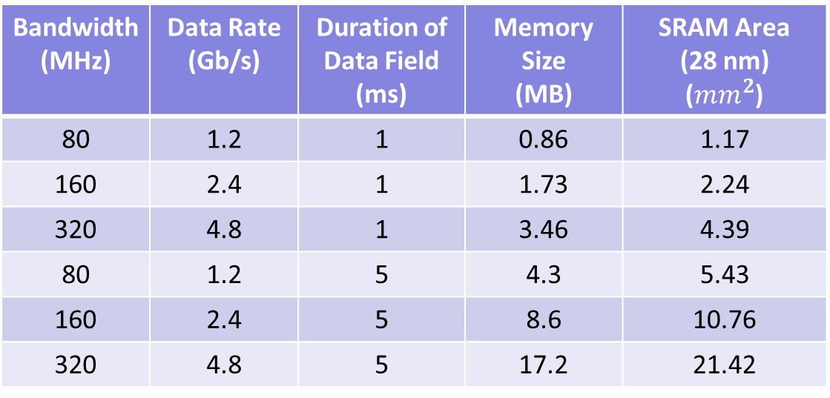
Downlink Examples – Required Memory at STA
Here we use MCS11 and Two Spatial Streams, and use Chase Combining
Here we assume 320 MHz has the same spectral efficiency as 80 and 160 MHz
Bandwidth (MHz) | Data Rate (Gb/s) | Duration of Data Field (ms) | Memory Size (MB) | SRAM Area (28 nm) ($mm^{2}$)
80 | 1.2 | 1 | 0.86 | 1.17
160 | 2.4 | 1 | 1.73 | 2.24
320 | 4.8 | 1 | 3.46 | 4.39
80 | 1.2 | 5 | 4.3 | 5.43
160 | 2.4 | 5 | 8.6 | 10.76
320 | 4.8 | 5 | 17.2 | 21.42
Memory die size for 28 nm and is based on $0.155 mm^{2}/Mb$ [1] for memory cells plus $0.1 mm^{2}$for addressing circuitry

Slide 8
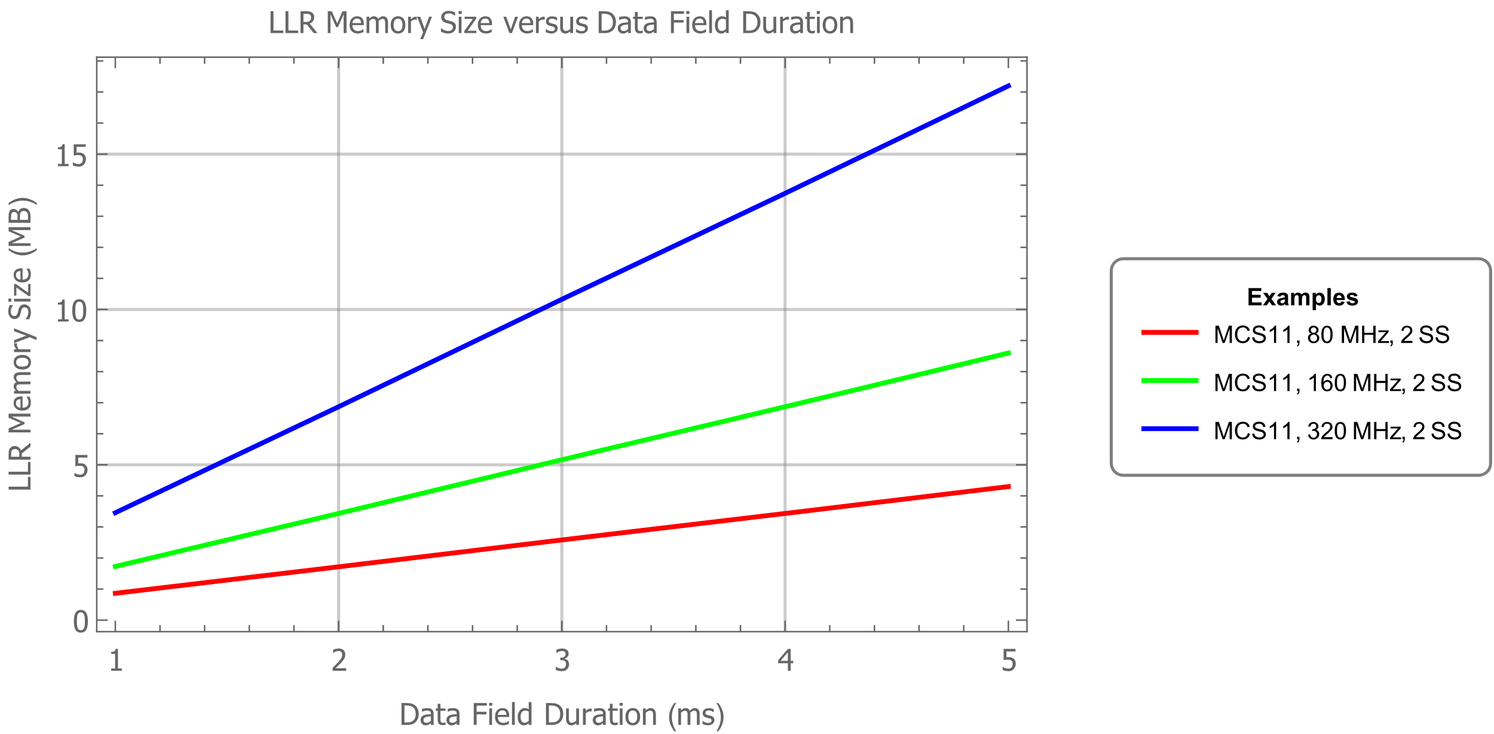
Memory Size (MB) versus Data Field Duration (ms)
These examples are for a Single HARQ Sequence
The memory requirements grow quickly with increased data rate and increased Data Field duration
A short Data Field duration incurs large overhead for HARQ Feedback

Slide 9
LDPC Codeword Processing

Slide 10
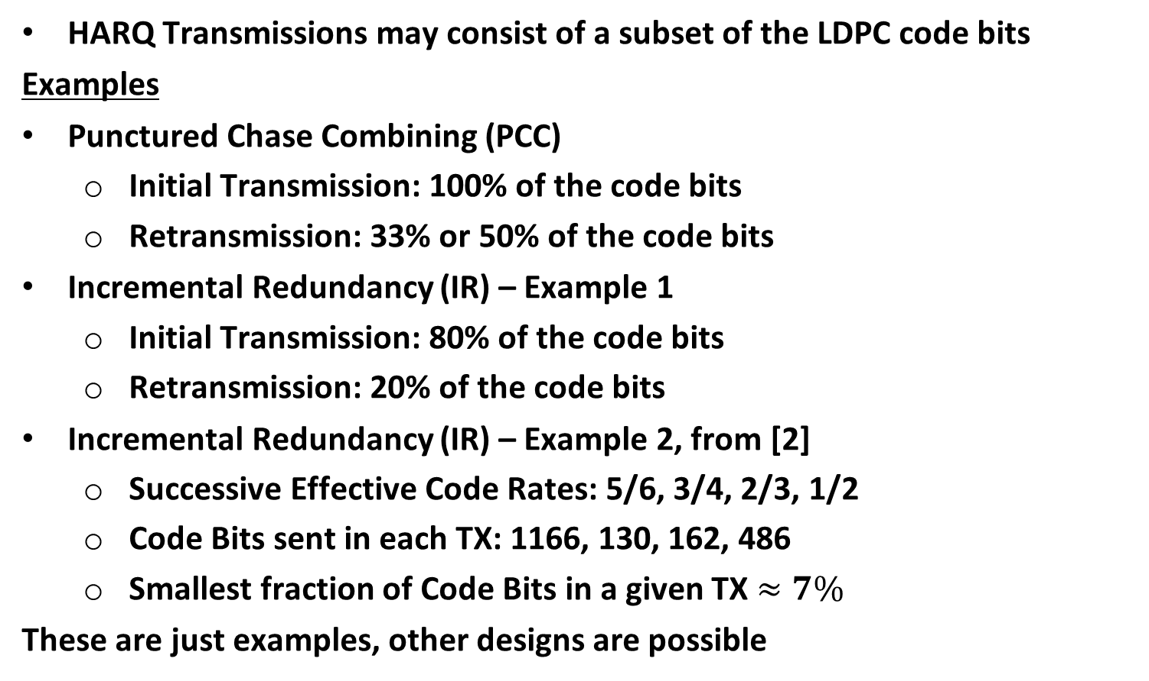
Introduction – HARQ Transmissions
HARQ Transmissions may consist of a subset of the LDPC code bits
Examples
Punctured Chase Combining (PCC)
  Initial Transmission: 100% of the code bits
  Retransmission: 33% or 50% of the code bits
Incremental Redundancy (IR) – Example 1
  Initial Transmission: 80% of the code bits
  Retransmission: 20% of the code bits
Incremental Redundancy (IR) – Example 2, from [2]
  Successive Effective Code Rates: 5/6, 3/4, 2/3, 1/2
  Code Bits sent in each TX: 1166, 130, 162, 486
  Smallest fraction of Code Bits in a given TX $≈7\%$
These are just examples, other designs are possible

Slide 11
LDPC Codeword Transmission Duration
In HARQ it often requires less time to transmit the code bits from an LDPC codeword
Hence more codewords are transmitted in a give period of time
To keep up with the incoming LCPC codewords, the codeword processing rate must increase
For example, if only 20% of the code bits are sent in an IR retransmission the receiver must combine the LLRs from the initial transmission and the retransmission and then decode the LDPC codeword in 20% of the time.
  This requires a 5x increase in LDPC codeword processing rate
If only 7% of the code bits are transmitted in a given HARQ transmission (as in Example 2) , then the increase in LDPC codeword processing rate is around 15x

Slide 12
STA LDPC Decoding Capability
Each STA has a maximum LDPC codeword processing rate
Increasing that decoding rate would increase implementation complexity
The HARQ Transmitter (H-TX) should take into account the LDPC codeword processing rate of the HARQ Receiver (H-RX)
Some of the PCC and IR gains come from transmitting a smaller subset of code bits in the retransmission
We need to evaluate those gains assuming realistic codeword processing rate of the HARQ receiver

Slide 13
MAC Layer Processing

Slide 14
MAC Layer Processing
The receiver MAC will need to process part of the A-MPDU based on the initial HARQ Transmission
The MAC may not be able to decode some of the MPDU delimiters so parsing the A-MPDU from the initial transmission could be challenging
Undecoded LDPC codeword data may not align with MPDU boundaries
The receiver MAC will need to process the initial undecoded parts of the A-MPDU based on the HARQ retransmission
  This may require storage of parts of the A-MPDU decoded from the initial HARQ Transmission

Slide 15
MAC Layer Processing Example
TX#1: 25% CWs fail, e.g., CW2, CW6 and CW11 fail
TX#2: In Re-Tx, if transmitting 20% of code bits → MAC processing needs to be 20x faster
MPDU 1
MPDU 2
MPDU 3
CW1
CW2
CW3
CW3
CW5
CW6
CW7
CW8
CW9
CW10
CW11
CW12
OFDM SYM 1
OFDM SYM 2
OFDM SYM 3
OFDM SYM 4
OFDM SYM 5
OFDM SYM 6
OFDM SYM 7
OFDM SYM 8
MPDU 1
MPDU 2
MPDU 3
CW2
CW6
CW11
OFDM SYM 1

Slide 16
References
Mahmut E. Sinangil, et. al., “A 28 nm 2 Mbit 6 T SRAM With Highly Configurable Low-Voltage Write-Ability Assist Implementation and Capacitor-Based Sense-Amplifier Input Offset Compensation,” IEEE Journal of Solid-State Circuits, Vol. 51, No. 2, February 2016
Yan Zhang, et. al., “Comparisons of HARQ transmission schemes for 11be,” IEEE 802.11-19/792r1, May 2019

Slide 17
Backup

Slide 18
Distribution on the Codeword Failure Rate
Probability of all codewords failing
CW (Codeword) error distribution for MCS6 at Packet error rate around 30%

