Slide 1
HARQ Gains with Overhead Considered
Date: 2019-07-15
Authors:

Slide 2
Presentation Outline
Introduction
HARQ Spectral Efficiency Gain Definition
Overhead Analysis Overview
HARQ Gains with and without Overhead
  Fixed MCS
  Variable MCS
  Feedback Based Rate Adaptation

Slide 3
Introduction
Here we investigate the throughput gains of HARQ compared to ARQ, under the same simulation conditions
The simulation details and throughput curves are provided in [1]
We support three types of rate selection/adaptation (see [1])
  Fixed MCS
  Variable MCS based on long-term SNR
  Feedback-based Rate Adaptation, based on short-term SNR from HARQ feedback
Beyond the intrinsic uncertainty in the long-term SNR, we also support addition SNR uncertainty [1]

Slide 4
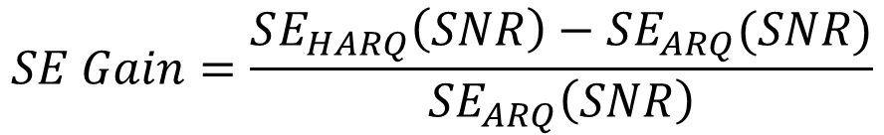
HARQ Spectral Efficiency Gain
For a given SNR value we calculate the difference of the spectral efficiency of HARQ and ARQ, divided by the spectral efficiency of ARQ
$$SE Gain=\frac{SE_{HARQ}\left(SNR\right)−SE_{ARQ}(SNR)}{SE_{ARQ}\left(SNR\right)}$$
HARQ can be either Punctured Chase Combining or Incremental Redundancy
We plot Spectral Efficiency Gain in percentage versus SNR

Slide 5
Overhead Analysis – Overview
All the Throughput analysis provided in [1] is based on the PHY Data Field and does not include any overhead
  This is true for IR, PCC and ARQ
Here we provide an Overview of the Overhead Analysis and how it affects the simulation Throughput Results
Overhead can include the following
  PPDU Preambles
  Time gaps between packets
  HARQ Feedback (if HARQ) or Block ACK (if ARQ)

Slide 6
Overhead Analysis – Overview
Always send the Initial HARQ Transmission
If HARQ Retransmission is needed
  Send HARQ Feedback and HARQ Retransmission
If HARQ Retransmission is not needed
  Send Block ACK (BA)

Slide 7
Overhead Analysis – Overview
Consider the average duration of the total overhead
Preamble
  One Preamble from Initial HARQ Transmission
  A second Preamble from HARQ Retransmission (weighted by probability of sending HARQ Retransmission)
HARQ Feedback
  Feedback packet (weighted by probability of sending HARQ Retransmission)
SIFS
  One SIFS after HARQ Initial Transmission
  Two additional SIFS (weighted by probability of sending HARQ Retransmission)
Block ACK
  End with a BA

Slide 8
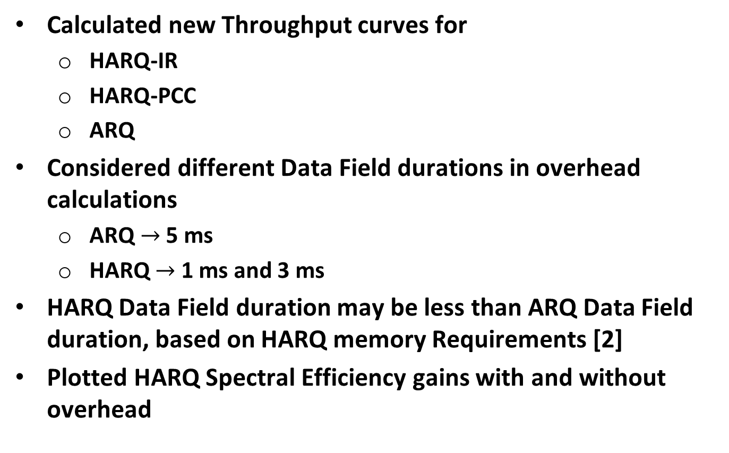
Overhead Analysis – Overview
Calculated new Throughput curves for
  HARQ-IR
  HARQ-PCC
  ARQ
Considered different Data Field durations in overhead calculations
  ARQ $→$ 5 ms
  HARQ $→$ 1 ms and 3 ms
HARQ Data Field duration may be less than ARQ Data Field duration, based on HARQ memory Requirements [2]
Plotted HARQ Spectral Efficiency gains with and without overhead

Slide 9
HARQ Spectral Efficiency Gains

Slide 10
Spectral Efficiency Gains – Fixed MCS
The overhead is higher in HARQ than in ARQ, so we see a drop in spectral efficiency gain with overhead included

Slide 11
Spectral Efficiency Gains – Fixed MCS
Increasing the HARQ PPDU duration lowers overhead, and so the gains with overhead are closer to those without overhead

Slide 12
Spectral Efficiency Gains – Variable MCS
HARQ gains higher with Variable MCS
Overhead loss is significant with shorter HARQ PPDU

Slide 13
Spectral Efficiency Gains – Variable MCS
Overhead loss drops with increased HARQ PPDU duration

Slide 14
Spectral Efficiency Gains – Feedback Based Rate Adaptation
HARQ gains even higher with Feedback Based Rate Adaptation
Overhead loss is significant with shorter HARQ PPDU

Slide 15
Spectral Efficiency Gains – Feedback Based Rate Adaptation
Overhead loss drops with increased HARQ PPDU duration

Slide 16
Spectral Efficiency Gains – Feedback Based Rate Adaptation
The HARQ Gains are higher when there is additional SNR Uncertainty – More robust to this uncertainty

Slide 17
Spectral Efficiency Gains – Feedback Based Rate Adaptation
Overhead loss drops with increased HARQ PPDU duration

Slide 18
Spectral Efficiency Gains – Feedback Based Rate Adaptation
With 5 dB Additional SNR Uncertainty of we see higher HARQ Gains

Slide 19
Spectral Efficiency Gains – Feedback Based Rate Adaptation
Overhead loss drops with increased HARQ PPDU duration

Slide 20
Conclusions
Incremental Redundancy consistently outperforms Punctured Chase Combining, as was mentioned in [1]
The largest gains are for the case of Feedback Based Rate Adaption
The largest HARQ Spectral Efficiency gains are below around 25 dB SNR, and start to taper off at high SNR
Losses due to overhead become significant for shorter HARQ PPDU durations
  It will be important to limit overhead loss in order to realize HARQ gains in real systems

Slide 21
References
Steve Shellhammer, et. al., “HARQ Simulation Results,” IEEE 802.11-19/1078r0, July 2019
Steve Shellhammer, et. al., “HARQ Complexity,” IEEE 802.11-19/1080r0, July 2019

