Slide 1
NGV 20MHz OFDM Numerology Discussions
Date: 2019-07-15
Authors:

Slide 2
Introduction
20MHz OFDM numerology was discussed in previous meetings [1].
The OFDM numerology will depend on the corresponding 20MHz spectrum mask definition.
We will first discuss the 20MHz spectrum mask for 11bd.
Then evaluate the feasibility of two 20MHz OFDM numerology designs using off-the-shelf PA.
  11ac 40MHz DC2
  11bd 10MHz + 10MHz.

Slide 3
20MHz Spectrum Mask (Class C)
11p 20MHz spectrum mask is relatively relaxed than 10MHz mask.
11bd may define a new tighter 20MHz spectrum mask.
  Similar power leakage as 10MHz mask → better adjacent channel operation.

Slide 4
Transmitter Structure
Tx Digital Waveform
Tx Digital Filter
Power Amplifier @5.9GHz
LO
To the best of our knowledge, DSRC market is looking for devices meeting class C mask.
  With state-of-art techniques, 11p 10MHz class C mask can be met.
  Spectrum at band edges can be guaranteed by transmitter digital filter.
  Spectrum leakage levels at 15MHz and 20MHz is mostly determined by the PA nonlinearity.
For 20MHz waveform spectrum,
  The spectrum leakage to adjacent 10MHz channel (PA non-linearity) will be more severe due to wider signal bandwidth.
  Need to evaluate feasibility of 20MHz waveform design.

Slide 5
Spectrum Mask Evaluation
Pre-generated digital waveform
RF Signal Generator @5.9GHz
Power Amplifier @5.9GHz
Spectrum Analyzer
Evaluate the spectrum of 20MHz signal
  Pre generate 20MHz digital waveform from simulator
  Generate the RF waveform through LitePoint VSG.
  Pass the RF signal to off-the-shelf Skyworks PA (DSRC channels).
  Analyze the spectrum of the output waveform
20MHz waveform design [1]
  Waveform 1: 11ac 40MHz DC2
  Waveform 2: 11ac 20MHz DC2 + 11ac 20MHz DC2

Slide 6
Spectrum: 11ac 40MHz DC2
Good margin compared to 11p 20MHz mask.
Difficult to meet the tight mask @+/-20MHz frequency.
  Need >6dB more suppression from PA to temperature sweep and max-hold measurment.

Slide 7
Spectrum: 10MHz + 10MHz
With off-the-shelf PA, the tight spectrum mask can be met with sufficient margin using 10MHz + 10MHz design.

Slide 8
Discussions
Option A: 11p 20MHz spectrum mask
  Both (11ac 40MHz DC2) and (11bd 10MHz + 11bd 10MHz) can meet.
Option B: a new tight 20MHz spectrum mask with same leakage level as 10MHz spectrum mask.
  11ac 40MHz DC2 is very challenging with exiting PA, most at 20MHz.
  Need to choose 10+10MHz OFDM numerology with two-PA design.
  May design single-PA system when better PA is available in the future.
Option C: a compromised 20MHz spectrum mask with similar leakage level as 10MHz spectrum mask, but relaxed at +/-20MHz. For example, -45dBr.

Slide 9
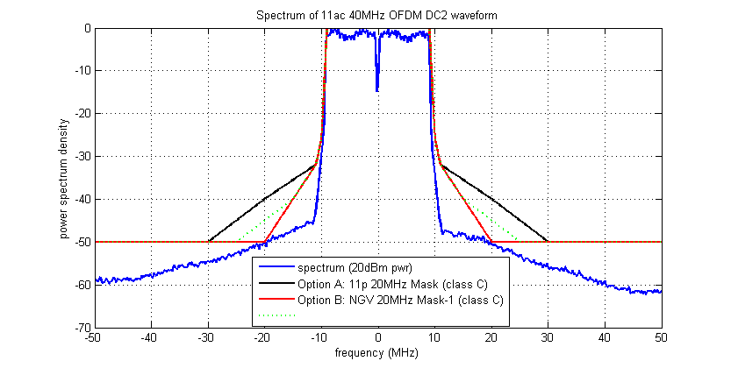
Spectrum Masks Options

Slide 10
Reference
[1] Rui Cao and etc., “PHY Numerology Discussions”, IEEE 802.11-19/0686.

Slide 11
Straw Poll 1
Do you agree that 11bd shall define 20MHz spectrum mask as follows?
Option A: 11p 20MHz spectrum mask
Option B: A new tight spectrum mask with the same leakage level as 10MHz spectrum mask?
Option C: A new tight spectrum mask with similar leakage level as 10MHz spectrum mask, but with xdB relaxed at +/-20MHz from center frequency?
Option A:
Option B:
Option C:
Abstain:

Slide 12
Straw Poll 2
Do you agree that 11bd 20MHz PPDU Data symbol shall use the following OFDM design?
  11ac 40MHz downclock by 2
  11bd 10MHz + 11bd 10MHz.
Option A:
Option B:
Abstain:

