Slide 1
NGV MIMO Simulations
Date: 2019-07-15
Authors:

Slide 2
Introduction
Single-stream is agreed to be the only mode to be supported in 11bd for OCB broadcast transmission [1].
As multi-antenna becomes available, multi-stream may be possible for high-throughput unicast tranmissions.
We simulate 2x2 MIMO scenarios and discuss about the benefits and feasibility.

Slide 3
MIMO Channel Model
Car2Car channel model [2] proposed for 11bd link simulations does NOT have MIMO modeling.
Modified UMi channel model [3], used for 3GPP Device-2-Device (D2D) link-level simulations, supports MIMO channel modeling.
Modified UMi channel model is used for MIMO simulations.
Five different scenarios are simulated:
  15Km/h NLos
  45Km/h Los
  45Km/h NLos
  70Km/h Los
  70Km/h NLos

Slide 4
Simulation Settings
10MHz DSRC channel @5.9GHz
OFDM numerology: 11ac 20MHz DC2.
Two-antenna system: 2x2-2ss v.s. 2x2-1ss
  No beamforming. DFT steering matrix.
Pkt size: 300 bytes.
No impairments. Ideal timing.
LDPC with Midamble:
  Default Midamble period M=5.
Goodput is the maximum achievable effective data rate.
Goodput (SNR) = max_{MCS}{Rate(MCS) * (1-PER(MCS, SNR))* M/(M+1)}
  M is the midamble period

Slide 5
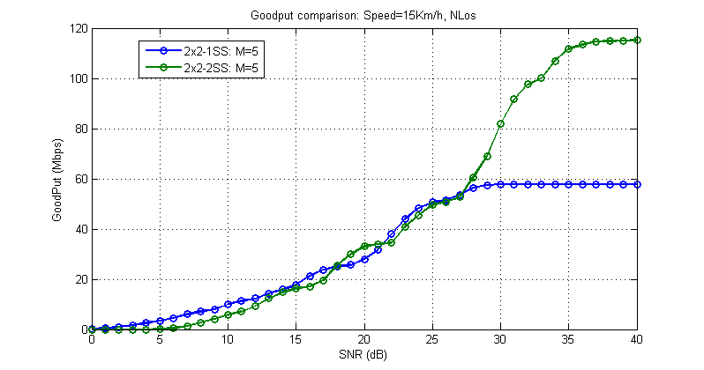
15Km/h NLos
Low speed environments: 2SS shows 2x peak goodput compared with 1SS.
At low to medium SNR (<28dB), 1SS shows better goodput.

Slide 6
45Km/h Los
Medium speed environments: 2SS shows ~1.7x peak goodput compared with 1SS.
At low to medium SNR (<23dB), 1SS shows better goodput.

Slide 7
45Km/h NLos
Medium speed environments: 2SS shows ~1.8x peak goodput compared with 1SS with denser Midamble requirement.
At low to medium SNR (<28dB), 1SS shows better goodput.

Slide 8
70Km/h Los
At high speed environments, 2SS shows ~50% peak goodput gain
At low to medium SNR (<23dB), 1SS shows better goodput.

Slide 9
70Km/h NLos
At high speed environments: 2SS shows ~1.6x peak goodput compared with 1SS.
At low to medium SNR (<28dB), 1SS shows better goodput.

Slide 10
Discussions
In 2x2 MIMO setup,
  At high SNR, two spatial stream transmission shows ~50% to 100% peak goodput gain compared with one spatial stream.
  At low-to-medium SNR region, one spatial stream gives better goodput.
The goodput gain is achieved at the SNRs when one spatial stream transmission reaches maximum MCS.
Support of two spatial stream is possible in vehicular communications for unicast transmission.
May limit to close-range low-speed applications.
  E.g. urban low-speed V2I HD map update.

Slide 11
Summary
In this contribution, we simulated the goodput of two-antenna MIMO systems using D2D channel models.
Two spatial streams transmission provides ~50%-100% peak goodput gain after one spatial stream reaches maximum MCS.

Slide 12
Reference
[1] Rui Cao and etc., “11bd MCS Discussion”, IEEE 802.11-19/0688.
[2] Prashant Sharma and etc., “Simulation of NGV Channel Models”, IEEE 802.11-19/0017.
[3] “Study on LTE Device to Device Proximity Services”, 3GPP TR 36.843 V12.0.1.

Slide 13
Straw Poll 1
Do you agree to add the following text into Section 3 of SFD?
  “11bd STA may support two spatial stream for unicast transmissions.”
Y:
N:
A:

Slide 14
Appendix

Slide 15
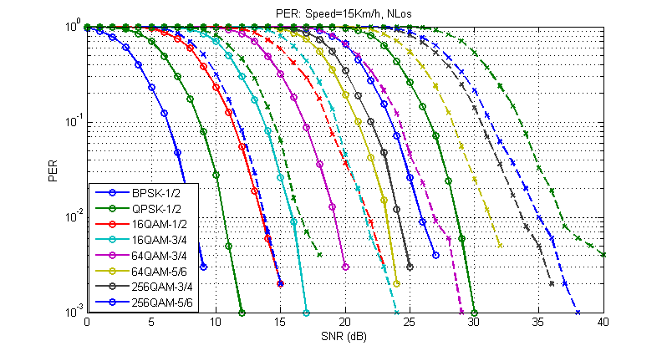
15Km/h NLos

Slide 16
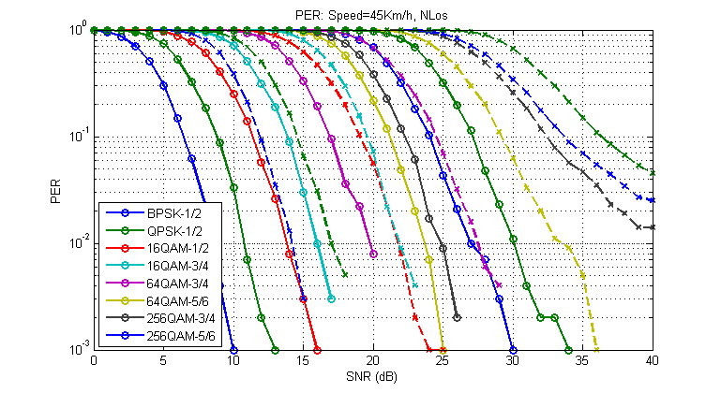
45Km/h NLos

Slide 17
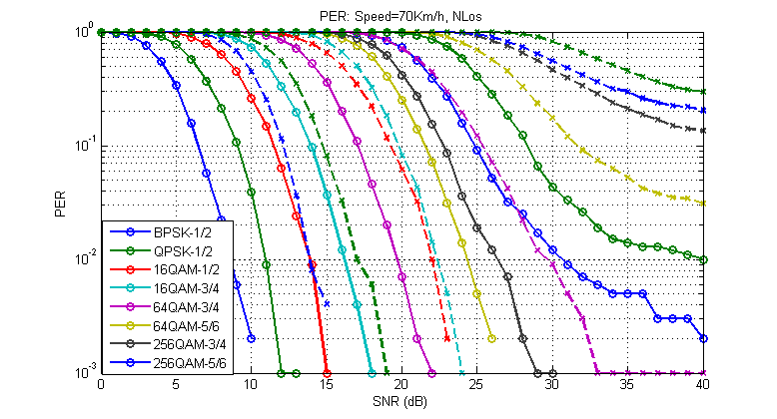
70Km/h NLOs

