Slide 1
Tone Plan Discussion
Date: 2019-07-15
Authors:
Name | Affiliation | Address | Phone | Email
Eunsung Park | LG Electronics | 19, Yangjae-daero 11gil, Seocho-gu, Seoul 137-130, Korea |  | esung.park@lge.com
Dongguk Lim |  |  |  | dongguk.lim@lge.com
Jinmin Kim |  |  |  | jinmin1230.kim@lge.com
Jinsoo Choi |  |  |  | js.choi@lge.com

Slide 2
Introduction
In [1], three options for a 320MHz BW tone plan design were discussed
Option 1 : Reuse the 11ax 80MHz tone plan four times
Option 2 : Design a new 160MHz tone plan and repeat it twice
Option 3 : Design a new 320MHz tone plan
In [2], new BW modes and their tone plan were proposed
New BW modes: 320MHz, 160+160MHz
Tone plan: Use HE160 in each PHY 160MHz subband
In this presentation, we further discuss new BW modes and tone plan designs

Slide 3
Proposals
New BW modes
320MHz, 160+160MHz
240MHz, 160+80MHz
Tone plan designs
Repeat the 11ax 80MHz tone plan for OFDMA tone plans in all new BW modes
Define a new RU for SU (or MU MIMO using entire BW) tone plans in contiguous 240MHz, 320MHz and even in contiguous 160MHz

Slide 4
New BW Modes
Two types of larger BW modes have many benefits
Larger BW modes can increase the peak throughput and improve the transmit range at high PHY rates [1][2]
Utilizing two larger BW modes (240MHz, 320MHz) in both SU and MU transmissions can provide better throughput (maximum 12% gain) and efficiency compared to using only the 320MHz mode [1]
Considering incumbents in 6GHz, available channels may be restricted, and thus, adopting various BW modes may be more beneficial to channel availability
Adopting two larger BW modes can give vendors a chance to consider various implementation choices
For example, 240MHz / 320MHz / both BWs capable devices can be considered for better throughput than 11ax
Non-contiguous BW modes can enhance efficiency
Other non-contiguous BW modes (e.g., 80+80+80+80MHz) may not be preferable from a hardware viewpoint
For further efficiency, preamble puncturing can be utilized

Slide 5
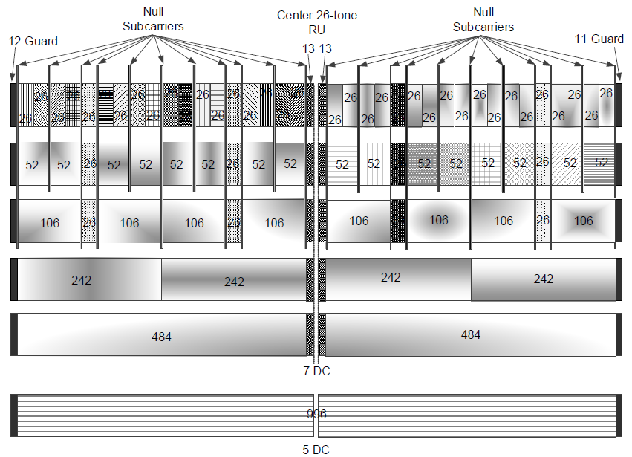
Tone Plan Designs (1/3)
Basically, we propose to repeat the 11ax 80MHz tone plan to build up OFDMA tone plans in all new contiguous / non-contiguous BW modes
It guarantees that all 80MHz segments have the same tone plan which results in a simple hardware implementation regardless of the BW modes
It can also give a chance to transmit data to HE and EHT STAs simultaneously in larger BWs which results in an efficiency and throughput enhancement
11ax 80MHz tone plan

Slide 6
Tone Plan Designs (2/3)
For SU (or MU MIMO using whole BW) tone plans in the contiguous BW modes, we propose to define new RUs, for example as shown in the next slide
Only EHT STAs can be assigned to 240/320MHz SU or MU MIMO transmission, and thus, we can use new RUs for them
By using new RUs, throughput and efficiency can be further enhanced
Assuming 16 SS transmission in 320MHz, a new RU can roughly achieve an additional 1Gbps* increase in peak rate compared to 4x996-tone RU
We can also benefit from new RUs in the future extension
In a much wider BW (> 320MHz), repeating 996-tone RU leads to too many null tones which can result in a throughput degradation
Whereas by using these new RUs as one of the RUs in the future, more efficient OFDMA tone plans can be expected
996
996
996
996
12 guard
5 null
23 null
5 null
23 DC
5 null
23 null
5 null
11 guard
* Additional 1.294Gbps (3.37%) increase in peak rate when using 4068-tone RU with 16 pilots, MCS11, 0.8us GI and 16SS

Slide 7
Tone Plan Designs (3/3)
New RU examples for SU (or MU MIMO using whole BW) tone plans
320MHz
240MHz
160MHz
→ The number of DC tones (as well as guard tones) needs to be further studied
4068 or 4066 or …
12 left guard
DC: 5 or 7 or …
11 right guard
3044 or 3042 or …
12 left guard
DC: 5 or 7 or …
11 right guard
2020 or 2018 or …
12 left guard
DC: 5 or 7 or …
11 right guard

Slide 8
Summary
We have proposed new BW modes and tone plan designs
New BW modes
320MHz, 160+160MHz
240MHz, 160+80MHz
Tone plan designs
Repeat the 11ax 80MHz tone plan for OFDMA tone plans
Define a new RU for SU (or MU MIMO using entire BW) tone plans in contiguous BW modes

Slide 9
SP #1
Do you support adding the following BW modes to 11be?
320MHz
160+160MHz

Slide 10
SP #2
Do you support adding the following BW modes to 11be?
240MHz
160+80MHz

Slide 11
SP #3
Do you support the following tone plans for 11be?
For the OFDMA tone plans in 320MHz and 160+160MHz, 11ax 80MHz tone plan is duplicated four times

Slide 12
SP #4
Do you support the following tone plans for 11be?
For the OFDMA tone plans in 240MHz and 160+80MHz, 11ax 80MHz tone plan is duplicated three times

Slide 13
SP #5
Do you support the following tone plans for 11be?
TBD-tone RU is used for the SU PPDU transmission in contiguous 320MHz BW
Note: This RU is not constructed from duplicating the 11ax 80MHz tone plan four times

Slide 14
SP #6
Do you support the following tone plans for 11be?
TBD-tone RU is used for the SU PPDU transmission in contiguous 240MHz BW
Note: This RU is not constructed from duplicating the 11ax 80MHz tone plan three times

Slide 15
SP #7
Do you support the following tone plans for 11be?
TBD-tone RU is used for the SU PPDU transmission in contiguous 160MHz BW
Note: This RU is not constructed from duplicating the 11ax 80MHz tone plan twice

Slide 16
References
[1] 802.11-19/0778r0 Consideration on 320MHz Bandwidth and 16 Spatial Streams
[2] 802.11-19/0797r0 320MHz Channelization and Tone Plan

