Slide 1
Adaptive Repetition
Date: 2019-07-05
Authors:

Slide 2
Abstract
Adaptive message repetition is a simple, efficient, and reliable technique. It was initially described in submissions NGV 11-18-1577 and 11-18/1186
  It is fully backword compatible
  It provides performance gain for 802.11p stations as well ad NVG stations.
In this submission, we provide evidence of the benefits based on the implementation of the proposed technique in existing commercial devices

Slide 3
Introduction (1)
From the PAR https://development.standards.ieee.org/get-file/P802.11bd.pdf?t=99204200003
  this amendment also defines at least one mode that achieves at least 3dB lower sensitivity level (longer range) […]
  This amendment shall provide interoperability, coexistence, backward compatibility, and fairness with deployed OCB (Outside the Context of a BSS) devices.
IEEE 802.11bd is a comprehensive toolbox that is a super-set of IEEE 802.11p, and that can be instantiated differently by regional C-ITS standardization bodies (ETSI ITS-G5, US SAE DSRC…)
  IEEE 802.11bd uses the same preamble as IEEE 802.11p and the same channel access mechanism ➔ co-channel coexistence is ensured.
  IEEE 802.11bd senses its environment, is able to detect neighbor legacy stations and can switch to legacy mode whenever needed ➔ backward compatibility is ensured,
  Backward compatibility, does not need a new channel each time a new standard is released

Slide 4
Introduction (2)
IEEE 802.11bd a super-set of IEEE 802.11p
So far, all accepted new features of IEEE 802.11bd (LDPC, 56 subcarriers, BPSK to 256QAM…) pertain to the “NGV operating mode”’
Still, we also have the opportunity to enhance performance when transmitting in legacy mode (PAR link?)
➔ We present a technique that improves performance of both legacy and NGV transmit modes (covers the light grey and dark greay area)
IEEE 802.11bd
(LDPC, 56 subcarriers, BPSK to 256QAM…)
IEEE 802.11p
(OFDM, Conv.coding, 52 subcarriers, BPSK to 64QAM)

Slide 5
IEEE 802.11bd repetitions: improving both legacy and NGV modes
Repetition of messages is a simple technique which improves both legacy & NGV transmission modes of IEEE 802.11bd
  Validated improvements for legacy IEEE 802.11p stations receiving repeated messages
    This technique is fully interoperable – the individual PPDUs are standard 802.11p transmissions.
    Temporal diversity is a strong asset for fast-varying channels
  Validated significant improvements for legacy IEEE 802.11bd stations receiving repeated messages transmitted in legacy IEEE 802.11p mode
    Major performance improvement from packet combining at the receiver side
  Also compatible and significant improvements for IEEE 802.11bd stations operating in NGV mode
  Based on mechanisms already present in 802.11/2016

Slide 6
Benefits from Repetition of Messages
  Legacy IEEE 802.11p stations see each retransmission as a standalone message
    Performance validated on real HW (1 to 2 dB) due to temporal diversity
    Duplicated messages naturally filtered by application (already performed by higher protocol layers)
    No software update needed
  Initial PPDU and retransmissions can be combined by NGV stations, either when sent in legacy IEEE 802.11p or new format NGV mode
    +4 dB performance boost for 1 retransmission
    +7 dB performance boost for 3 retransmissions
    Combining at LLR levels is the recommended technique, but other are possible

Slide 7
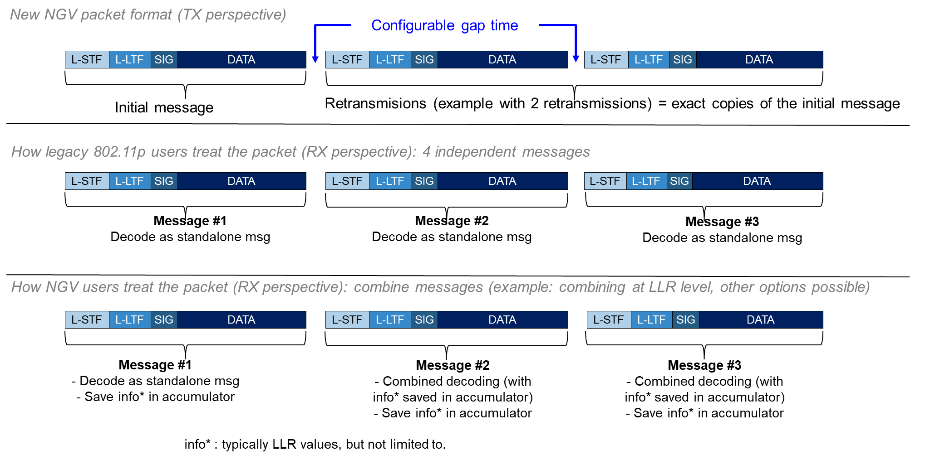
Example with legacy IEEE802.11p mode, Two Repetitions

Slide 8
Performance Validated in Numerical Simulations
Simulations results indicate:
with 1 repetition: 0.5-0.8 dB improvement for 802.11p stations and 3-4 dB improvement for NGV stations
with 3 repetitions: 1.0-1.7 dB improvement for 802.11p stations and 6-8 dB improvement for NGV stations
 |  | improvement for 802.11p stations | improvement for NGV stations
AWGN | 1 retransmission | 0.5 dB | 3.0 dB
 | 2 retransmissions | 0.7 dB | 4.7 dB
 | 3 retransmissions | 0.8 dB | 6.0 dB
G5-HighwayNLOS 886 Hz Doppler | 1 retransmission | 0.8 dB | 4.3 dB
 | 2 retransmissions | 1.4 dB | 6.7 dB
 | 3 retransmissions | 1.7 dB | 8.1 dB

Slide 9
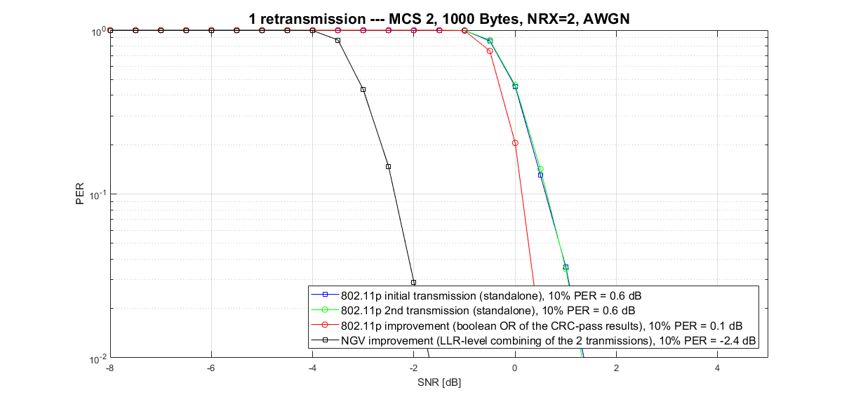
Simulation Results, Example (a)

Slide 10
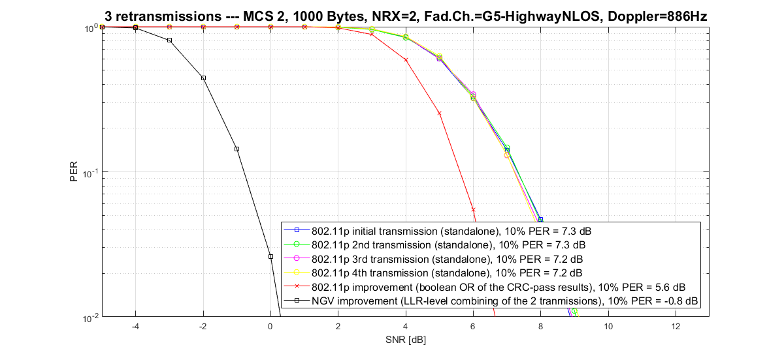
Simulation Results, Example (b)

Slide 11
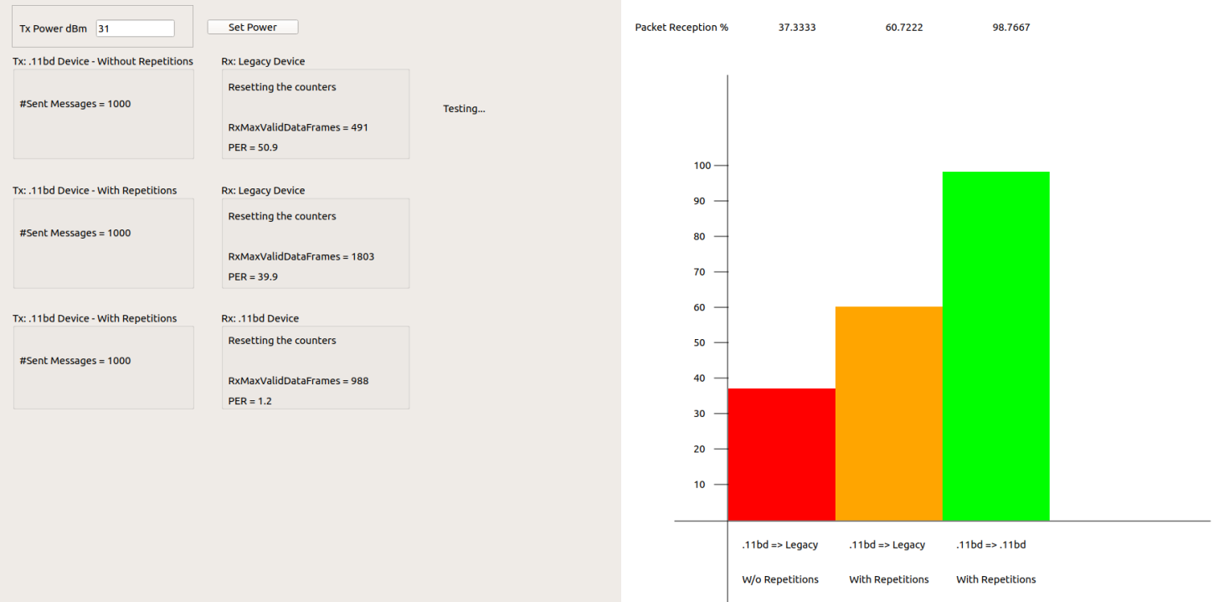
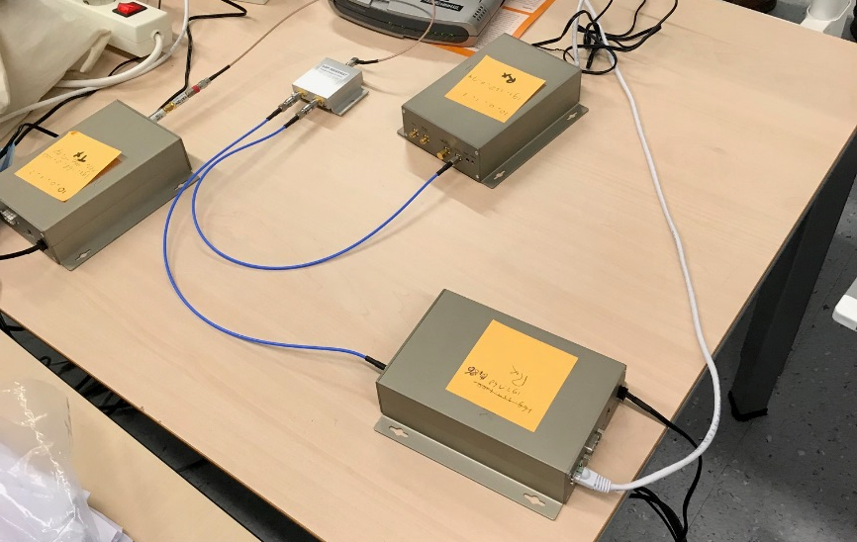
Performance Demonstrated on Real Commercial IEEE802.11p/bd HW: setup
Cable
Rx
EVK
11p
PRR
Tx
11bd
Repeat
attenuator
Legacy 11p receiver (no modifications)
No repetition: 11p performance
Repetition: slight performance increase (~0.5 dB)
11p
Legacy
Repeat
EVK
11p/bd
11p
Legacy
11p/bd Transmitter
No repetition: 11p mode
Repetitions: 11bd mode
11bd
Rx
Rx
11bd Tx
EVK
11bd
11p Rx
Legacy

Slide 12
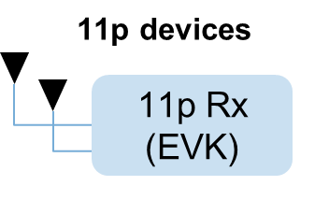
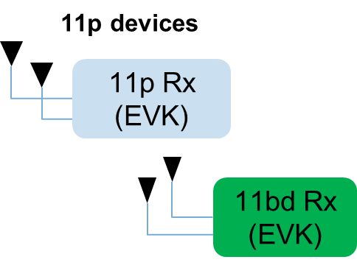
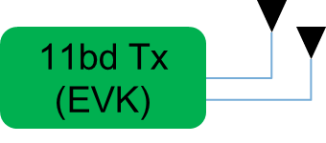
Performance Demonstrated on Real Commercial IEEE802.11p/bd HW: concept
Few devices present (day1, rural)
Many devices present (high density)
The 11bd device transmits the same 11p packet multiple times
Fully backward compatible
Increase coverage of 11p devices (packet diversity) when most needed (few cars)
Increase coverage of 11bd devices (Time-MRC) when most needed (few cars)
The 11bd device transmits as an 11p device with no repetition
Fully backward compatible

Slide 13
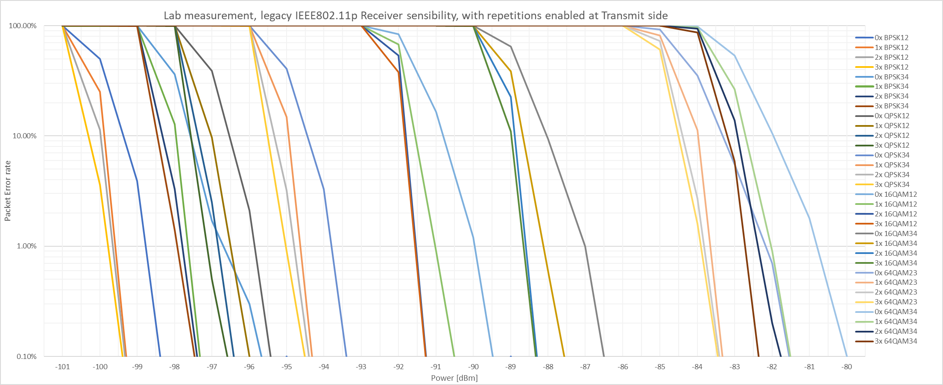
Performance Demonstrated on Real Commercial
IEEE 802.11p/bd HW: legacy stations performance
Concept validated on commercial legacy IEEE 802.11p device, for all transmit rates
HW measurements aligned with simulation results: in AWGN channel, from 0.5 (1x repetition) to 0.8 dB gain (3x repetitions)
Repetition gain is visible in every MCS

Slide 14
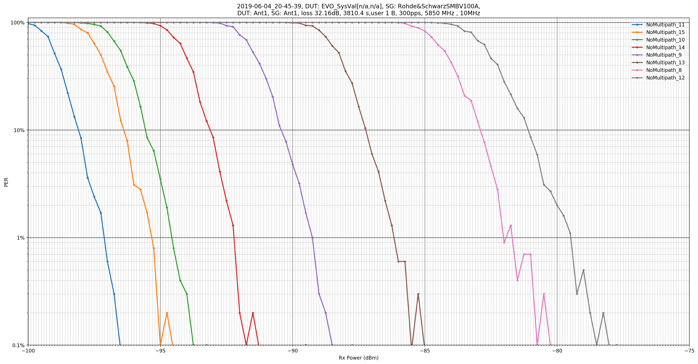
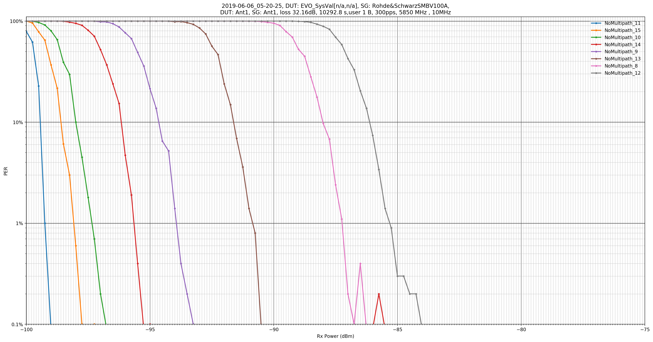
Performance Demonstrated on Real Commercial
IEEE 802.11bd HW: NGV stations performance (1)
Concept validated on commercial IEEE 802.11p/bd device (transmitting in legacy mode), for all rates
HW measurements aligned with simulation results: in AWGN channel, from 1 to 5 dB gain
AWGN
- Improved sensitivity
Legacy IEEE 802.11p station
IEEE 802.11bd NGV station

Slide 15
Time Gap Between Repeated PPDUs
There are several alternatives for the time gap between repeated PPDUs:
The recommended approach sends the repetitions as a burst, separated by a small time gap, typically set as SIFS (32 µsec)
  SIFS is the minimum gap that maintains interoperability with 802.11p stations, although measurements on commercial IEEE 802.11p device indicate smaller values possible
  Time gap should be lower than the min AIFS (58 µsec), to avoid other messages sent in between
  Each PPDU burst looks like a single transmission to CCA at other stations within range

Slide 16
Combining of Repeated PPDUs
For NGV stations, the substantial performance improvement comes from the combining of the multiple transmissions of a message into a combined decoding
This allows the receiving station to fully leverage white-noise reduction and fading channel temporal diversity
The combining of different transmissions can be performed at different stages of the NGV receiver PHY
  This includes, but not limited to, joint equalization or LLR generation
  LLR-level combining is what is typically used in HARQ implementation for 3GPP LTE

Slide 17
Adaptive Retransmission Control
We propose that the IEEE 802.11bd provides capability of up to 3 number retransmissions, based on the measured congestion of the channel (for instance using the Channel Busy Ratio metrics)
ITS standardization bodies such as ITS-G5 or SAE 1609 can define the exact transition steps.
Two example schemes are given on the next slide.

Slide 18
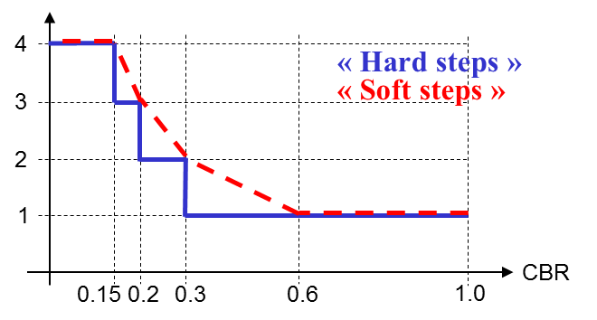
Adaptive Retransmission Control: exemplary control schemes (done at upper layers, like 1609 for ex.)
The number of retransmissions can be gradually increased as the occupancy of the channel goes down. In congested environment (high CBR), retransmissions are disabled. Exemplary schemes for controlling the number of repetitions:
« Hard steps »
Recommended method, but open for discussion
Measured CBR | Number of Rep. | Traffic increase for this transmitter
≥ 0.3 | 0 | No increase in traffic
[0.2 – 0.3[ | 1 | x2
[0.15 – 0.2[ | 2 | x3
< 0.15 | 3 | x4
Average number of transmissions

Slide 19
Benefits
Repetition technique improves performance while maintaining interoperability, coexistence, and proven backward compatibility with 802.11p equipment
This technique provides substantial improvements for communication, both for already deployed legacy IEEE 802.11p stations, and for IEEE 802.11bd stations (either operating in legacy or NGV mode)
These techniques do not increase channel load in congested environments
These techniques do not require changing higher layers of the ITS protocol stack

Slide 20
Straw Poll
Do you agree to add the following text into Section 3 of SFD?
  “Repetition of NGV messages, primarily targeting performance improvement under low or medium channel congestion, is a feature benefitting to both 802.11p and NGV stations population. The number of repetitions ranges from 1 to 3 and is adapted based on metrics such as CBR, with thresholds defined at upper layers.”
Y:
N:
A:

