Slide 1
Simulation results for LC-optimized PHY proposal
Date: 2019-07-15
Authors:

Slide 2
Abstract
The submission presents the simulations regarding the LC-optimized PHY for TGbb based on G.9991 PHY 1 [1].

Slide 3
Outline
Simulation setup
Frame detection simulation results
Header modulation and coding simulation results
Payload modulation and coding simulation results

Slide 4
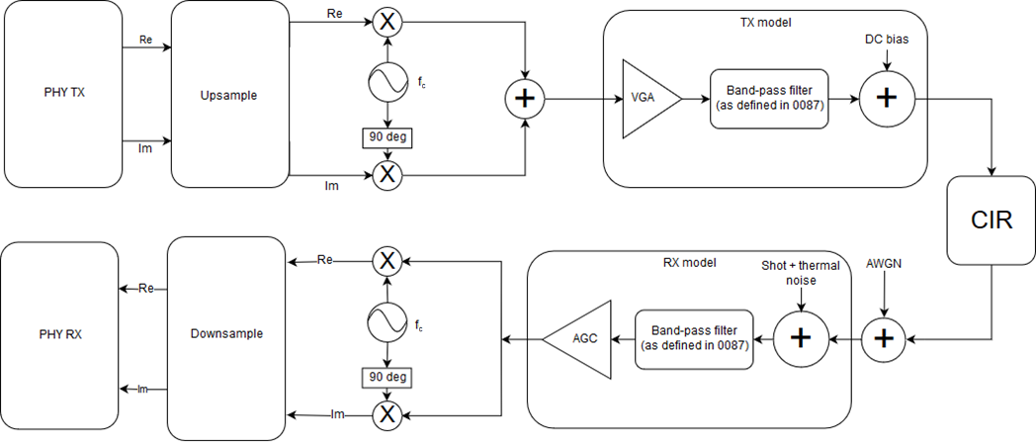
Simulation setup
See doc. 11-19/187r4:
Preamble: 100,000 repetitions,
false alarm rate 0,1%
Header: 10,000 repetitions
Payload: 1,000 repetitions
OCR: 200 MHz
Signal power is measured at red circle. The SNR is set by adjusting noise power in the following AWGN block accordingly. The impact of the Rx model on SNR is assumed to be neglibible, as the used bandpass cutoff frequencies exceed the signal bandwidth.

Slide 5
Simulation setup (cont.)
Payload OFDM setup:
Subcarriers 24..965: 4.6875..188.4765625 MHz
Modulation depths: 1, 6, 12 bits/subcarrier
FEC configuration: block length 4320 bits, code rates 1/2, 5/6, 20/21

Slide 6
Frame detection simulation results
Min. SNR for Detection rate > 0.999
OFE only | -6 dB
Industrial Wireless D7 | -7 dB
Enterprise conf. room S1-D1 | -6 dB
Enterprise conf. room S1-D2 | -6 dB
Enterprise conf. room S3-D1 | -6 dB
Enterprise conf. room S3-D2 | -6 dB

Slide 7
Header simulation results
Header parameters:
Header information: 168 bits
Bandwidth: 200 MHz
(used: 183.98 MHz)
FFT size: 1024
(occupied subcarriers: 942)
Cyclic prefix length: 256
Modulation: QPSK (2 bits/SC)
FEC code rate: 1/2
FEC block size: 168 bits

Slide 8
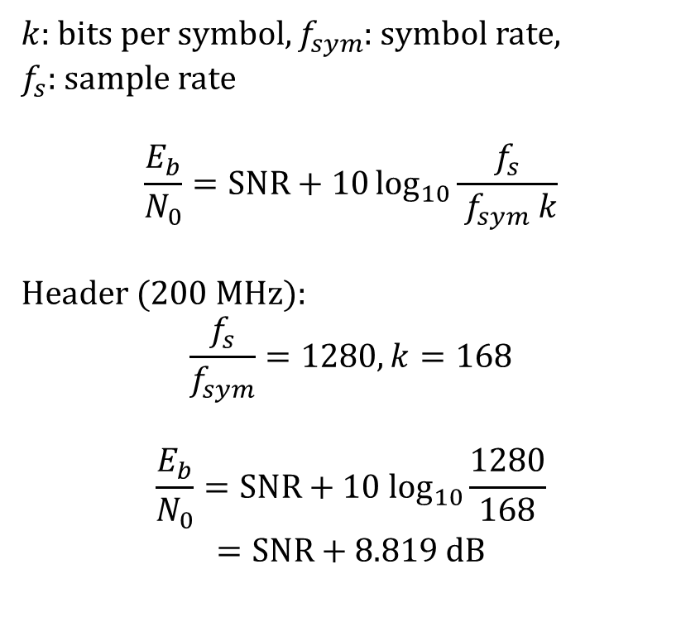
Header simulation results
$k$: bits per symbol$, f_{sym}$: symbol rate,
$f_{s}$: sample rate
$$\frac{E_{b}}{N_{0}}=SNR+10\log_{10}{\frac{f_{s}}{ f_{sym} k}}$$
Header (200 MHz):
$$\frac{f_{s}}{f_{sym}}=1280, k=168$$
$$\frac{E_{b}}{N_{0}}=SNR+10 \log_{10}\frac{1280}{168}$$
$$=SNR+8.819 dB$$

Slide 9
Header simulation results
Header parameters:
Header information: 168 bits
Bandwidth: 200 MHz
(used: 183.98 MHz)
FFT size: 1024
(occupied subcarriers: 942)
Cyclic prefix length: 256
Modulation: QPSK (2 bits/SC)
FEC code rate: 1/2
FEC block size: 168 bits

Slide 10
Payload simulation results – Low MCS
Payload parameters:
Data length: 4320000 bits
Bandwidth: 200 MHz
(used: 183.98 MHz)
FFT size: 1024
(occupied subcarriers: 942)
Cyclic prefix length: 64
Modulation: BPSK (1 bit/SC)
FEC code rate: 1/2
FEC block size: 4320 bits

Slide 11
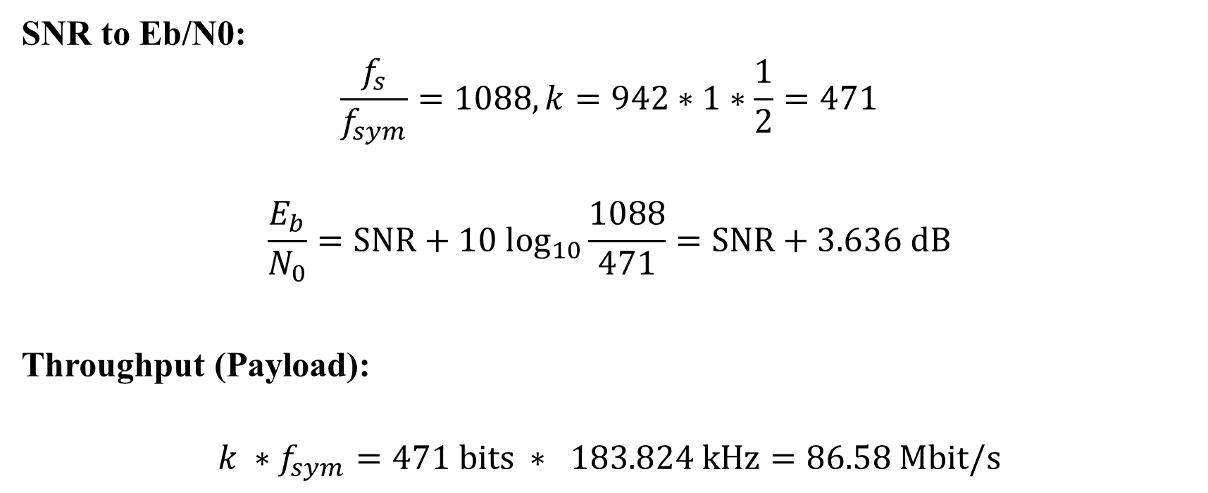
Payload simulation results – Low MCS
SNR to Eb/N0:
$$\frac{f_{s}}{f_{sym}}=1088, k=942∗1∗\frac{1}{2}=471$$
$$\frac{E_{b}}{N_{0}}=SNR+10 \log_{10}\frac{1088}{471}=SNR+3.636 dB$$
Throughput (Payload):
$$k ∗f_{sym}=471 bits ∗ 183.824 kHz=86.58 Mbit/s$$

Slide 12
Payload simulation results – Low MCS
Payload parameters:
Data length: 4320000 bits
Bandwidth: 200 MHz
(used: 183.98 MHz)
FFT size: 1024
(occupied subcarriers: 942)
Cyclic prefix length: 64
Modulation: BPSK (1 bit/SC)
FEC code rate: 1/2
FEC block size: 4320 bits

Slide 13
Payload simulation results – Medium MCS
Payload parameters:
Data length: 4320000 bits
Bandwidth: 200 MHz
(used: 183.98 MHz)
FFT size: 1024
(occupied subcarriers: 942)
Cyclic prefix length: 64
Modulation: 64-QAM (6 bits/SC)
FEC code rate: 5/6
FEC block size: 4320 bits

Slide 14
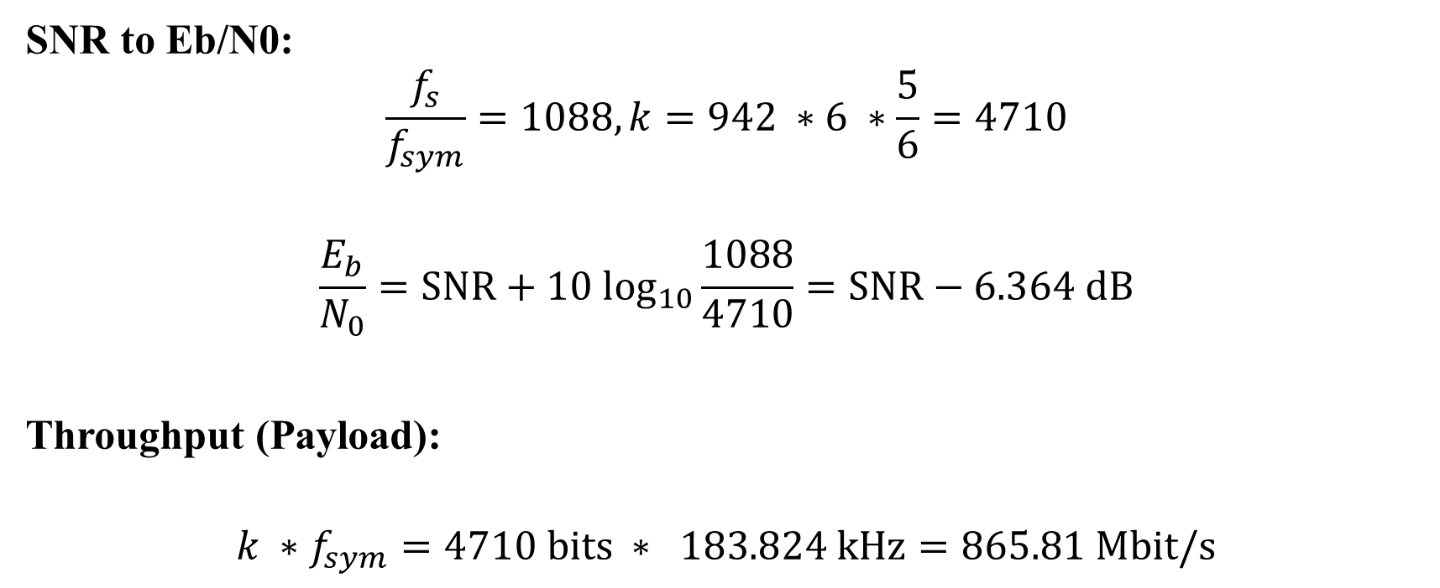
Payload simulation results – Medium MCS
SNR to Eb/N0:
$$\frac{f_{s}}{f_{sym}}=1088, k=942 ∗6 ∗\frac{5}{6}=4710$$
$$\frac{E_{b}}{N_{0}}=SNR+10 \log_{10}\frac{1088}{4710}=SNR−6.364 dB$$
Throughput (Payload):
$$k ∗f_{sym}=4710 bits ∗ 183.824 kHz=865.81 Mbit/s$$

Slide 15
Payload simulation results – Medium MCS
Payload parameters:
Data length: 4320000 bits
Bandwidth: 200 MHz
(used: 183.98 MHz)
FFT size: 1024
(occupied subcarriers: 942)
Cyclic prefix length: 64
Modulation: 64-QAM (6 bits/SC)
FEC code rate: 5/6
FEC block size: 4320 bits

Slide 16
Payload simulation results – High MCS
Payload parameters:
Data length: 4320000 bits
Bandwidth: 200 MHz
(used: 183.98 MHz)
FFT size: 1024
(occupied subcarriers: 942)
Cyclic prefix length: 64
Modulation: 4096-QAM (12 bits/SC)
FEC code rate: 20/21
FEC block size: 4320 bits

Slide 17
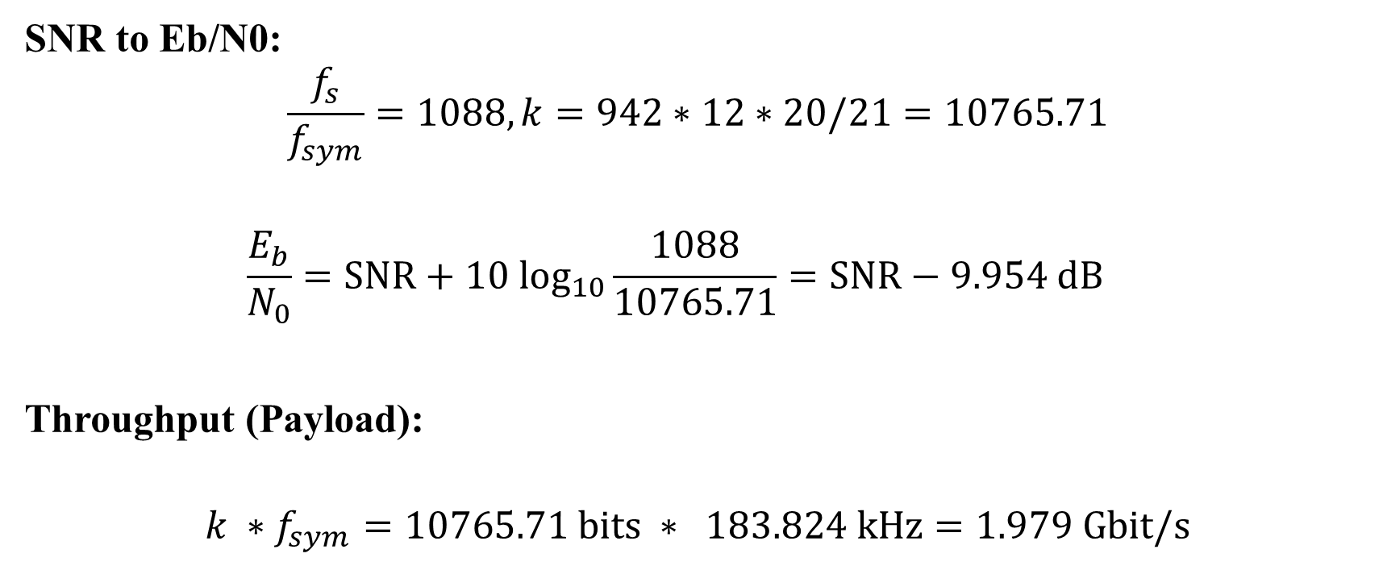
Payload simulation results – High MCS
SNR to Eb/N0:
$$\frac{f_{s}}{f_{sym}}=1088, k=942∗12∗20/21=10765.71$$
$$\frac{E_{b}}{N_{0}}=SNR+10 \log_{10}\frac{1088}{10765.71}=SNR−9.954 dB$$
Throughput (Payload):
$$k ∗f_{sym}=10765.71 bits ∗ 183.824 kHz=1.979 Gbit/s$$

Slide 18
Payload simulation results – High MCS
Payload parameters:
Data length: 4320000 bits
Bandwidth: 200 MHz
(used: 183.98 MHz)
FFT size: 1024
(occupied subcarriers: 942)
Cyclic prefix length: 64
Modulation: 4096-QAM (12 bits/SC)
FEC code rate: 20/21
FEC block size: 4320 bits

