Slide 1
Simulation results for LC-optimized PHY proposal
Date: 2019-07-01
Authors:

Slide 2
Abstract
The submission presents the simulations regarding the LC-optimized PHY proposal for TGbb based on G.9991 PHY 1 [1] described in the companion doc. 11-19/1053r0 [2].

Slide 3
Outline
Simulation setup
Frame detection simulation results
Header modulation and coding simulation results

Slide 4
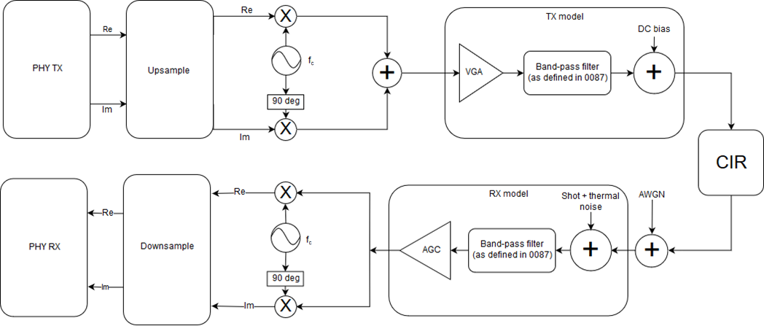
Simulation setup
See doc. 11-19/187r4:
Preamble: 100,000 repetitions,
false alarm rate 0,1%
Header: 10,000 repetitions
Payload: 1,000 repetitions
Sample rate/OCR: 200 MHz
Signal power is measured at red circle. The SNR is set by adjusting noise power in the following AWGN block, accordingly. The impact of the Rx model on SNR is assumed to be neglibible, as the used bandpass cutoff frequencies exceed the signal bandwidth.

Slide 5
Frame detection simulation results
Min. SNR for Detection rate > 0.999
OFE only | -6 dB
Industrial Wireless D7 | -7 dB
Enterprise conf. room S1-D1 | -6 dB
Enterprise conf. room S1-D2 | -6 dB
Enterprise conf. room S3-D1 | -6 dB
Enterprise conf. room S3-D2 | -6 dB

Slide 6

Header simulation results
$k$: bits per symbol$, f_{sym}$: symbol rate,
$f_{s}$: sample rate
$$\frac{E_{b}}{N_{0}}=SNR+10\log_{10}{\frac{f_{s}}{2 f_{sym} k}}$$
Header (200 MHz):
$$\frac{f_{s}}{f_{sym}}=2560, k=168$$
$$\frac{E_{b}}{N_{0}}=SNR+10 \log_{10}\frac{2560}{336}$$
$$=SNR+8.819 dB$$

Slide 7
References
[1] ITU-T G.9991 - https://www.itu.int/rec/T-REC-G.9991-201903-P
[2] LC-optimized PHY proposal for TGbb
[3] https://www.photonics21.org/ppp-projects/workgroup-4/Eliot.php

