Slide 1
LC-optimized PHY proposal for TGbb
Authors:
Date: 2019-07-13

Slide 2
Abstract
The submission presents the proposal for an LC-optimized PHY for TGbb based on G.9991 PHY 1 [1].

Slide 3
Philosophy of this proposal
We want to integrate LiFi into the 802.11 ecosystem. This is key to the success as it allow seamless integration of LiFi into current networks.
This means that the interfaces towards upper layers (medium access, security, mobility, etc…) have to be fully 802.11 compliant.
  This compliancy is a must and independent on the choice of the PHY layer.
Efficient operation needs a PHY which is optimized for the medium.
  Chose a highly performant PHY (bandwidth, spectral efficiency, complexity).
Once both is achieved, we will be able to integrate LiFi into any mobile chip.
  Mobile chips include many physical layers today (LTE, WiFi, Bluetooth, etc…).
  Adding another PHY for LiFi is feasible and it only depends on economics.

Slide 4
Characteristics of LC PHYs
LC requires a non-negative and real-valued baseband-signal.
Bipolar signals can be turned non-negative by adding a DC-bias before transmission.
It is removed by using a high-pass filter before reception.
optical
channel
TX
DSP
+
Driver & LED
Photo-diode
High-pass
RX
DSP
DC

Slide 5
Reuse OFDM PHYs for LC
Complex OFDM-baseband signals are real-valued after up-conversion to the carrier frequency f_{c}.
For LC, one can change f_{c} to a low carrier (“low IF”), yielding a real-valued baseband signal.
Up-con-
version
Data
IFFT
CP
Re(.)
LED
f_{c}

Slide 6
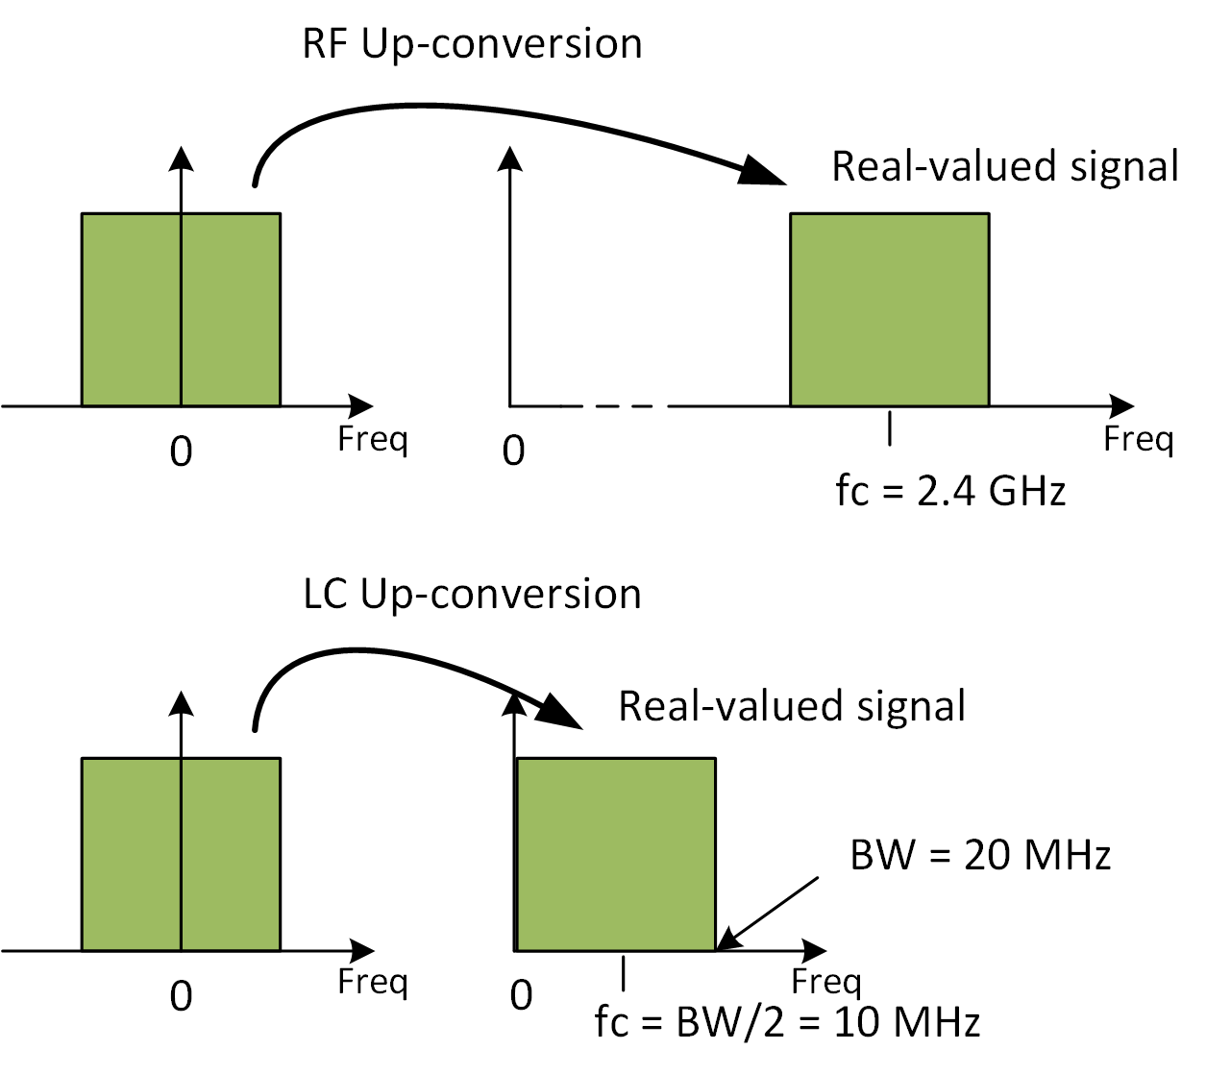
Use existing 802.11 PHYs for LC
RF frontend up-converts baseband signals onto e.g. f_{c}=2.4 GHz.
LC frontend up-converts
baseband onto low IF e.g.
f_{c}=BW/2 (+ Δ).
  Δ≠0 for analog upconversion
  Δ=0 for oversampled digital upconversion
Efficient implementation needs changes from complex I/Q to digital up-conversion

Slide 7
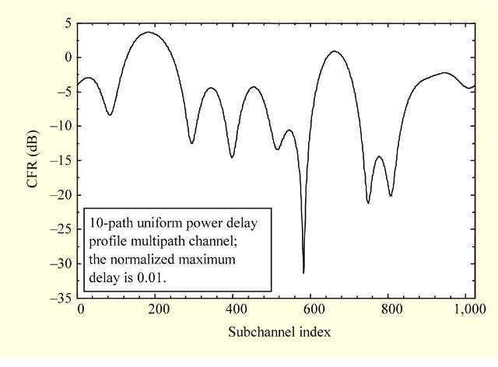
Why a LC-optimized PHY is needed?
Bit-interleaved coded modulation (BICM) is the concept behind all existing 802.11 PHYs. In RF NLOS channels, BICM works quite well.
BICM creates redundancy and permutes the coded bits randomly over all subcarriers. In a rare fading event, lost bits can be repaired by the FEC.
LC NLOS channels are 1st order low-pass [1]. Same holds for the LED characteristics. In this case, the concept behind BICM may not work. Assuming 100 MHz bandwidth and 20 MHz cut-off, 80% of the bits will be lost.
Approach: Replace BICM by adaptive bitloading!
RF
LC

Slide 8
Use G.9991 as LC-optimized PHY
LC-optimized PHY obviously needs adaptive bitloading
  Robust operation in both, LOS and NLOS channel conditions
802.11 has discussed but never supported adaptive bitloading
  Adaptive bitloading brings additional complexity and overhead
Ways to bring adaptive bitloading into 802.11
  Integrate G.9991 as LC-optimized PHY under 802.11 MAC
    G.9991 is already used in many LC demos and early products
    Next-gen G.9991 will have 1 GHz bandwidth (based on G.hn2 coax) -→ use of lasers
  Integrate adaptive bitloading in next-gen 802.11 RF PHY → SG EHT
    Next-gen RF PHY is limited to 320 MHz what is unlikely to be increased for LC

Slide 9
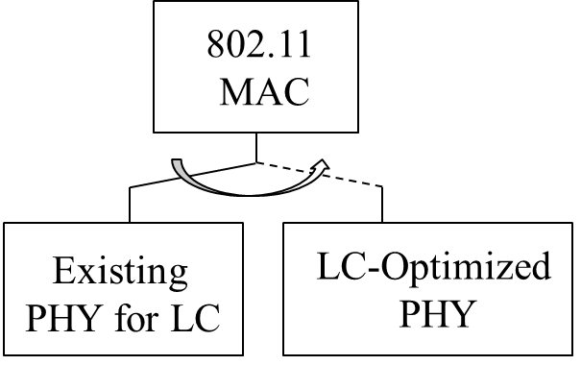
Use existing and LC-optimized PHY under 802.11 MAC
802.11 MAC could integrate existing 802.11 and LC-optimized PHY

Slide 10
Straw Poll from May 2019 meeting
Are you interested in further presentations discussing the potential suitability
of the G.9991 PHY for 802.11bb?
Y / N / A: 6 / 0 / 5

Slide 11
Outline
LC-optimized waveform
  1.1. Main characteristics
  1.2. Forward Error Correction
  1.3. Adaptive Bitloading
  1.4. OFDM modulator
PPDU format
  2.1. Synchronization header
  2.2. Physical layer header, HCS
  2.3. MIMO CE symbols
  2.4. PHY payload
SISO
optional MIMO
Preamble
CE
symbols
PHY header
HCS
MIMO CE symbols
PSDU
SHR
PHR
PHY payload

Slide 12
1. LC-optimized waveform
Based on G.9991 aka “G.vlc”
  ITU-T Recommendation (Q18/15 “In-premises networking”)
  G.vlc project started in 2015, was approved on 01/04/2019
  G.9991 is largely based on G.9960/61 (aka “G.hn”)
  Leverage the highly flexible OFDM engine provided by G.hn
Use of G.9991 PHY 1 for light is approved by ITU-T and tested in devices
  DCO-OFDM & frequency-upshift with f_{upshift}=B/2, B is bandwidth defined by band plan
  G.9991 brings bitloading capability into LC-optimized waveform
  Existing LC prototypes from several vendors prove functionality and high performance
Key is reuse of the existing waveform
  Corresponding to PMA & PMD from G.9991
  Reuse of G.9991 implies no compromise for the performance

Slide 13
1.1. Main characteristics of G.9660 PHY
System architecture and PHY layer
  LDPC Forward Error Correction (FEC)
  Windowed OFDM (Orthogonal Frequency Division Multiplexing)
  QAM modulation up to 12 bit/s/Hz, selectable on each subcarrier
  Adaptive bitloading
  MIMO-capable

Slide 14
Parameters
Area | Value | Notes
Modulation type | DCO-OFDM | Configurable OFDM parameters (cyclic prefix, per-subcarrier PSD, etc)
Max modulation | Up to 12 bits/subcarrier | Each sub-carrier is modulated with a different number of bits, depending on SNR (Bitloading), Odd constellations are optional
FEC | LDPC | FEC rates (1/2, 2/3, 5/6, 16/18, 20/21) and block sizes dynamically selected
Spectrum | 5-200 MHz is used for LC | Individual sub-carriers can be notched to coexist with other services
Bandplans | 50, 100, 200 MHz, … | 256, 512 and 1024 subcarriers respectively, fully interoperable
Subcarrier spacing | 195 kHz (LC) | Sub-carrier spacing optimized for the expected delay spread in LC medium
Notches | Yes | Partial spectrum can be notched
Min SNR for frame detection | -3 dB
Bidirectional traffic | Yes | Specific PHY frame for bidirectional traffic

Slide 15
Functional model
G.9961
Reuse the lower parts from G.9991 PHY 1
  G.9991 is a specific profile for LC based on G.9960
  Reuse only PMA and PMD
Integrate lower PHY layer of G.9991 into 802.11 MAC
  Proposed interface lies at the α-reference point
G.9960

Slide 16
G.9960 PHY description

Slide 17
Possible frame formats in G.996x vs. 802.11bb
Application
Entity
Ethernet frame
DLL layer
APC sublayer
ADPU
LFH
ADPU (data) or LCDU (LLC control)
Encrypted LLC frame has also CCMP header and MIC fields
LLC frame
LLC sublayer
LLC frame block
LLC frame f
LLC frame f+1
….
LLC frame g
Padding
Replaced by 802.11 MAC
From G.9960 PHY
Segment h
Segment h+1
Segment h+2
Segment h+3
Segment h+4
LPDU
LPH
Segment h+1
CRC
LPDU size = FEC block size (120 or 540 bytes)
MAC sublayer
MPDU
LPDU h
LPDU h+1
LPDU h+2
LPDU h+3
LPDU h+4
Pad
PHY layer
Preamble
Header
ACE
symbols
Payload
Phy Frame
Notes:
In the transmission direction, application data primitive (ADP) sets enter the DLL from the AE through the A-interface. Every incoming ADP set meets the format defined by the particular application protocol; for an Ethernet type AE, the ADP set has one of the standard Ethernet formats. Each incoming ADP set is converted by the APC into APC protocol data units (APDUs), which include all parts of the ADP set intended for communication to the destination node or nodes. The APC also identifies ADP classification primitives (e.g., priority tags), which can be used by the LLC to support QoS requirements assigned to the service delivered by the ADP. Furthermore, the APC is responsible for establishing flows of APDUs between peer APCs and assigning one or more queues for these flows according to the classification information associated with each APDU.
The APDUs are transferred to the LLC across the x1 internal reference point, which is independent of both application and medium. Additionally, LLC receives management data primitives from the DLL management entity intended for LLC control frames, which are mapped into Link Control Data Units (LCDU). The LLC is responsible for establishing flows of LCDU (control frames) between peer LLCs.
In the LLC sublayer, the incoming APDU and LCDU are converted into LLC frames and might be encrypted using assigned encryption keys. LLC frames are subject to concatenation and segmentation. Segments are transformed into LLC Protocol Data Units (LPDUs) by adding an LPDU header (LPH) and CRC. The size of the segment shall be equal to the size of the FEC block minus the size of the LPDU header and minus the size of the LPDU check sequence. LPDUs are then passed to the MAC across the x2 reference point. The LLC is responsible for retransmission and relay operations too.
The MAC sublayer is responsible for concatenating LPDUs into MAC Protocol Data Units (MPDUs) and then conveying these MPDUs to the PHY in the order determined by the LLC (scheduling, using number of transmission queues) and applying medium access rules established in the domain by the DM.
In the PHY layer, a PHY frame consists of a preamble, header, additional channel estimation (ACE) symbols (optional field, its presence is frame type dependent) and payload. The Payload includes one MPDU composed of one or more LPDUs (LLC Protocol Data Unit). Each LPDU carries a segment of the transmitted data, a header identifying the carried segment, and the CRC to detect “errored” LPDU for selective retransmission.

Slide 18
1.2. Forward error correction
Scrambler
All data starting from the first bit of the PHY-frame header and ending by the last bit of the payload are scrambled using a pseudorandom sequence generated by the linear feedback shift register (LFSR) with the polynomial p(x) = x²³ + x¹⁸ + 1. There are different ways to initialize the LFSR for header and payload data.

Slide 19
LDPC encoder
Why LDPC (Low-Density Parity Check) codes?
  LDPC works better than other alternatives over a wide range of media (powerline, phoneline, coaxial and LC) and operation points (both low and high block error rates)
  LDPC is the only code that works well at very high data rates (hundreds of Mbps) because it is easier to parallelize
  LDPC is used by many other very high data rate standards: 10GBase-T Ethernet (802.3an), WiMAX (802.16e), (802.11n,ac,ax) and 5G NR

Slide 20
G.9960 LDPC code (I)
Block length (bits) | Codeword length (bits) | Rate | Expansion Factor
168 | 336 | 1/2 | 14
960 | 1920 | 1/2 | 80
960 | 1440 | 2/3 | 60
960 | 1152 | 5/6 | 48
960 | 1080 | 16/18 | 48
960 | 1008 | 20/21 | 48
4320 | 8640 | 1/2 | 360
4320 | 6480 | 2/3 | 270
4320 | 5184 | 5/6 | 216
4320 | 4860 | 16/18 | 216
4320 | 4536 | 20/21 | 216
3 block sizes: 168, 960 and 4320 bits
3 mother code rates: 1/2, 2/3 and 5/6
Apart from the mother codes, 2 more rates are available by puncturing 5/6 rate (16/18 and 20/21)
Puncturing is used to generate higher rates by simply discarding some of the encoded bits. Puncturing is applied to both payload and parity bits.
Unpuncturing consists of inserting a zero-valued LLR in those codeword positions that were punctured at the encoder

Slide 21
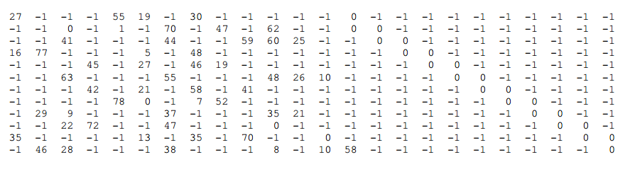

G.9960 LDPC code (II)
All the parity-check matrices in their compact form have 24 columns; depending on the rate, they have 12 rows (1/2), 8 rows (2/3) and 4 rows (5/6)
The parity-check matrices for the 1/2 and 2/3 rate are quite sparse. However, the ones for the 5/6 rate are pretty dense (see the examples below).
N = 1920 ; R = 1/2
N = 5184 ; R = 5/6

Slide 22
G.9960 LDPC performance: pre-FEC BER vs. post-FEC BLER
code rate 1/2 allows robust transmission for small block size (header)
code rate 5/6 maximizes the throughput for large block size (payload)
further resilience is reached through fast repetition
P. W. Berenguer et al., "The benefit of frequency-selective rate adaptation for optical wireless communications," 2016 10th International Symposium on Communication Systems, Networks and Digital Signal Processing (CSNDSP), Prague, 2016.

Slide 23
G.9960 LDPC and Shannon bound
minimal SNR for BLER 1e-3
BPC | FEC RATE
 | 1/2 | 2/3 | 5/6 | 16/18 | 20/21
12 | 24 | 28.6 | 33.6 | 35.6 | 38.2
10 | 19.9 | 24.1 | 28.3 | 30.1 | 32.5
8 | 15.6 | 19.3 | 22.9 | 24.6 | 26.7
6 | 11.3 | 14.5 | 17.6 | 19 | 21
4 | 6.75 | 9.4 | 12 | 13.2 | 15
3 | 4.1 | 6.5 | 8.9 | 10 | 11.7
2 | 1.44 | 3.5 | 5.7 | 6.7 | 8.4
1 | -1.5 | 6 | 2.7 | 3.7 | 5.4
Points marked with “o” in the curve of each code rate represent 4QAM, 16QAM, 64QAM, 256QAM and 1024 QAM constellations respectively

Slide 24
Repetition encoding

Slide 25
1.3. Adaptive Bitloading
July 2019
data
(from FEC)
RX spectrum
in STA #1
SNR at
STA #1
Bitloading
for STA #1
Signal Received
by STA #1
Tone mapping
Constellation encoding
Noise spectrum
PSD
(dBm/Hz)
TX spectrum
Different STAs are using different modulations!!
Adaptive bitloading algorithm
Frequency-domain transmit power shaping
f(MHz)
RX spectrum
in STA #2
SNR at
STA #2
Bitloading
for STA #2
Constellation scrambling
symbols/subcarrier
(to OFDM modulator)
Signal Received
by STA #2
Noise spectrum
Slide 25

Slide 26
Benefits of G.9960 bitloading mechanism
July 2019
System is constantly measuring SNR between all nodes (in both directions) and adapting the bit-loading in real-time.
In this way, the system becomes resilient against any problems in the medium.
  Works well despite severe frontend impairments (high-pass and low-pass, non-linear LED and driver characteristics).
  Works well despite severe multipath propagation in some LC channels (LOS+NLOS).
STAs can use their best possible modulation allowed by own SNR.
  No need to add SNR margin to ensure far-away STAs get zero packet-loss.
Slide 26

Slide 27
Tone mapping
Tone mapping is based on bit allocation tables (BATs)
Transmitter-defined BATs are typically pre-defined (same modulation on all subcarriers).
Runtime BATs can be defined by the transmitter or receiver (variable modulation on each subcarrier) where number of bits depends on signal-to-noise ratio (SNR) on each subcarrier.
Unloaded subcarriers are loaded with a pseudorandom binary sequence using linear feedback shift register (LFSR) with the polynomial p(x) = x²³ + x¹⁸ + 1.
BAT_ID | Type | Content
0 | predefined | uniform 1-bit loading on all subcarriers
1 | predefined | uniform 2-bit loading on all subcarriers,
2 to 7 | predefined | reserved
8 to 31 | runtime | see below

Slide 28
Constellation encoding
b=1
b=2
b=3
b=4 (first quadrant)
Square constellations for even number of bits (b=2, 4, 6, 8, 10, 12)
  mandatory at Tx and Rx
Cross-shaped constellations for odd number of bits (B= 1, 3, 5, 7, 9, 11)
  mandatory at Tx, optional at Rx

Slide 29
Frequency-domain transmit spectrum shaping
Achieved by a scaling factor tss defined on each subcarrier.
Set by the transmitter between 0 and -30 dB in steps of -0.5 dB.
Allows vendors to statically pre-distort the transmitted signal and adapt it to non-ideal driver + LED characteristic
Allows dynamic fine tuning of BER per subcarrier via adaptive power loading

Slide 30
Constellation scrambling
Constellation scrambling is useful to randomize interference from other APs/STAs.
The phase of constellation points is shifted according to the PRBS generated by a LFSR by using the polynomial g(x) = x¹³ + x¹² + x¹¹ + x⁸ + 1.
The LFSR is advanced by two bits for supported and masked subcarriers. The two LSBs of the LFSR are taken to determine the phase shift of the constellation scrambler.
LFSR output |  | Phase shift (rad)
s2 | s1
0 | 0 | 0
0 | 1 | π/2
1 | 0 | π
1 | 1 | 3 π/2

Slide 31
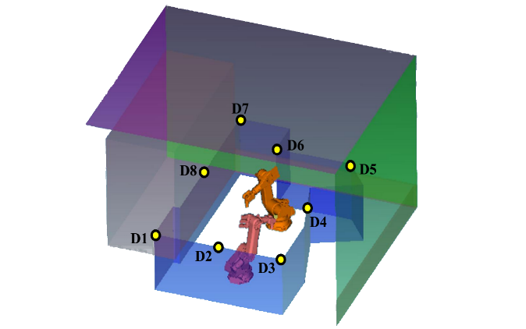
Bitloading example
July 2019
TGbb channel model for industrial wireless
Channel frequency responses seen by the different receiver photodiodes D1-D8
Channel frequency response for receiver at D2
Shows strong fade at around 65 MHz → Fewer bits are loaded around this frequency
Frequency-selective transmit power shaping makes BER on all subcarriers equal, i.e. FEC faces AWGN-like error statistics despite multipath fading in the channel
PSD
(dBm/Hz)
P. W. Berenguer et al., "The benefit of frequency-selective rate adaptation for optical wireless communications," 2016 10th International Symposium on Communication Systems, Networks and Digital Signal Processing (CSNDSP), Prague, 2016.
Slide 31

Slide 32
1.4. OFDM modulator
Start is complex OFDM waveform with IFFT and CP
Windowing avoids EMI over phone and power line, not used for coax and LC
Frequency upshift to realize real-valued passband signal
DC-offset realizes non-negative waveform for POF, LC

Slide 33
Numerology for LC-optimized PHY
Waveform |  |  | DC biased OFDM
Subcarrier Spacing F_{SC} |  |  | 195.3125 KHz
OFDM Symbol Duration |  |  | 5120 ns
Cyclic Prefix length for header (payload) |  |  | 1.280 (k*160) ns, k=1…8
Number of bits/subcarrier |  |  | 1, 2, 3, 4, 5, 6, 7, 8, 9, 10, 11, 12
FEC, Information Block Size |  |  | LDPC, 21, 120 or 540 bytes
Code Rates |  |  | 1/2, 2/3, 5/6, 16/18, 20/21
Bandplan / MHz | Clock cycle / ns | Frequency up-shift F_{US} / MHz | N (N_{supported}) / clock cycles | Gross data rate / Mbit/s
 |  |  |  | Min. | Max.
50 | 20 | 25 | 256 (245) | 23 | 530
100 | 10 | 50 | 512 (501) | 47 | 1084
200 | 5 | 100 | 1024 (1013) | 96 | 2192

Slide 34
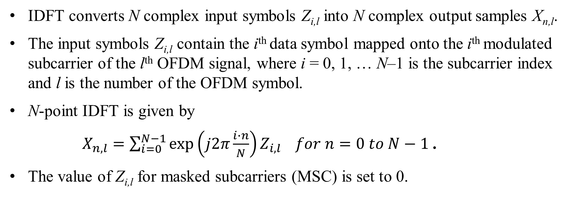
IDFT
IDFT converts N complex input symbols Z_{i,l} into N complex output samples X_{n,l}.
The input symbols Z_{i,l} contain the i^{th} data symbol mapped onto the i^{th} modulated subcarrier of the l^{th} OFDM signal, where i = 0, 1, … N–1 is the subcarrier index and l is the number of the OFDM symbol.
N-point IDFT is given by
$X_{n,l}=\sum_{i=0}^{N−1}{exp\left(j2π\frac{i∙n}{N}\right)Z_{i,l}} for n=0 to N−1$.
The value of Z_{i,l} for masked subcarriers (MSC) is set to 0.

Slide 35
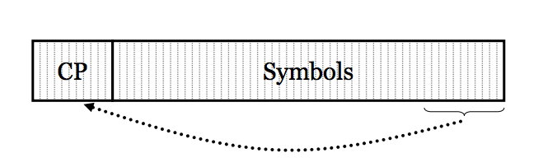
Cyclic prefix
The CP provides a guard interval between adjacent OFDM symbols to protect against inter-symbol interference (ISI).
The CP is implemented by prepending the last N_{CP} samples of the IDFT output to its output N samples. The first sample is the IDFT output sample N-N_{CP}. The last sample of the CP is the IDFT output sample N-1. The next sample is the IDFT output sample 0.
Total OFDM symbol duration is N_{W} = N + N_{CP} samples. The value of N_{CP} varies during a frame.
In the header and first two symbols after the header, N_{CP}=N_{GI-HD}=N/4. All the rest of the payload has the same value N_{CP}=N_{GI}.

Slide 36
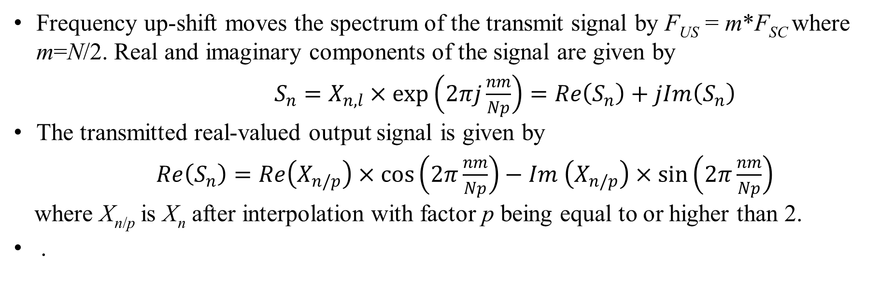
Frequency upshift
Frequency up-shift moves the spectrum of the transmit signal by F_{US} = m*F_{SC} where m=N/2. Real and imaginary components of the signal are given by
$S_{n}=X_{n,l}×\exp\left(2πj\frac{nm}{Np}\right)=Re\left(S_{n}\right)+jIm\left(S_{n}\right)$
The transmitted real-valued output signal is given by
$Re\left(S_{n}\right)=Re\left(X_{n/p}\right)×\cos\left(2π\frac{nm}{Np}\right)−Im \left(X_{n/p}\right)×\sin\left(2π\frac{nm}{Np}\right)$
where X_{n/p} is X_{n} after interpolation with factor p being equal to or higher than 2.
.

Slide 37
2. PPDU structure
SISO
optional MIMO
SISO = single-input single-output
MIMO = multiple-input multiple-output
SHR = Synchronization header
CE = Channel estimation
PHR = Physical layer header
HCS = Header check sequence
PSDU = PLCP Service Data Unit
PLCP = Physical layer convergence protocol
Preamble
CE
symbols
PHY header
HCS
MIMO CE symbols
PSDU
SHR
PHR
PHY payload

Slide 38
2.1. Synchronization header (SHR)
Synch preamble
CE symbols
N₁ = 10
N₂ = 4
N₃ = 2.5
β = 0 for coax, LC
Preamble time domain generation

Slide 39
Synch preamble
The synch preamble consists of two sections.
  First section comprises 10 repetitions of an OFDM symbol S employing subcarrier spacing 4 × F_{SC}, where F_{SC} denotes the subcarrier spacing.
  The second section comprises 4 repetitions of the inverted symbol -S.
The synch preamble uses the subcarriers with indices 4, 8, 12, 16, …, N-4.
  At first, bit sequence of all ones is mapped using the 1-bit constellation.
  Next, the LFSR generator of the constellation scrambler is initialized as 16E6₁₆=1011011100110. The LFSR is advanced by two bits per subcarrier.
  The output of the mapper is rotated using the two LSBs of the LFSR.
The resulting constellation sequence is finally fed into the OFDM modulator.

Slide 40
CE symbols
The CE sequence is used for header detection.
  It comprises 2.5 repetitions of an OFDM symbol S employing subcarrier spacing 1 × F_{SC}, where F_{SC} denotes the subcarrier spacing.
  The number of repetitions is a non-integer number to indicate that two OFDM symbols are used so that the CP is the same as in the PHY header, i.e. N_{CP}=N_{GI-HD}=N/4.
In the channel estimation preamble, all subcarriers are used.
  A bit sequence of all ones is mapped using the 1-bit constellation.
  Next, the LFSR generator of the constellation scrambler is initialized as 1105₁₆= 1000100000101. The LFSR is advanced by two bits for all subcarriers.
  The output of the mapper is rotated using the two LSBs of the LFSR.
The resulting constellation sequence is finally fed into the OFDM modulator.

Slide 41
2.2. PHY header
Frame type
Destination node
Duration
Multicast indication
Domain identifier
Source node
Header segmentation indication
Extended header Indication
Frame-specific fields
Header check sequence
Core header: Common to all PHY frames (both G.hn/vlc and 802.11)
Frame-type specific header: Specific for each frame type
FT field contains extension pointer to further frame types. Can be defined by 802.11

Slide 42
Header check sum (HCS)
The HCS uses CRC-16.
  It starts with LSB of first field and ends with the MSB of last field of PHY frame header.
The HCS is computed using the following generator polynomial:
G(x) = x¹⁶ + x¹² + x⁵ + 1
  The value of the HCS shall be the remainder after the contents (treated as a polynomial where the first input bit is associated with the highest degree, XPHYH–17, where PHYH is the header length in bits, and the last input bit is associated with X0) of the calculation field is multiplied by x¹⁶ and then divided by G(x).
The HCS field is transmitted starting with the coefficient of highest order term.
  The HCS bits shall be processed in the transmitted order.
The registers shall be initialized to all ones.

Slide 43
Header encoding
The size of the FEC code word is 168 bit and coding rate is ½.
The header repetition encoder (HRE) works as follows
  The FEC codeword is first copied M times, where M = ceiling (k_{H}/N_{FEC}), k_{H} is the number of bits to be loaded on to the OFDM symbol carrying the header (i.e. 336).
  The first encoded header block is formed by concatenation of M copies of the header FEC encoder output. The bits (b_{i}) within each codeword are cyclically shifted by 2 bits as follows
    1st copy is {b₀, b₁, …, b_{NFEC–2}, b_{NFEC–1}}.
    2nd copy is {b₂, b₃, …, b_{NFEC} _{–1}, b₀, b₁}.
    3rd copy is {b₄, b₅, …, b_{NFEC–1}, b₀, b₁, b₂, b₃}.
    Mth copy, where M > 3, is {b_{(2×M–2)}, b_{(2×M–1)}, …, b_{NFEC–1}, b₀, b₁, …, b_{(2×M–4)}, b_{(2×M–3)}}.
  There is a similar rule if there is a second encoded header block, see G.9660.

Slide 44
Header segmentation
The encoded header block is segmented into symbol frames.
Header symbol frames are passed to the adaptive bitloading using a fixed constellation of 2 bits per subcarrier.
The encoded header block is segmented into D = 1, 2 OFDM symbol frames.
  First k_{H} bits of the first encoded header block is mapped into the first symbol frame, so that b₀ is transmitted first.
  If D = 2, the first k_{H} bits of the second encoded header block is mapped into the second symbol frame, so that b_{NFEC/2} is transmitted first.
  The rest of the bits of the first and the second encoded header blocks are discarded.

Slide 45
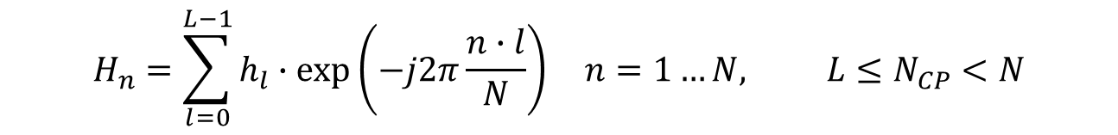
2.3. MIMO CE symbols
LC can have many TRXs in one room that may be considered as remote optical front ends controlled by the same AP. The number of LEDs can be in the order of 100 and more. Hence we need 100s of MIMO reference symbols.
We can pack MIMO reference symbols quite dense in the frequency domain.
Relation between channel in frequency and time domain is a set of equations.
Not all subcarriers must contain pilots to identify the channel for one LED.
Usually, no more taps in the channel L than samples in the guard interval N_{CP}.
Every N/N_{CP}=5120 ns/ (k*160) ns = 32/k^{th} subcarrier actually needs a pilot.
For efficient interpolation schemes on pilot grids and for OFDMA, see [8-11].
$$H_{n}=\sum_{l=0}^{L−1}{h_{l}∙exp\left(−j2π\frac{n∙l}{N}\right)} n=1…N, L≤N_{CP}<N$$

Slide 46
Orthogonal combs with frequency reuse
Use a comb of equally-spaced subcarriers. A cyclic shift in the frequency domain identifies the LED. One comb is reserved for noise estimation.
The channel is interpolated between non-zero subcarriers, see [11].
Classical frequency reuse schemes can be applied for pilot assignments to LEDs.

Slide 47
Formal definition of MIMO CE symbols
Construction of MIMO RS starts from the LFSR also used in the SHR.
RS for the first LED use the subcarriers with indices Δ, 2Δ, 3Δ, 4Δ, …, N-Δ, where Δ is the comb spacing. The value of Δ is defined by higher layers taking the Δ≤N/N_{CP} into account.
  A bit sequence of all ones is mapped onto used subcarriers using the 1-bit constellation.
  The LFSR generator of the constellation scrambler is initialized as 16E6₁₆=1011011100110.
  The LFSR is advanced by two bits per subcarrier. The output of the mapper is rotated using the two LSBs of the LFSR.
The resulting constellation sequence is finally fed into the OFDM modulator.
For CS≥1, a cyclic shift of the comb is performed so that subcarriers with indices CS, Δ+CS, 2Δ+CS, 3Δ+CS, 4Δ+CS, …, N-Δ+CS are used.
  By using a single RS, up to CS_{max} ≤Δ-1 streams or transmitters can be identified.

Slide 48
MIMO CE for more than Δ-1 LEDs
The MAC layer will add more RSs for more transmitters as indicated by N_{RS}. In this way, up to N_{RS}*(Δ-1) streams can be identified.
Decompose the identifier of the i^{th} transmitter as
i=a*(Δ-1)+b where b<Δ-1
The comb shift is then CS=b. The corresponding RS is now multiplied with the entries in the a^{th} row of the MxM Hadamard matrix H_{K} where M=2^{K}. H_{K} is obtained iteratively by incrementing k from k=1…K as

Slide 49
2.4. PHY payload
Block length (bits) | Codeword length (bits) | Rate | Expansion Factor
168 | 336 | 1/2 | 14
960 | 1920 | 1/2 | 80
960 | 1440 | 2/3 | 60
960 | 1152 | 5/6 | 48
960 | 1080 | 16/18 | 48
960 | 1008 | 20/21 | 48
4320 | 8640 | 1/2 | 360
4320 | 6480 | 2/3 | 270
4320 | 5184 | 5/6 | 216
4320 | 4860 | 16/18 | 216
4320 | 4536 | 20/21 | 216
The PHY payload is divided into sequential blocks of information bits, K bits per block each encoded by the FEC. The table shows valid values of K, block size N_{FEC}, and code rate R.
  In normal mode (REP = 001 in PHY header), codewords are passed directly to the output.
  In robust mode, each FEC codeword is repeated REP times and concatenated at the output.
For more details on the sophisticated repetition scheme, see G.9660.

Slide 50
Summary
It is proposed in TGbb to integrate lower parts (PMA and PMD) from ITU-T Rec. G.9991 as LC-optimized PHY under 802.11 MAC.
This PHY is also used by G.vlc and in IEEE P802.15.13 which use different MAC protocols. All these standards address different market segments.
Using same PHY allows coexistence and interoperability between devices.
A detailed functional description was presented, mostly based on G.9991 and G.9660 recommendations of ITU-T.
This slide set is followed by simulation results detailed in doc. 11-19/1054.
High performance is proven by numerous demos, prototypes and products from several vendors, see e.g. doc. 11-19/1208.

Slide 51
References
[1] V. Jungnickel, V. Pohl, S. Nonnig and C. von Helmolt, "A physical model of the wireless infrared communication channel," in IEEE JSAC, vol. 20, no. 3, pp. 631-640, April 2002.
[2] V. Jungnickel, K.L. Bober, A. Paraskevopoulos, N. Serafimovski, H. Haas, “Proposed way forward on PHY in TGbb”, doc. 11-19/0388r0.
[3] K.L. Bober, M.Emmelmann, V. Jungnickel, A. Corici, D. Xiong; “LC-optimized PHY for TGbb”, doc. 11-19/0865r1.
[4] ITU-T G.9991 - https://www.itu.int/rec/T-REC-G.9991-201903-P
[5] ITU-T G.9660 - https://www.itu.int/rec/T-REC-G.9960
[6] P. Wilke Berenguer et. al.: The benefit of frequency-selective rate adaptation for optical wireless communications, IEEE CSBDSP 2016.
[7] https://www.photonics21.org/ppp-projects/workgroup-4/Eliot.php

Slide 52
References (2)
[8] P. Hoeher, S. Kaiser, and P. Robertson, "Two-dimensional pilot-symbol aided channel estimation by Wiener filtering," in Proc. IEEE International Conference on Acoustics, Speech, and Signal Processing, 1997, pp. 1845-1848.
[9] P. Hoeher, S. Kaiser, and P. Robertson, "Pilot-symbol-aided channel estimation in time and frequency," in (CTMC) within IEEE Global Telecommunication Conference (GLOBECOM97), Phoenix, USA, 1997, pp. 90-96.
[10] J. Bonnet and G. Auer, "Chunk-based channel estimation for uplink OFDM," in Proc. Vehicular Technology Conference (accepted), Spring 2006.
[11] V. Jungnickel, T. Haustein, A. Forck, S. Schiffermüller, C. von Helmholt, F. Luhn, M. Pollock, C. Jucheras, M. Lampe, S. Eichinger, W Zirwas, and E. Schulz, "Gbit/s MIMO-OFDM transmission experiments," VTC-2005-Fall. vol. 2, Sept. 2005, pp. 861-866.
[12] S. Schiffermuller and V. Jungnickel, "SPC08-3: Practical Channel Interpolation for OFDMA," IEEE Globecom 2006, San Francisco, CA, 2006.

