Slide 1
NDP Power Control for EVM
Date: 2019-06-11
Authors:

Slide 2
Need for Power Control
Trade-off between Tx power and Tx EVM
  In any wireless communication
    Especially OFDM in WiFi, has large peak-to-average power ratio (PAPR)
    Needs power amplifier to back off more (so peaks avoid non-linear region)
  Maximizing Tx power usually reduces signal quality
    Typically sacrifice back-off
    Power amplifier will go (more often) into non-linear region
  Tx signal distortion is measured as Error Vector Magnitude (EVM)
    Typical range -10 to -30 dB
    WiFi’s 11ax has increased EVM range (1024 QAM, MU-MIMO, etc)

Slide 3
Typical Approach Based on ACK
Most WiFi Packets are acknowledged
  If no ACK is received, packet was most likely lost
  Typically due to insufficient SINR at receiver to decode packet
  Required SINR to decode a packet depends on the Modulation and Coding Scheme (MCS) used
  Definition of receiver sensitivity maps required SINR for each MCS
  Given required SINR
    Maximize Tx power
    Keeping EVM below required SINR (reduces SINR by at most 3 dB)
  If packet is lost, drop MCS (assumes SINR is fixed) and adjust Tx power

Slide 4
EVM on Channel Sounding Packets
Channel Sounding
  In WiFi uses Null Data Packets (NDP)
  No data in packet, no frame check sequence (FCS)
    There is no “correct” reception of NDP
    SNR will gradually change quality of channel estimates (no cut-off)
  To set Tx power and EVM correctly, transmitter needs to know the pathloss or get some other feedback (to replace the ACK)
Estimate pathloss
  Receiver can measure RSSI, but needs to know Tx power

Slide 5
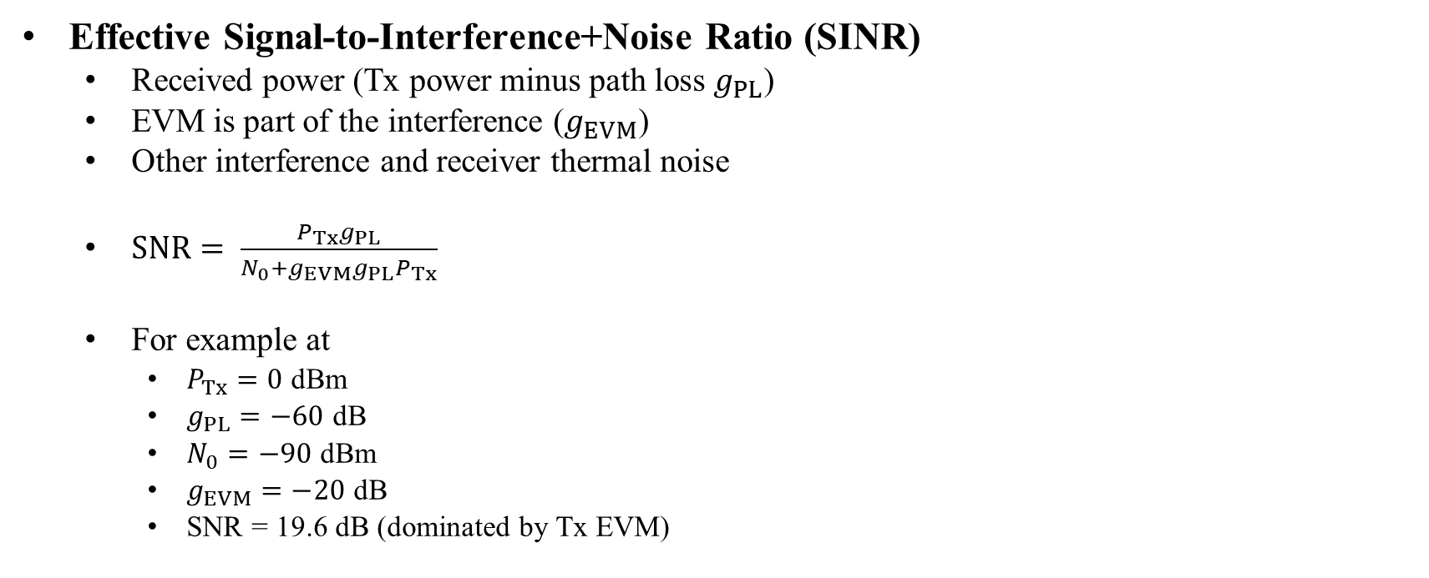
Effect of EVM on SINR
Effective Signal-to-Interference+Noise Ratio (SINR)
  Received power (Tx power minus path loss $g_{PL}$)
  EVM is part of the interference ($g_{EVM}$)
  Other interference and receiver thermal noise
  $SNR= \frac{P_{Tx}g_{PL}}{N_{0}+g_{EVM}{g_{PL}P}_{Tx}}$
  For example at
    $P_{Tx}=0$ dBm
    $g_{PL}=−60$ dB
    $N_{0}=−90$ dBm
    $g_{EVM}=−20$ dB
    SNR = 19.6 dB (dominated by Tx EVM)

Slide 6
Optimize EVM in Non-TB Ranging
Each STA transmits one data packet and one NDP
  Best to measure RSSI of NDP packets
  Pathloss is symmetric (assume tx/rx antenna gain symmetric)
  Data packets could either include
    RSSI (of some previous NDP)
    Tx power level of NDP

Slide 7
Step 1: Measure Pathloss
To optimize EVM/Tx Power
  Need to know pathloss
Suggestion
  Tx Power in NDP-A
  RSSI in LMR

Slide 8
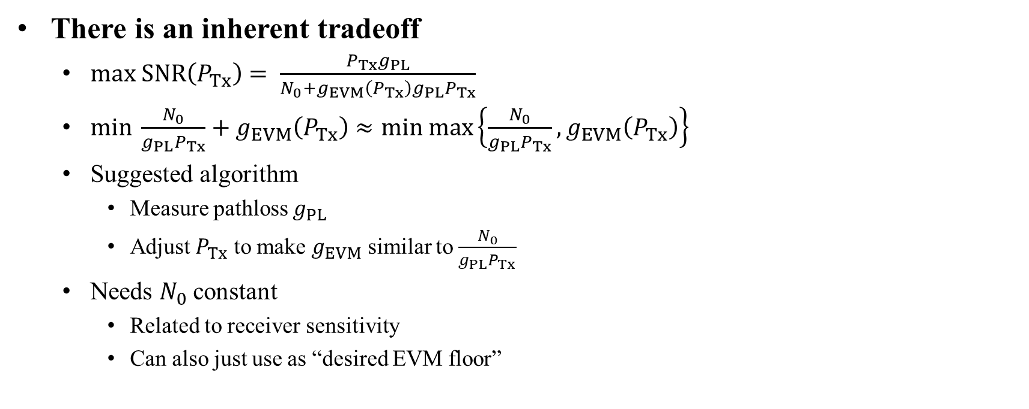
Step 2: Adjust Tx Power and EVM
There is an inherent tradeoff
  $max SNR\left(P_{Tx}\right)= \frac{P_{Tx}g_{PL}}{N_{0}+g_{EVM}\left(P_{Tx}\right){g_{PL}P}_{Tx}}$
  $min \frac{N_{0}}{{g_{PL}P}_{Tx}}+g_{EVM}\left(P_{Tx}\right)≈min max\left\{\frac{N_{0}}{{g_{PL}P}_{Tx}},g_{EVM}\left(P_{Tx}\right)\right\}$
  Suggested algorithm
    Measure pathloss $g_{PL}$
    Adjust $P_{Tx}$ to make $g_{EVM}$ similar to $\frac{N_{0}}{{g_{PL}P}_{Tx}}$
  Needs $N_{0}$ constant
    Related to receiver sensitivity
    Can also just use as “desired EVM floor”

Slide 9

Details and Example
Example
  Assume Tx Power was 0 dBm
  Reported RSSI was -70 dBm
  $N_{0}$ is – 90 dBm (configured in negotiation)
  EVM at current Tx Power is -20 dB
  $\frac{N_{0}}{{g_{PL}P}_{Tx}}=−20 dB$

Slide 10
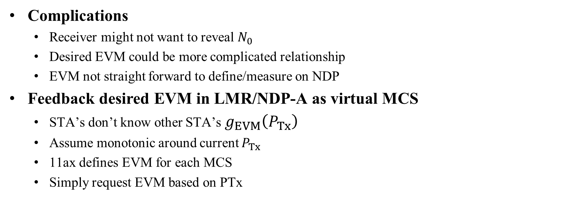
Alternative Step 2
Complications
  Receiver might not want to reveal $N_{0}$
  Desired EVM could be more complicated relationship
  EVM not straight forward to define/measure on NDP
Feedback desired EVM in LMR/NDP-A as virtual MCS
  STA’s don’t know other STA’s $g_{EVM}\left(P_{Tx}\right)$
  Assume monotonic around current $P_{Tx}$
  11ax defines EVM for each MCS
  Simply request EVM based on PTx

Slide 11
Proposal: Enable Measurement
Add Tx power in NDP-A
  Reuse format of trigger frame “AP Tx Power” subfield is 6 bit, mapping values of 0:60 to -20:40 dBm; would have to add an extra “STA Info” 32 bit, similar to SAC
  Alternatively can use 6 bit used for “Offset” in secure TB Ranging

Slide 12
Proposal (cont.)
Add RSSI in LMR
  7 bits (0:127)
  Map to 0:-1:-127 dBm RSSI
Alternatives
  Add Tx Power
  Add pathloss (Tx Power – RSSI)
 | Category | Public Action | Dialog Token | ToD |  | ToA | ToD Error | ToA Error | RSSI
Octets: | 1 | 1 | 1 | 6 |  | 6 | 1 | 1 | 1
 | CFO Parameter | Secure LTF Parameter (optional) | AoA Feedback (optional)
Octets: | 2 | 13 | 9

Slide 13
How to Set EVM at Tx Side
Tx side can control EVM
  Maps Tx Power to EVM
  Some dependence on modulation used
How to optimize SINR?
  Tx side does not know receiver noise figure
  Related to receiver sensitivity
Option 1: Transmitter decides best EVM
Option 2: Receiver shares N₀ in negotiation
Option 3: Receiver proposes an EVM setting using “Virtual MCS”
  Virtual MCS specifies that, an NDP is transmitted with the same transmit power and the same transmit configuration parameters as the ones the device would use to transmit a data packet at the MCS rate that is equal to the Virtual MCS rate, in order to meet the corresponding EVM requirement defined in Table 27-49 of 802.11ax D4.2.

Slide 14
Proposal: Set EVM
Let each STA select desired EVM based on “virtual MCS”
  Feed back virtual MCS (values 0-11)
  The application could be delayed or immediate
  Add similar field in LMR

Slide 15
Proposal (cont.)
Alternatively, use 2 reserved bits in STA Info
  Format can be compressed based on pathloss
  4 values can be spread out, e.g., MCS 1-4-7-10
  4 values are mapped to MCS [0:3]+MCSoffset (e.g., based on 11ax Table 27-51—Receiver minimum input level sensitivity)
    Pathloss < -70, MCSoffset=0, MCS 0-3
    -70 < Pathloss < -60, MCSoffset=1, MCS 1-4
    -60 < Pathloss < -50, MCSoffset=2, MCS 2-5
    …

Slide 16
Strawpoll I
Do you support to add subfields in Ranging NPD-A and LMR to facilitate tx-power and EVM optimization in Non-TB Ranging?
Yes: No: Abstain:

Slide 17
Strawpoll II
Do you support to add the AP Tx Power subfield in the Ranging NPD-A as presented in Option
Option I (Extra Field):
Option II (Reuse Offset):
I: II : Abstain:

Slide 18
Strawpoll III
Do you support to add the following field in the LMR frame from non-TB Ranging
Option I: AP Tx Power
Option II: RSSI
Option III: Pathloss
I: II : III: Abstain:

Slide 19
Straw poll IV
Do you support to add the ”Requested Virtual MCS” in the NDPA frame and the “Transmitted Virtual MCS” in the R2I LMR frame for non-TB Ranging per slide 14?
Yes: No: Abstain:

