Slide 1
Do Not Fear Random MAC Addresses!
Date: 2019-07-04
Authors:

Slide 2
Abstract
The rise of MAC randomization has been treated as if it is an outbreak of an infectious disease and discussion around it has been “how do we respond?”
This submission discusses the motivations of MAC randomization, why it’s a good thing, 802c applicability, and the concerns raised over MAC randomization.

Slide 3
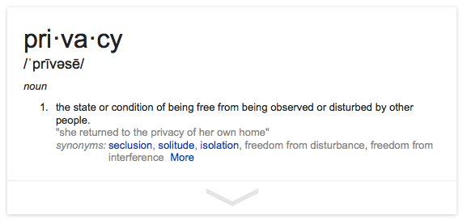
Motivation For 802.11 MAC Randomization

Slide 4
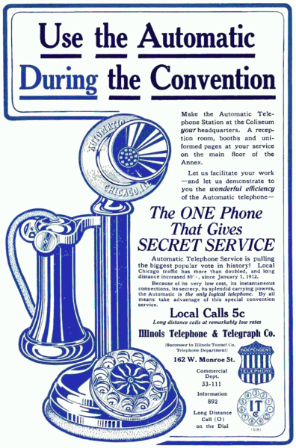

Concerns of Communications Privacy are Not New
Privacy was an important selling
point for dial phones in 1912 since
they did not require the use of an
operator to make the call

Slide 5
Privacy Concerns with 802.11
Passive observation of 802.11 bands reveals MAC addresses and more!
  STAs active probing when not connected to a network
  Communication to connected network
  STAs frantically searching for particular SSIDs
Location plus time plus frequency plus MAC address allows sensitive information to be gleaned
  This MAC address pops up at the AIDs clinic twice a week
  This MAC address is near the liquor store at 8am every day
  This MAC address leaves a certain apartment building in the early morning almost every weekend
Straightforward to create Personally Identifiable Information (PII) from this data

Slide 6
802.11 Privacy is Not Theoretical
London Trashcans Silently Track Smartphones
  The company boasted that the cans, which included LCD advertising screens, "provide an unparalleled insight into the past behavior of unique devices"—and hence of the people who carry them around
Seattle Police Deactivate Wi-Fi Spy Grid After Outcry
  A DHS and Seattle police network collecting location information of Wi-Fi devices
Transport for London to track all Wi-Fi devices in 2019
  Month-long trial collected 509M pieces of information from 5.6M unique devices on 42M journeys
  Marketed as a service to users– map delays and congestion, notify where queues are forming– but commercial applications are obvious. So are nefarious ones
  Claim that scheme will eventually tokenize MAC address for privacy

Slide 7
Privacy and MAC Randomization
MAC randomization
  Choose a random 48-bit number, interpret it as a MAC address
  Set the local bit, clear the broadcast bit, assign it
  Periodically change this value
Simple and effective
  Opt-in/out schemes presume that all parties are trustworthy
  Garbage in, garbage out more effective: if the data is garbage then the result of Big Data Analytics will be garbage– there will be no PII
  Control is in the hands of the user, where it should be

Slide 8
How is “Client Privacy” Addressed in 802.11?
IEEE 802.11aq added a MIB variable for “privacy”
When that MIB variable is set, a STA will:
  Periodically randomize its MAC address pre-association by selecting an address out of the local address space
  Not probe for specific SSIDs
  Reset the sequence number counter used to identify MSDUs and MMPDUs when the MAC address changes
  Reseed the OFDM scrambler when the MAC address changes
  Choose a random MAC address to associate to an AP and retain that MAC address during the STA’s connection to the ESS
  Set its MAC address to a previously used (random) MAC address when it attempts to use some state on the AP bound to the previous MAC address
Some vendors are already randomizing MAC addresses
  Whether they are doing in per-802.11aq remains to be seen

Slide 9
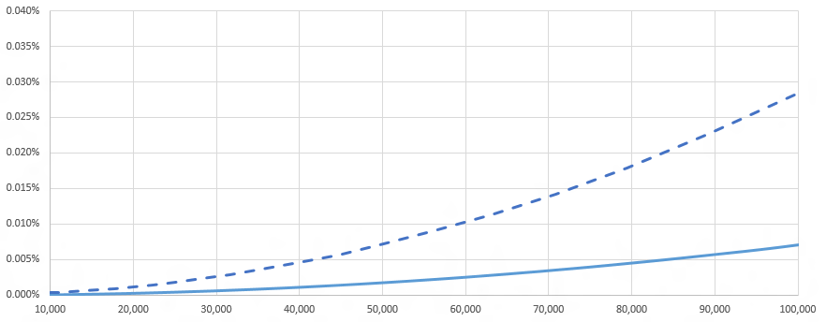
802c and MAC Randomization
802c partitioned the local address space into quadrants
  ELI– prefix is a CID, remaining octets are assigned per policy
  SAI– for use with 802.1CQ
  AAI– administrator has some arbitrary local policy and wishes to not conflict with ELI– or SAI–style addresses that may also be on his network
  Reserved
802c consumes 2 of the 46 available bits of a 48-bit MAC
  This vastly increases likelihood of MAC address collision

Slide 10
802c and MAC Randomization
802c does not assign local address space
  The SLAP is optional
  802c provides a way to support multiple administrative policies in the same local address space if the administrator so desires, but it’s still local
  Using any CID, or no CID, to construct a local address is not prohibited
802c does not restrict random MACs to a quadrant
  Randomness in the AAI is an example of a possible local policy but is clearly not the only local policy for the AAI quadrant
Randomizing with all available (46) bits of a MAC…
  …has always been possible, is still possible, will be possible in the future
  …is the wise thing to do in order to avoid collision
802c is a LAN administrator issue, not a user/STA issue
  Policy enforcement does not scale for 802.11 STAs in access network

Slide 11
802c is Not Useful for an 802.11 Network
802c motivation was data centers and non-access networks
  Handle networking of a large number of VMs
  Identification of weirdo L2 protocols on a data center network
Privacy Issues of 802.11 are aimed at network connectivity
  Planes, trains, automobiles…shopping malls, bars, restaurants… enterprise, home, office… it’s all the same: get on the ‘net
  A network that accepts all comers cannot presume to have instilled sufficient local address policy knowledge on each and every client
  Privacy concerns are lessened if local policy has been provisioned already
  No historical concerns about local address usage in these sorts of access networks, no reason to believe that would change going forward
  MAC address is only significant on local LAN segment, once it gets to a router the MAC address of the STA is irrelevant
802c is unlikely to ever be used in an 802.11 network

Slide 12
WBA Liasion
Raised issues that were perceived to be problems associated with randomization of 802.11 MAC addresses
  Some were unserious or overblown: different MAC address used with same Passpoint Profile, Pay-per-use services are associated with MAC addresses, complimentary service offerings can be abused by changing MAC addresses, blacklisting by MAC address will no longer be effective, lawful intercept issues, etc
  Some point to changes that will be necessary: band-steering will be difficult if different MACs are used on different bands, helpdesks that have come to rely on fixed MAC addresses will have issues
None of the issues raised compel a loss of privacy by users
MAC addresses are being randomized, that trend will grow
  Important to ensure they do it the 11aq way

Slide 13
Summary
802.11 MAC randomization is not the networking equivalent of Ebola
There are valid reasons to for users to randomize their 802.11 MAC address
Randomization is not illegal, nor is it prevented or limited by any other 802 standards
Randomization will not create chaos in networks
  It is a disruptive technology, but disruption can be good
  Better ways of tracking and accounting for users will be employed– e.g. authenticated identities
  Better security will be provided for network service offerings by not assuming a fixed global MAC address

Slide 14
References
IEEE 802.11-13/1448r1
  – Paul Lambert’s original proposal on MAC randomization for privacy
IEEE 802.11-14/0430r2
IEEE 802c
Draft P802.11REVmd_D2.0
IEEE 802.11-18/1579r1

