Slide 1
Virtual BSS For Multi AP Coordination
Date: 2019-07-xx
Authors:

Slide 2
Introduction
There are many categories of multi-AP coordination including joint processing, coordinate OFDMA, null forming, coordinated beamforming, AP selection, etc
In this contribution, we propose virtual BSS concept

Slide 3
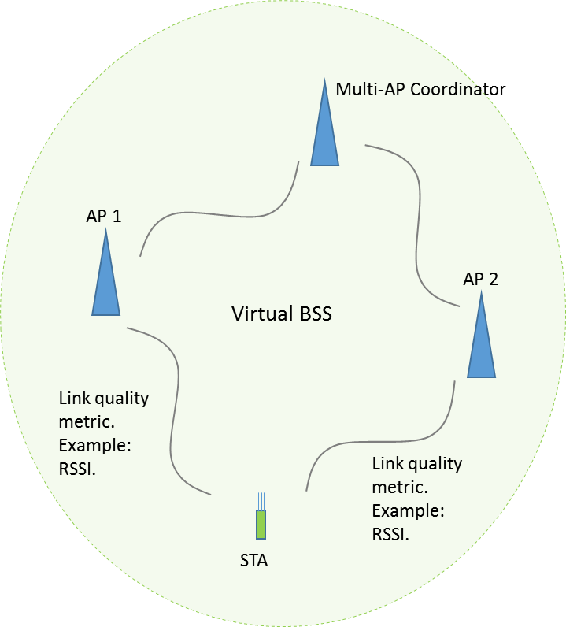
Virtual BSS
We define the following concepts
  Virtual BSS: An infrastructure BSS with a group of coordinated APs. In the coordinated AP group, there is one multi-AP coordinator and one or more member APs
  Anchor AP(s): selected AP(s) for serving a STA
  Features of virtual BSS:
    All member APs share same SSID
    All member APs share the association / authentication
    When STA roaming in a virtual BSS, no association/authentication required
    STA use same AID in the virtual BSS
    STA will keep a local copy of capabilities of anchor AP and neighboring APs
    We can also consider same BSSID for all member APs
  Note that all of the member APs are on the same channel (BSS)

Slide 4
Anchor AP(s) Selection
Not all APs in the network will give benefit to a STA. For example,
  Joint beamforming shows no benefit when pathloss difference between APs is large (e.g. 20dB in below figure)
Need to select proper AP(s) to minimize complexity

Slide 5
Dynamic AP selection
In a coordinated AP group, STA or AP can dynamically select the anchor AP based on link quality metric (LQM)
  Examples of possible LQM:
    Measurement at STA side: RSSI etc
    Information from member APs: member AP’s channel capacity to multi-AP coordinator, member AP’s capabilities, number of STAs attached to the member AP etc
Options of dynamic AP selection:
  Option 1: STA driven AP selection
    AP may send all AP side link quality metric information to the STA
    STA select its anchor AP in the coordinated AP group based on information provided by member APs and/or its own measurements
  Option 2: multi-AP coordinator controlled AP selection
    STA can request anchor AP switching
    STA broadcast sounding frames
    Member APs measure the RSSI and forward the information to the multi-AP coordinator
    Multi-AP coordinator select the anchor AP for a STA
  Option 3: Combination of option 1 and 2
    STA select anchor AP for UL transmission follow option 1
    AP decide anchor AP for DL transmission follow option 2

Slide 6
STA driven AP selection
STA dynamically select the anchor AP based on its own measurement
  When STA selects an anchor AP or switches to a new anchor AP, the STA shall initiate some UL transmission
  Below figure is an example.
  Link between APs and coordinator can be in-band or out-band including DS.
in-band or out-band
ACK
DL data
in-band
Coordinator
Beacon 1
AP 1
Relayed data
Beacon 2
ACK
Relayed data
AP 2
STA
UL data to the
selected anchor AP

Slide 7
Coordinator controlled AP selection
STA provide measurement information to the neighboring member APs
  STA can individually report CSI to the neighboring member APs or
  STA can broadcast sounding NDP packets to the neighboring member APs. These APs will measure the link quality metric based on the sounding packets
Member APs report the link quality metric between itself and the STA to the coordinator
Coordinator selects the anchor AP for the STA
in-band or out-band
in-band
ACK
ACK
Coordinator
DL data
LQM report
AP 1
LQM report
ACK
AP 2
Relayed data
STA
Broadcast sounding
UL data to the
anchor AP

Slide 8
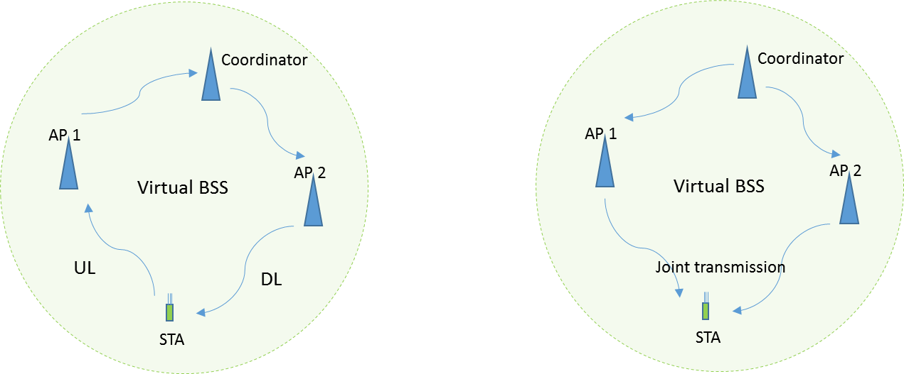
Multiple anchor APs and coordinated transmission
STA may have more than one anchor AP in the virtual BSS
  DL and UL traffic may use different anchor AP
  Multiple anchor AP may jointly serve one STA
    Joint transmission can be done using same time and frequency resources or different resources, e.g. in TDM/FDM manner
  Supporting of multiple anchor APs:
    In STA driven AP selection scheme, STA need to inform master AP the list of anchor APs of its choice
    In coordinator controlled AP selection, the coordinator can choose the anchor APs for a STA in DL traffic.

Slide 9
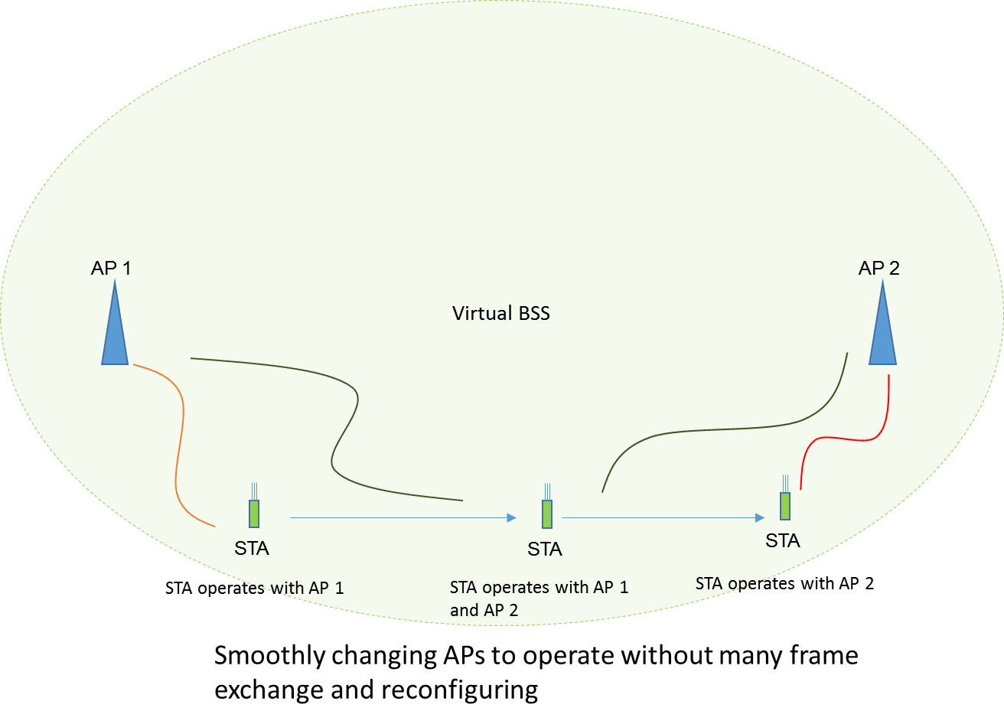
Seamless Operation
Sharing association / authentication in the virtual BSS will speed up the handover procedure between member APs
STA driven anchor AP selection will make handover seamless
  Reuse roaming algorithm
  STA has better knowledge on link quality to neighboring member APs
  STA can select/update its anchor AP based on its own measurements
  Load balancing can be done by AP

Slide 10
Transparent Data Reception
STA may receive packet from any AP within virtual BSS
  STA can process all data packet based on anchor AP as if only the AP is transmitting
DL PPDU reception is same as single AP PPDU reception
  Whether data is transmitted/beamformed by multiple AP or single AP is not important for data receive process
  Coordinated BFed (including null forming) PPDU is same as SU BFed PPDU
  Coordinated OFDMA PPDU is same as OFDMA PPDU
  Joint Processed PPDU is same as DL MU-MIMO PPDU
Sounding procedure and beamforming feedback procedure may be different from single AP operation: TBD

Slide 11
Conclusion
In this contribution, we proposed virtual BSS for multi-AP coordination.
In virtual BSS, non-AP STA can perform fast and seamless handover.
In virtual BSS, non-AP STA’s operation is almost identical to that of single BSS operation while getting benefit from multi-AP coordination.

Slide 12
Reference
[1] 11-18/1575r0, “Further study on potential features”

