Slide 1
Feedback Overhead Reduction
Date: 2019-07-xx
Authors:

Slide 2
Introduction
In [1], we showed the benefit of supporting 16 streams
Especially for MU-MIMO, 16 antennas at AP provides almost double throughput than 8 antennas at AP
There were several proposals to support 16 antennas [2-6]
  Overhead reduction scheme
  Implicit feedback scheme
In this contribution, we share our view and preliminary results

Slide 3
High Level Comparison
Explicit feedback
  Pros: Higher data rate feedback can be used for larger number of (receive) antennas
  Cons: As number of antenna increases, complexity and feedback overhead increases
Implicit feedback
  Pros: Lower complexity at non-AP STA
  ??: Potentially lower feedback overhead
    Performance is bounded by weak uplink due to low power transmission from non-AP STA. Channel estimation should be done per antenna pair, so there is no receiver combining gain which can be done in digital feedback. Especially in low SNR region, it is a limiting factor. May need more reference signal to increase SNR.
  Cons: Require calibration at AP

Slide 4
Simulation
Throughput (system) simulation assumption:
  80MHz BSS, 16 antennas at AP, 2 antennas at non-AP STA
  Downlink MU-MIMO
    10 STAs in BSS
    MU scheduling with greedy algorithm
    Ideal link adaptation
    Ideal channel estimation, perfect sync
    MMSE MU Precoder
  NDP and uplink sounding channel
    Real channel estimation
      ideal channel estimation result can be found in appendix for reference
    Compressed beamforming: see slide 6
    Sounding channel:
      No quantization, no calibration error.
      Uplink channel is 0dB or 10dB lower than downlink channel.
  Did not include feedback/sounding overhead

Slide 5
Throughput Simulation
Note that dimension reduction scheme is slightly better than baseline since dimension reduction scheme uses covariance matrix which averages channels within a certain amount of subcarriers which helps to reduce channel estimation error for wideband. When there is ideal channel estimation, then performance of baseline and dimension reduction scheme matches.

Slide 6
Explicit Feedback
We tested explicit feedback channel performance with three different cases
  Baseline 16 x 2 MU
    With codebook info = 1: Ng = 4 with compressed beamforming feedback which requires CBR of 14752 Byte
  Dimension reduction 16 x 2 MU
    Ng = 4 with dimension reduction technique (K=8, subband size of 5MHz) in [reference 3 or in appendix] which requires CBR of 9696 Byte (Size of VWB: 16 x 8, size of Vsc: 8 x 2, MU with codebook info = 1)
  Baseline 8 x 2 MU
    With codebook info = 1: Ng = 4 with compressed beamforming feedback which requires CBR of 6752 Byte
Note that for SU-MIMO case, we can reduce overhead around 50%. Here we compare the most challenging scenario for overhead reduction scheme
Feedback (link) simulation assumption:
  80MHz BSS, 16 or 8 antennas at AP, 2 antennas at non-AP STA
  Uplink SU-MIMO, Nss = 2 for CBR
  Including all impairments and compensation, e.g. CFO, phase noise, sync, channel estimation, tracking, etc

Slide 7
Feedback Simulation
 | Baseline 16 x 2 MU (14752B) | Dimension reduction 16 x 2 MU (9696B) | Baseline 8 x 2 MU (6752B)
Nss2, MCS2 | 724us | 500us | 372us
Nss2, MCS3 | 564us | 388us | 292us
Nss2, MCS4 | 404us | 292us | 228us
Performance of 16Rx MCS3 almost matches with that of 8Rx MCS2
Performance of 16Rx MCS4 almost matches with that of 8Rx MCS3
In this case, 16 antenna over the airtime of overhead reduction scheme almost matches with that of 8 antenna
On the other hand, without overhead reduction scheme, 16 antenna is 40-50% more than 8 antenna

Slide 8
Conclusion
Performance of implicit feedback is bounded by uplink channel. Good calibration is required for this method. We can’t rely on implicit feedback only for 16 antenna system.
With overhead reduction scheme, feedback overhead of 16 antenna system is similar to that of 8 antenna system while conventional scheme requires 40-50% more over the air time.

Slide 9
Reference
[1] 11-18/1575r0, “Further study on potential features”
[2] 11-19/0391r0, “Feedback Overhead Reduction in 802.11be”
[3] 11-19/0805r0, “Considerations on feedback overhead”
[4] 11-18/1191r0, “MU sounding improvement”
[5] 11-19/0767r0, “Implicit Channel Sounding in 802.11 (Feasibility Study)”
[6] 11-19/0828r0, “Feedback Overhead Analysis for 16 Spatial Stream MIMO”

Slide 10

Dimension Reduction Scheme
Wideband/sub band beamforming feedback combined with subcarrier beamforming feedback with reduced dimension
  Wideband/sub band beamforming matrix could has dimension N_{TX} × K where N_{TX} is Number of transmit antennas and K is design parameter for dimension reduction. This is to project the space of channel H to its K dimensional principal subspace.
  Subcarrier beamforming feedback will have reduced dimension N_{RX} × K
Feedback Wideband beamforming matrix $V_{WB}$ of N_{TX} × K
For each sub carrier/group of subcarriers,
feedback beamforming matrix $V_{sc}$ of N_{RX} × K

Slide 11
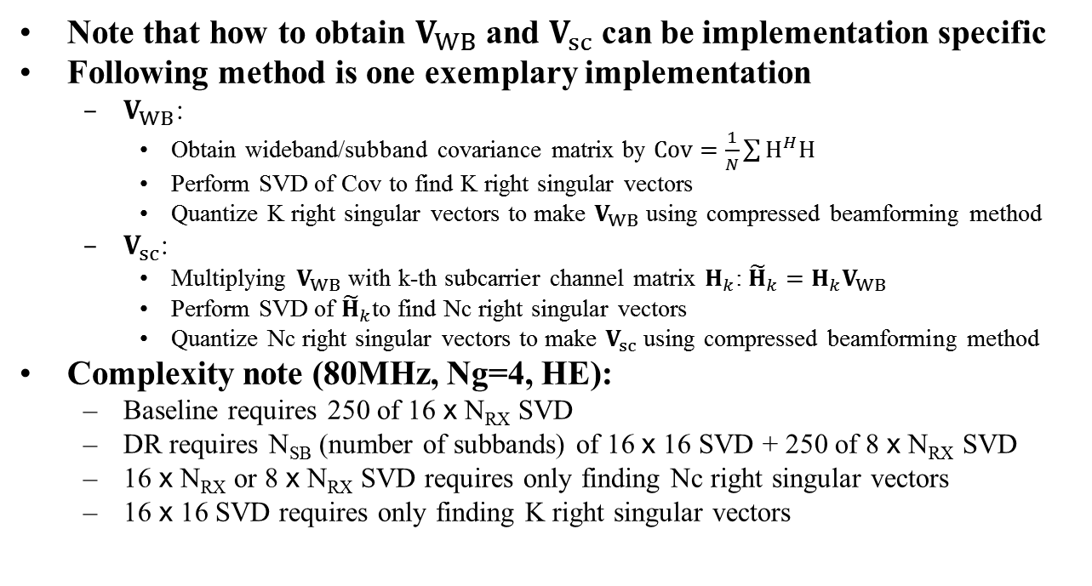
Example Implementation of DR
Note that how to obtain $V_{WB}$ and $V_{sc}$ can be implementation specific
Following method is one exemplary implementation
  $V_{WB}$:
    Obtain wideband/subband covariance matrix by $Cov=\frac{1}{N}\sum{H^{H}H}$
    Perform SVD of Cov to find K right singular vectors
    Quantize K right singular vectors to make $V_{WB}$ using compressed beamforming method
  $V_{sc}$:
    Multiplying $V_{WB}$ with k-th subcarrier channel matrix $H_{k}$: ${\tilde{H}}_{k}=H_{k}V_{WB}$
    Perform SVD of ${\tilde{H}}_{k}$to find Nc right singular vectors
    Quantize Nc right singular vectors to make $V_{sc}$ using compressed beamforming method
Complexity note (80MHz, Ng=4, HE):
  Baseline requires 250 of 16 x N_{RX} SVD
  DR requires N_{SB} (number of subbands) of 16 x 16 SVD + 250 of 8 x N_{RX} SVD
  16 x N_{RX} or 8 x N_{RX} SVD requires only finding Nc right singular vectors
  16 x 16 SVD requires only finding K right singular vectors

Slide 12
Throughput Simulation (Reference)

Slide 13
Impact of K and Subband Size
 |  | WB | SC | Total | NSS=2, MCS2(8RX), MCS3(16Rx) | NSS=2, MCS3(8RX), MCS4(16Rx)
8x2, 80MHz, Ng=4, MU Fine, HE | Baseline | - | 6752B | 6752B | 372us | 292us
16x2, 80MHz, Ng=4, MU Fine, HE | Baseline | - | 14752B | 14752B | 564us | 404us
 | K=8, 5MHz | 2944B | 6752B | 9696B | 388us (31%↓) | 292us (28%↓)
 | K=8, 10MHz | 1472B | 6752B | 8224B | 340us (40%↓) | 260us (36%↓)
 | K=4, 5MHz | 1728B | 2752B | 4480B | 228us (60%↓) | 180us (55%↓)

Slide 14
Impact of K and Subband Size

