Slide 1
EHT Multi-Link Operation Follow-up
Date: 2019-09-18
Authors:

Slide 2
Abstract
In this contribution, we further evaluate performance of multi-link operation (MLO) under various BSS and OBSS traffic load, and propose the inclusion of the TID-to-link mapping concept in the TGbe SFD.

Slide 3
Recap: Multi-link Operation
A multi-link device may perform a channel access (e.g., EDCA or Triggered Uplink Access) on multiple links independently [1,2].
When such a multi-link device obtains TXOPs on multiple links, it can send frames belonging to the same TID over multiple links simultaneously.
Back-off
Multi-link AP
9
8
7
6
5
4
3
2
1
0
Data [Seq3, TID1]
Data [Seq4, TID1]
6GHz
Multi-link STA
Block ACK
Back-off
Multi-link AP
5
4
3
2
1
0
Data [Seq1, TID1]
Data [Seq2, TID1]
5GHz
Multi-link STA
Block ACK
<Asynchronous MLO>

Slide 4
Recap: Multi-link Operation
But, if a multi-link device is adversely affected by in-device coexistence interference across multiple links, it may not reliably transmit and receive frames over those links simultaneously.
In such a case, the multi-link device may coordinate and synchronize its transmission and reception timing over those multiple links.
Back-off
PIFS
Multi-link AP
9
8
7
6
5
4
Data [Seq3, TID1]
Data [Seq4, TID1]
6GHz
Multi-link STA
Block ACK
Back-off
Multi-link AP
5
4
3
2
1
0
Data [Seq1, TID1]
Data [Seq2, TID1]
5GHz
Multi-link STA
<Synchronous MLO>
Block ACK

Slide 5
Performance Evaluation via Simulation
In previous performance evaluation [1], we compared throughput between single-link operation (legacy) and multi-link operation under one STA per BSS scenario.
It shows an upper bound of the throughput gain through the multi-link operation.
In this contribution, we evaluate multi-link performance in the presence of BSS and OBSS background traffic generated by multiple STAs per BSS.

Slide 6
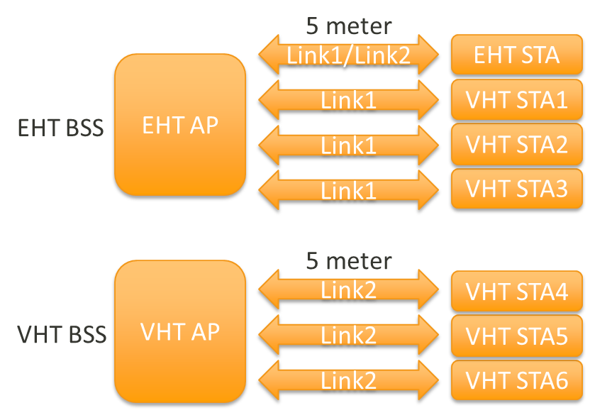
Performance Evaluation via Simulation
Topology
My BSS
1 EHT AP and 1 EHT STA
3 VHT STAs
OBSS
1 VHT AP and 3 VHT STAs
Parameters:
MCS 9 at 80 MHz bandwidth (390 Mbps)
Background traffic load: 2%, 20%, 55%, 85% airtime link
Bi-directional UDP application

Slide 7
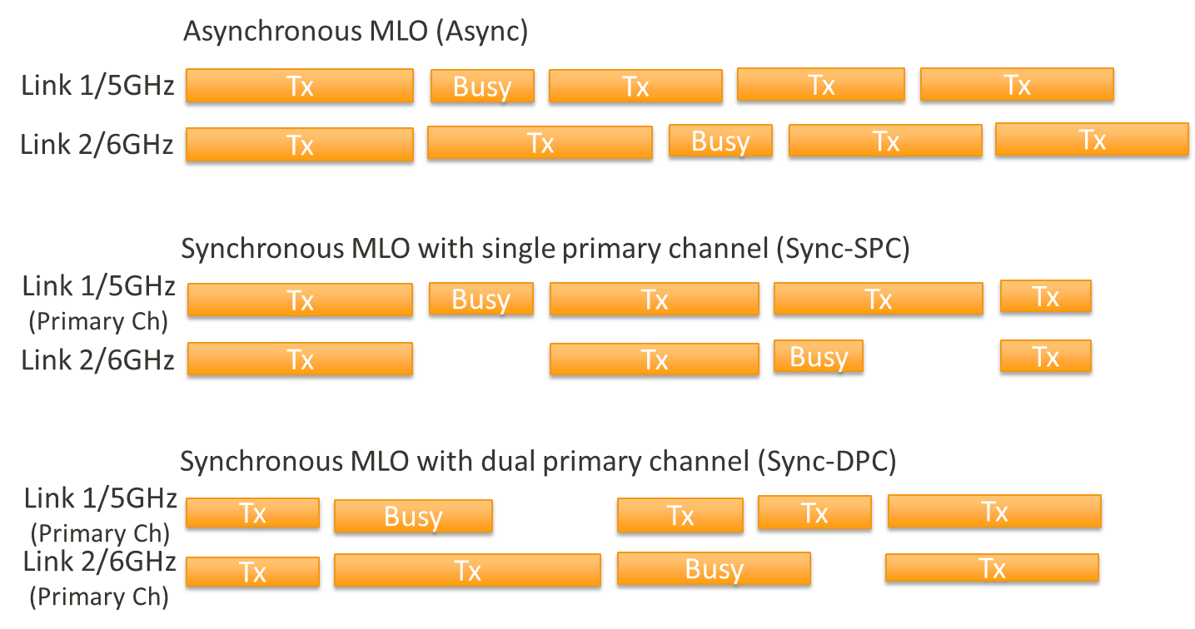
Performance Evaluation via Simulation
An EHT AP accesses links through the asynchronous MLO.
An EHT STA accesses links through one of the following three MLO types.

Slide 8
Performance Evaluation via Simulation
Throughput Comparisons

Slide 9
Performance Evaluation via Simulation
Latency Comparisons

Slide 10
Proposal
Many TGbe MLO submissions are going in a direction that allows a STA to send frames belonging to single TID over multiple links.
But, the details about channel access protocol of the multi-link operation [2] are TBD.
In a way forward, we propose to define the TID-to-link mapping in the TGbe SFD as a top level concept of EHT MLO.
TID-to-link mapping : A single TID is mapped to one or more links. The frames belonging to the single TID are sent on the mapped link(s).

Slide 11
Conclusion
In this contribution, we evaluate performance (throughput and latency) of the multi-link operation under more realistic environments.
Even though the performance gain of the MLO operation varies depending on the BSS and OBSS background traffic load, we can see throughput and latency improvement in all scenarios.
To achieve those gains, the multi-link operation should allow frames of the same TID (or different TIDs as well) to be transmitted over multiple links concurrently or non-concurrently.

Slide 12
Reference
[1] https://mentor.ieee.org/802.11/dcn/19/11-19-0766-01-00be-enhanced-multi-band-multi-channel-operation.pptx
[2] https://mentor.ieee.org/802.11/dcn/19/11-19-0731-00-00be-multi-link-operation.pptx
[3] https://mentor.ieee.org/802.11/dcn/19/11-19-0822-00-00be-extremely-efficient-multi-band-operation.pptx

Slide 13
Straw Poll 1
Do you support defining a TID-to-link mapping mechanism among the enabled links of a multi-link logical entity.
Note: For each TID, TID-to-link mapping can be 1-to-1 or 1-to-many.
Yes/No/Abstain: 56 / 9/ 55

Slide 14
Motion 1
Move to add to the specification framework document:
Define a TID-to-link mapping mechanism among the enabled links of a multi-link logical entity. Note: For each TID, TID-to-link mapping can be 1-to-1 or 1-to-many.
DCN: 11-19/979r2, SP Result: 56/ 9/ 55
Moved by: Yongho Seok

