Slide 1
What is Harmonized Standard EN 301 893?
Date: 2019-05-16
Authors:

Slide 2
What is a Harmonized Standard (HS)?
“A harmonised Standard
  is a European standard developed by a recognised European Standards Organisation:
    CEN, CENELEC, or ETSI.
  It is created following a request from the European Commission to one of these organisations.” [1]

Slide 3
Why are HSs important?
“Manufacturers, other economic operators, or conformity assessment bodies can use harmonised standards to demonstrate that products, services, or processes comply with relevant EU legislation.” [1]
  A HS allows a vendor, a manufacturer, a dealer etc. to put a product on the European market
  Finding a product to meet the requirements of a HS provides a presumption of conformity
Allows for self-declaration
  E.g., a vendor may sell a radio device after having successfully performed a self-assessment of the device
  Unlike the US, no type approval is needed
If self-assessment is not feasible a vendor may approach a notified body (“test lab”, technical experts) to perform assessment
  For the assessment, notified bodies rely on HSs and their technical expertise

Slide 4
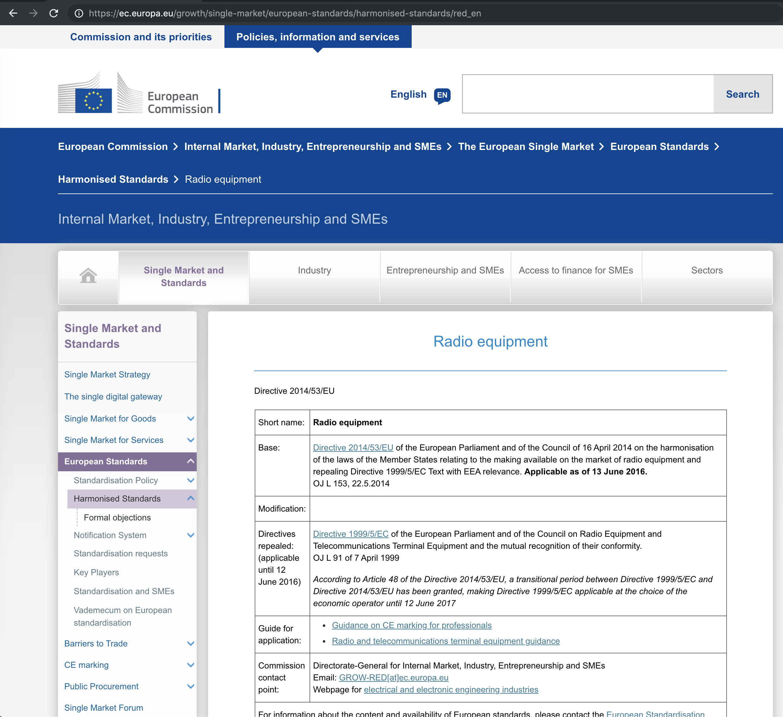
Where to find HSs?
“The references of harmonised standards must be published in the Official Journal of the European Union.” (OJEU) [1]
  https://eur-lex.europa.eu/content/help/oj/intro.html
For Radio Equipment
  https://ec.europa.eu/growth/single-market/european-standards/harmonised-standards/red_en

Slide 5
What is the Radio Equipment Directive (RED)?
“The Radio Equipment Directive 2014/53/EU (RED) establishes a regulatory framework for placing radio equipment on the market.
  It ensures a Single Market for radio equipment by setting essential requirements for
  safety and health, electromagnetic compatibility, and the efficient use of the radio spectrum.
  It also provides the basis for further regulation governing some additional aspects.
  These include technical features for the protection of privacy, personal data and against fraud. Furthermore, additional aspects cover interoperability, access to emergency services, and compliance regarding the combination of radio equipment and software.” [2]

Slide 6
What is ETSI?
European Telecommunications Standards Institute (ETSI)
  A European Standards Organization (ESO)
  Created by European Conference of Postal and Telecommunications Administrations (CEPT) in 1988
  Focus is on telecommunication standards
  Examples: GSM, UMTS, DECT, TETRA …

Slide 7
What is ETSI TC BRAN?
Technical Committee (TC) Broadband Radio Access Networks (BRAN)
  Formed 1997
  Developed HiperLAN/2
    Part of the Hiper family (HiperMAN, HiperLAN etc.)
    An “ancestor” of IEEE 802.16 (WiMAX)
Outside Europe, HiperLAN/2 and IEEE 802.11a could have shared the 5 GHz band
  Thus, IEEE 802.11 and TC BRAN have standing liaison since the 1990s
  In Europe, 5 GHz had a technology specific assignment for HiperLAN/2

Slide 8
What does TC BRAN do today?
After HiperLAN/2 became no commercial success, TC BRAN started developing several HSs
  EN 301 893, 5 GHz
  EN 302 567, 60 GHz
  EN 301 598, TV Whitespace
  EN 303 316, Direct air to ground
  …
The most important HSs are EN 301 893 and EN 302 567
  Because of the Radio Equipment Directive (RED) both HSs had to be updated
  Now, both HSs at version 2.1.1
RED enforced adding receiver requirements
  Selectivity, blocking …

Slide 9
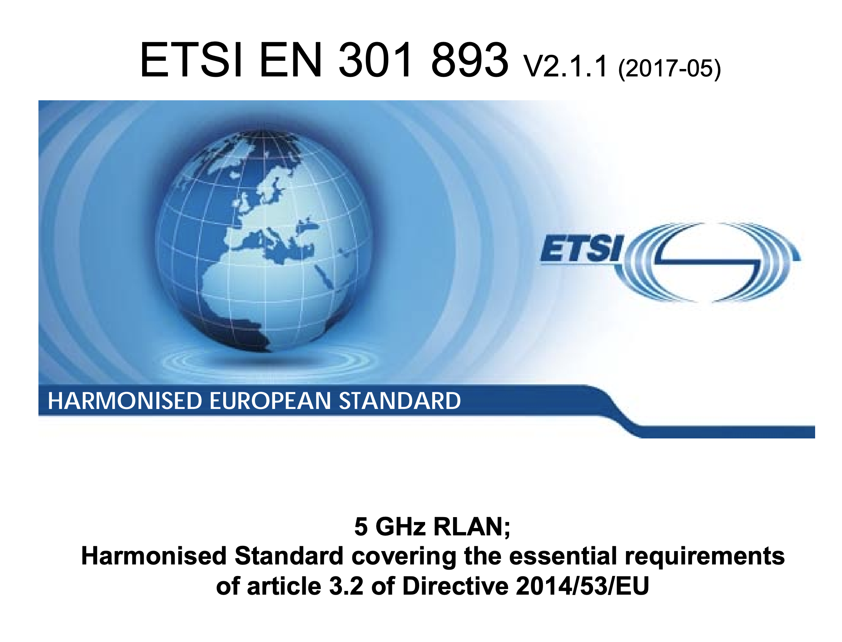
What is HS EN 301 893?
5 GHz RLAN; Harmonised Standard covering the essential requirements of article 3.2 of Directive 2014/53/EU
  Defines rules for operating in 5 GHz
  Most important: protection of incumbent services (radars)
    Anything else is secondary, additionally added by TC BRAN
    Additionally: Maximum transmit power, leakage, medium access etc.

Slide 10
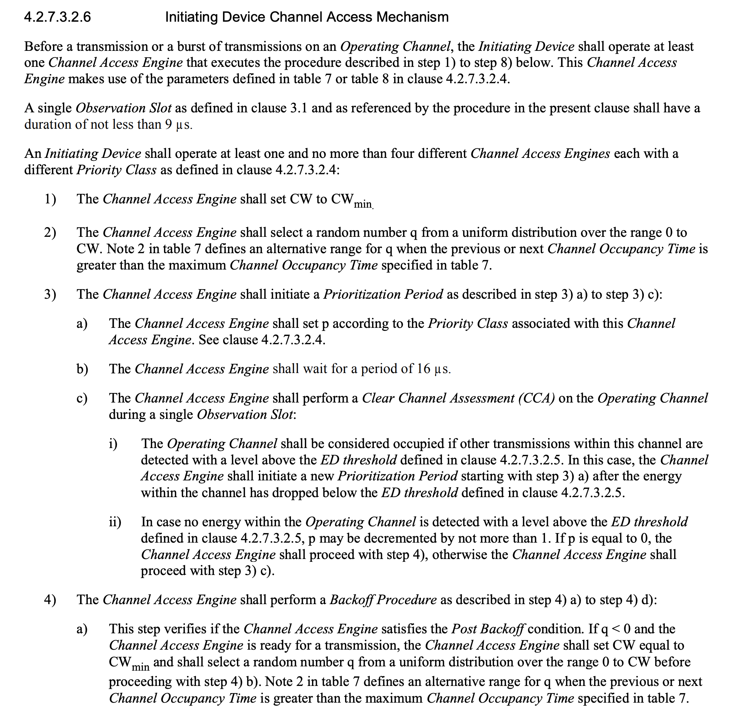
Major aspects in EN 301 893 (1)
Requirements for radar detection
  Definition of pulse patterns
  Rules for vacating radar channels
Adaptivity (Medium Access)
  Load Based Equipment (LBE)
    Similar to IEEE 802.11
  Frame Based Equipment (FBE)
    May access medium at discrete times
    Sensing but no backoff process

Slide 11
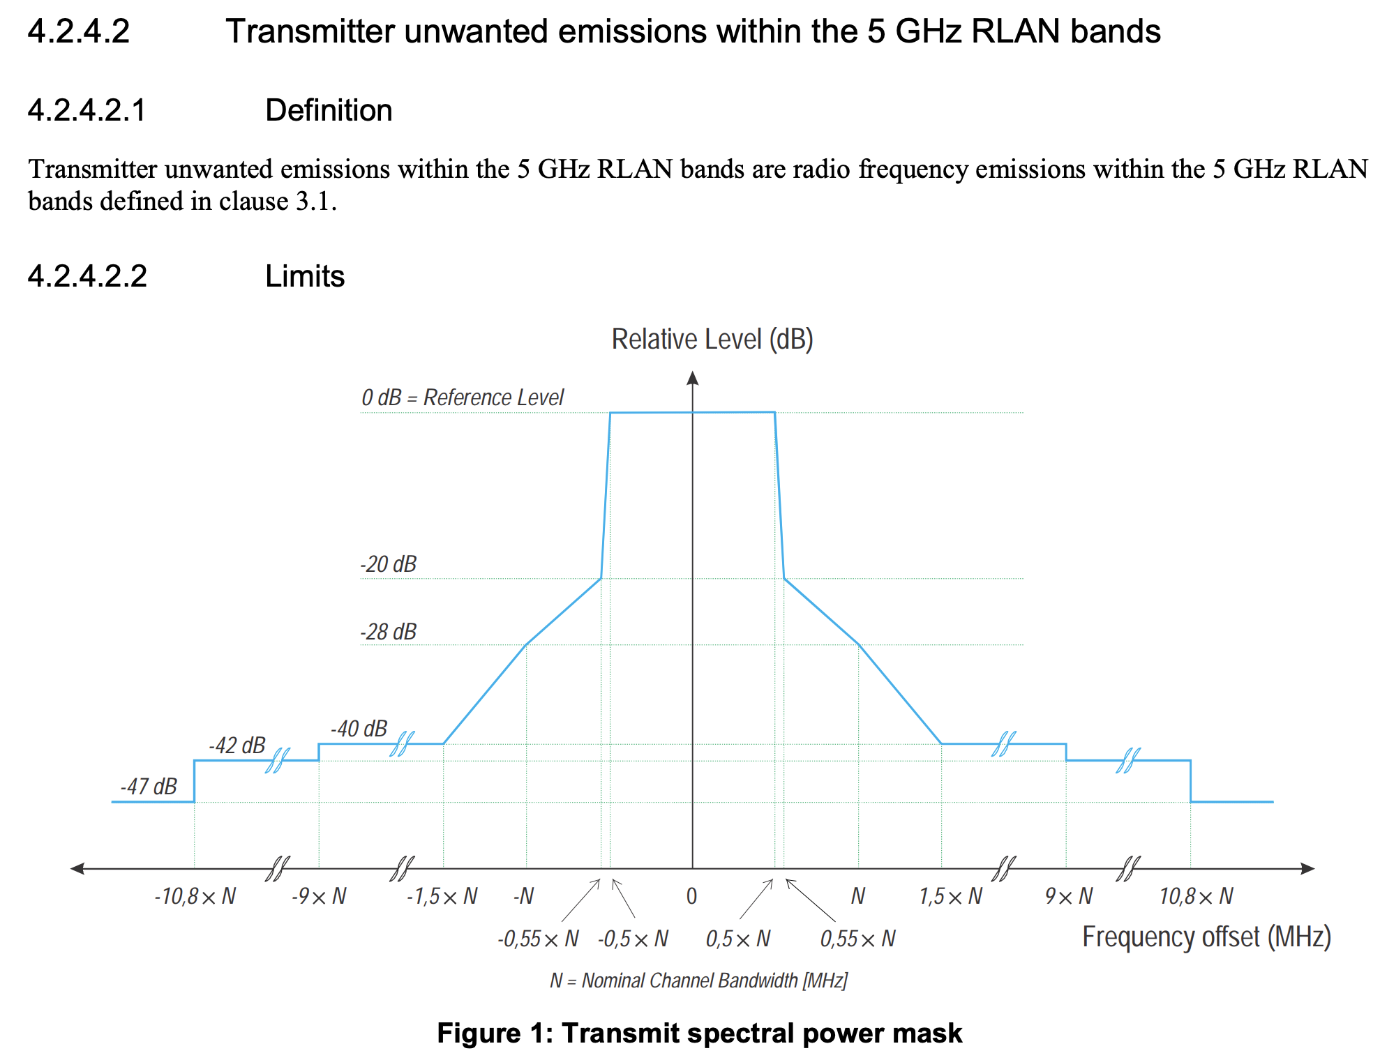
Major aspects in EN 301 893 (2)
Rules for channel bonding
Maximum transmit power
Spectral masks
Detection thresholds for Listen-before-Talk (LBT)
Description of various tests
  Adaptivity, radar detection, sensing thresholds, channel bonding, …

Slide 12
What is is new in version 2.1.1?
Until version 1.8.1
  Requirements focusing on device
  Generic concept defining maximum transmit duration dependent on random medium access deferral
  Simple tests measuring duty cycle etc.
From version 2.1.1
  Fixed channel raster
    Temporal minimal bandwidth of 2 MHz
  Testing system behavior
    Channel access behavior of device under test (DUT) and companion
    Duration of DUT and companion device transmissions not to exceed TXOP (Channel Occupancy Time, COT) threshold
  Very detailed LBE requirements
    Testing backoff behavior, measuring statistics etc.
  Restricting user access to software and device behavior
    Must not disable radar detection
  Deferral to different modulated signals
    Not only testing gaussian noise

Slide 13
LBE adaptivity
Emulating EDCA
  Prioritization period ≡ AIFS[AC]
  Backoff procedure ≡ CW[AC] dependent random waiting
  Virtual collisions etc.
DCF & “Post-backoff” behavior are permitted

Slide 14
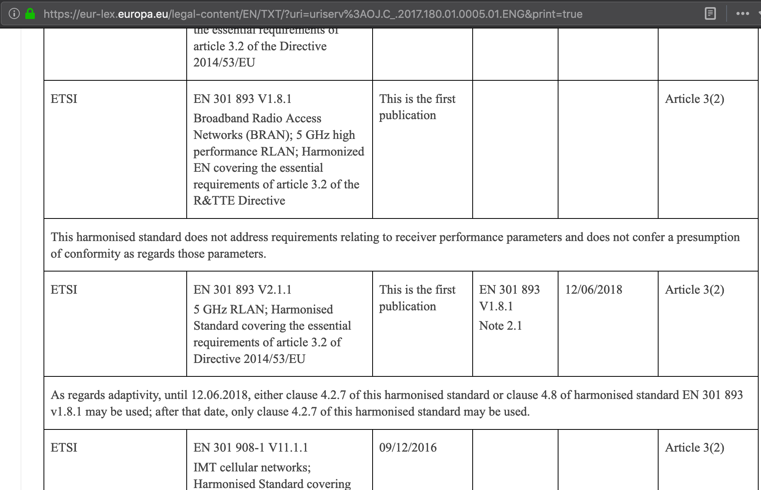
Transition period
Transition period for version 1.8.1 of EN 301 893 ended 2018-06-12
  Version 2.1.1 in force since then

Slide 15
What will the next version of EN 301 893 bring?
Exception to “declare compliance” instead of testing has been withdrawn
Testing of …
  Backoff behavior
  TXOP limit
… mandatory with next release
  (Open Source) Tools as presented in 11-19/693 help to analyze product behavior
Applying a transmit power independent LBT threshold of −62 dBm requires using IEEE 802.11a preamble as secondary trigger
  Hence, mandatory testing of IEEE 802.11a preamble conformance
  Devices needing to defer for duration indicated in preamble SIGNAL field
  Device’s sensitivity to preamble threshold to be tested

Slide 16
What are essential requirements?
Basically, all “shall” statements
Examples
  Radar detection
  Unwanted emissions
    Inside band
    Outside band
  Receiver blocking
  Channel bonding, spectral masks
  Power density
    Max transmit power
  LBT thresholds
    Deferral to modulated signals & noise
  Backoff behavior
    Slot distribution
  Maximum TXOP duration

Slide 17
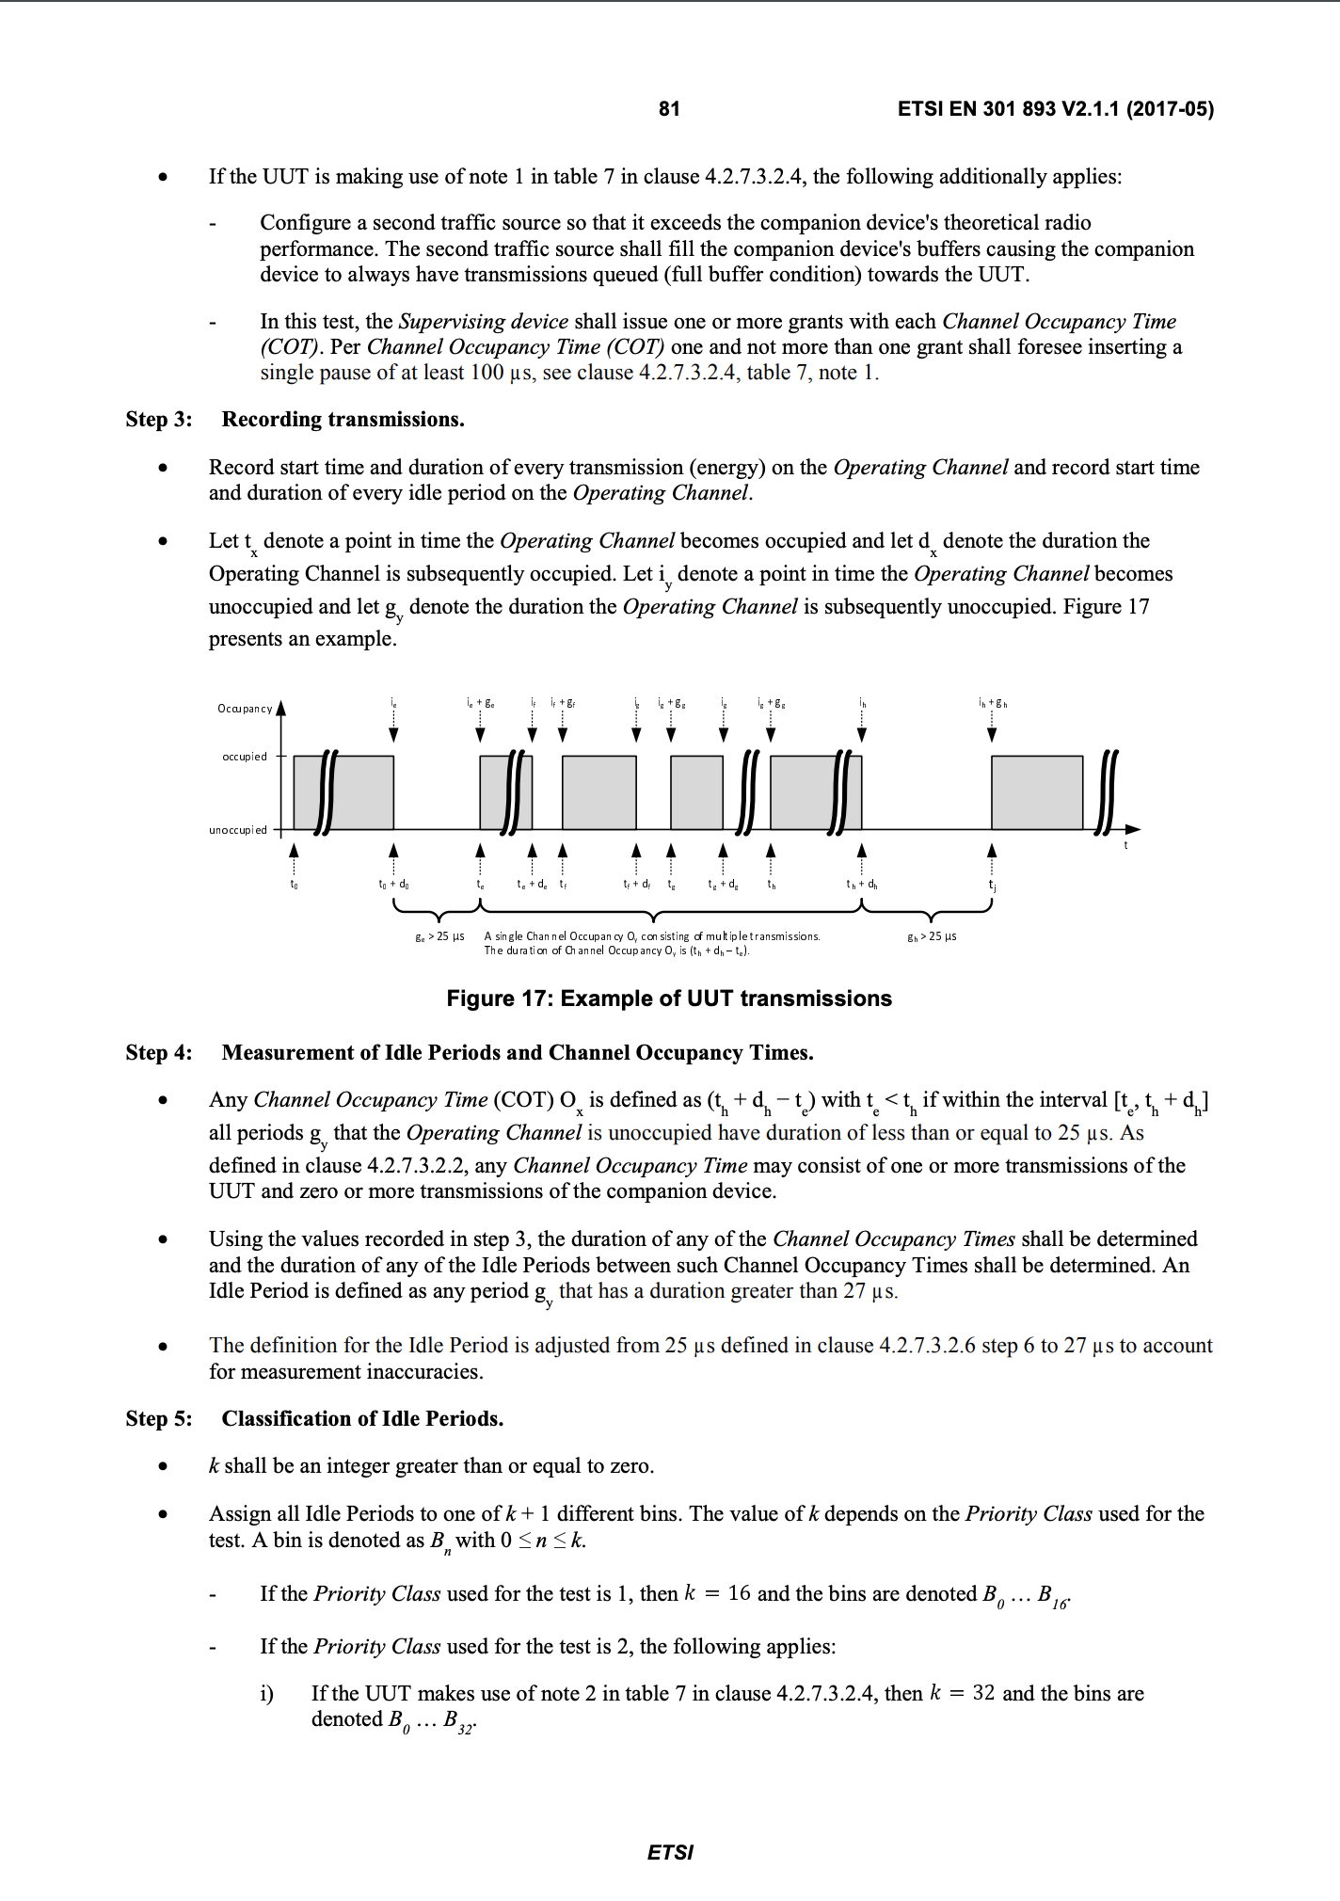
Example: Backoff test (1)
EN 301 893 defines a Channel Occupancy Time (COT = TXOP) as sequence of transmissions having no gaps of more than 25 µs duration
  Defined by occupied and unoccupied periods
  Used to classify measurements

Slide 18
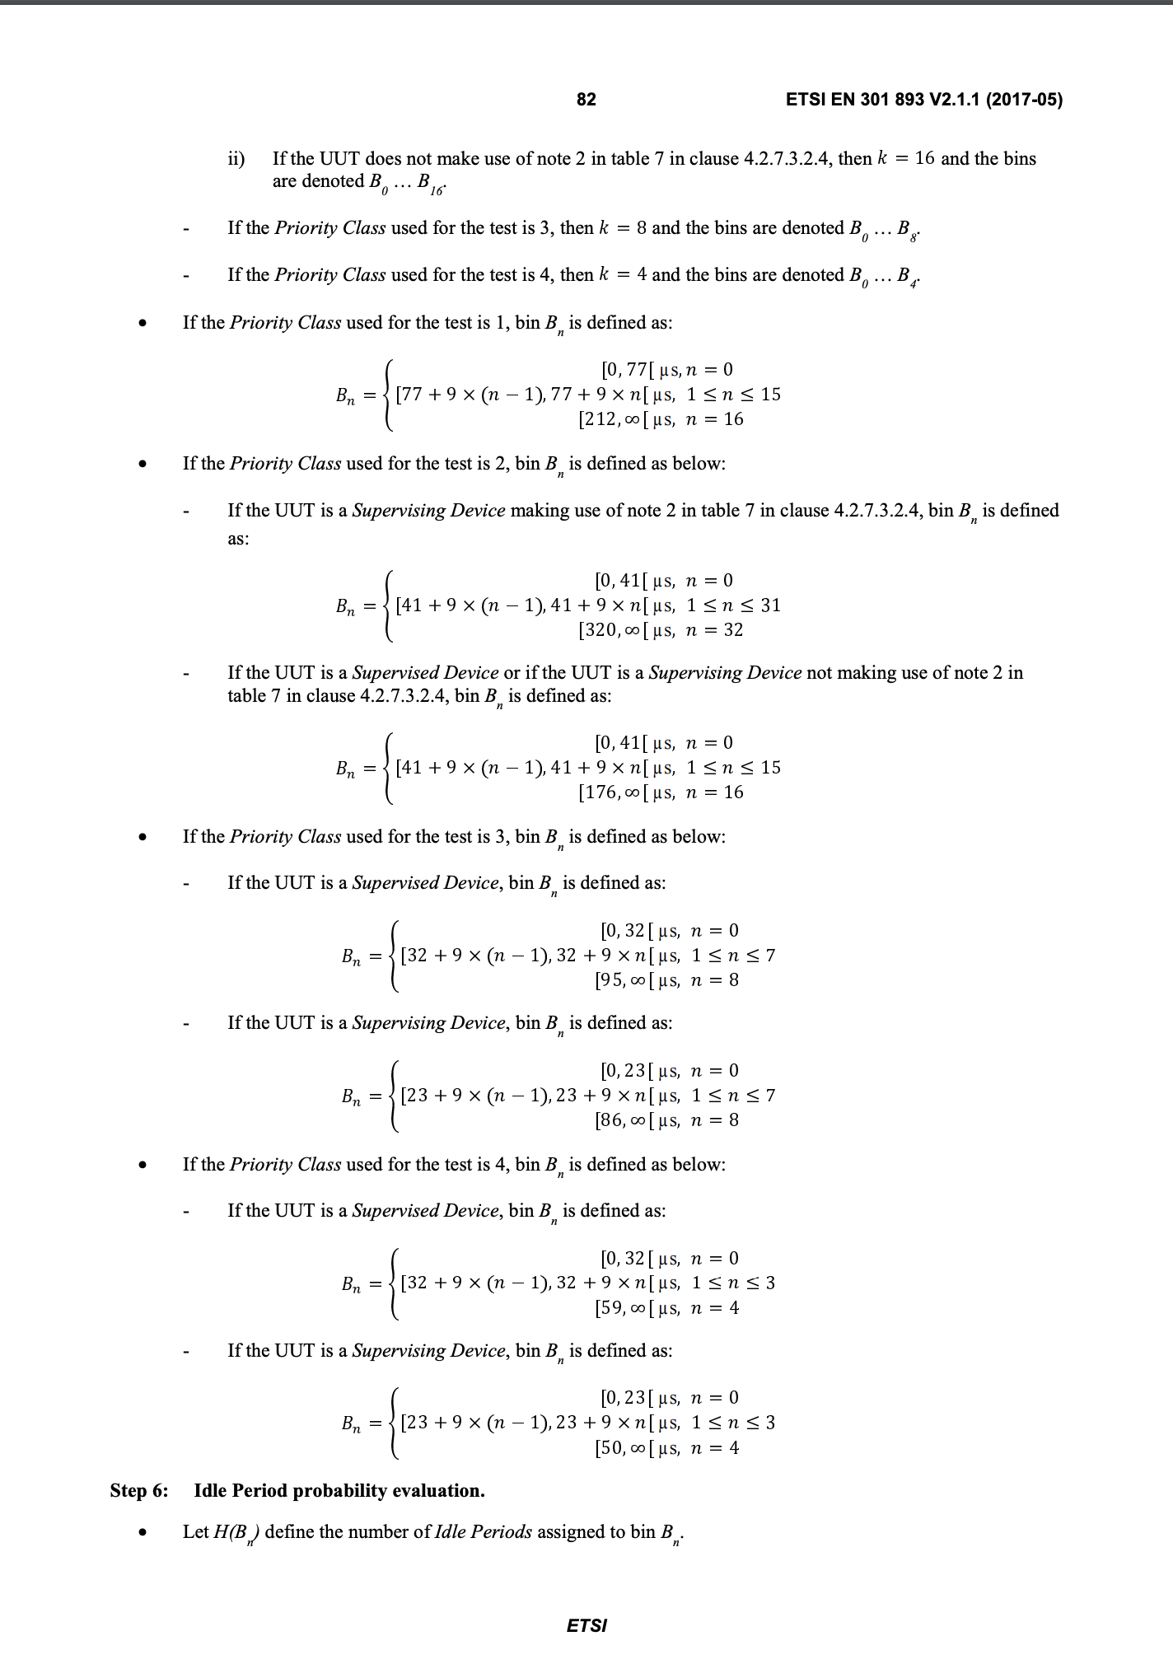
Example: Backoff test (2)
EN 301 893 translates the adaptivity requirements on the truncated exponential backoff into discrete bins of certain duration
  Depends on priority and device category (e.g. non-AP STA or AP STA)

Slide 19
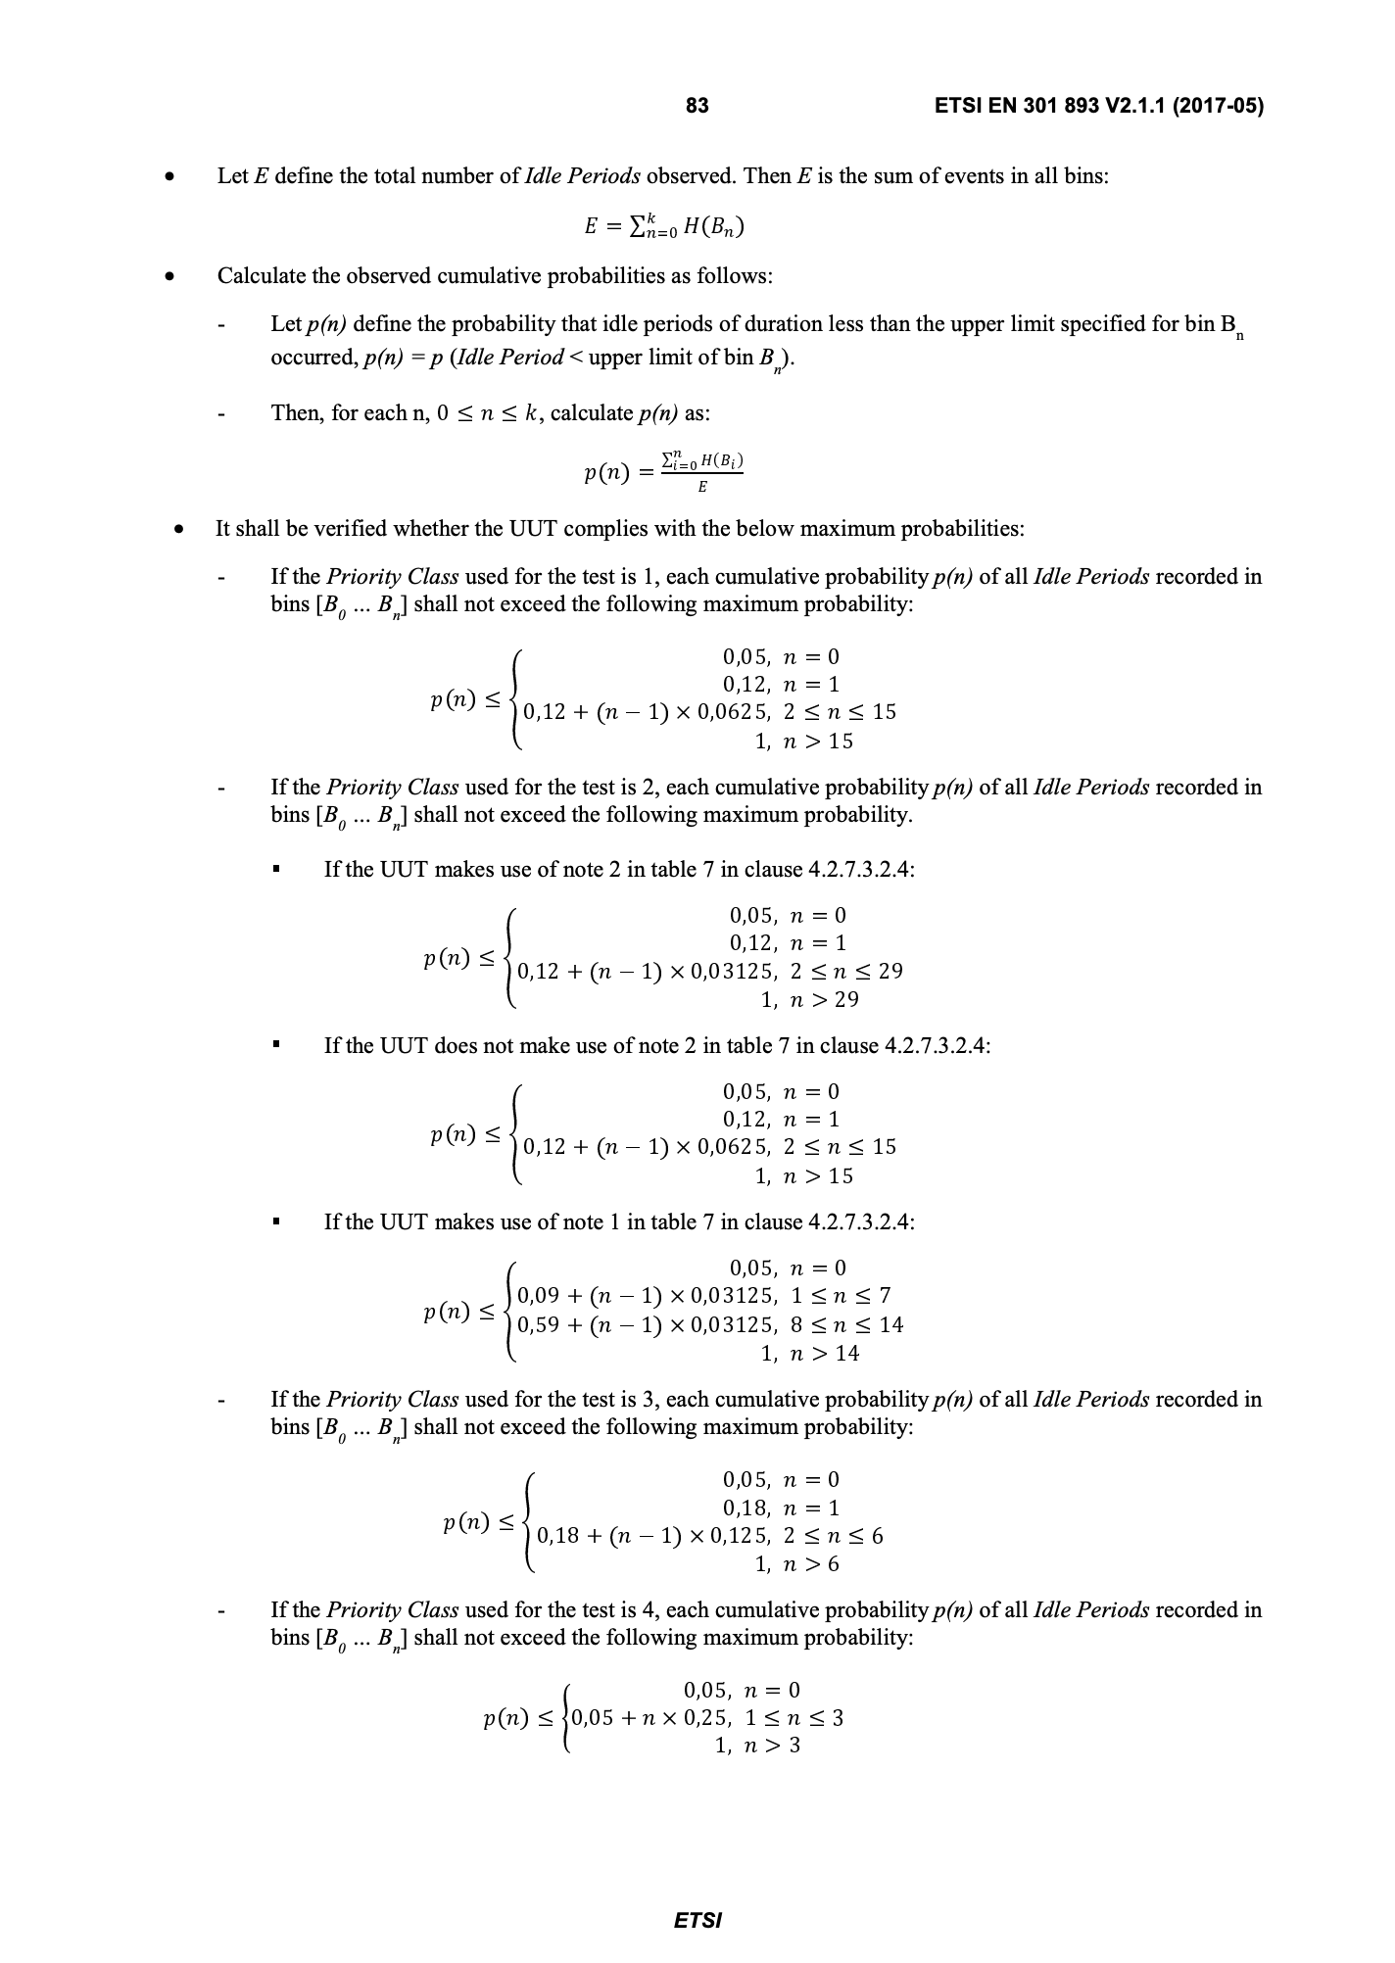
Example: Backoff test (3)
A Cumulative Distribution Function (CDF) describes a tolerable probability per bin
  Devices fail if probability of bins are exceeded
  Devices may always wait longer than permitted
    Less aggressive behavior

Slide 20
What is special about an essential requirement?
Regulatory authorities demand every essential requirement to be accompanied by a test
  Authorities need descriptions of tests to analyze products
  Authorities required to perform market surveillance
  Tests also used by notified bodies
Example market surveillance report by German Bundesnetzagentur (BNetzA)
  Only 15 % w/o issues, >30 % not compliant with DFS requirements
[3]

Slide 21
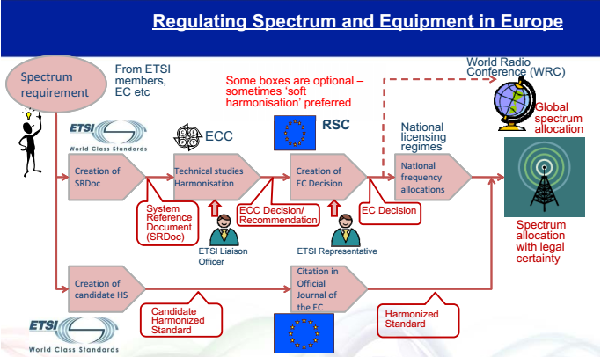
From requirement to allocation
ETSI develops HS on being directed by the European Commission
ETSI groups approve HS by consensus
Followed by national voting
  ENAP (European Norm Approval Process)
[4]

Slide 22
What are the issues in the process?
Approval of an HS requires a decision at ETSI
  Consensus driven
Afterwards, an EN Approval Procedure (ENAP) follows
  European Union member companies vote on the EN
  Comments must be resolved by the ETSI TC
Recently, the European Commission (EC) began additionally reviewing HSs
  On behalf of the EC, consultants of Ernst & Young perform the review
  Based on the review, HSs have been denied listing in the Official Journal of the EU (OJEU)
  W/o listing, vendors cannot use a HS for putting products onto the European market

Slide 23
How to engage?
ETSI has entity based membership
If your employer is an ETSI member company you may attend TC BRAN meetings
Next meetings
  2019-06-17 until 2019-06-20, 2019-10-07 until 2019-10-10, and 2019-12-02 until 2019-12-05
  See https://portal.etsi.org/tb.aspx?tbid=287&SubTB=287#/5069-meetings
Online (GoToMeeting for screensharing and audio) and face-to-face attendance possible

Slide 24
References
European Commission, “Harmonised Standards,” [Online]. Available: https://ec.europa.eu/growth/single-market/european-standards/harmonised-standards_en
European Commission, “Radio Equipment Directive (RED),” [Online]. Available: https://ec.europa.eu/growth/sectors/electrical-engineering/red-directive_en
S. Winkelmann, “Statistik Marktüberwachung 2018,” Bundesnetzagentur Referat 411 - Marktüberwachung nach EMVG und FuAG, Mainz, Germany, 9 January 2019, [Online]. Available: https://www.bundesnetzagentur.de/SharedDocs/Downloads/DE/Sachgebiete/Telekommunikation/Verbraucher/WeitereThemen/Marktueberwachung/StatistikMarktueberwachung2018.pdf?__blob=publicationFile&v=2
T. Weber, “CEPT/ECC-ETSI Co-operation Process and relation to standardisation activities,” 53 shades of RE-D workshop, Sophia Antipolis, France, 4 November 2015.

