Slide 1
802.11 Coex Simulation and Analysis
Date: 2019-05-16
Authors:
Name | Affiliations | Address | Phone | Email
Chung-Ta Ku | Mediatek | 2840 Junction Ave San Jose, CA 95134 | +1-408-526-1899 | chung-ta.ku@mediatek.com
Paul Cheng | Mediatek |  |  | paul.cheng@mediatek.com
James Wang | Mediatek |  |  | james.wang@mediatek.com
Gabor Bajko | Mediatek
Yongho Seok | Mediatek
James Yee | Mediatek
Thomas Pare | Mediatek

Slide 2
Outline
Simulation Setup
Simulation Parameters Analysis
  Airtime Usage (Medium usage time)
    Simulation Results
    Analysis & Issues
  System TP
    Simulation Results
    Analysis & Issues
Conclusions

Slide 3
Priority Classes in IEEE and ETSI
AP EDCA Parameter | AIFSN | Td | CWmin | CWmax | TXOP Limit
Voice (VO) | 1 | 25 us | 3 | 7 | 2.080ms
Video (VI) | 1 | 25 us | 7 | 15 | 4.096ms
Best effort (BE) | 3 | 43 us | 15 | 63 | 2.528ms
Background (BK) | 7 | 79 us | 15 | 1023 | 2.528ms
ETSI Priority class | P₀ | Td | CWmin | CWmax | maxCOT
Class 4 | 1 | 25 us | 3 | 7 | 2ms
Class 3 | 1 | 25 us | 7 | 15 | 4ms
Class 2 | 3 | 43 us | 15 | 63 | 6ms
Class 1 | 7 | 79 us | 15 | 1023 | 6ms
IEEE (VO)
ETSI (class 4)
Non-AP STA default EDCA parameter in Table 9-155 of REVmd. ETSI parameters in Table 7 and 8 of EN301893 v2.1.1
Observation (key difference highlighted in dashed circle):
  IEEE default TXOP Limit and larger CWmax versus equivalent ETSI priority class COT and CWmax can affect medium utilization rate

Slide 4
Simulation Setup

Slide 5
OMNeT++ Baseline Simulation Setup
(IEEE vs IEEE)
Simulation Time: 10s
Full-buffer traffic loads
UDP Packet Size = 1472 Bytes
2 IEEE Links
  Using 11ac, 20MHz, no SGI, Nss =1
  MPDU Size = 1552 Bytes, fixed MCS 8
  IEEE AC
CCA-CS = -82 dBm
CCA-ED = -62 dBm
TX Power = 20 dBm
(0.5, 9.5)
(0.5 + X, 9.5)
AP
STA
Distance Y = 9m
AP
STA
(0.5, 0.5)
(0.5 + X, 0.5)
Distance X = 10m, 20m, 30m, …

Slide 6
OMNeT++ Coexist Simulation Setup
(ETSI vs IEEE)
Simulation Time: 10s
Full-buffer traffic loads
UDP Packet Size = 1472 Bytes
1 IEEE Link
  Using 11ac, 20MHz, no SGI, Nss =1
  MPDU Size = 1552 Bytes, fixed MCS 8
  IEEE AC
1 ETSI(LAA) Link
  Using LTE, 20MHz , Nss =1
  TBSize = 75376 Bytes, fixed MCS 28
  LAA priority class
CCA-CS = -82 dBm
CCA-ED = -62 dBm
TX Power = 20 dBm
(0.5, 9.5)
(0.5 + X, 9.5)
eNB
UE
Distance Y = 9m
AP
STA
(0.5, 0.5)
(0.5 + X, 0.5)
Distance X = 10m, 20m, 30m, …

Slide 7
Airtime Usage
- Simulation Results

Slide 8
Airtime Usage
(IEEE vs IEEE)
Distance X = 10m
(sec)
(sec)
Observation
  Airtime includes “successful transmission time” and “collision time”
  Airtime = (10s – “collision time”)/2 + “collision time”
  From VO to BE category: CWmin↑ => collision time↓ => Airtime ↓

Slide 9
Airtime Usage
(ETSI vs IEEE)
Distance X = 10m
(sec)
(sec)
TXOP
2ms
2.080ms
4ms
4.096ms
6ms
2.528ms
6ms
2.528ms
Observation
  ETSI Class 2 and 1 have airtime advantage mainly contributed by using larger TXOP
  ETSI Class 4 and 3 still has some airtime advantage despite EDCA parameters being the same as ETSI’s. We will analyze this case.

Slide 10
Airtime Usage
- Simulation Results
(BE & BK use 6ms TXOP Limit)

Slide 11
Airtime Usage
(IEEE vs IEEE)
Distance X = 10m
(sec)
(sec)
Observation
  Airtime includes “successful transmission time” and “collision time”
  Airtime = (10s – “collision time”)/2 + “collision time”
  From VO to BE category: CWmin↑ => collision time↓ => Airtime ↓

Slide 12
Airtime Usage
(ETSI vs IEEE)
Distance X = 10m
(sec)
(sec)
TXOP
2ms
2.080ms
4ms
4.096ms
6ms
6ms
6ms
6ms
Observation
  All ETSI Class 4, 3, 2, 1 have airtime advantage despite TXOP limit being the same as ETSI’s

Slide 13
Airtime Usage and TP
- Analysis

Slide 14
Factors Affect Medium Access and Utilization
EDCA Parameters
  AIFSN(Td), CWmin, CWmax, TXOP Limit
BA time out
  IEEE waiting for BA timeout issue (LAA uplink ACK is via licensed spectrum)
CW Adjustment issue
  In LAA, it adjusts CW based on reference subframe which is transmitted at least 4ms ago. By doing so, we observed LAA gets slight advantage (delay the doubling of CW) over IEEE, which adjusts the CW based on the last receiving PPDU (0ms ago).

Slide 15
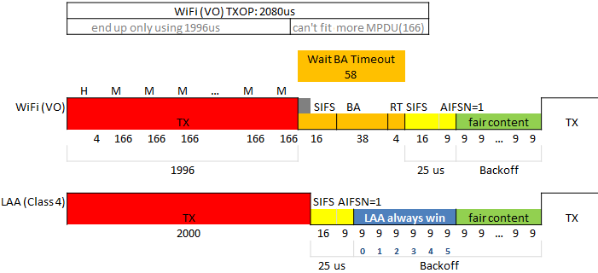
Issue due to Waiting for BA Timeout
Observation
  When collision happens
    LAA transmitter starts to sense the channel once the media become idle immediately after a collision (yellow part). Note LAA uses the licensed band for uplink ack.
    IEEE transmitter waits for STA to send BA for a duration of 58us (i.e, Wait for BA Timeout), and then starts to sense the channel (yellow part)
  Thus, LAA has higher channel access probability especially in a high collision environment

Slide 16
TXOP vs CA Prob.
Distance X = 10m
VO vs Class 4
IEEE : fixed TXOP 2.08ms
ETSI (LAA): scan TXOP 1.9ms ~ 2.4ms
(Prob.)
Region II
Region I
Observation
  Region I
    Regardless of TXOP (COT), CA prob. (probability of gaining channel access) is approximately equal
  Region II
    Affected by Waiting for BA Timeout Issue
    ETSI (LAA) gets advantage by easily obtaining the channel after collision
Conclusion
  The red dashed circle shows the CA prob. of current VO vs Class 4 parameters in spec, where Waiting for BA Timeout issue is the main factor cause unfairness of CA prob.
  The ratio of CA prob. 65% vs 35% here is what was observed in airtime simulation results 7.4s vs 4.0s

Slide 17
System TP
- Simulation Results

Slide 18
System TP
(IEEE vs IEEE)
(Mbps)
(Mbps)
Observation
  TP is proportional to “successful TX time” and “Data Rate”
  Successful TX time = (10s – “collision time”)/2
  From VO to BE category: CWmin↑ => collision time↓ => successful TX time ↑ => TP ↑

Slide 19
System TP (ETSI vs IEEE)
(Mbps)
(Mbps)
TXOP
2ms
2.080ms
4ms
4.096ms
6ms
2.528ms
6ms
2.528ms
Observation
  TP is determined by “successful TX time” and “Data Rate”
  The average MAC data rate in simulation are
    ETST(LAA) MCS28: 84Mbps
    IEEE MCS8: 75.4Mbps

Slide 20
System TP
- Simulation Results
(based on BE & BK use 6ms TXOP Limit)

Slide 21
System TP
(IEEE vs IEEE)
(Mbps)
(Mbps)
Observation
  TP is proportional to “successful TX time” and “Data Rate”
  Successful TX time = (10s – “collision time”)/2
  From VO to BE category: CWmin↑ => collision time↓ => successful TX time ↑ => TP ↑

Slide 22
System TP (ETSI vs IEEE)
(Mbps)
(Mbps)
TXOP
2ms
2.080ms
4ms
4.096ms
6ms
6ms
6ms
6ms
Observation
  TP is determined by “successful TX time” and “Data Rate”
  Average MAC data rate in simulation are
    ETST(LAA) MCS28: 84Mbps
    IEEE MCS8: 75.4Mbps
  The differences in TP is the results of BA timeout.

Slide 23
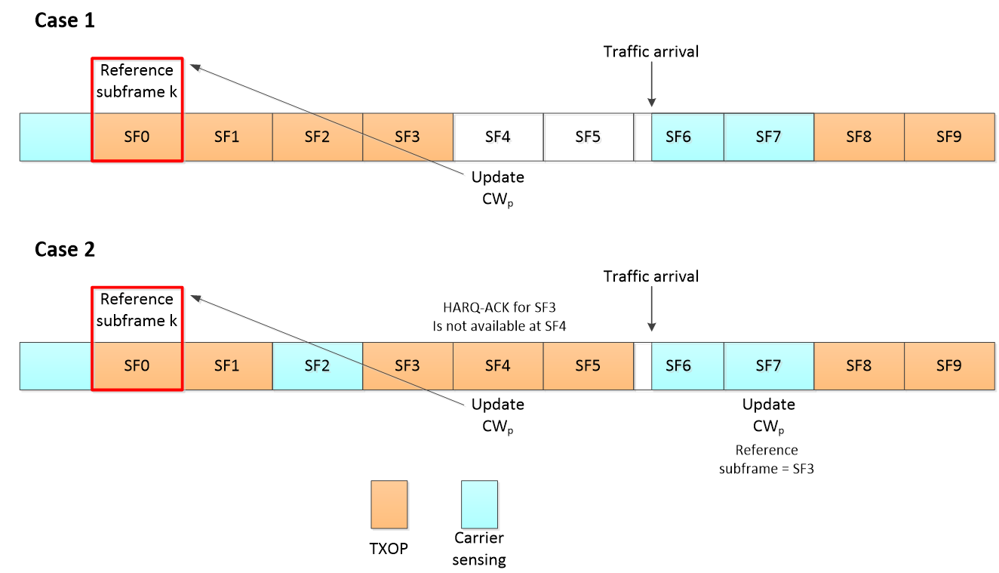
CW Adjustment Issue
Reference
subframe
Reference
subframe
HARQ-ACK
for SF0 is ready
Update as CW (v1)
HARQ-ACK
for SF3 is ready
Update as CW (v2)
Use CW (v1)
from SF0
A: use CW referenced from the last reference subframe transmitted at least 4ms ago
4ms
Use CW (v2)
from SF3
B: use CW referenced from the last reference subframe transmitted immediately before (same as IEEE)
Observation
  Previous simulation results (Slide 8 to Slide 22) use mechanism B.
  When using mechanism A (adopted in LAA), we would see some discrepancy between collision count (occurs 800 times) and doubling CW count (occurs 600 times), which is unexpected
  When switching LAA to use mechanism B (the same as IEEE), the collision count and doubling CW count can be matched (ex: both occur 800 times)
0ms

Slide 24
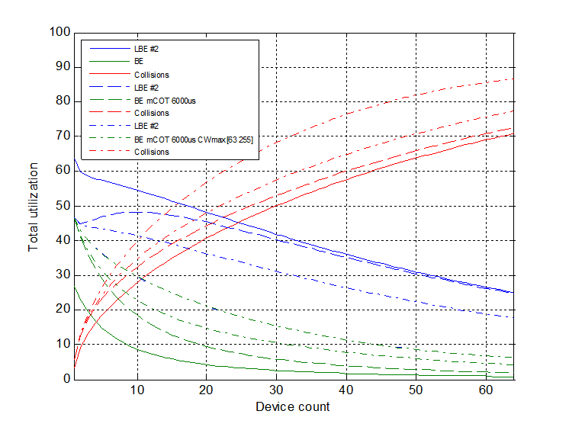
The impact of CWmax
To evaluate the impact of CWmax, we use a simplified simulation which contains more devices. (previous OMnet simulation does not have enough devices to reach CWmax)
The simulation assumes perfect ED and the TXOP limit of BE is set to 2.528ms (solid line) and 6ms (dashed line, same as ETSI priority class 2), respectively.
Total airtime utilization is significantly different (IEEE is less than ETSI PC2).
CW_{max} = 63
Chung-Ta Ku, Mediatek

Slide 25
Conclusions
System level simulation regarding 802.11 and LAA is presented to evaluate fairness for medium occupancy
Multiple factors impacting coexistence fairness were investigated
  Timeout for BA
  Default EDCA parameters
  CW adjustment
Proper setting of EDCA Parameters can be used to mitigate the effects of medium utilization (subject to further study)
Due to the use of licensed channel, LAA has advantage in medium utilization in some cases
Chung-Ta Ku, Mediatek

