Slide 1
Discussion on IMT-2020 mMTC and URLLC
Date: 2019-05-14
Authors:

Slide 2
Abstract
This contribution provides a summary of IMT-2020 mMTC and URLLC requirements and an analytical evaluation of 802.11ax capabilities with respect to them.

Slide 3
mMTC: Summary of requirements
With a layer 2 PDU (Protocol Data Unit) message size of 32 bytes and 1 message/day/device or 1 message/2 hours/device:
  Connection density of 1,000,000 devices per km².
  99th percentile delay per user less than or equal to 10s

Slide 4
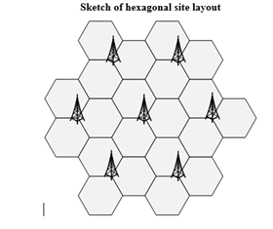
mMTC: Key aspects of the evaluation scenario
Evaluation Configuration: Two configurations A and B, 500m ISD and 1732m ISD respectively
Sufficient to meet the requirements for only one
Carrier frequency 700 MHz
Urban Macro topology: Hexagonal layout, 1 site with 3 TRxPs each
UE deployment: 80% indoor, 20% outdoor
Building type: 80% low loss, 20% high loss
Channel model: UMa_A or UMa_B
O-to-I loss:
  UMa_A: 20dB (for <= 6GHz)
  UMa_B: variable function of penetration loss due to glass and concrete
Indoor loss: 0.5*d, d ~ Uniform (0, 25)
TRxP Tx Power 49 dBm (20 MHz bandwidth)
UE Tx power 23 dBm, UE speed 3 km/hr
Up to 64 Rx/Tx antennas at the TRxP
Up to 2 Tx/Rx antennas at the UE
Evaluations can be either non-full buffer or full buffer
System bandwidth of up to 50 MHz (can be distributed across TRxPs)
  Up to 10 MHz is also possible, but we are not considering it for 11ax

Slide 5
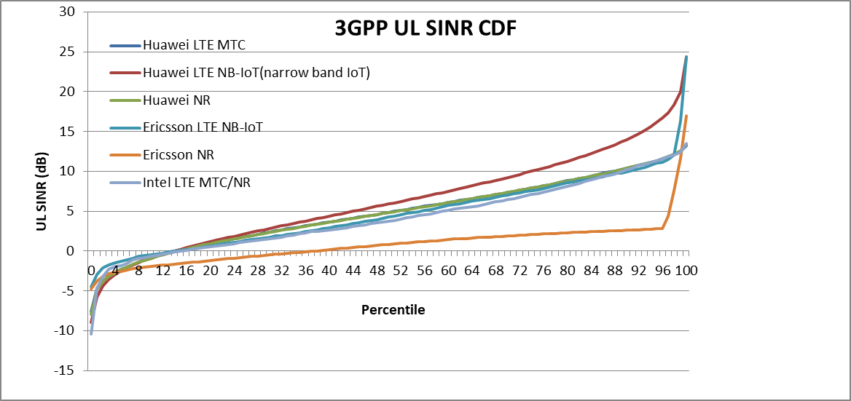
mMTC: Analytical evaluation of 802.11ax
From the perspective of spectral efficiency, it is easy to support mMTC as each device may require at most O(100) microseconds to transmit the required small packet even with BPSK/QPSK.
The limiting factor is the 10s or less delay to be supported even at 1%ile SINR.
The mMTC 1%ile SINR can be low, due to the high loss for some of the Indoor UEs.
Problem is more acute at the UL, since DL has a much higher transmit power (49 dBm at DL vs 23 dBm UL).
3GPP has simulated the SINRs in the mMTC topology and they get a 1%ile UL SINR of -5dB.
3GPP has assumed a simpler UE configuration of 1 Tx/Rx, in line with typical simple mMTC devices
This means that, 11ax has to support non-zero data rates at the following SINRs:
-5dB if it assumes 1 Tx/Rx as 3GPP
-2dB if it assumes 2 Tx/Rx, as allowed by IMT 2020.
While it may be possible today to meet the requirement at -2dB with advanced receivers in current Wi-Fi, it is much better if sensitivity is improved via HARQ. Also, smaller bandwidth allocation will help for coverage limited scenarios (for example 3GPP assumes min allocations of 180 KHz).
Note that while HARQ may sometimes improve spectral efficiency, it will always improve sensitivity relative to ARQ.

Slide 6
URLLC: Summary of requirements
Reliability: (1-10⁻⁵) success probability of transmitting a layer 2 PDU of 32 bytes within 1 ms at the coverage edge (5%ile SINR), at either DL and UL
User Plane Latency: 1 ms assuming unloaded conditions (i.e. a single user) for small IP packets (e.g. 0 byte payload + IP header), for both downlink and uplink.
Control Plane Latency: 20 ms (same as in eMBB)
Mobility Interruption time: 0 ms (same as in eMBB and needs to be addressed above IEEE 802.11)

Slide 7
URLLC: Key aspects of the evaluation scenario
One of 2 evaluation frequencies: 4 GHz and 700 MHz
Urban Macro environment (hexagonal layout, 1 site with 3 TRxPs addressing 3 sectors or hexagons)
ISD of 500m
UEs: 80% outdoor, 20% indoor,
Buildings 100% low loss.
TRxP Tx Power 49 dBm (20 MHz bandwidth)
UE Tx power 23 dBm
10 UEs per TRxP
Antenna configuration:
  TRxP: 64 Tx/Rx for 700 MHz, 256 Tx/Rx for 4 GHz
  UE: 4 Tx/Rx for 700 MHz, 8 Tx/Rx for 4 GHz
UE speed 3 km/hr Indoor and 30 km/hr Outdoor
System bandwidth of up to 100 MHz (can be distributed across TRxPs)
The reliability and user plane latency requirements must be met at the 5th percentile downlink or uplink SINR value obtained in the above evaluation scenario.

Slide 8
URLLC: Analytical evaluation of 802.11ax
Similar to mMTC, the limiting factor is achieving (1-10⁻⁵) success probability of transmitting the required small packet and with 1 ms latency at the 5%ile SINR
This requires non-zero data rate with near zero error probability to be supported at 5%ile SINR (possibly with retransmissions)
5%ile SINR from 3GPP simulations varies between -2dB to 2dB (there is wide variation between results from different companies)
11ax may be able to meet the requirement at this SINRs. However, here too, HARQ may become very crucial to meet the very low error probability (0.001% error) at such low SINRs.

Slide 9
References
[1] IEEE P802.11ax™/D3.0, “Draft Standard for Information technology Tele-communications and information exchange between systems Local and metropolitan area networks— Specific requirements Part 11: Wireless LAN Medium Access Control (MAC) and Physical Layer (PHY) Specifications; Amendment 6: Enhancements for High Efficiency WLAN” – June 2018
[2] Report ITU-R M.2412-0 (10/2017), Guidelines for evaluation of radio interface technologies for IMT-2020
[3] Report ITU-R M.2410-0 (11/2017), Minimum requirements related to technical performance for IMT-2020 radio interface(s)

