Slide 1
VLC based Simulation Results in Enterprise and Industrial Environment
Date: 2019-05-12
Authors:
Name | Company | Address | Phone | Email
Jeong Gon Kim Ho Kyung Yu | Korea Polytechnic University | 237 Sangidaehak Ro, Si Heung, Kyunggi Do., 15073 Korea | +823180410486 | jgkim@kpu.ac.kr
Vinayagam Mariappan Jae Sang Cha | Seoul National University of Science and Technology | 232 Gongneung-ro, Nowon-gu, Seoul, 01811, Korea | +811043455985 | chajs@seoultech.ac.kr

Slide 2
Summary
Current Status of Simulation Methodology
  Only multi carrier modulation, DCO-OFDM, is mentioned for PHY evaluation in doc. 11-19-0187-02.
  The optical frontend model is proposed for detailed link level simulations in doc. 11-19-0087-01.
  To extend the VLC application, single carrier modulation format can
  be considered in order to include low rate based various IoT application
It is needed to investigate the single carrier modulation other than OFDM
  Single carrier modulation that meet 10Mbps requirement need to be considered
  for IoT application.
  Link level simulation for single carrier (OOK, 4PAM, 8PAM) is presented
  BER and throughput are shown based on the CIR models and Optical frontend model for Industrial Wireless(CIR D7) and Enterprise(CIRs D1 and D2) environment.
  Single Carrier and Multi Carrier need to be considered for support of various data rate and the complexity of implementation

Slide 3
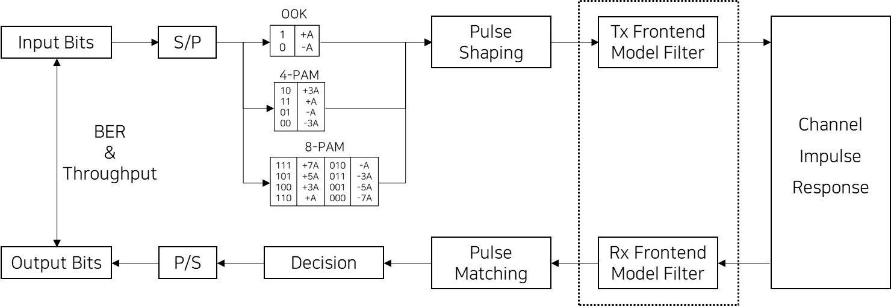
Single Carrier Modulation Overview and Frontend model integration

Slide 4
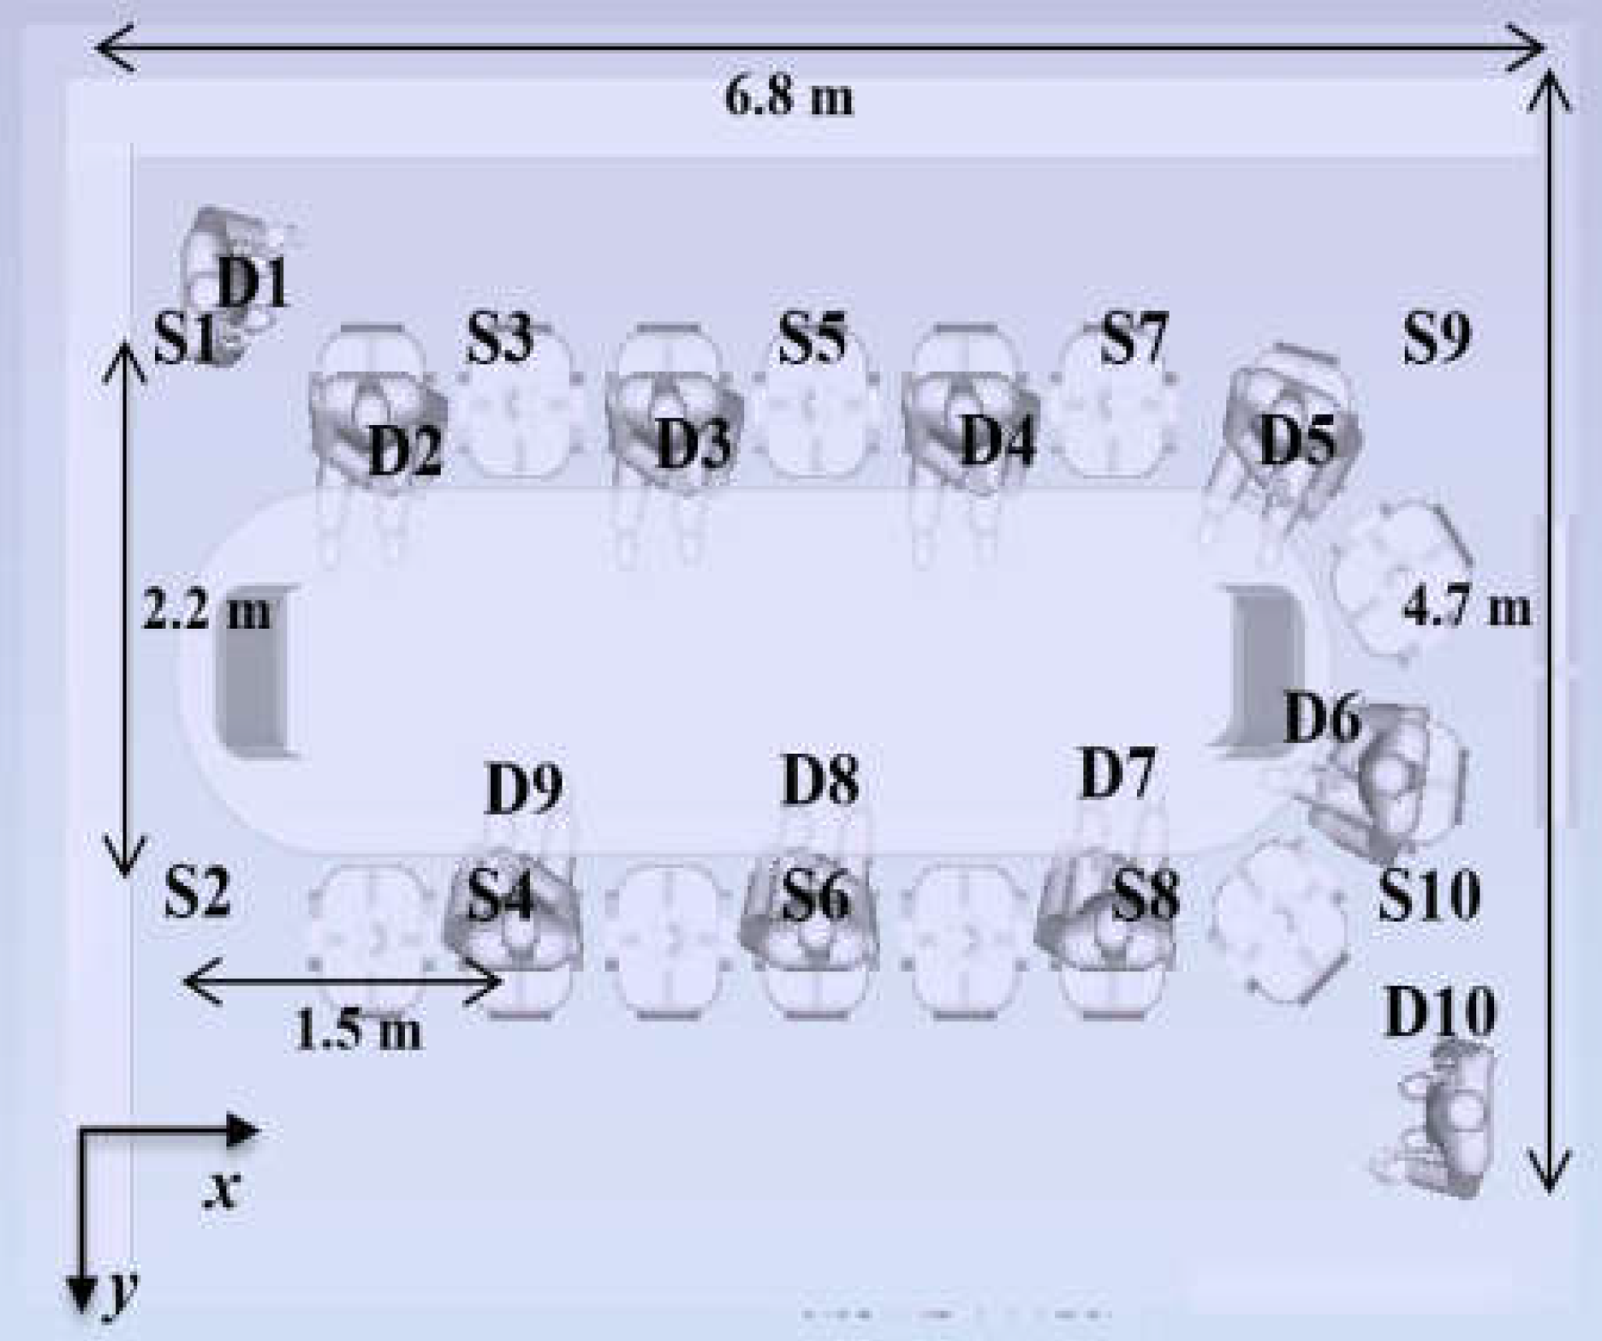
Enterprise System Model
  Topology for enterprise scenario
Conference Room in Enterprise Scenario
  Dimension : 6.8m x 4.7m x 3m
  10 LED Transmitter, 10 PD based Photo Detector

Slide 5
Set of Simulation Scenario and Parameters
 | Scenario Name | Topology | Management | Channel Model | Traffic profile [tentative]
1 | Enterprise | C - Dense small BSSs e.g. ~ 6.8 m × 4.7 m × 3 m size, ~1-3m inter AP distance, ~5 STAs/light, P2P pairs | Managed | Indoor- Office | Enterprise
Parameter | Value
Number of bits | 1,000,000
Number of repeated counts | 100
TX beam angle of AP | 40 degrees
FOV of Rx | 85 degrees
Point of Tx | S1, S3
Point of Rx | D1, D2
noise floor | -70dBm
Optical Channel Impulse Response(CIR) | S1-D1, S1- D2, S3-D1, S3-D2 [4][5]

Slide 6
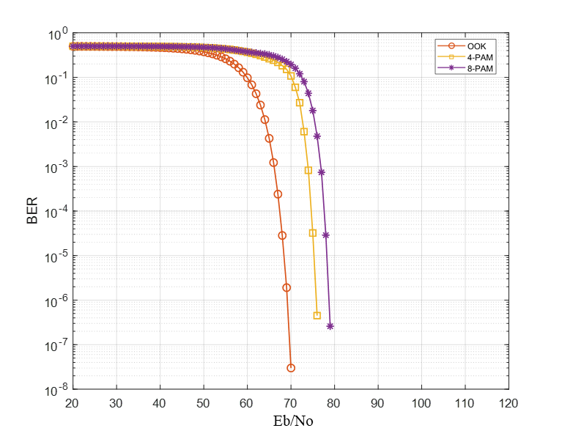
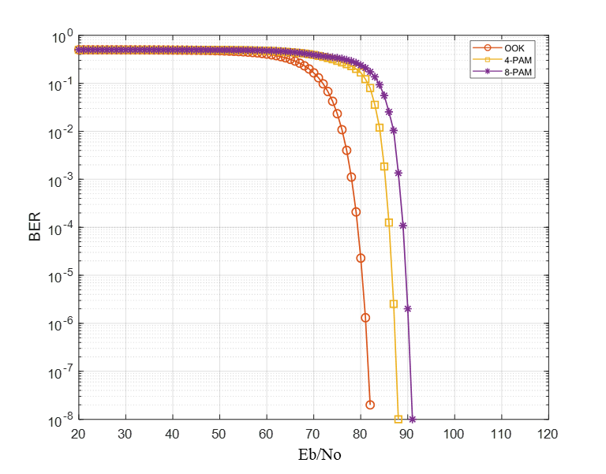

BER Simulation Results(S1-D1, D2)
S1-D1
S1-D2

Slide 7
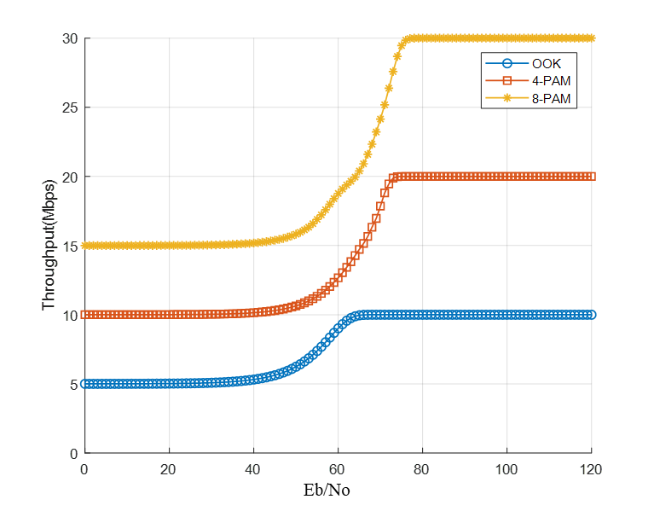
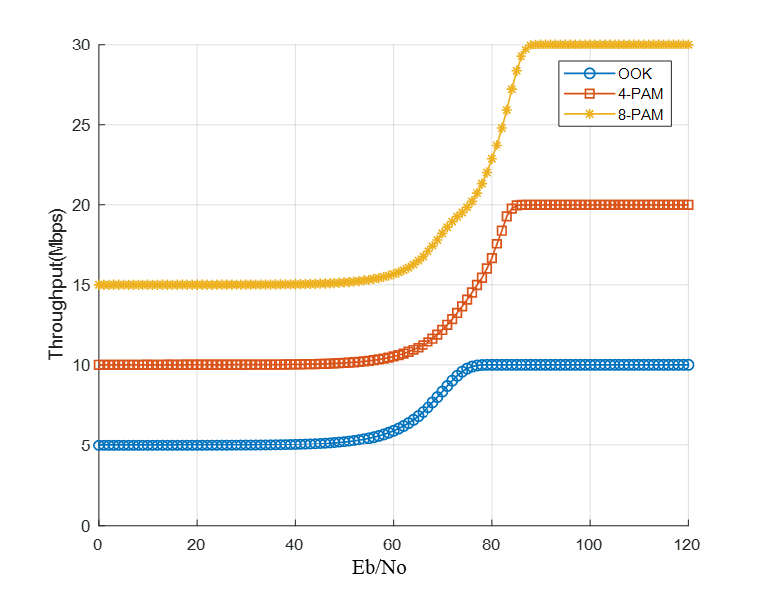
Simulation Results for Throughput(S1-D1, D2)
S1-D1
S1-D2

Slide 8
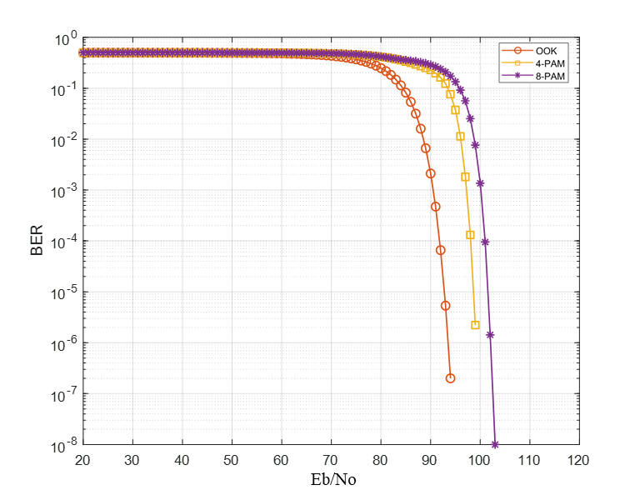
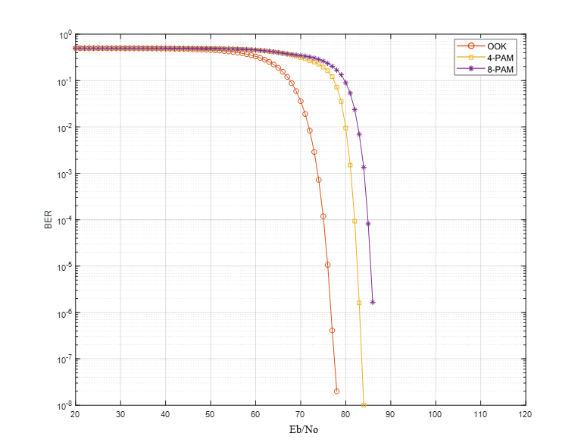
BER Simulation Results(S3-D1, D2)
S1-D1
S1-D2

Slide 9
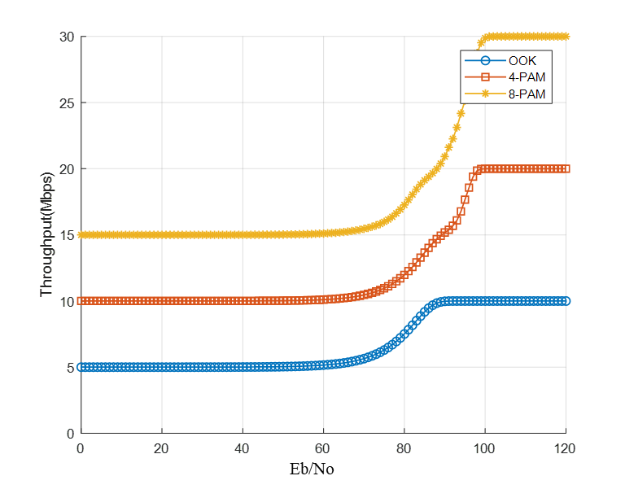
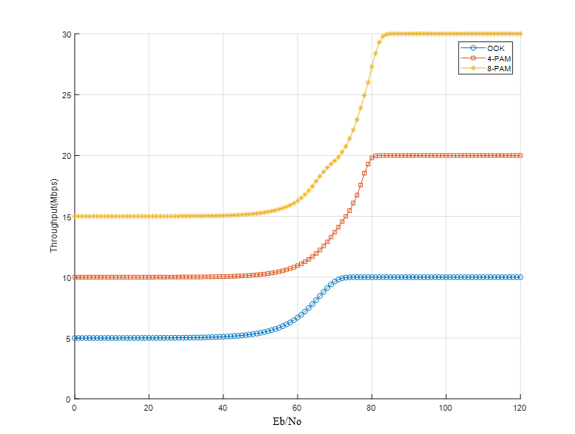
Simulation Results for Throughput(S3-D1, D2)
S3-D1
S3-D2

Slide 10
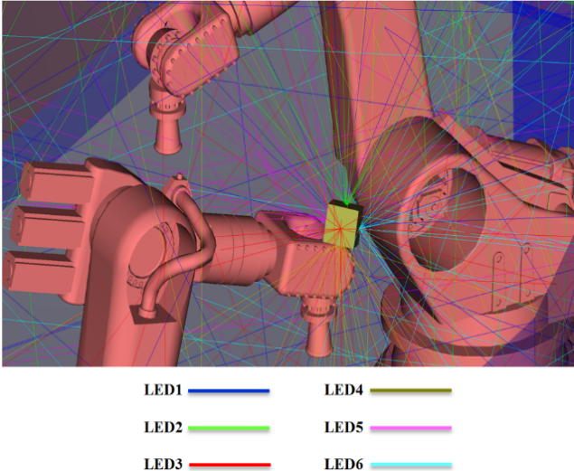
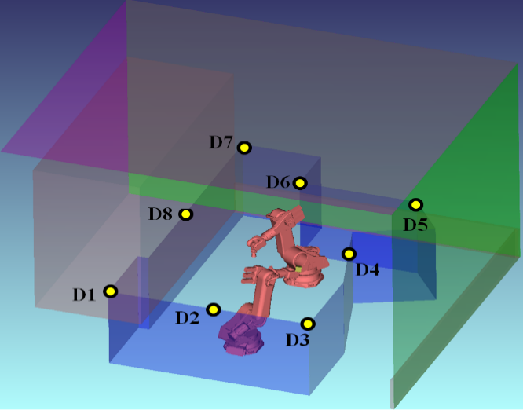
Industrial Wireless System Model
  Scenario for Transmitter
  Scenario for Receiver
Industrial Wireless Scenario
  Dimension : 8m x 10m x 7m
  1 LED Transmitter, 8 PD based Photo Detector

Slide 11
Set of Simulation Scenario and Parameters
 | Scenario Name | Topology | Management | Channel Model | Traffic profile [tentative]
1 | Industrial wireless | A – Industrial Robotic work cell e.g. ~8 m × 10 m × 7 m size, ~2 STAs/AP, P2P pairs | Managed | Indoor- Manufacturing Cell | Industrial
Parameter | Value
Number of bits | 1,000,000
Number of repeated counts | 100
TX beam angle of AP | 60 degrees
FOV of Rx | 85 degrees
Point of Tx | Overall (6 LEDs)
Point of Rx | D7
Noise floor | -70dBm
Optical Channel Impulse Response(CIR) | D7 [4][5]

Slide 12
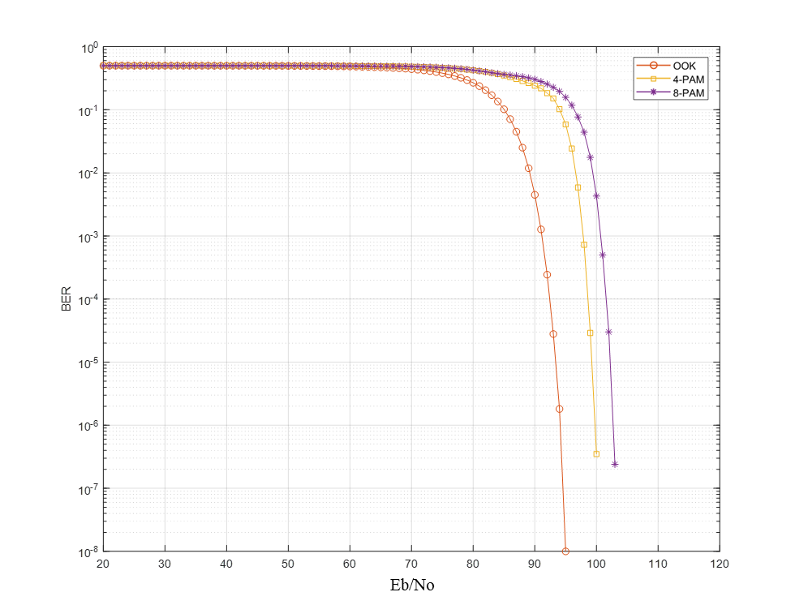
BER Simulation Results(D7)
Overall LED - D7

Slide 13
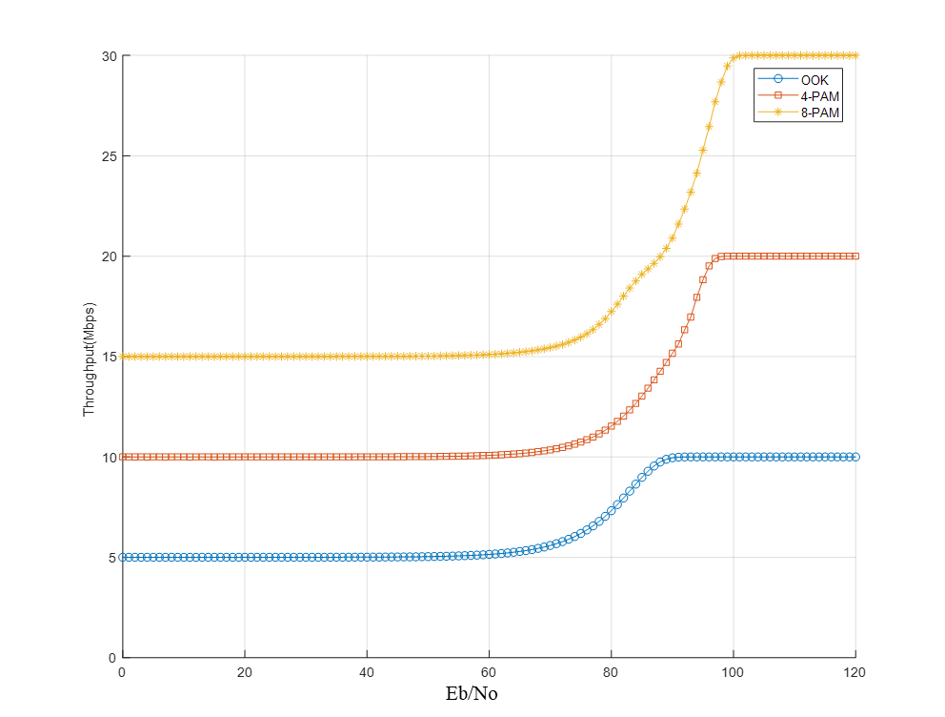
Simulation Results for Throughput(D7)
Overall LED - D7

Slide 14
Conclusion
It is observed that simulation for single carrier modulation using optical frontend model is investigated in the enterprise and industrial wireless environment.
OOK can be applied to some limited region and 8-PAM seems to be effective rather than 4-PAM regarding the tradeoff between BER and throughput.
It is considerable that single carrier rather than OFDM need
to be considered to provide the low data rate and IoT application in the future

Slide 15
References
[1] S. Dimitrov and H. Haas, “Principles of LED Light Communications
: Towards Networked Li-Fi” Cambridge University Press, 2015.
[2] Z. Ghassemlooy, W. Popoola, and S. Rajbhandari, “Optical wireless
communications: system and channel modelling with Matlab®“ CRC
Press, 2012.
[3] Oliver Luo,.“ 11-18-0556-01-00lc-modulation-schemes-for-optical-wireless-
communications”, IEEE TGbb, March 2018.
[4] Murat Uysal. et al. “11-18-1582-04-00bb-ieee-802-TGbb-reference-channel-
models-for-indoor-environments”, IEEE TGbb, November 2018.
[5] Kai Lennert Bober. et al. “11-19-0187-02-00bb-ieee-802-TGbb-Evaluation
methodology for PHY and MAC proposals”, IEEE TGbb, February 2019.
[6] Malte Hinrichs. et al. “11-19-0087-01-00bb-ieee-802-TGbb-optical-frontend-
model-for phy-simulation”, IEEE TGbb, January 2019.

