Slide 1
Current Status of submission about EUHT
Date: 2019-05-13
Authors:

Slide 2
Abstract
This presentation is a follow up work of the proposal about joint submission to ITU as IMT-2020 standard [1].
In this contribution, we present the current status of the joint submission in the perspective of EUHT.
The evaluation results show that EUHT can meet the ITU requirements[4].
The documents required for submission are ready.
Notes:
Here is the abstract.

Slide 3
Abbreviation
RIT ( Radio Interface Technology)
URLLC（Ultra-Reliable and Low Latency Communications）
eMBB（enhanced Mobile Broadband）
mMTC (massive Machine Type Communication)
LMLC (Low Mobility Large Cell )
NSA（Non-Standalone ）
EUHT（Enhanced Ultra High Throughput）

Slide 4
Outline
Background
Requirements Compliance
Submission Documents Status
Evaluation Results for Rural eMBB
Conclusion
References

Slide 5
Background
In the previous meeting, it was proposed that 11ax and EUHT are combined together to be submitted to ITU as SRIT (set of RIT) [1].
In [1], EUHT is proposed to meet the requirements of the following scenarios while 11ax meets the requirements of indoor and dense urban eMBB
Rural eMBB, Urban Marco URLLC and Urban Macro mMTC
The self-evaluation results must be submitted together with the technical documents before July 1st according to ITU[5].
Evaluation results of Urban Marco URLLC/ mMTC , Mobility( up to 500km/h) were presented in the previous teleconferences
11-19-0671-00, 11-19-0694-00, 11-19-0728-00
5 documents are required for submission
Technical Description，Self evaluation report，Link budget report，Requirements compliance report，Patent policy compliance declaration

Slide 6
Requirements Compliance

Slide 7
Evaluation Methodology (1)
Analytical Approach
Peak spectral efficiency
Peak data rate
User experienced data rate
Area traffic capacity calculation
Control plane latency
User plane latency
Mobility interruption time

Slide 8
Evaluation Methodology (2)
System Simulation Approach
Average spectral efficiency
5th percentile user spectral efficiency
Connection density
Mobility
Reliability
Inspection Approach
Bandwidth
Energy efficiency
Support of wide range of services
Supported spectrum band(s)/range(s)

Slide 9
Requirements Compliance (1)
Item | Requirement | EUHT | Note
Service capability requirements | Support for wide range of services | YES | The EUHT RIT can support rural-eMBB, URLLC and mMTC usage scenarios.
Compliance template for spectrum | Spectrum capability requirements
 | Frequency bands identified for IMT | YES | The EUHT RIT can support frequency range 1 (FR1)
 | Higher Frequency range/band(s) | YES | The EUHT RIT can support frequency range 1 (FR2)

Slide 10
Requirements Compliance (2)
Item | Requirement | EUHT | Note
Peak data rate (Gbit/s) | eMBB downlink 20 | 32.7~67.07 YES | The values are achieved by using 16-carrier aggregation
 | eMBB uplink 10 | 12.72~42.08 YES | The values are achieved by using 16-carrier aggregation
Peak spectral efficiency (bit/s/Hz) | eMBB downlink 30 | 30.0~52.4 YES | The values are achieved by using 16-carrier aggregation
 | eMBB uplink 15 | 16.6~52.6 YES | The values are achieved by using 16-carrier aggregation

Slide 11
Requirements Compliance (3)
Item | Requirement | EUHT | Note
5th percentile user spectral efficiency (bit/s/Hz) Rural – eMBB | Downlink 0.12 | 0.37 | For evaluation configuration B (4 GHz), Channel model B.
 | Uplink 0.045 | 0.13
 | Downlink 0.12 | 0.21 | For evaluation configuration C (LMLC), Channel model A.
 | Uplink 0.045 | 0.06

Slide 12
Requirements Compliance (4)
Item | Requirement | EUHT | Note
Average spectral efficiency (bit/s/Hz/ TRxP)Rural – eMBB | Downlink 3.3 | 8.6 | For evaluation configuration B (4 GHz), Channel model B.
 | Uplink 1.6 | 4.2
 | Downlink 3.3 | 6.5 | For evaluation configuration C (LMLC), Channel model A.
 | Uplink 1.6 | 3.6

Slide 13
Requirements Compliance (5)
Item | Requirement | EUHT | Note
User plane latency (ms) | eMBB downlink eMBB uplink 4 | 0.65~2.72 0.59~2.64 YES | 1/2/4 ms frame for eMBB
 | URLLC downlink URLLC uplink 1 | 0.65~0.91 0.59~0.84 YES | 1ms frame for URLLC
Control plane latency (ms) | eMBB 20 | 4~13 YES | 1/2 ms frame for eMBB
 | URLLC 20 | 4 YES | 1 ms frame for URLLC
Connection density (devices/km²) | Urban Macro – mMTC 1 000 000 | 126,763,209 (500 kHz) YES | configuration A (ISD=500m)
 | Urban Macro – mMTC 1 000 000 | 44,681,596 (500 kHz) YES | configuration B (ISD=1762m)

Slide 14
Requirements Compliance (6)
Item | Requirement | EUHT | Note
Energy efficiency | eMBB Capability to support a high sleep ratio and | Sleep ratio: 60%~99.5% Sleep duration: Up to 100ms. YES | Network side
 | eMBB long sleep duration | Sleep ratio: 80%~99.9% Sleep duration: Up to 1s . YES | Device side
Reliability Urban Macro –URLLC | 1-10⁻⁵ success probability (32 Bytes layer 2 PDU with in 1ms) Downlink | >99.999999% YES | Configuration A (4 GHz),
 | Uplink | >99.999999% YES | Configuration A

Slide 15
Requirements Compliance (7)
Item | Requirement | EUHT | Note
Mobility Traffic channel link data rates (bit/s/Hz) | Rural – eMBB Uplink 0.8 (120 km/h) | 1.23 YES | Configuration B (4 GHz), Channel model A, NLOS.
 | Rural – eMBB Uplink 0.45 (500 km/h) | 0.9 YES
Bandwidth and Scalability | At least 100 MHz Up to 1GHz(e.g. above 6 GHz) | YES
 | Support of multiple different bandwidth values⁽⁴⁾ | 4~11different component carrier bandwidth values

Slide 16
Submission Documents Status
Technical Description： 90%
Self evaluation report： 95%
Link budget report： 100%
Requirements compliance report： 100%
Patent policy compliance declaration： 100%

Slide 17
Evaluation Results for Rural eMBB

Slide 18
Simulation Configuration
Simulation bandwidth : 10 MHz
Carrier Frequency: 4GHz , 700MHz
BS Tx power : 46 dBm, UE Tx power: 23 dBm
BS Antenna gain: 8 dBi, UE antenna gain: 0 dBi
BS noise figure: 5 dB, UE noise figure : 7 dB
BS antenna configuration : dual polarization 8Tx/8Rx with 8 dBi gain in intended direction.
UE antenna configuration : dual polarization 8Tx/8Rx (4T4R for 700MHz) with with 0 dBi gain.
The complete configuration is specified in the ITU-R guidelines for self-evaluating a RAT ([3]).

Slide 19
Simulation Assumptions
TCH Payload : 1500 Byte
QPSK with repletion, QPSK, 16~256 QAM
LDPC, 1/2, 5/8, 3/4, 7/8 code rate
Up to 8 spatial stream ( 4 spatial stream for 700MHz) SU-MIMO
DPI( Dedicated Reference Symbol Period Interval) in time domain is 8
Every DRS symbol follows 8 OFDM symbols
Channel estimation based on 2-Dimension linear interpolation
Performance will be further improved with L-MMSE channel estimation
Maximum Ratio Combining
Min-sum LDPC decoding

Slide 20
Minimum Requirements
The minimum requirements in rural eMBB in [4] are quoted as follows
Items | Requirement
Average Spectral Efficiency | Downlink: 3.3 bit/s/Hz Uplink: 1.6 bit/s/Hz
5th percentile user spectral efficiency | Downlink: 0.12 bit/s/Hz Uplink: 0.045 bit/s/Hz

Slide 21
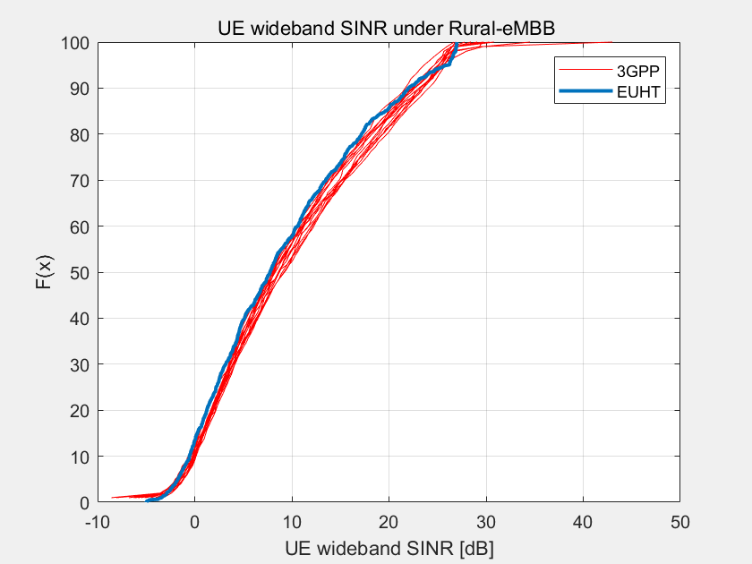
Simulation Calibration
SINR CDF matches the simulation results in 3GPP RT-180010

Slide 22
Simulation Results
DL/UL | Environment | Required SE (bit/s/Hz) | Performance Bit/s/Hz
DL | Rurual eMBB 4GHz, 8T8R | Average: 3.3 | 8.6
 |  | 5%: 0.12 | 0.37
 | Rurual eMBB 700MHz LMLC | Average: 3.3 | 6.5
 |  | 5% : 0.12 | 0.21
UL | Rurual eMBB 4GHz | Average : 1.6 | 4.2
 |  | 5% : 0.045 | 0.13
 | Rurual eMBB 700MHz LMLC | Average : 1.6 | 3.6
 |  | 5% : 0.045 | 0.06
Better performance is expected with MU-MIMO

Slide 23
Conclusion
The evaluation results show that EUHT can meet the requirements of IMT-2020 in rural eMBB, URLLC and mMTC scenarios.
The required documents for submission are complete.

Slide 24
Reference
[1] IEEE 802.11-19/0625r0, Proposal to Cooperate to Submit 5G Standards
[2] IEEE 802.11-19/0869r0, EUHT Technical Brief
[3] Report ITU-R M.2412-0 (10/2017), Guidelines for evaluation of radio interface technologies for IMT-2020
[4] Report ITU-R M.2410-0 (11/2017), Minimum requirements related to technical performance for IMT-2020 radio interface(s)
[5] Report ITU-R M.2411-0 (11/2017) , Requirements, evaluation criteria and submission templates for the development of IMT-2020
[6] Document 5D/1050-E, Preliminary Description Template and Self-Evaluation of 3GPP 5G candidate for inclusion in IMT-2020

