Slide 1
P802.1CQ MAC Address Assignment Requirements
Date: 2019-05-12
Authors:

Slide 2
Abstract
This presentation provides a brief summary of the conclusions for P802.1CQ out of the discussions on impact of randomized MAC addresses at the 802.1 OmniRAN TG Jan 2019 interim meeting.
P802.1CQ: Standard for Local and Metropolitan Area Networks: Multicast and Local Address Assignment
  This standard specifies protocols, procedures, and management objects for locally-unique assignment of 48-bit and 64-bit addresses in IEEE 802 networks. Peer-to-peer address claiming and address server capabilities are specified.

Slide 3
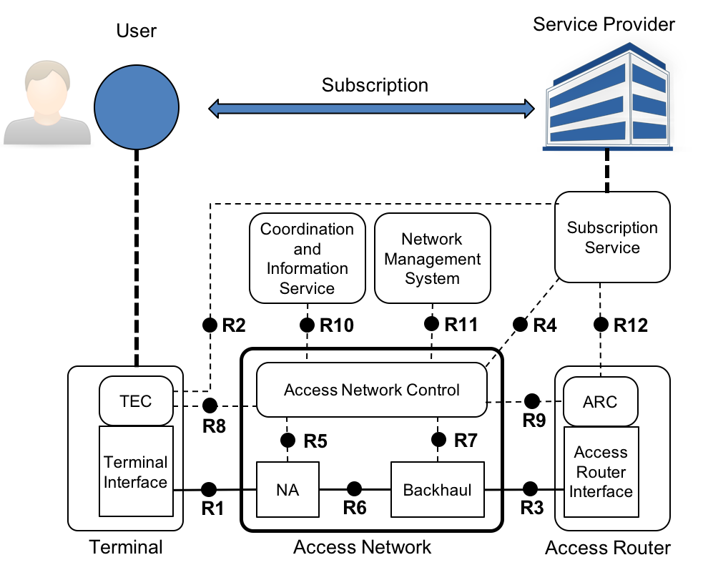
Random address discussions in OmniRAN TG
Triggered by WBA liaison to
IEEE 802.11 and Wi-Fi Alliance
  https://mentor.ieee.org/802.11/dcn/18/11-18-1579-01-0000-2018-09-liaison-from-wba-re-mac-randomization-impacts.docx
Issue arises through binding of a human user with the terminal interface identifier (MAC address)
  No major issue when user isn’t related to a human, e.g. if user is a control unit of a robot in a factory.

Slide 4
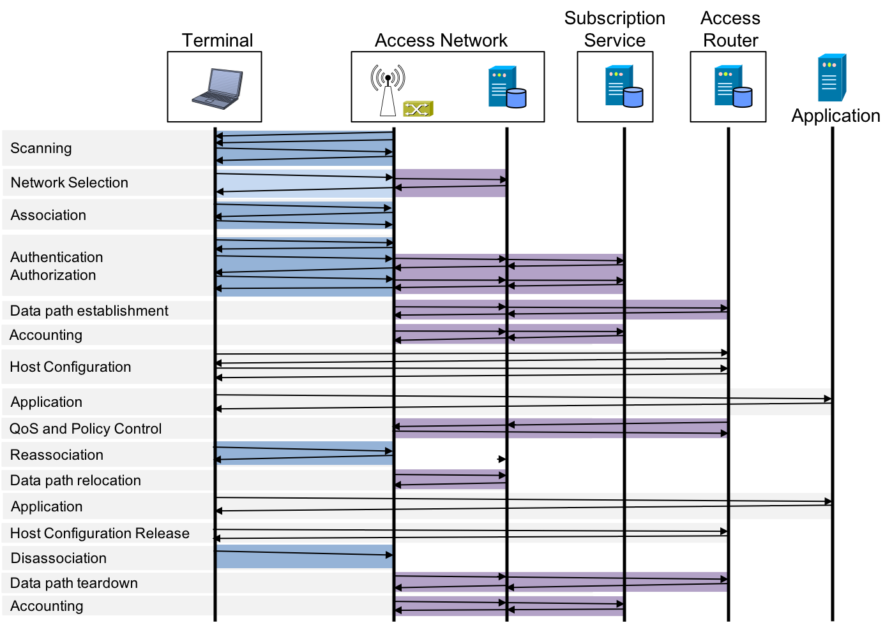
IEEE 802.1 Assumptions
Bridging protocols (main scope of IEEE 802.1) assume that MAC addresses of end-stations do not change while being connected to a bridge.
  From Association to Disassociation
P802.1CQ is currently the only 802.1 project dealing with end-station behavior
  Formerly, protocols for end-stations were out of scope for 802.1

Slide 5
P802.1Q position on MAC randomization
Discussion slides:
  https://mentor.ieee.org/omniran/dcn/19/omniran-19-0002-00-CQ00-random-mac-impact.pptx
Agreement reached that WBA use cases are legitimate reasons to provide the possibility to assign static device identifier to stations for initiating the dynamic MAC address assignment
  Static device identifier allows LAAP to assign fixed MAC addresses to devices.
Conclusions:
  Protocol proposal will allow for secure signaling of a static device identifier to the access network
  Functional requirements section will describe the need to provide the possibility of fixed device identifiers

