Slide 1
TGbb PHY proposal
Date: April 24, 2019
Authors:

Slide 2
Abstract
This presentation aims to provide a suggestion on the integration of a PHY layer that could enable existing .11 PHY specifications to be applied for LC as well as the introduction of a new LC PHY to provide enhanced optimization for higher throughput and enhanced robustness in frequency-selective channels.

Slide 3
Introduction
TGbb pre-proposal was discussed in do. 11-19/0388r0.

Slide 4
LC PHY Options
 | Existing 802.11 PHY | LC-optimized PHY
Main difference | - 20-160 MHz bit-interleaved coded modulation | 25…200 MHz closed-loop adaptive bitloading
Pro | existing IEEE 802.11 technology more advanced MIMO schemes | existing ITU-T G.vlc technology good performance in frequency-selective channel
Con | suboptimal performance in frequency-selective channel | needs liaison btw. IEEE and ITU-T

Slide 5
Characteristics of LC PHYs
LC requires a non-negative and real-valued baseband-signal.
Bipolar signals can be turned non-negative by adding a DC-bias before transmission.
It is removed by using a high-pass filter before reception.
optical
channel
TX
DSP
+
Driver & LED
Photo-diode
High-pass
RX
DSP
DC

Slide 6
Option 1) Use existing 802.11 PHYs for LC
Complex OFDM-baseband signals are real-valued after up-conversion to the carrier frequency f_{c}.
For LC, one could simply change f_{c} to a low carrier (“low IF”), yielding a real-valued baseband signal.
Data
IFFT
CP
Up-con-
version
Re(.)
LED
f_{c}

Slide 7
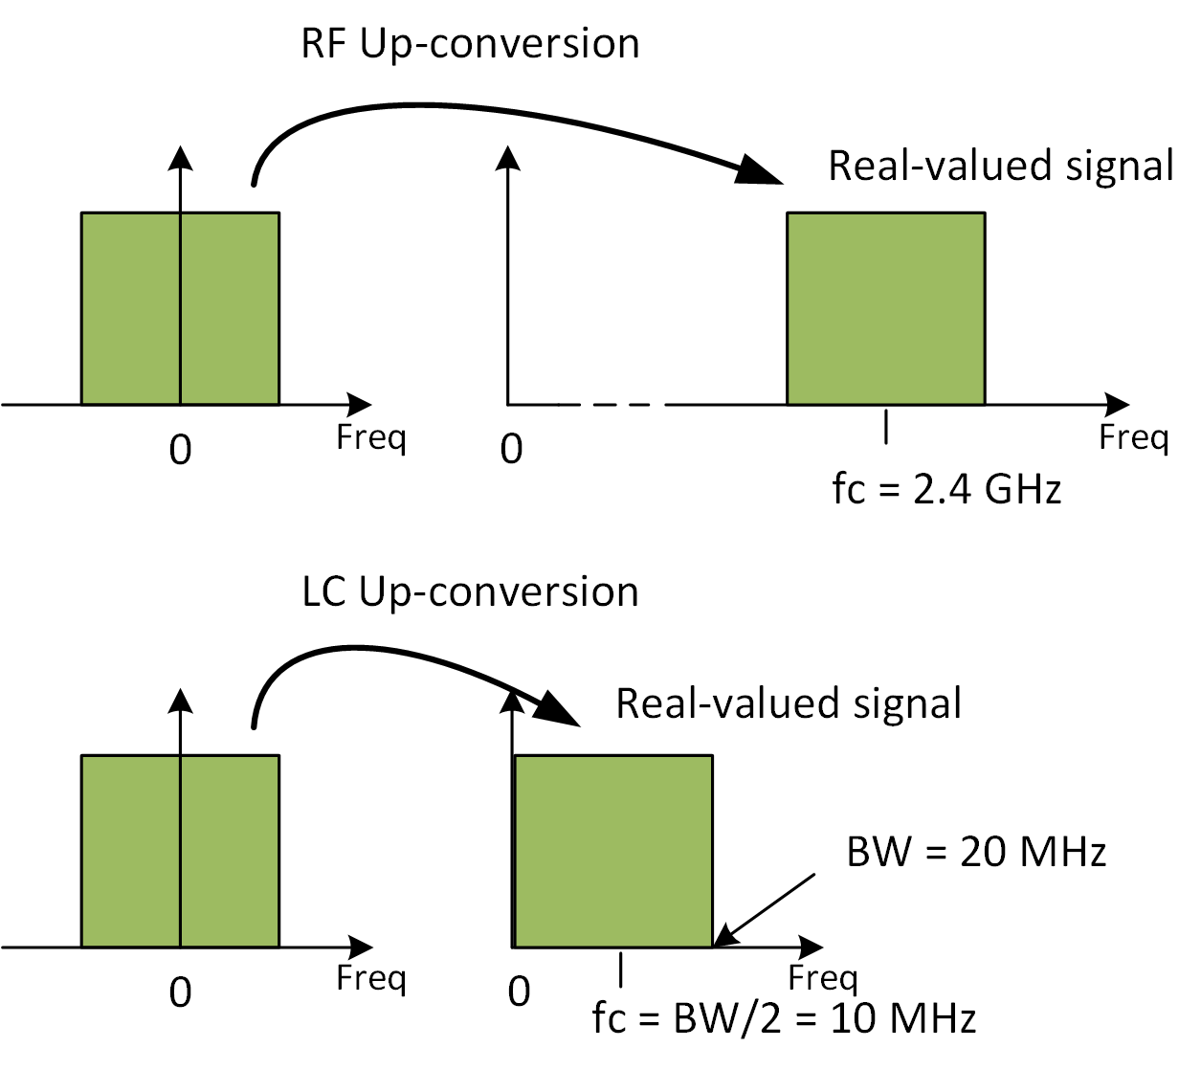
Using existing 802.11 PHYs for LC (2)
RF frontend up-converts
baseband signals onto e.g.
f_{c}=2.4 GHz.
LC frontend up-converts
baseband onto low IF e.g.
f_{c}=BW/2 + Δ.
  Δ is to be agreed depending on signal mask design.
This way, any complex-valued baseband signal (i.e. any existing IEEE 802.11 PHY) can be used to facilitate LC.

Slide 8
PROPOSAL: Baseband-offset (Δ)
Straw Poll:
Should the mandatory baseband offset (Δ) for existing 802.11 PHY modes as described in Slide 6 be set to 1.5 MHz for TGbb?
Y/N/A

Slide 9
Option 2) Use a LC-optimized PHY
The LC-optimized PHY benefits from adaptive bitloading
  Adaptive bitloading is widely used in LC R&D papers
  Brings enhanced mobility support and optimized PHY performance
  Seamless operation in both, LOS and NLOS channel conditions
Ways to bring adaptive bitloading into 802.11
  Integrate G.hn as LC-optimized PHY under 802.11 MAC

Slide 10
Use existing and LC-optimized PHY under 802.11 MAC
802.11 MAC could integrate existing and optimized PHY
Use existing 802.11ax PHY as a common, mandatory OFDM PHY.
Negotiate the use of the LC-optimized PHY if both devices have that capability.
802.11
MAC
Existing
PHY for LC
LC-Optimized
PHY

Slide 11
PROPOSAL: Use 11ax PHY as the common-mode for TGbb
Straw Poll:
Should the 11ax (High Efficiency PHY specification) be used as a mandatory, common-mode for TGbb?
Y/N/A

Slide 12
References
[1] V. Jungnickel, V. Pohl, S. Nonnig and C. von Helmolt, "A physical model of the wireless infrared communication channel," in IEEE Journal on Selected Areas in Communications, vol. 20, no. 3, pp. 631- 640, April 2002.
[2] https://mentor.ieee.org/802.11/dcn/18/11-18-1237-02-00bb-ieee-802-11bb-reference-channel-models-for-vehicular-communications.pdf
[3] ITU-T recommendation G.9660-2015
[4] P. W. Berenguer, V. Jungnickel and J. K. Fischer, "The benefit of frequency-selective rate adaptation for optical wireless communications," 2016 10th International Symposium on Communication Systems, Networks and Digital Signal Processing (CSNDSP), Prague, 2016, pp. 1-6.

