Slide 1
TGbb MAC Channel Access features proposal
Date: April 24, 2019
Authors:

Slide 2
Abstract
The presentation also provides the review of Multi-User (MU) operations in 802.11ax and suggestion on the modifications of channel access for TGbb.

Slide 3
Background on Channel Access in 802.11ax

Slide 4
HCF in 802.11ax
HCF consists of HCCA(with centralised controller) and EDCA(ad-hoc).
HCCA is not used in 802.11ax STAs.
Contention exists in:
  UL MU operation, UORA, DL MU operation, and non-UORA STAs
  Inside UORA

Slide 5
Top level contention
DL MU operation, UL MU operation, UORA, and non-UORA STAs all compete on the WM based on EDCA.
A STA that does not support UORA can contend for the WM using EDCA for sending UL frames to the AP with which it intends to communicate.
Non-UORA STA
Non-UORA STA
DL MU operation
UL MU operation
UORA
Backoff
Backoff
Backoff

Slide 6
Illustrations for MU operations in IEEE P802.11ax

Slide 7
DL MU operation (1)
One to many transmission
SIFS
HE MU PPDU to STA n
HE TB PPDU to ACK AP by STA n
…
…
…
HE MU PPDU to STA 2
HE TB PPDU to ACK AP by STA 2
Padding
HE MU PPDU to STA 1
HE TB PPDU to ACK AP by STA 1
Backoff

Slide 8
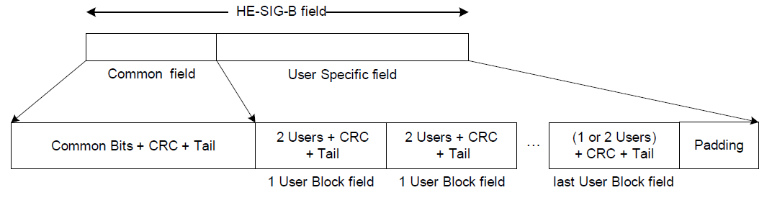
RU allocation
The HE-SIG-B field provides the OFDMA and DL MU-MIMO resource allocation information to allow the STAs to look up the corresponding resources to be used in the data portion of the frame.
One STA is not allowed to be allocated with multiple RUs in User Specific field. Up to one User field per STA.
User Field 1
User Field 2
Bit-loading can be supported with minor changes.
STA ID
NSTS
Tx beamforming
MCS
DCM
coding
Notes:
The User Specific field of an HE-SIG-B content channel consists of zero or more User Block fields followed by padding (if present). Each User Block field is made up of two User fields that contain information for two STAs to decode their payloads. The last User Block field may contain information for one or two STAs depending on the number of users indicated by the RU Allocation field and the Center 26-tone RU field.

Slide 9
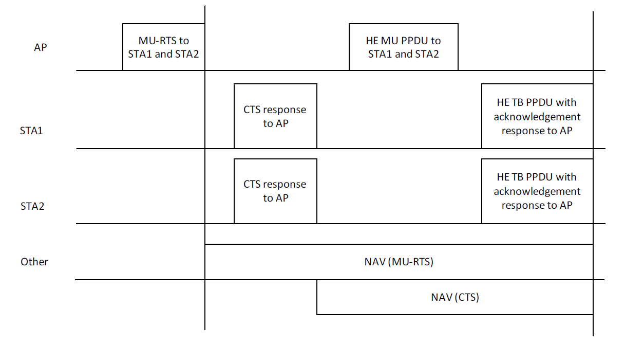
DL MU operation (2) – with MU-RTS/CTS
Early detection of failure

Slide 10
PROPOSAL: Modified DL MU operation
Allow STA to be allocated with multiple RUs in each cycle of the DL MU operation.
SIFS
HE MU PPDU to STA n
HE TB PPDU to ACK AP by STA n
…
…
…
HE MU PPDU to STA 2
HE TB PPDU to ACK AP by STA 2
HE MU PPDU to STA 2
HE TB PPDU to ACK AP by STA 2
Padding
HE MU PPDU to STA 1
HE TB PPDU to ACK AP by STA 1
Backoff

Slide 11
PROPOSAL: DL MU operation
To enable bit-loading on DL in TGbb using 11ax as a basis:
  The modification needs to allow multiple User Specific fields to be added for the same STA in HE-SIG-B.
  Revise the following text in IEEE P802.11axD3.0 to support bit-loading:
    L13-17pp488, 28.3.10.8.5, ‘The RU Allocation field in the Common filed and the position of the User field in the User Specific field together identify the RU used to transmit a STA’s date. Multiple RUs addressed to a single STA shall not be allowed in the User Specific field. Therefore, the signaling that enables STAs to decode their data is carried in only one User field. ’

Slide 12
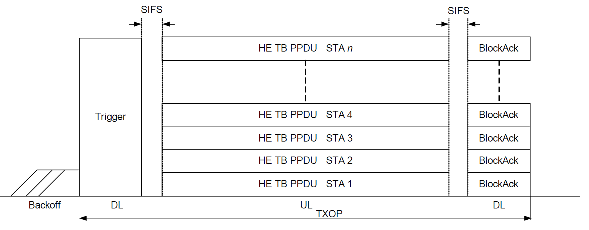
UL MU operation (1)
Dedicated allocation for all selected STAs
Multi‐STA BlockAck

Slide 13
UL MU operation (2)
Trigger frame
One selected STA, one RU allocated, one MCS selected.
Bit-loading can be supported with minor changes.

Slide 14
PROPOSAL: UL MU operation (3)
To enable bit-loading in TGbb using 11ax as a basis:
  Set the bit for ‘CS Required’ subfield in the ‘Common Info’ field of Trigger Frame as ‘0’, in order to disable the requirement of channel sensing before sending TB PPDU response.
  Revise the following text in IEEE P802.11axD3.0 to support bit-loading:
    L51-52pp286, 27.5.3.3, ‘The received PPDU contains either a Trigger frame (that is not an MU-RTS variant) with a User Info field addressed to the STA, ’
    L16-17pp287, 27.5.3.3, ‘A STA addressed by a User Info field in a Trigger frame (i.e., the AID12 subfield is equal to the 12 LSBs of the AID of the STA) may ignore the remainder of User Info fields in the Trigger frame. ’
    L11pp293, 27.5.3.5, ‘The CS Required subfield in the MU-RTS Trigger frame shall be set to 1. ’
    L23-26pp284, 27.5.3.2.3, ‘A Trigger frame shall not contain more than one User Info field with the same value in the AID12 subfield except when the value of the AID12 subfield is 0, or greater than 2007. ’

Slide 15
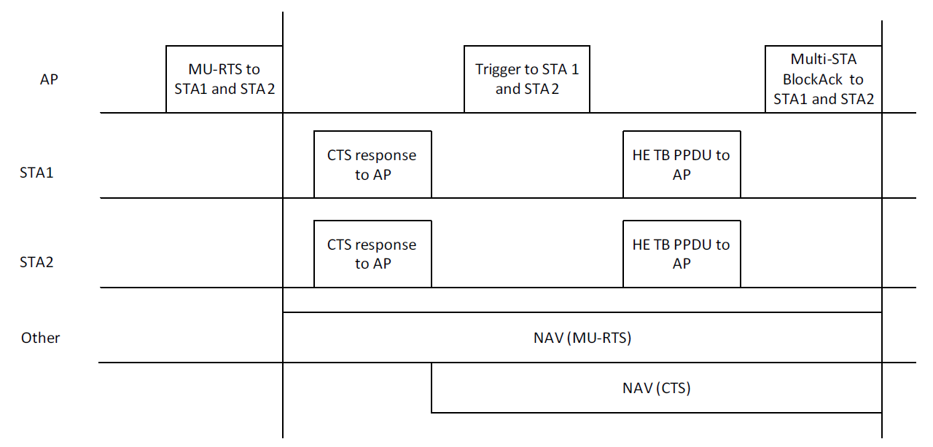
UL MU operation (4) – with MU-RTS/CTS
Dedicated allocation for all selected STAs; early detection of failure

Slide 16
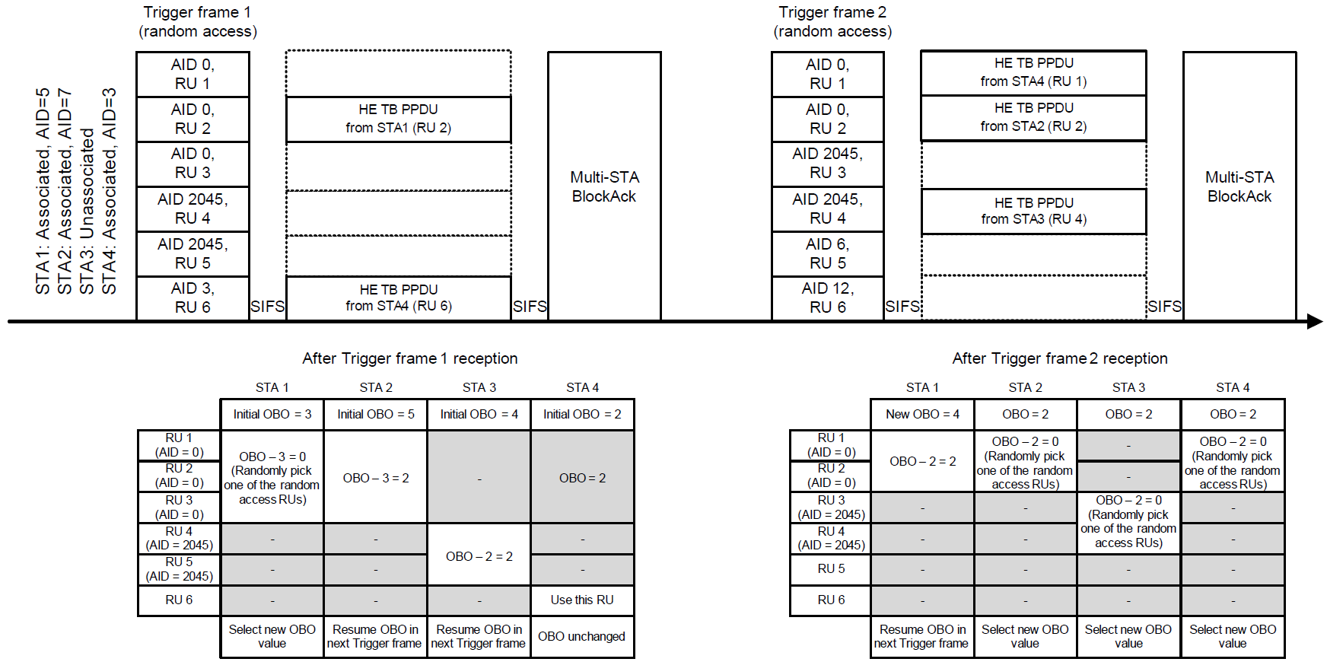
UORA (UL OFDMA-based Random Access)
No dedicated resource allocation for all STAs
Eligible STAs with OBO counter number (<= Available RUs for AID0/2045) compete for RA-RUs
Random selection of AID0/2045 RUs causes collisions
No knowledge after/if others selected any AID0/2045 RUs

Slide 17
PROPOSAL: Summary of changes for RA
Do not use UORA (UL OFDMA-based Random Access) in TGbb
  In the use cases of TGbb, no such frequent change in terms of existence is expected as in IEEE P802.11ax.
  The UORA is designed to serve large amount of users, which is also not the case in TGbb.
  Channel sensing in WiFi cannot easily migrate to TGbb.
Reserve a RU (Resource Unit) for random access in UL MU operation
  STAs know where to do RA.
  Benefits will also include fewer wasted resources, fewer collisions, fewer retransmissions.

Slide 18
PROPOSAL: Modified UL MU operation
Frequency
SIFS
SIFS
Trigger frame
AID 0,
RU 1
RU 1 is reserved for Random Access
Multi-STA BlockAck
AID 4,
RU 2
HE TB PPDU from STA of AID 4
AID 4,
RU 3
HE TB PPDU from STA of AID 1
AID 9,
RU 4
HE TB PPDU from STA of AID 9
AID 3,
RU 5
HE TB PPDU from STA of AID 3
AID 3,
RU 6
HE TB PPDU from STA of AID 6
Backoff
Time

Slide 19
PROPOSAL: Technical details
UORA (27.5.5 in IEEE P802.11axD3) is to be disabled due to the limitation on Channel Sensing for LC
Random access is introduced in UL MU operation (27.5.3 in IEEE P802.11axD3)
  In each Trigger frame sent by the AP in UL MU operation, the RU1 is reserved for random access. The AP shall set the AID12 subfield of a User Info field in the Trigger frame to 0 to indicate that the RA-RU is allocated for any un-selected STA.
  Different APs may reserve different RUs for random access in order to avoid collisions from OBSS. This could be considered in the future implementation.

Slide 20
List of related clauses/sub-clauses
DL MU operation (EDCA 27.5.1.1)
UL MU operation (EDCA 27.5.3.2.4)
MU-RTS/CTS procedure (EDCA 27.2.5)
STAs do not support UORA (EDCA 27.5.5.1)
Randomness in resource selection caused collision in UORA (27.5.5.3)
Trigger frame (9.3.1.23)

