Slide 1
Use Cases for 11bd using High Data Rate
Date: 2019-7-15
Authors:
Part of this work has been done under a project named "5G-MiEdge" supported by the European Commission Horizon 2020 and the Ministry of Internal affairs and Communications (MIC), Japan.

Slide 2
Abstract
This submission discusses use cases for 11bd [1] using high data rate
Reviews discussion and feedbacks to the initial proposal [2] during/after Bangkok meeting.
We propose:
to add a use case “V2V See-through” as one of the use cases for 11bd, that is supposed to be enabled using 60 GHz band due to high data rate requirements.
to add application examples for uploading to the RSUs to the existing use case, “4. Infrastructure Applications,” which currently defines downloading applications. Proposed applications are supposed to be enabled by 5.9 GHz or 60 GHz technologies.
[1] 11-18/1323r02 NGV SG Use Cases
[2] 11-18/1977r05 Use Cases for NGV using High Data Rate

Slide 3
Discussions during Bangkok meeting
For the proposed use case “Traffic Offloading to 60 GHz band,”
The majority was not-in-favor or abstaining to the SP during NGV Bangkok meeting in Nov.’18.
SP results: 14Y /12N/22A, Motion not taken
Proposed another use case, “Rich Sensor Sharing,” was voted down.
SP result: 22Y/7N/13A, Motion result: 20Y/8N/12A(failed)
Question focused on:
“11ax or 11ad/ay may realize “Traffic Offloading to 60 GHz band.” Also, Meaning of “Traffic Offloading” is unclear.”
“Lack of feasibility study especially on V2I scenario”

Slide 4
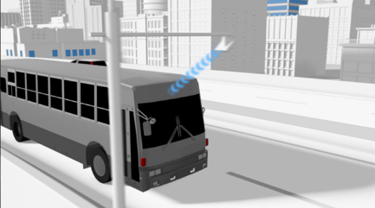
“11ax or 11ad/ay may realize it. Also, the meaning of “Traffic Offloading” is unclear.”
The previous proposal [2] failed to distinguish 11ac/ad/ay applications and V2X applications that should be focused in NGV/11bd.
Example applications we would like to propose to NGV/11bd are: downloading HD map, uploading pictures of obstacles, or potentially sensor data such as camera, radar or LiDAR data to combine to HD maps[3] in mobility scenarios.
These applications are potentially realized by 5.9GHz-NGV, but should realized more efficiently using 60 GHz band. (e.g. reducing congestion in 5.9GHz spectrum; providing more detailed map, ...)
60 GHz V2X communications/applications are used to complement 5.9 GHz V2X communications/applications rather than replacing them.
Downloading HD map is already covered by use case 4 in [1]. We propose to add the other applications shown above, which are related to uploading.
~60km/h
[3] Kei Sakaguchi, et. al., “Where, When, and How mmWave is Used in 5G and Beyond,” IEICE Trans. Electron., vol.E100-C, No.10, October 2017

Slide 5
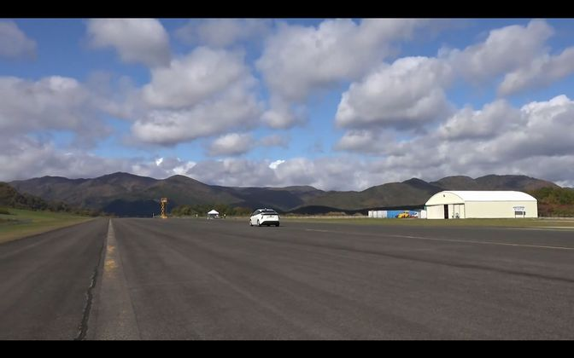
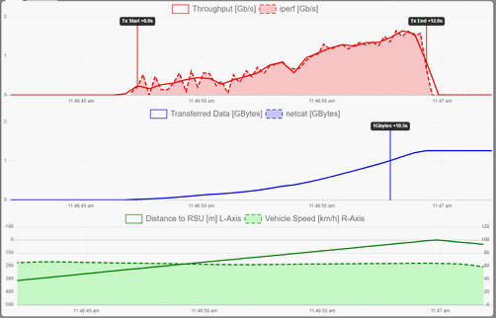
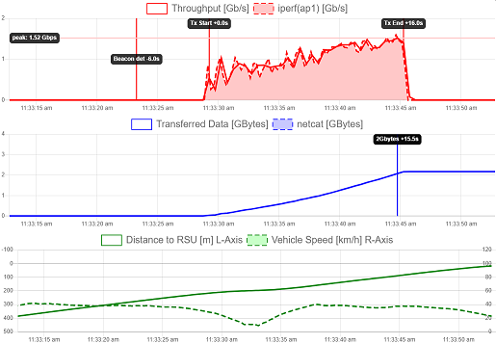
“Lack of feasibility study especially on V2I scenario”
We have conducted several testing and demonstration using actual 11ad devices. We ran 60-100km/h tests as reported in [4].
11ad PHY worked well, and realized >1Gbps. It was shown that it can transfer 100-1000 MBytes per one RSU at 60km/h depending on vehicles connecting to the RSU.
The PHY has suitable characteristic for “short time” uploading/downloading in several seconds and will enable applications shown in the previous slide.
Besides the T-put measurements, our other tests show initial link setup delay performance.
We observe <500 ms delay in typical cases without security procedure, with optimized parameters compliant with 11ad, but also measured >5 sec delay in some cases.
We would propose to consider improvement/optimization on higher MAC/MLME procedures (e.g. active scanning procedure) or consider OCB to support mobility required by the proposed applications.
6sec delay after
the beacon detection to completion of the association
[4] 11-19/0100r0 preliminary test results of 11ad-based 60GHz mmW for V2I use cases – measured in Japan, Nov.18
Measured in Singapore, Jan.19

Slide 6
Proposal(1)
Propose to add application examples using uploading to RSUs to “4. Infrastructure Applications.”
Currently the use case description mentions about downloading
The applications are enabled by 5.9GHz technologies, and optionally by 60 GHz
We withdraw proposal for “Traffic Offloading” that is realized only with 60 GHz band.

Slide 7
4. Infrastructure Applications
Overview: Transmission of safety and non-safety data from infrastructure to vehicles and from vehicles to infrastructure
High amount of data can be received in a short time, for example, CRL database or potentially HD map
High amount of data can be transmitted in a short time, for example, pictures of obstacles, animals or hazards, or potentially sensor data such as camera, radar or LiDAR data to construct/update dynamic maps
Deployment timeline: Now
Requirements:
High throughput (Packet NGV should carry higher number (>50%) of transmitted bytes than IEEE802.11p packet under same conditions)
Limitations:
Infrastructure should select usage of IEEE802.11p or NGV packet based on application and capabilities of vehicles in proximity
Higher layer (e.g. IEEE1609) protocol should be defined for version negotiation (out of NGV scope)

Slide 8
Review on “Rich Sensor Sharing”
Example applications included both V2I and V2V – intending general “bird’s eye view.”
After received a lot of feedbacks from the group, we understand we need further feasibility study on this challenging application before proceed PHY/MAC design/standardization.
A part of the application, V2V see-through is an important scenario and expected to be initially deployed as a rich sensor sharing application.
Scenarios include Platooning, and potentially CACC and general urban traffic.

Slide 9
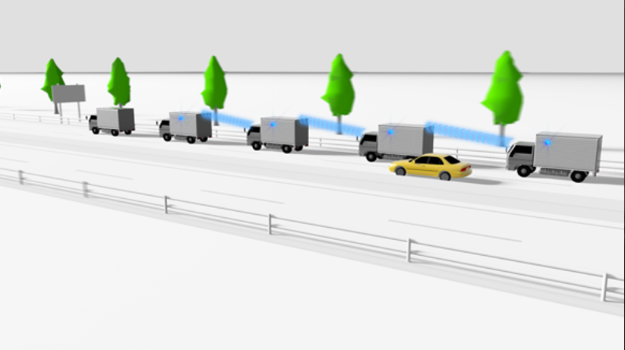
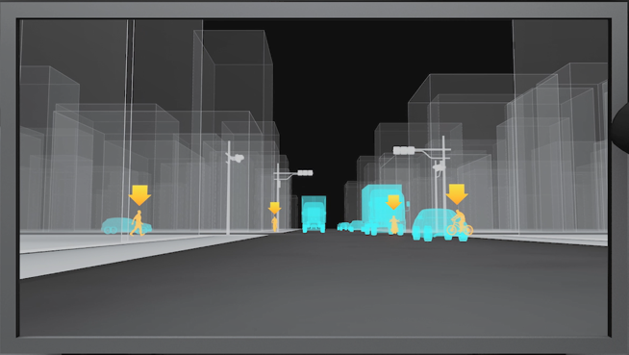
Proposal(2): V2V See-through
V2V See-through for Platoon
V2V See-through via connected vehicles
Vehicles share their own views to the neighbor vehicles to provide see-through views
Platooning: for driver assistance or conditional automated driving
The driver at the 1st car can watch the view around the whole platoon
In case each car has a driver, each driver can watch the view around the platoon
Cooperative perception / Realtime situation awareness in Urban:
Vehicles may share camera, radar and/or LiDAR data for driver assistance or conditional/full automated driving

Slide 10
Target performance
Example application: Real-time video sharing in truck platooning
Trucks in the platooning share high data rate sensor data, e.g. camera picture or LiDAR data each other
Small size messages (e.g. for control) are transmitted over different (5.9 GHz) band. 60 GHz band carries large data.
Trucks in the middle of the platoon re-transmit (or relay) the pictures from the other trucks.
The 2nd and 3rd tracks from the leading truck require 5Tx + 3Rx streams for transmission of its own pictures and retransmission in 4-car platooning.
(N+1) Tx and (N-1) Rx are required for N-car platooning
We assume 4~5 trucks in the platoon (about 100m platoon length)
Assume one STA for each truck
Example - platooning with 4 vehicles
📷
picture from car#1
📷
picture from car#1
📷
picture from car#1
📷
📷
📷
📷
📷
picture from car#2
picture from car#2
picture from car#2
picture from car#3
picture from car#3
picture from car#3
picture from car#4
picture from car#4
picture from car#4

Slide 11
Target performance (cont’d)
Data rate
Example estimation for the platooning
1280 x 720, 60 fps, H265/HEVC: ~20Mbps
x2 camera per vehicle
x10 (6Tx+4Rx) streams (for 5-car platooning)
-> 400 Mbps
Another required data rate example: [3] suggested the estimation of 80-560 Mbps for LiDAR sensors, 160-320 Mbps for cameras
We propose 1 Gbps as the target performance
400 Mbps (camera) + 560 Mbps (LiDAR) + 50 Mbps (the other sensor/application data)
[3] Kei Sakaguchi, et. al., “Where, When, and How mmWave is Used in 5G and Beyond,” IEICE Trans. Electron., vol.E100-C, No.10, October 2017

Slide 12
Target performance (cont’d)
Latency
As one of the example reference, the UN regulation No.46 for camera-monitor system (CMS) [4] specifies the system latency of 200 ms and frame rate of at least 30 Hz for indirect vision.
200 ms is the minimum requirement, and the actual products require better latency (e.g. 100ms) considering existing indirect vision produces.
We propose 10 ms latency for single wireless link as the target performance that is defined as end-to-end latency at the application layer.
example time budget
📷
📷
📷
📷
📷
📷
📷
📷
📷
📷
32ms decoder
+ display
10ms wireless link
10ms wireless link
10ms wireless link
10ms wireless link
32ms camera
+ encoder
40 ms end-to-end communication (measured at application layer)
104 ms camera to display

Slide 13
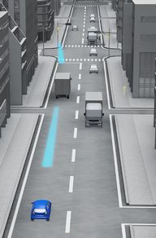
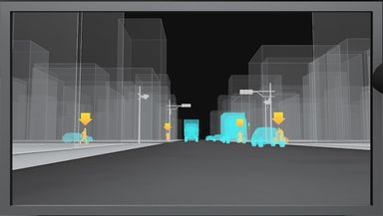
Target performance (cont’d)
Relative speed in an example scenario
The following vehicle starts to accelerate 2 seconds after the preceding vehicle started. Assuming 0.25 G=8.826 (km/h)/s
Relative speed will be 8.826*2 = 17.7 km/h (~= 20km/h)
Propose target relative speed of ~60x2=120 km/h in urban scenario
t=0
t=2
0.25 G
0 km/h
0 G
0 km/h
0.25 G
17.7 km/h
0.25 G
0km/h

Slide 14
N. V2V see-through
Overview: Vehicles share their own views to each other to construct see-through view
the views are used for safety and driver/passengers usage
example scenario: (1)platooning, (2)urban traffic
Target performance:
>1 Gbps max data rate
10 ms end-to-end latency at the application layer per single wireless link
~120 km/h relative speed

Slide 15
Conclusion
This submission proposed applications and use case to add to 11bd use case.
V2V See-through is a use case using 60 GHz band. And the band may also contribute to the realization of high-data rate Infrastructure Applications.
In both cases, 60 GHz V2X communications/applications are used to complement 5.9 GHz V2X communications/applications rather than replacing them.

Slide 16
References
[1] 11-18/1323r02 NGV SG Use Cases
[2] 11-18/1977r05 Use Cases for NGV using High Data Rate
[3] Kei Sakaguchi, et. al., “Where, When, and How mmWave is Used in 5G and Beyond,” IEICE Trans. Electron., vol.E100-C, No.10, October 2017
[4] 11-19/0100r0 preliminary test results of 11ad-based 60GHz mmW for V2I use cases
[5] ECE/TRANS/WP.29/2015/84 Proposal for Supplement 2 to the 04 series of amendments to Regulation No. 46 (Devices for indirect vision)

Slide 17
Straw Poll 1
Do you agree to adopt the text changes on “4. Infrastructure Applications” proposed in slide 7 to 11-18/1323r02 NGV SG Use Cases?
Y /N /A

Slide 18
Straw Poll 2
Do you agree to add the “V2V See-through” use case on slide 14 to 11-18/1323r02 NGV SG Use Cases?
Y /N /A

