Slide 1
Performance Evaluation of 16 Spatial Stream based MU-MIMO
Date: 2019-00-xx
Authors:
Name | Affiliation | Address | Phone | Email
Junghoon Suh | Huawei |  |  | junghoon.suh@huawei.com
Osama Aboul-Magd |  |  |  | osama.aboulmagd@huawei.com
Edward Au |  |  |  | edward.ks.au@huawei.com

Slide 2
Background
Number of Spatial Streams will be extended to 16 streams in the EHT
We evaluated the Performance of 16 Stream based MU-MIMO with the different MIMO Detection schemes

Slide 3

Simulations Setting
16 TX MU-MIMO with 4, 6, and 8 STA MU-MIMO scheduling (2 streams each STA; 8, 12 and 16 total streams)
  16 LTF symbol based Channel Estimation for 12 and 16 total streams (6 and 8 STA MU-MIMO case)
  8 LTF symbol based Channel Estimation for 8 total streams (4 STA MU-MIMO case)
  Perfect sounding (No CSI Quantization error, No CSI feedback error, but real channel estimation using the 4X LTF based NDP)
  User Selection algorithm [1] to select from 8 total STAs for MU-MIMO scheduling
  Zero-forcing BF in the TX, and MMSE detection or Interference Whitening based MLD in each STA
  BCC for FEC
  MCS 1, 3, 5, and 7
  Packet size for PER: 400 bytes for MCS 1, 3, 5, and 500 bytes for MCS 7
  P-matrix for 16 Stream Channel Estimation in case of 16 LTF symbol based case
$P_{16X16}$=$\left[\begin{matrix}P_{8X8} & P_{8X8} \\ P_{8X8} & {−P}_{8X8}\end{matrix}\right]$

Slide 4
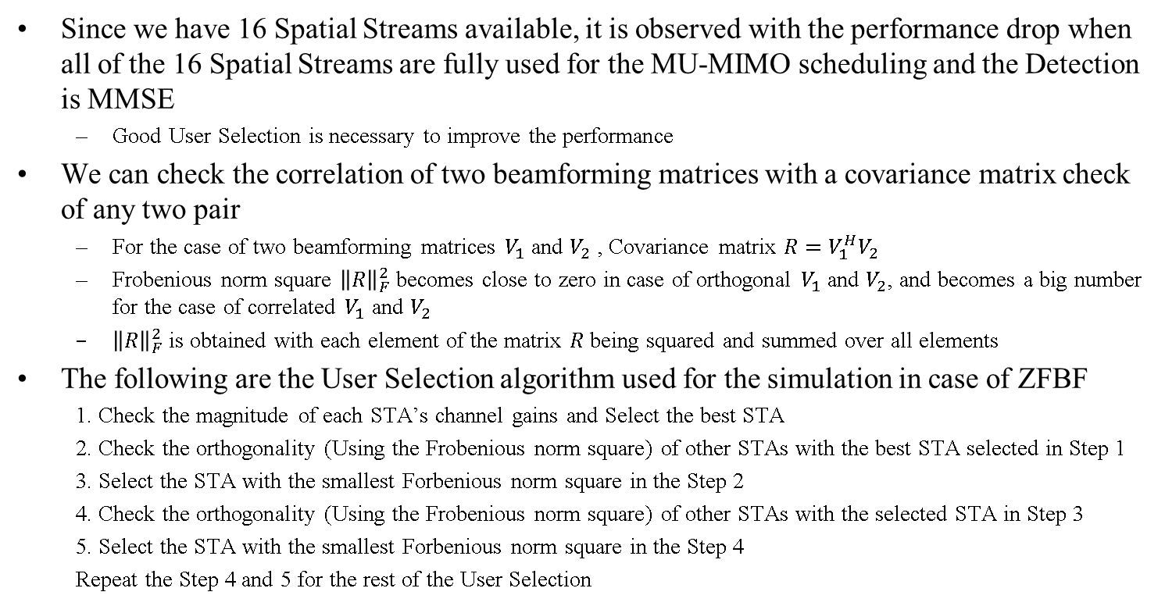
User Selection for MU-MIMO [1]
Since we have 16 Spatial Streams available, it is observed with the performance drop when all of the 16 Spatial Streams are fully used for the MU-MIMO scheduling and the Detection is MMSE
  Good User Selection is necessary to improve the performance
We can check the correlation of two beamforming matrices with a covariance matrix check of any two pair
  For the case of two beamforming matrices $V_{1}$ and $V_{2}$ , Covariance matrix $R=V_{1}^{H}V_{2}$
  Frobenious norm square ${\left\|R\right\|}_{F}^{2}$ becomes close to zero in case of orthogonal $V_{1}$ and $V_{2}$, and becomes a big number for the case of correlated $V_{1}$ and $V_{2}$
  ${\left\|R\right\|}_{F}^{2}$ is obtained with each element of the matrix $R$ being squared and summed over all elements
The following are the User Selection algorithm used for the simulation in case of ZFBF
  1. Check the magnitude of each STA’s channel gains and Select the best STA
  2. Check the orthogonality (Using the Frobenious norm square) of other STAs with the best STA selected in Step 1
  3. Select the STA with the smallest Forbenious norm square in the Step 2
  4. Check the orthogonality (Using the Frobenious norm square) of other STAs with the selected STA in Step 3
  5. Select the STA with the smallest Forbenious norm square in the Step 4
  Repeat the Step 4 and 5 for the rest of the User Selection

Slide 5
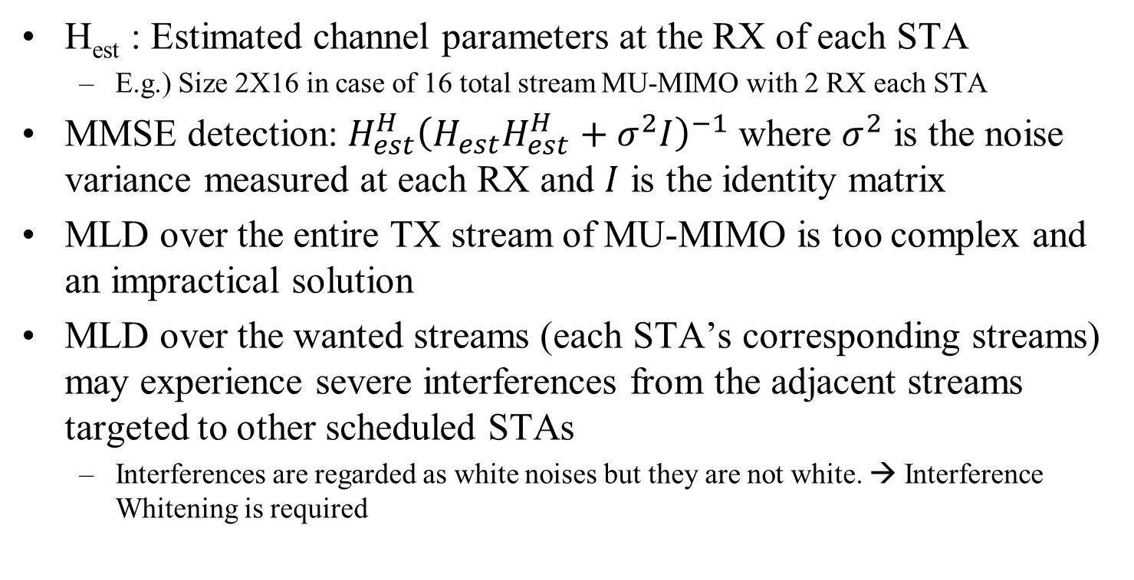
Why we need MLD with Interference Whitening
H_{est} : Estimated channel parameters at the RX of each STA
  E.g.) Size 2X16 in case of 16 total stream MU-MIMO with 2 RX each STA
MMSE detection: $H_{est}^{H}{\left(H_{est}H_{est}^{H}+σ^{2}I\right)}^{−1}$ where $σ^{2}$ is the noise variance measured at each RX and $I$ is the identity matrix
MLD over the entire TX stream of MU-MIMO is too complex and an impractical solution
MLD over the wanted streams (each STA’s corresponding streams) may experience severe interferences from the adjacent streams targeted to other scheduled STAs
  Interferences are regarded as white noises but they are not white. → Interference Whitening is required

Slide 6
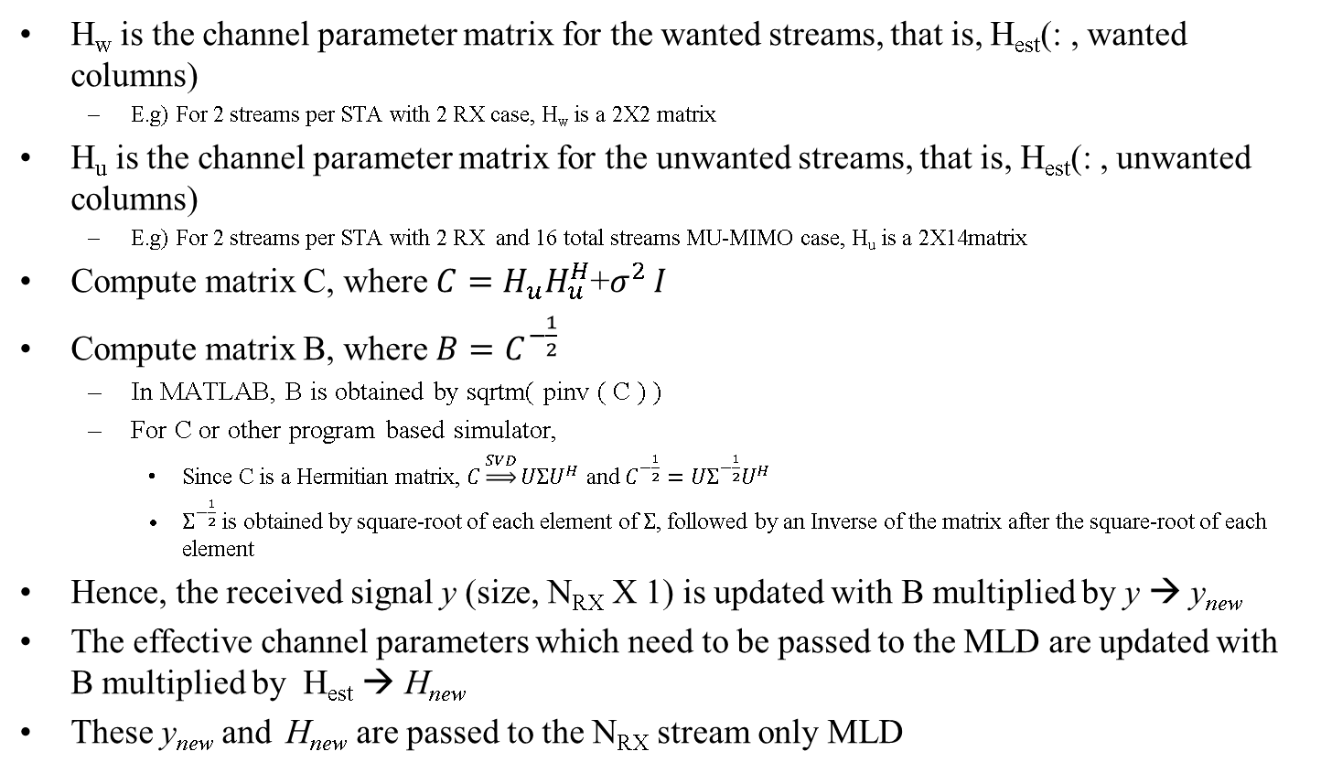
MLD with Interference Whitening
H_{w} is the channel parameter matrix for the wanted streams, that is, H_{est}(: , wanted columns)
  E.g) For 2 streams per STA with 2 RX case, H_{w} is a 2X2 matrix
H_{u} is the channel parameter matrix for the unwanted streams, that is, H_{est}(: , unwanted columns)
  E.g) For 2 streams per STA with 2 RX and 16 total streams MU-MIMO case, H_{u} is a 2X14matrix
Compute matrix C, where $C=H_{u}H_{u}^{H}$+$σ^{2 }I$
Compute matrix B, where $B=C^{−\frac{1}{2}}$
  In MATLAB, B is obtained by sqrtm( pinv ( C ) )
  For C or other program based simulator,
    Since C is a Hermitian matrix, $C\underset{⇒}{SVD}UΣU^{H}$ and $C^{−\frac{1}{2}}=UΣ^{−\frac{1}{2}}U^{H}$
    $Σ^{−\frac{1}{2}}$ is obtained by square-root of each element of $Σ$, followed by an Inverse of the matrix after the square-root of each element
Hence, the received signal y (size, N_{RX} X 1) is updated with B multiplied by y → y_{new}
The effective channel parameters which need to be passed to the MLD are updated with B multiplied by H_{est} → H_{new}
These y_{new} and H_{new} are passed to the N_{RX} stream only MLD

Slide 7
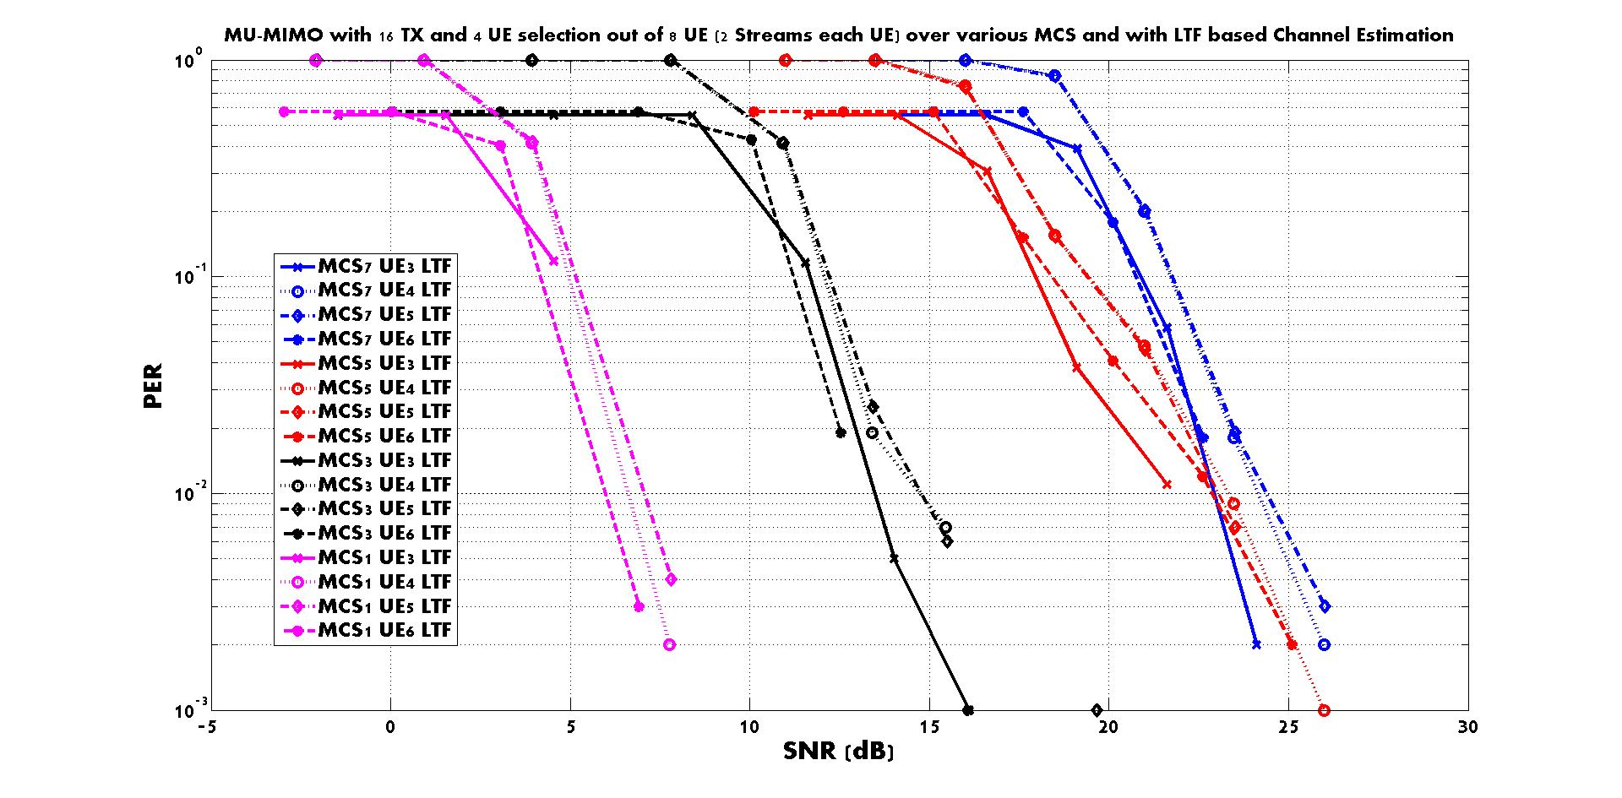
  8 LTF (4x LTF) symbol based channel estimation of 8 total streams with MMSE Detection

Slide 8
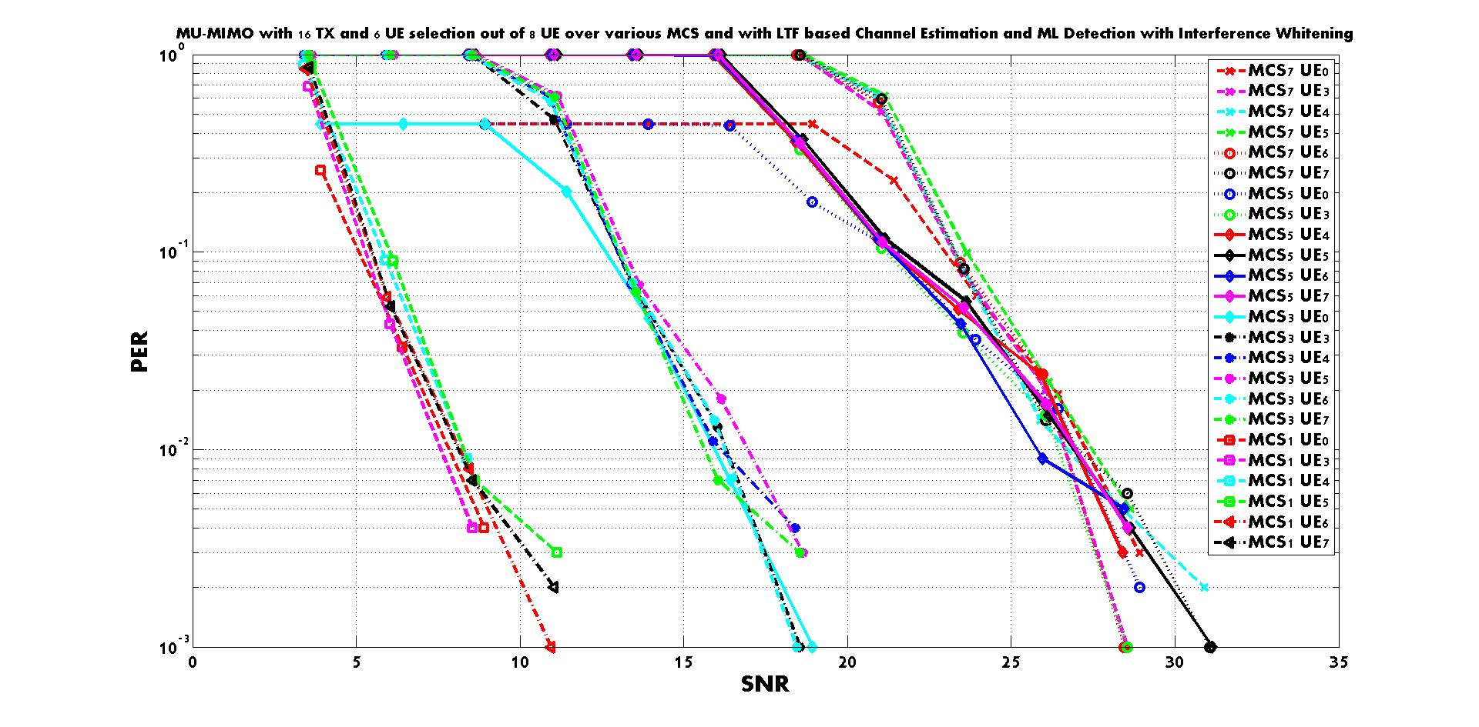
  16 LTF symbol based Channel Estimation for 12 total streams (6 STA MU-MIMO case)
  ML Detection with Interference Whitening

Slide 9
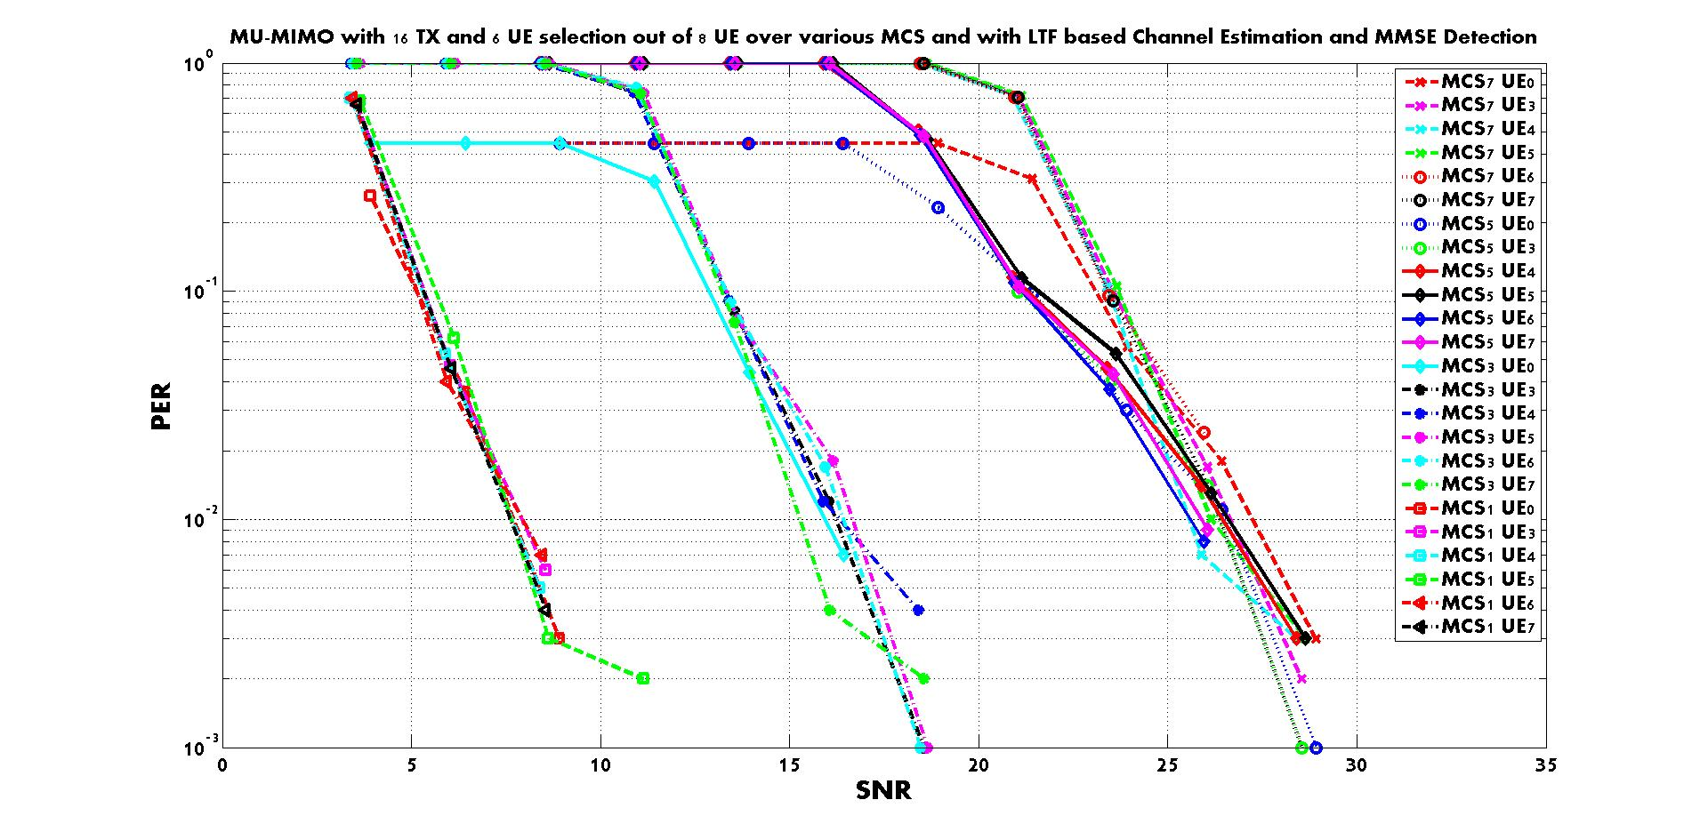
  16 LTF symbol based Channel Estimation for 12 total streams (6 STA MU-MIMO case)
  MMSE Detection

Slide 10
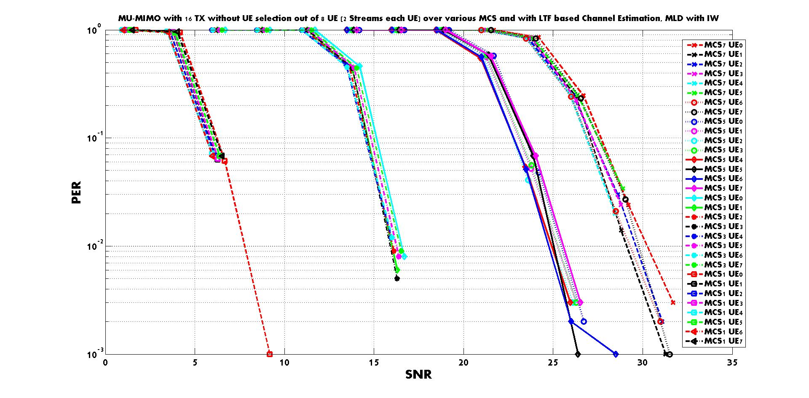
  16 LTF symbol based Channel Estimation for 16 total streams (8 STA MU-MIMO case)
  ML Detection with Interference Whitening

Slide 11
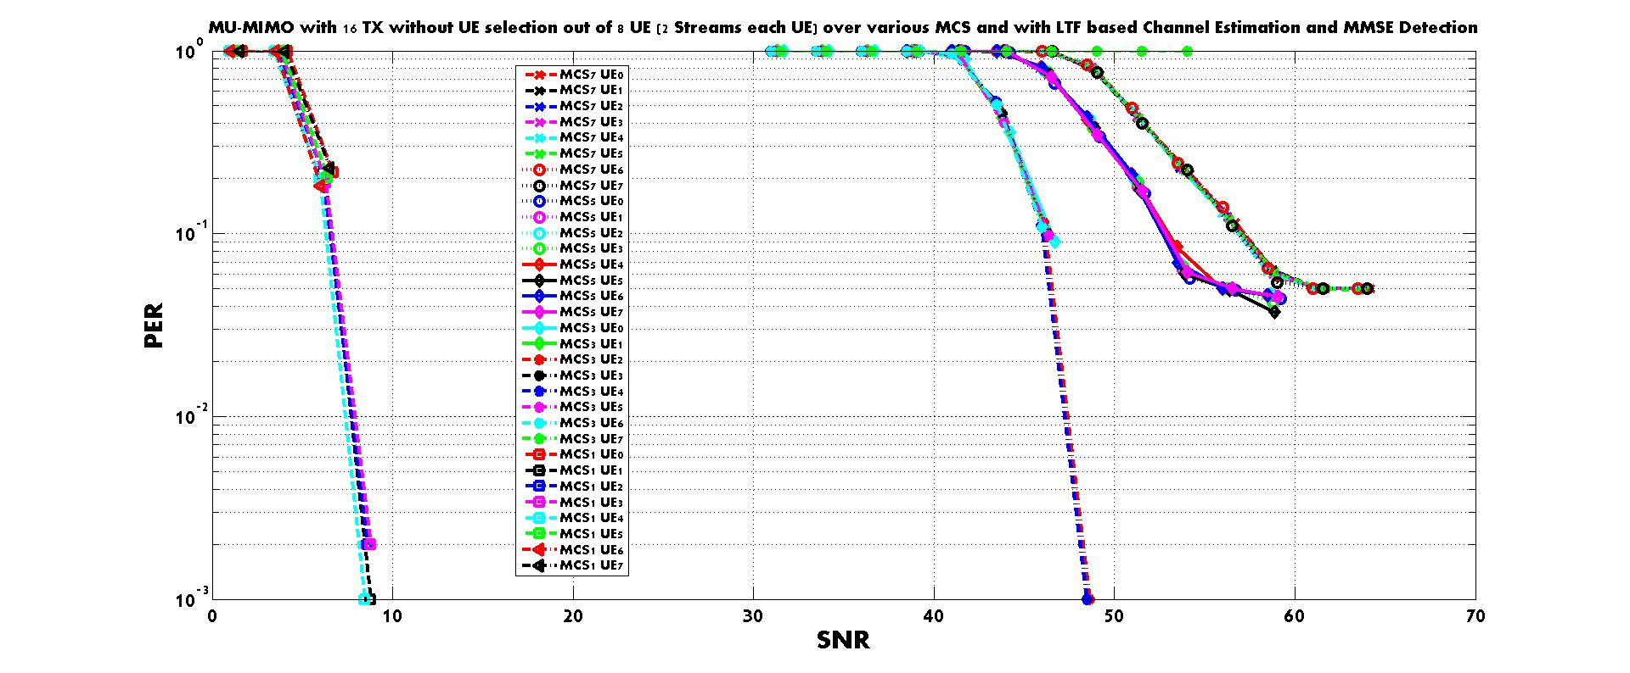
  16 LTF symbol based Channel Estimation for 16 total streams (8 STA MU-MIMO case)
  MMSE Detection

Slide 12
Summary
We tested MU-MIMO schemes when 16 Spatial Streams are available in an AP side with a ZF-BF scheme
  Any MIMO detection schemes including the MMSE detection shows good performance in case a partial set of available streams such as 8 or 12 streams are scheduled for MU-MIMO
  Performance severely drops when the full 16 streams are used for the MU-MIMO scheduling and the MMSE detection is used for the receiving side.
  A certain detection scheme such as MLD with an interference whitening is required to fully utilize the available spatial resources
    An advanced beamforming (BF) scheme may work with MMSE detection
Further study
  Test the performance with various BF schemes

Slide 13
Reference
[1] T. Yoo and A. Goldsmith, “On the optimality of multiantenna broadcast scheduling using zero-forcing beamforming”, IEEE Journal on Selected Areas in Communications, Vol. 24, March 2006

