Slide 1
Feedback Overhead Analysis for 16 Spatial Stream MIMO
Date: 2019-05-09
Authors:

Slide 2
Abstract
In this contribution, we provide an overhead analysis for sounding/feedback for 16 spatial streams using 802.11ax protocols and discuss the need for feedback overhead reduction for 16 Spatial Stream MIMO and Multi-AP coordination in 802.11be.

Slide 3
Introduction
  16 spatial streams has been discussed as a possible feature for 802.11be [1].
    Preliminary simulation results show performance benefits in increasing the number of spatial streams [2].
    However, this comes with an attendant increase in the amount of sounding and feedback needed.
  Sounding and feedback have been modified in 802.11ax to support a new numerology and OFDMA transmissions [9].
  Methods to reduce the overhead of channel acquisition at the transmitter to assist in 16 Spatial Stream MIMO and Multi-AP coordination in 802.11be were discussed in [3].
    Some questions were raised if the sounding and feedback mechanisms defined in 802.11ax were enough to support 16 spatial stream.
  In this contribution, we provide an overhead analysis of 16 SS training using 802.11ax sounding/feedback mechanism

Slide 4
Sounding and Feedback in 802.11ax (1/2)
  One-to-multiple sounding feedback mechanism is supported in 802.11ax. This mechanism enables concurrent feedback from multiple STAs, and reduces overhead compared to one-by-one sounding feedback mechanism defined in 802.11ac. [9]

Slide 5
Sounding and Feedback in 802.11ax (2/2)
  Feedback Segmentation:
    If HE compress BF/CQI frame exceeds 11454 bytes, the report should be split into up to 8 feedback segments.
    All feedback segments shall be sent in a single A-MPDU contained in a PPDU and shall be included in the A-MPDU in the descending order of the Remaining Feedback Segments subfield values. [9]
  The length of feedback report is limited by the L-Length field in the L-SIG field.
    L-Length field has 12 bits, which can cover up to 4095 bytes
    L-Length is calculated from TXTIME using 6Mbps rate in legacy mode.

Slide 6
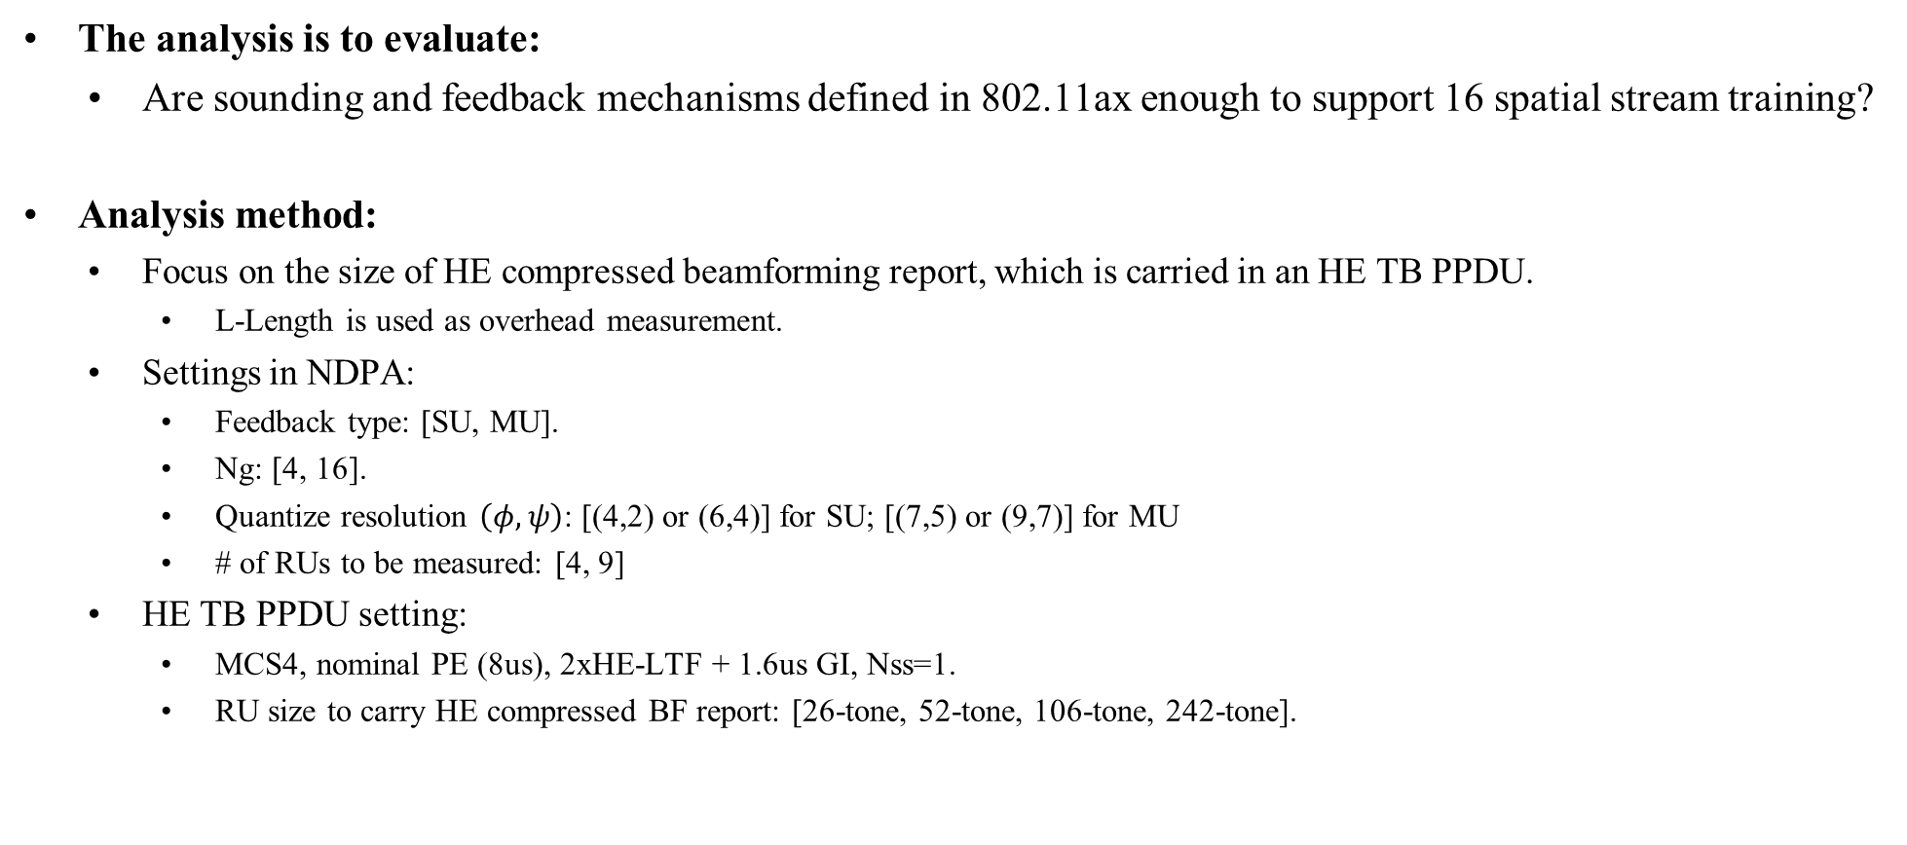
Feedback Overhead Analysis for 16 SS
  The analysis is to evaluate:
    Are sounding and feedback mechanisms defined in 802.11ax enough to support 16 spatial stream training?
  Analysis method:
    Focus on the size of HE compressed beamforming report, which is carried in an HE TB PPDU.
      L-Length is used as overhead measurement.
    Settings in NDPA:
      Feedback type: [SU, MU].
      Ng: [4, 16].
      Quantize resolution $\left(φ,ψ\right)$: [(4,2) or (6,4)] for SU; [(7,5) or (9,7)] for MU
      # of RUs to be measured: [4, 9]
    HE TB PPDU setting:
      MCS4, nominal PE (8us), 2xHE-LTF + 1.6us GI, Nss=1.
      RU size to carry HE compressed BF report: [26-tone, 52-tone, 106-tone, 242-tone].

Slide 7
SU-MIMO: 16 SS Cases 11ax Can’t Support
    Current 11ax mechanism can’t support: feedback with L-Length greater than 4095 Bytes
    SU report
    Nr x Nc is the V matrix size.
    TXOP duration = NDPA + NDP + BFRP + Feedback + 3SIFS
    Trade off for Feedback RU size and TXOP for training: To support the same number of concurrent STA sounding/feedback, the larger RU size allocated for each STA, the smaller the number of concurrent STAs supported for each BFRP, and thus the longer the TXOP duration for the sounding and training procedure.
Nr | Nc | Ng | phi | # 26-tone RUs | fdbk_RU | txop (us) | report L_LENGTH | report AMPDU size (bytes)
16 | 4 | 4 | 6 | 9 | 26 | 7610.4 | 5266 | 4364
16 | 8 | 4 | 4 | 9 | 26 | 7830.4 | 5431 | 4504
16 | 8 | 4 | 6 | 4 | 26 | 6228 | 4228 | 3500
16 | 8 | 4 | 6 | 9 | 26 | 12543.2 | 8965 | 7448
16 | 8 | 4 | 6 | 9 | 52 | 6517.6 | 4495 | 7448
16 | 16 | 4 | 4 | 9 | 26 | 9994.4 | 7054 | 5856
16 | 16 | 4 | 6 | 4 | 26 | 7912.8 | 5494 | 4556
16 | 16 | 4 | 6 | 9 | 26 | 16139.2 | 11662 | 9696
16 | 16 | 4 | 6 | 9 | 52 | 8317.6 | 5845 | 9696
Notes:
TXOP includes: NDPA-NDP-BFRP trigger-Feedback? With fdbk_RU=26, it can support 9 STA training and feedback. With fdbk_RU=52, it can support 4 STA training and feedback, right?
They may suggest using larger RU for feedback. Our argument should be the TXOP duration then. To support the same number of STA training/feedback, using larger RU per STA will increase the total TXOP duration considering TF, preamble etc…

Slide 8
MU-MIMO: 16 SS Cases 11ax Can’t Support
    Current 11ax mechanism can’t support: feedback with L-Length greater than 4095 Bytes
    MU report
    Nr x Nc is the V matrix size. TXOP duration = NDPA + NDP + BFRP + Feedback + 3SIFS
Nt | Nr | Ng | phi | # 26-tone Rus | fdbk_RU | txop (us) | report L_LENGTH | report AMPDU size (bytes)
8 | 8 | 4 | 9 | 9 | 26 | 6719.2 | 4693 | 3888
16 | 16 | 4 | 7 | 4 | 26 | 9741.6 | 6865 | 5696
16 | 16 | 4 | 7 | 9 | 26 | 20031.2 | 14581 | 12128
16 | 16 | 4 | 7 | 9 | 52 | 10261.6 | 7303 | 12128
16 | 16 | 4 | 9 | 2 | 26 | 7460 | 5152 | 4272
16 | 16 | 4 | 9 | 4 | 26 | 12621.6 | 9025 | 7496
16 | 16 | 4 | 9 | 4 | 52 | 6556.8 | 4525 | 7496
16 | 16 | 4 | 9 | 9 | 26 | 26172 | 19186 | 15968
16 | 16 | 4 | 9 | 9 | 52 | 13335.2 | 9607 | 15968
16 | 16 | 4 | 9 | 9 | 106 | 6543.2 | 4534 | 15968
16 | 16 | 16 | 9 | 9 | 26 | 8651.2 | 6046 | 5016
16 | 8 | 4 | 7 | 4 | 26 | 7517.6 | 5197 | 4308
16 | 8 | 4 | 7 | 9 | 26 | 15242.4 | 10990 | 9136
16 | 8 | 4 | 7 | 9 | 52 | 7867.2 | 5506 | 9136
16 | 8 | 4 | 9 | 4 | 26 | 9727.2 | 6853 | 5688
16 | 8 | 4 | 9 | 9 | 26 | 20016.8 | 14572 | 12120
16 | 8 | 4 | 9 | 9 | 52 | 10253.6 | 7297 | 12120
16 | 8 | 16 | 9 | 9 | 26 | 6717.6 | 4597 | 3808
16 | 4 | 4 | 7 | 9 | 26 | 9194.4 | 6454 | 5356
16 | 4 | 4 | 9 | 9 | 26 | 11959.2 | 8527 | 7084
16 | 4 | 4 | 9 | 9 | 52 | 6225.6 | 4276 | 7084
16 | 2 | 4 | 9 | 9 | 26 | 6736 | 4609 | 3820

Slide 9


8 Spatial Stream vs 16 Spatial Stream
    Feedback overhead is more than doubled from 8 ss to 16 ss.
    Assumptions: Ng = 4; # of measured RUs = 9; RU allocated for feedback=26 tone RU
$\left(φ,ψ\right)$={6,4}
$\left(φ,ψ\right)$={9,7}

Slide 10
16 SS Feedback Overhead Reduction
    These analysis results show that some new design may be needed in 802.11be to support 16 SS training
    Some feedback overhead reduction methods that were discussed in [3] include:
      ϕ only feedback as defined in 802.11ah
      Time domain channel feedback as defined in 802.11ad/ay
      Differential Givens rotation: Feed back time or frequency difference in Given’s Rotation angles
      Variable Angle Quantization: Use different quantization levels for different Given’s rotation angles (ϕi, ψi).
      Multi-component Feedback: splits feedback into multiple components [4][5]
      Codebook based Feedback: Feed back codeword from a well designed codebook [6]
      Two way channel training [7]
      Implicit Feedback: Bfer solicits packets suitable for channel estimation in the reverse direction [7]

Slide 11
Overhead Reduction Schemes
 | Scheme | Pros | Cons
1 | ϕ only feedback | exists in 802.11ah | single data stream only
2 | time domain channel | exists in 802.11ad/ay | may need additional signaling to identify tap positions and the extra matrix
3 | Differential Givens Rotation | Simple improvement from 802.11ax, variant in 11ay | Additional processing, Error Propagation
4 | Variable Angle Quantization | simple improvement from 802.11ax | additional processing
5 | Multi-component Feedback | Well understood, reduced feedback overhead | May need additional design
6 | Codebook based Feedback | Well understood, reduced feedback overhead | May need additional design
7 | Two way channel training | Do not need calibration, reduced feedback overhead | May need additional design
8 | Implicit Feedback | Simple improvement from 802.11n | Needs calibration

Slide 12
Conclusions
In this contribution, we have performed overhead analysis using current 802.11ax sounding feedback mechanism to support up to 16 spatial stream training.
  We identified several cases where current 11ax mechanism can not support feedback transmission ad currently defined
  Further feedback overhead comparisons between 8 ss and 16 ss are provided. Feedback overhead is more than doubled from 8 ss to 16 ss.
New designs may be needed to support 16 SS training in 802.11be
  Feedback overhead reduction methods [3] should be discussed

Slide 13
References
11-19/244r0 EHT PAR document, Michael Montemurro (BlackBerry)
IEEE 802.11-18/0818r3, 16 Spatial Stream Support in Next Generation WLAN, Sameer Vermani (Qualcomm)
IEEE 802.11-19/0391r0, Feedback Overhead Reduction in 802.11be, Kome Oteri (InterDigital)
IEEE 802.11-18/1184r1, EHT discussions on throughput enhancement, Tianyu Wu (Samsung)
Chaiman Lim; Taesang Yoo; Clerckx, B.; Byungju Lee; Byonghyo Shim, "Recent trend of multiuser MIMO in LTE-advanced," in Communications Magazine, IEEE , vol.51, no.3, pp.127-135, March 2013
Love, D.J.; Heath, R.W.; Lau, V.K.N.; Gesbert, D.; Rao, B.D.; Andrews, M., "An overview of limited feedback in wireless communication systems," in Selected Areas in Communications, IEEE Journal on , vol.26, no.8, pp.1341-1365, October 2008.
L. P. Withers, R. M. Taylor and D. M. Warme, "Echo-MIMO: a two-way channel training method for matched cooperative beamforming," IEEE Trans. Signal Process., vol. 56, no. 9, pp. 4419-4432, Sep. 2008.
IEEE 802.11-18/1191r0, MU sounding improvements, Sigurd Schelstraete (Quantenna)
IEEE P802.11ax™/D4.0, February 2019, (amendment to IEEE P802.11REVmd/D2.0)

Slide 14
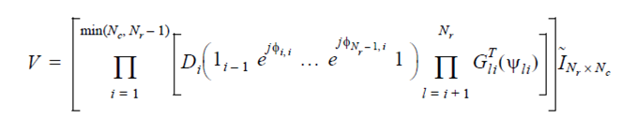
Appendix: Givens Decomposition and 16 ss Support
Givens Rotation and extension to 16 SS. Assuming a Nr x Nc complex matrix V, then it can be compressed with D and G matrices
Exemplary extension to 16 ss:
Nr | Nc | # Phi | # Psi
8 | 1 | 7 | 7
8 | 2 | 13 | 13
8 | 4 | 22 | 22
8 | 8 | 28 | 28
16 | 1 | 15 | 15
16 | 2 | 29 | 29
16 | 4 | 54 | 54
16 | 8 | 92 | 92
16 | 16 | 120 | 120

