Slide 1
Multi-link Operation Performance
Date: 2019-05-12
Authors:

Slide 2
Introduction
In March meeting, presented classification of multi-link MAC integration and features supported [1]
In May meeting, several discussions on multi-link operation, architecture and capability [2,3,4,5]
Multi-link aggregation, (re)ordering workarounds, operating mode indications, etc.
Multi-link simulation model, example scenario and evaluation

Slide 3
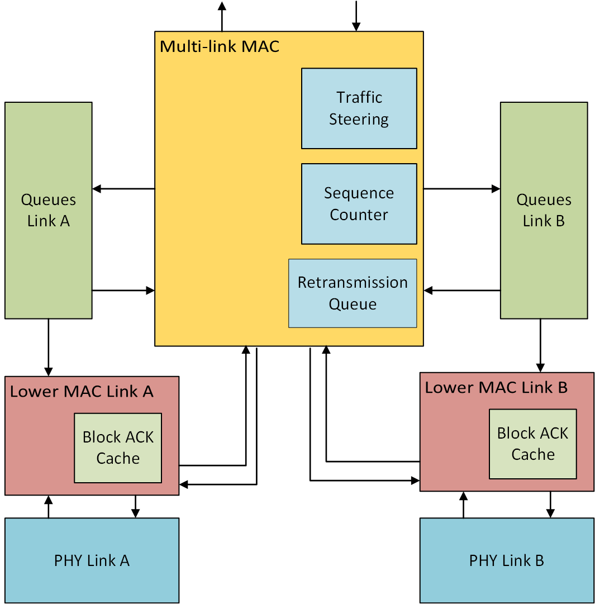
Multi-link simulation model
Shared Block ACK agreements
Separate queueing for each link
Per-link Block ACK
Acknowledgement for packet
transmitted on received link
Asynchronous operation
Shared retransmission queue
Retransmissions can be enabled
to occur on any link

Slide 4
Network model
Topology incorporated from 11ax enterprise scenario [6] (Appendix)
EHT multi-link BSS
80 MHz + 80 MHz operation, primary channel on each link
Asynchronous transmission and reception on individual links
Optional BSS in neighboring office
Single link 80 MHz operation
Same primary channel and spectrum as one of the EHT multi-band links
Performance comparison:
Single link 80 MHz
Single link 160 MHz BSS
Random contention-based EDCA access with RTS-CTS enabled

Slide 5
Traffic model
EHT BSS
Full-buffer uplink best effort traffic in EDCA Best Effort queue
UDP uplink video streaming (4 Mbps) using EDCA Video queue [7]
Optional Neighboring BSS
8 STAs with full-buffer uplink best effort traffic
Multi-link traffic steering models
Uniform: link to enqueue selected in round-robin manner
Per-packet round-robin for simplicity
Dedicated: particular link selected for each TID traffic
Example: Best effort traffic on link A, video traffic on link B
Fixed MCS HE MCS 5 for all data transmissions
MPDU aggregation limit and Block ACK size
256 for best effort traffic, 64 for video traffic

Slide 6
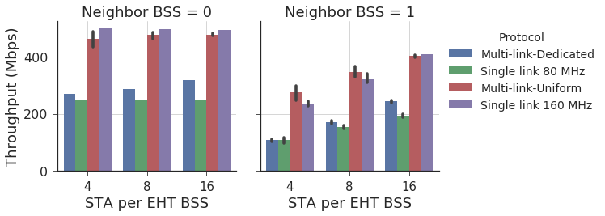
Multi-Session traffic: Throughput
Slight decrement for multi-link is due to additional control overhead
Single link operation impacted by additional congestion

Slide 7
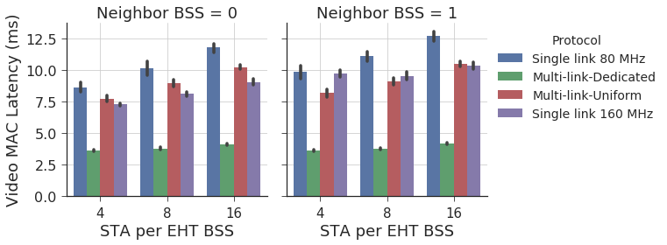
Multi-Session traffic: Video Latency
Higher latency than single link 160 MHz for multi-link Uniform in certain cases
As low-rate traffic is split into multiple links, under-utilizes the channel capacity when medium access is gained in a congested network

Slide 8
Conclusion and Future Work
Overview of multi-link simulation model assumptions
Initial analysis of multi-link operation in a congested network scenario with multi-session traffic
Further evaluation with updated multi-link model assumptions (e.g. shared TX buffers)
Encourage discussion on simulation scenarios worth investigating for multi-link operation

Slide 9
References
[1] 11-19/0360r0, “MAC Architectures for EHT Multi-band Operation”
[2] 11-19/0731r0, “Enhanced Multi-band/Multi-channel Operation”
[3] 11-19/0823r0, “Multi-Link Operation: Design Discussion”
[4] 11-19/0822r0, “Extremely Efficient Multi-band Operation”
[5] 11-19/0821r0, “Multiple Band Operation Discussion”
[6] 11-14/0980r16, “TGax simulation scenarios”
[7] 11-14/0571r12, “11ax Evaluation Methodology”

Slide 10
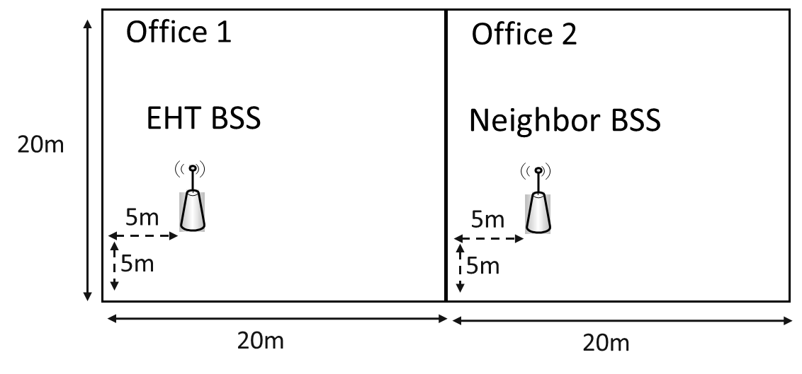
Appendix
APs not in the center as there are other APs in the office
STAs associate to the AP in their office based on 11ax enterprise scenario propagation loss
STAs for simulation selected from the candidate STAs that associate to the APs shown in figure

