Slide 1
Multi-link Operation Performance
Date: 2019-05-12
Authors:

Slide 2
Introduction
In March meeting, presented classification of multi-link MAC integration and features supported [1]
In May meeting, several discussions on multi-link operation, architecture and capability [2,3,4,5]
  Multi-link aggregation, (re)ordering workarounds, operating mode indications, etc.
Multi-link simulation model, example scenario and evaluation

Slide 3
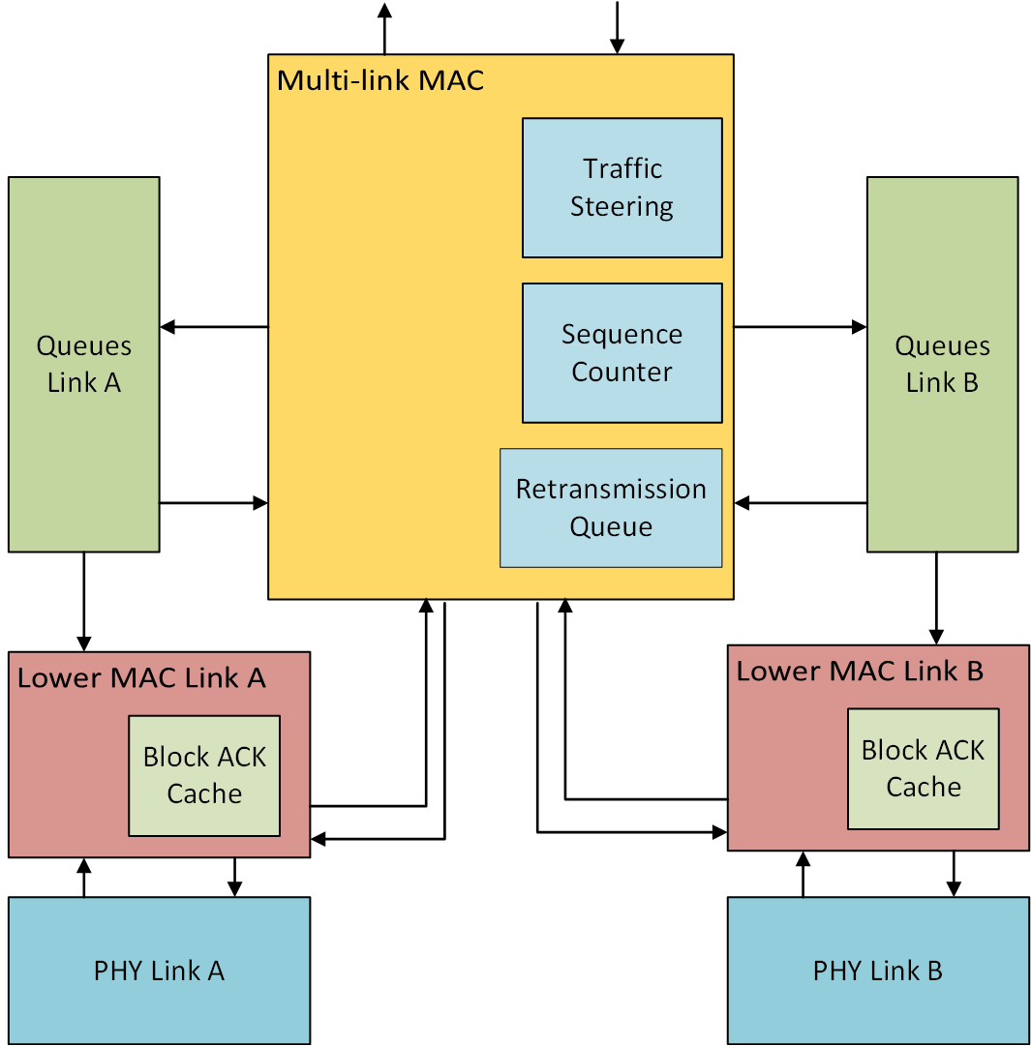
Multi-link simulation model
Shared Block ACK agreements
Separate queueing for each link
Per-link Block ACK
  ACKs for packets received
  only on that link
Asynchronous operation
Shared retransmission queue
  Retransmissions can be enabled
  to occur on any link

Slide 4
Network model
Topology incorporated from 11ax enterprise scenario [6] (Appendix)
EHT multi-link BSS
  80 MHz + 80 MHz operation, primary channel on each link
  Asynchronous transmission and reception on individual links
Optional BSS in neighboring office
  Single link 80 MHz operation
  Same primary channel and spectrum as one of the EHT multi-band links
Performance comparison:
  Single link 80 MHz
  Single link 160 MHz BSS
Random contention-based EDCA access with RTS-CTS enabled

Slide 5
Traffic model
EHT BSS
  Full-buffer best effort traffic in EDCA Best Effort queue
  UDP video streaming (4 Mbps) using EDCA Video queue [7]
  Uplink only
Optional Neighboring BSS
  8 STAs with same multi-session traffic as above
Multi-link traffic steering models
  Uniform: link to enqueue selected in round-robin manner
  Dedicated: particular link selected for each TID traffic
Fixed MCS HE MCS 5 for all data transmissions
MPDU aggregation limit and Block ACK size
  256 for best effort traffic
  64 for video traffic

Slide 6
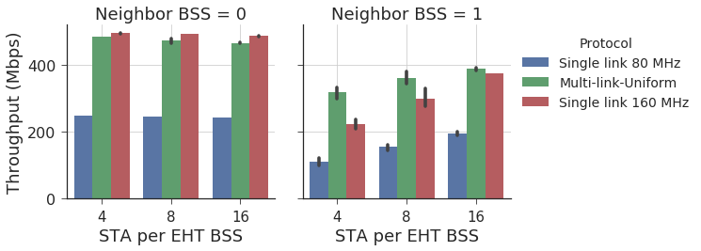
Multi-Session traffic: Throughput
Slight decrement for multi-link is due to additional control overhead
Single link operation impacted by additional congestion

Slide 7
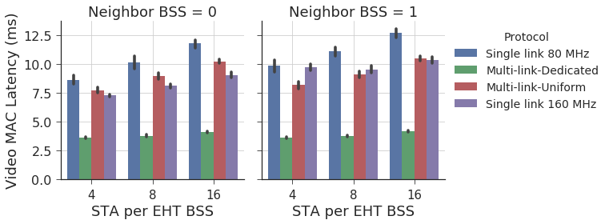
Multi-Session traffic: Video Latency
Higher latency than single link 160 MHz for multi-link Uniform in certain cases
  As low-rate traffic is split into multiple links, under-utilizes the channel capacity when medium access is gained in a congested network

Slide 8
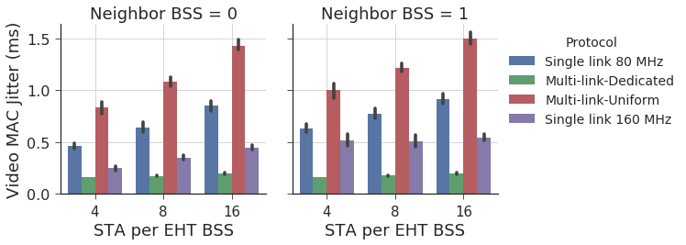
Multi-Session traffic: Video Jitter
Variance in access delay increases jitter with increased network size
Due to the traffic split, the variance of access delay is higher for the multi-link Uniform model

Slide 9
Conclusion and Future Work
Overview of multi-link simulation model assumptions
Initial analysis of multi-link operation in a congested network scenario with multi-session traffic
Further evaluation with updated multi-link model assumptions (e.g. shared TX buffers)
Encourage discussion on simulation scenarios worth investigating for multi-link operation

Slide 10
References
[1] 11-19/0360r0, “MAC Architectures for EHT Multi-band Operation”
[2] 11-19/0731r0, “Enhanced Multi-band/Multi-channel Operation”
[3] 11-19/0823r0, “Multi-Link Operation: Design Discussion”
[4] 11-19/0822r0, “Extremely Efficient Multi-band Operation”
[5] 11-19/0821r0, “Multiple Band Operation Discussion”
[6] 11-14/0980r16, “TGax simulation scenarios”
[7] 11-14/0571r12, “11ax Evaluation Methodology”

Slide 11
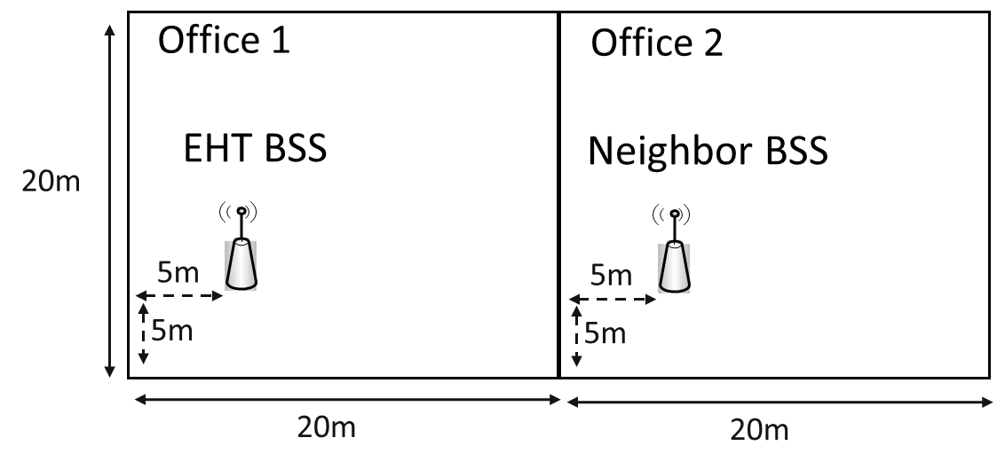
Appendix
APs not in the center as there are other APs in the office
STAs associate to the AP in their office based on 11ax enterprise scenario propagation loss
STAs for simulation selected from the candidate STAs that associate to the APs shown in figure

