Slide 1
Multi-link Operation Performance
Date: 2019-05-12
Authors:

Slide 2
Introduction
In March meeting, presented classification of multi-link MAC integration and features supported [1]
In May meeting, several discussions on multi-link operation, architecture and capability [2,3,4,5]
Multi-link aggregation, (re)ordering workarounds, operating mode indications, etc.
Multi-link simulation model, example scenario and evaluation

Slide 3
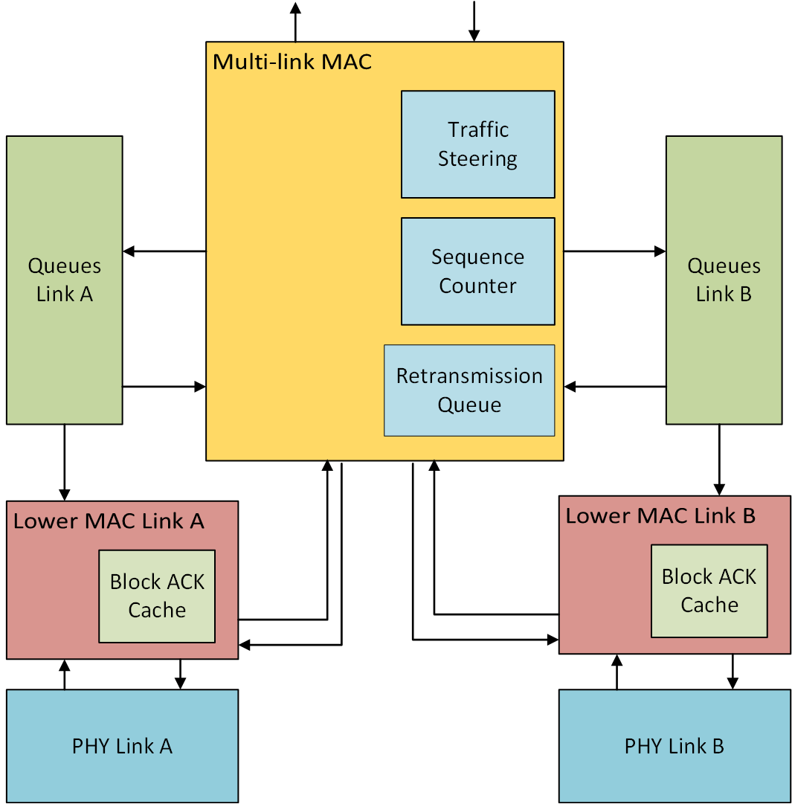
Multi-link simulation model
Shared Block ACK agreements
Separate queueing for each link
Per-link Block ACK
ACKs for packets received
only on that link
Asynchronous operation
Shared retransmission queue
Retransmissions can be enabled
to occur on any link

Slide 4
Network model
EHT multi-link BSS in 11ax Enterprise simulation scenario [6]
80 MHz + 80 MHz operation, primary channel on each link
Asynchronous transmission and reception on individual links
Optional BSS in neighboring office
Single link 80 MHz operation
Same primary channel and spectrum as one of the EHT multi-band links
Performance comparison:
Single link 80 MHz
Single link 160 MHz BSS
Random contention-based EDCA access with RTS-CTS enabled

Slide 5
Traffic model
EHT BSS
Full-buffer best effort traffic in EDCA Best Effort queue
UDP video streaming (4 Mbps) using EDCA Video queue [7]
Uplink only
Optional Neighboring BSS
4 STAs with same multi-session traffic as above
Multi-link traffic steering models
Uniform: link to enqueue selected in round-robin manner
Dedicated: dedicated link for traffic of particular TID
Fixed MCS HE MCS 5 for all data transmissions
64 MPDU aggregation

Slide 6
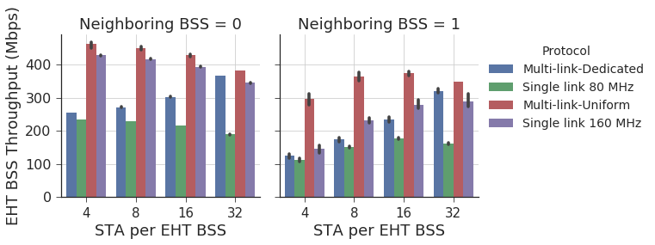
Multi-Session traffic: Throughput
With neighboring BSS, throughput initially increases as chances of STAs from EHT BSS gaining access increases
Single link operation impacted by additional congestion in primary 80 MHz
Video traffic monotonically increases for multi-link dedicated method

Slide 7
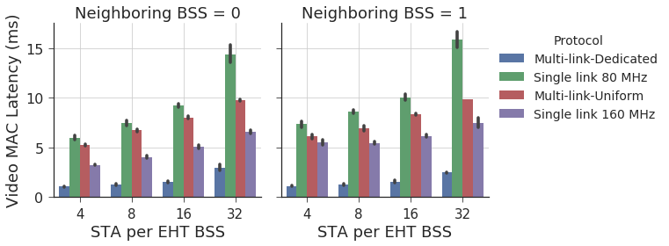
Multi-Session traffic: Video Latency
Multi-link Uniform has higher latency than single link 160 MHz
As low-rate traffic is split into multiple links, under-utilizes the channel capacity when medium access is gained in a congested network

Slide 8
Conclusion and Future Work
Overview of multi-link simulation model assumptions
Initial analysis of multi-link operation in a congested network scenario with multi-session traffic
Further evaluation with updated multi-link model assumptions
Encourage discussion on simulation scenarios worth investigating for multi-link operation

Slide 9
References
[1] 11-19/0360r0, “MAC Architectures for EHT Multi-band Operation”
[2] 11-19/0731r0, “Enhanced Multi-band/Multi-channel Operation”
[3] 11-19/0823r0, “Multi-Link Operation: Design Discussion”
[4] 11-19/0822r0, “Extremely Efficient Multi-band Operation”
[5] 11-19/0821r0, “Multiple Band Operation Discussion”
[6] 11-14/0980r16, “TGax simulation scenarios”
[7] 11-14/0571r12, “11ax Evaluation Methodology”

Slide 10
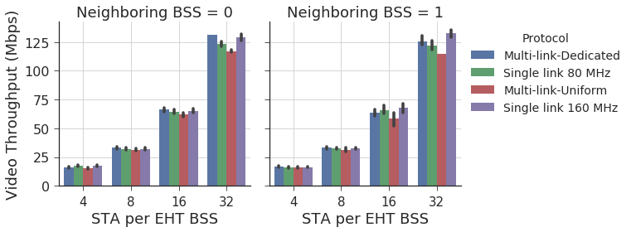
Appendix A Multi-session traffic: Video throughput

