Slide 1
Coordinated Null Steering for EHT
May 2019
Date: 2019-05-10
Authors:
Name | Affiliation | Address | Phone | Email
Adrian Garcia-Rodriguez | Nokia
David Lopez-Perez
Mika Kasslin
Olli Alanen
Lorenzo Galati Giordano

Slide 2
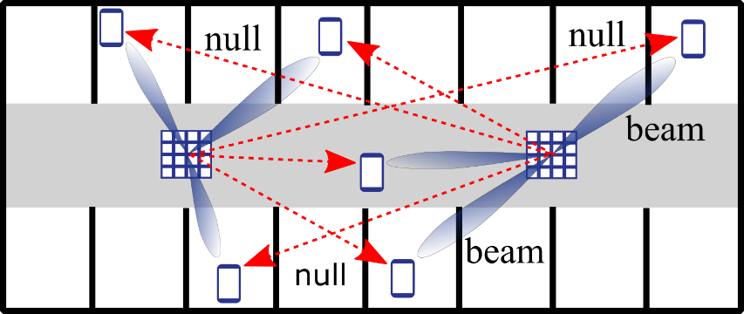
Introduction
May 2019
Null steering is a wireless technology through which a device performing data transmission/reception can place spatial radiation nulls towards non-served STAs for interference suppression purposes
Null steering presents a number of benefits
  Leads to a better spatial reuse
  Mitigates inter-cell interference
It also has challenges
  APs need to acquire channel state information (CSI) from non-served STAs
  APs require coordination procedures for controlling null steering transmissions
Illustration of coordinated null steering in downlink

Slide 3
Null steering-related proposals in EHT
May 2019
In previous EHT TIG/SG meetings, null steering has attracted considerable attention, touching on a number of topics
  Motivation for EHT
  Usage of the right terminology and nomenclature in EHT
11-18-1461: Discussions on the PHY features for EHT | Xiaogang Chen (Intel)
11-18-1533: View on EHT Candidate Features | Yusuke Tanaka (Sony)
11-18-1547: Technology Features for 802.11 EHT | Kome Oteri (InterDigital)
11-18-1161: EHT Technology Candidate Discussions | Hongyuan Zhang (Marvell)
11-19-0105: Functional Requirements for EHT Specification Framework | Yonggang Fang (ZTE)
11-18-1926: Terminology for AP Coordination | Sameer Vermani (Qualcomm)
11-18-1509: Discussions on Multi-AP Coordination | Jianhan Liu (MediaTek)
11-18-1576: Considerations on AP Coordination | Bo (Boyce) Yang (Huawei)

Slide 4
Null steering-related proposals in EHT
May 2019
  MIMO channel sounding issues and enhancements
  Null steering performance analysis
  None of the above contributions identify the scenarios where coordinated null steering could be the most appealing multi-AP coordination alternative
11-18-1191: MU sounding improvements | Sigurd Schelstraete (Quantenna)
11-18-1982: Consideration on multi-AP coordination for EHT | Kiseon Ryu (LG electronics)
11-19-0071: Coordinated Multi-AP Transmission for EHT | Kome Oteri (InterDigital)
  In this contribution, we describe the challenges of coordinated null steering, as well as the scenarios where it is particularly effective

Slide 5
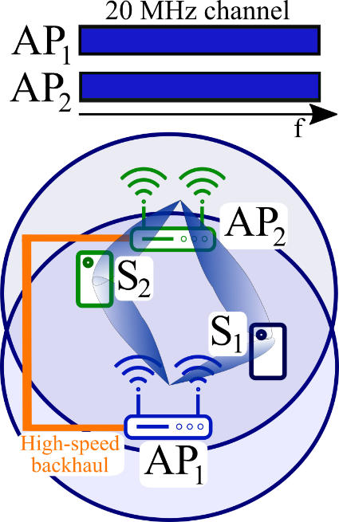
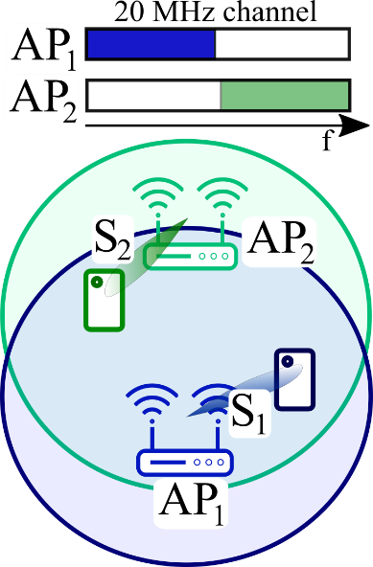
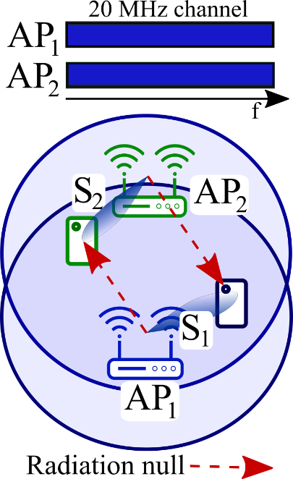
Multi-AP coordination techniques
May 2019
Joint Distributed MIMO
(D-MIMO)
Coordinated OFDMA
Coordinated null steering
Reuses time/freq. resources through joint spatial multiplexing [1, 2]
Coordinates time/freq. resource allocation [3, 4]
Reuses time/freq. resources by placing spatial radiation nulls
Solution with the most demanding synchronization and backhaul requirements
Solutions with simplified requirements
Null steering offers an appealing complexity and performance trade-off

Slide 6
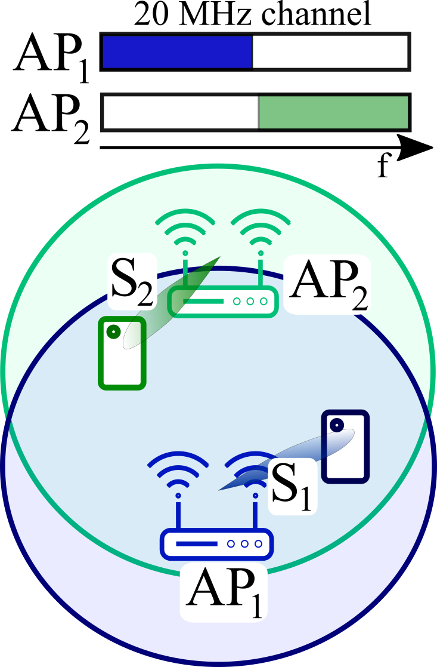
When is coordinated OFDMA effective?
May 2019
Medium to large AP densities [4]
  Coordinated transmissions enable a more efficient time/freq. resource utilization
  Resource splitting among APs could suffice to provide a satisfactory performance
Also for STAs experiencing high interference [4]
  Interference mitigation is possible through an intelligent resource unit assignment
Illustration of coordinated OFDMA
Coordinated OFDMA for short packets and highly interfered STAs

Slide 7

When is coordinated null steering effective?
May 2019
Medium to large AP densities and APs with multiple antennas [4-6]
  Coordinated transmissions enable a more aggressive time/freq. resource utilization
  Spatial reuse could be necessary to provide a satisfactory performance
Also for STAs experiencing high interference and medium to high SNRs [4]
  APs dedicate spatial resources for interference suppression purposes
Illustration of coordinated null steering
Coordinated null steering for dense scenarios with multi-antenna APs

Slide 8


What does coordinated null steering require?
May 2019
EHT
APs with multiple antennas
No severe spatial channel correlation among STAs
Efficient CSI acquisition procedures
Methods to acquire CSI from STAs served by other APs
Coordination procedures for null steering transmissions
EHT
→ in line with other EHT targets
→ more specific work
EHT
EHT
Null steering requirements are aligned with key EHT potential features

Slide 9
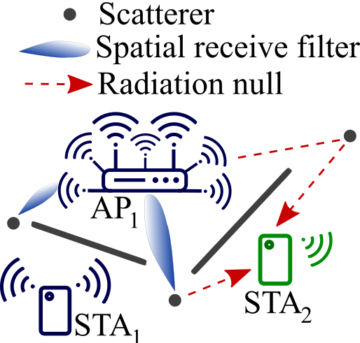
Spatial domain-related requirements
May 2019
APs with multiple antennas
  In agreement with 16 spatial streams feature considered by EHT
No severe spatial channel correlation among STAs
  Suitable for the typical indoor channels with good condition numbers [7]
  STA separability can always be guaranteed through an appropriate scheduling policy
EHT
EHT
Illustration of AP₁ receiving data from STA₁ and placing a radiation null towards the non-served STA₂
Typical APs and indoor channels are ideal for null steering

Slide 10
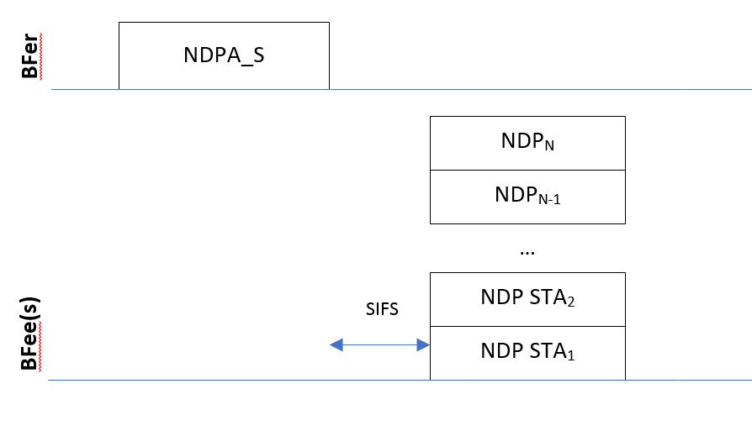
CSI acquisition-related requirements
May 2019
Efficient CSI acquisition procedures
  Explicit CSI acquisition
    Feedback compression to reduce wireless overhead [4]
  Implicit CSI acquisition [8]
    In agreement with 16 spatial streams feature considered by EHT
    Would greatly limit overhead
EHT
Illustration of multi-user implicit CSI feedback process [8]
Decreasing CSI acquisition overhead for an efficient null steering

Slide 11
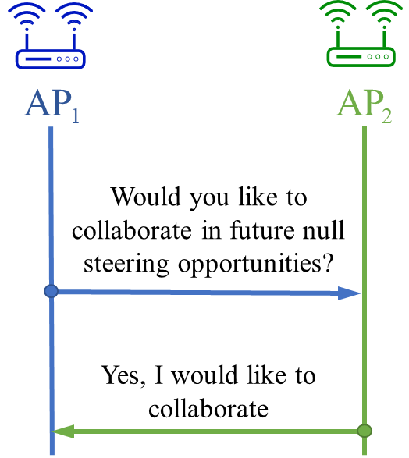
Inter-BSS CSI acquisition requirements
May 2019
Methods to acquire CSI from STAs served by other APs
  Communication between non-served STAs and APs is essential
    Multi-AP association might not be the only alternative
  Agreement among collaborative APs is beneficial
    Collaboration frames exchanged on a sporadic basis (long-term agreement)
Illustration of a long term agreement between AP₁ and AP₂ for performing subsequent coordinated null steering transmissions
Enabling CSI acquisition from non-associated STAs is crucial

Slide 12
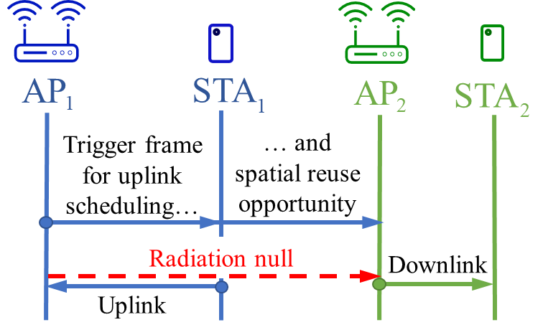
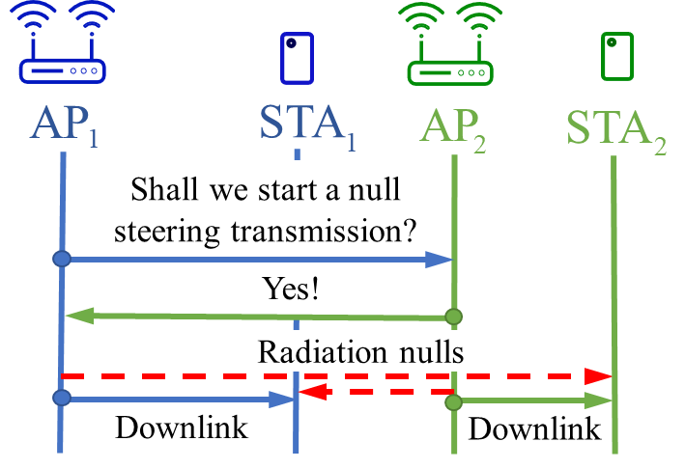
Multi-AP coordination requirements
May 2019
Coordination procedures for null steering transmissions
a) Implicit coordination building on 802.11ax spatial reuse framework
b) Explicit coordination building on coordinated OFDMA framework
Distribution of null steering-related information prior to data TX/RX
Handshake among APs prior to
a simultaneous data TX/RX
Coordinated null steering extends 802.11ax spatial reuse framework

Slide 13
Conclusions
May 2019
In this contribution, we identified the suitable scenarios and requirements for the implementation of coordinated null steering:
  Similarly to 802.11ax spatial reuse frameworks, coordinated null steering targets dense deployments with multi-antenna APs
  Many of the specifications required to implement coordinated null steering are essential for an efficient implementation of the 16 spatial streams feature considered within EHT. In addition,
    APs need to acquire CSI from non-served STAs
    Coordination procedures for controlling null steering transmissions should be defined

Slide 14
References
May 2019
[1] D. Lopez-Perez (Nokia), “Distributed MU-MIMO architecture design considerations,” IEEE 802.11-18/1190r0, Jan. 2019.
[2] Ron Porat (Broadcom), “Joint Processing MU-MIMO,” IEEE 802.11-19/0094, Jan. 2019.
[3] Bo (Boyce) Yang (Huawei), “Considerations on AP Coordination,”, IEEE 802.11-18/1576, Sep. 2018.
[4] Kome Oteri (InterDigital), “Coordinated Multi-AP Transmission for EHT,” IEEE 802.11-19/0071, Jan. 2019.
[5] G. Geraci, A. Garcia-Rodriguez, D. López-Pérez, L. Galati Giordano, P. Baracca, and H. Claussen, “Indoor massive MIMO deployments for uniformly high wireless capacity,” in Proc. IEEE WCNC, Apr. 2018.
[6] A. Garcia-Rodriguez, G. Geraci, D. López-Pérez, Lorenzo Galati Giordano, Ming Ding, and Holger Claussen, “Massive MIMO Unlicensed for High-Performance Indoor Networks,” in IEEE GLOBECOM, Dec. 2017.
[7] Sameer Vermani (Qualcomm), “16 Spatial Stream Support in Next Generation WLAN”, IEEE 802.11-18/0818, May 2018.
[8] Sigurd Schelstraete (Quantenna), “MU sounding improvements”, IEEE 802.11-18/1191, Jul. 2018.

Slide 15
Appendix
May 2019

Slide 16
Wired- vs. wireless-based coordination
May 2019
Null steering admits both wireless and wired implementations
  Wireless-based coordination
    Overhead can be always limited by simplifying the coordination
    Suitable for implementations with explicit or implicit coordination
  Wired-based coordination
    Solution with the smallest wireless overhead
    Suitable for implementations with explicit coordination
Coordinated null steering does not require a wired-based coordination

