Slide 1
Multi-AP Transmission Procedure
Date: 2019-05-13
Authors:
Name | Affiliation | Address | Phone | Email
Sungjin Park | LG Electronics | 19, Yangjae-daero 11gil, Seocho-gu, Seoul 137-130, Korea |  | allean.park@lge.com
Ensung Park |  |  |  | esung.park@lge.com
Jeongki Kim |  |  |  | jeongki.kim@lge.com
Jinsoo Choi |  |  |  | js.choi@lge.com
Kiseon Ryu | LG Electronics | 10225 Willow Creek Rd, San Diego, CA, USA |  | kiseon.ryu@lge.com

Slide 2
Introduction
The Multi-AP transmission has been discussed as candidate features for adoption in 11be. [1]
There are many types of Multi-AP coordinated transmission that have been discussed in EHT study group.
  Joint TX [2], [3], [4], [7]
  Coordinated BF [3], [7], [8]
  Coordinated OFDMA [3], [5], [6], [7], [8]
  Coordinated SR [6], [8]
To support the Multi-AP transmission in 11be, the feasible procedure needs to be discussed.

Slide 3
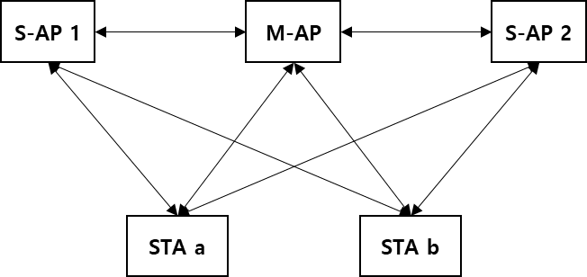
Multi-AP environment assumption
We consider the following assumptions in this document.
  The Slave AP which is the candidate of Multi-AP transmission hears the Master AP.
  The Slave APs may not hear each other.
  The STA which is the recipient of Multi-AP transmission can hear the Master AP and the Slave APs.
Master AP (M-AP)
- Being a role of the AP coordinator
Slave AP (S-AP)
- Participating in the Multi-AP transmission coordinated by Master AP

Slide 4
Multi-AP transmission procedure
Multi-AP sounding
  NDP transmission from the M-AP and the S-AP to the STA at the same time by the Master AP’s coordination
  NDP feedback from STA to the M-AP
Multi-AP selection
  Verifying whether the selected S-AP can participate in Multi-AP transmission
  Reselecting if the selected S-AP cannot participate
Multi-AP data transmission
  Data packet is transmitted by using one of the Multi-AP transmission schemes (e.g., Joint TX, Coordinated BF, Coordinated OFDMA, and Coordinated SR)

Slide 5
Multi-AP sounding
In order that the Joint TX and the Coordinated BF are used, the sounding procedure should be preceded.
  To acquire the CSI between the Master/Slave APs and STAs
In addition, the Coordinated OFDMA and the Coordinated SR also may need the sounding procedure to be preceded to achieve the improvement of performance of the Multi-AP transmission schemes.
  To allocate more appropriate RU/CH to the recipient STA in the Multi-AP coordination
In the Multi-AP sounding, we propose the general sounding procedure to support all types of the Multi-AP transmission schemes.
  The contents to be exchanged may vary depending on the schemes.

Slide 6
Multi-AP sounding procedure
To achieve the improved performance of the Multi-AP coordinated transmission, the Multi-AP sounding should be performed beforehand.
The M-AP transmits MAP trigger frame to the S-APs in order to initiate the sounding.
The S-APs receiving the MAP trigger frame and the M-AP send MAP NDPA frame and then MAP NDP packet at the same time.
  To acquire the channel information between each M-AP/S-AP and each STA.
The recipient STA should send a MAP NDP feedback frame to the M-AP in response to the MAP NDPA frames and the MAP NDP packets.
  The feedback information can be used to determine the S-AP and the Multi-AP transmission type.

Slide 7
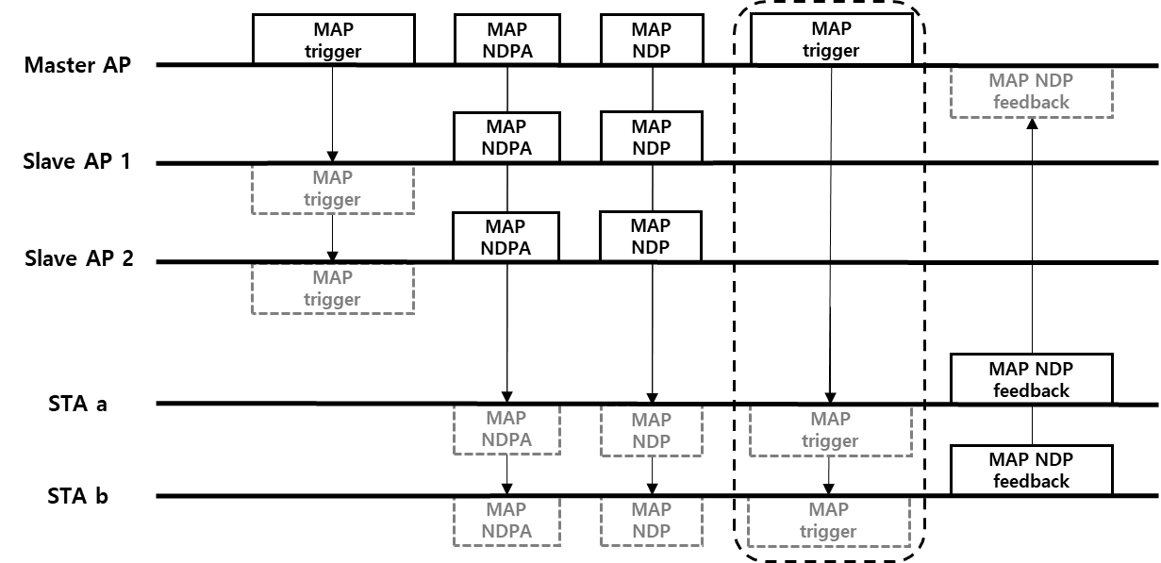
Example of
Multi-AP sounding
Can be skipped in the SU case
Reusing conventional NDP (Considering all APs as one AP)
Stringent synchronization requirement between the APs
MAP NDP PPDU format
Total number of LTF symbols depends on the sum of antennas of all APs
Master AP
Slave AP 1
Slave AP 2
L-part | SIG-A | STF | LTF | LTF | … | LTF

Slide 8
Multi-AP selection
After the Multi-AP sounding, the Multi-AP selection procedure can be used to help the M-AP to coordinate before the Multi-AP data transmission.
The M-AP needs to recognize whether the selected S-AP can participate according to the response of the S-AP’s channel state.
  When the channel state of the selected S-AP is BUSY, the selected S-AP cannot participate in the Multi-AP transmission.
  If the selected S-AP cannot respond and participate, the M-AP can reselect other S-AP(s) among the candidates.
In addition, the information of buffer state or bandwidth query obtained through the Multi-AP selection procedure can be helpful to allocate resources to the selected S-AP.

Slide 9
Multi-AP selection procedure
The M-AP selects the appropriate S-AP based on the sounding feedback and sends MAP selection frame to the selected S-AP.
  This frame may include the contents requesting S-AP’s bandwidth query or buffer state.
The selected S-AP sends MAP selection response frame to the M-AP in response to MAP selection frame if the channel state is ‘IDLE’.
  This frame may include the contents reporting S-AP’s bandwidth query or buffer state.
If the selected S-AP cannot send MAP selection response frame due to the channel state, the M-AP can reselect other S-AP(s) and sends MAP selection frame to the reselected S-AP.

Slide 10
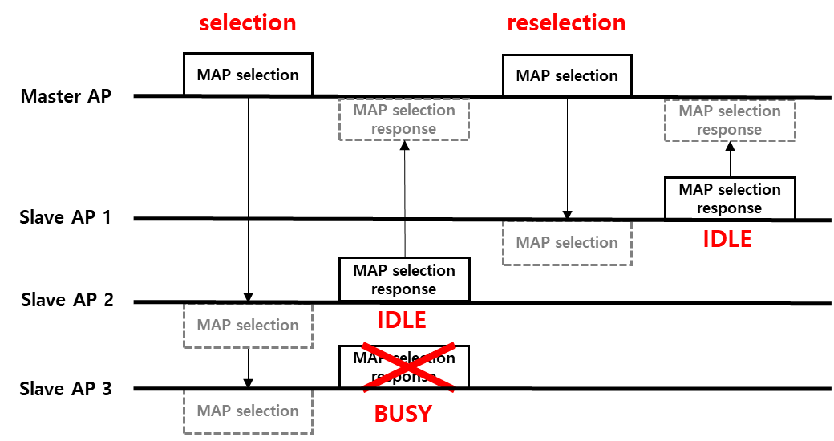
Example of
Multi-AP selection
  After first selection, the M-AP recognizes that only S-AP 2 can participate in the Multi-AP transmission.
  The selection procedure can be complete if it is enough to use S-AP 2 for the Multi-AP data transmission.
  If not, M-AP reselects another S-AP such as S-AP 1 and then S-AP 1 & 2 can participate in the Multi-AP data transmission.

Slide 11
Multi-AP data transmission procedure
The M-AP initiates the Multi-AP transmission by sending the MAP trigger frame to the final selected S-AP.
  Including the Multi-AP transmission type (e.g., Joint TX, Coordinated BF, Coordinated OFDMA, or Coordinated SR, etc.) and the Multi-AP transmission setup (Nss, BW, or RU, etc.)
The S-AP that received the MAP trigger frame and the M-AP send Data by using the Multi-AP.
  Including the information for decoding the PSDU (e,g., the recipient STAs’ ID(s) and the transmission information such as MCS, PSDU length, Nss, and etc.)
Depending on the Multi-AP transmission scheme, the STA sends BA frame to the M-AP or S-AP.
  If the Joint TX is used, BA can be sent to M-AP.
  If the Coordinated TX is used, BA can be sent to its own associated AP.

Slide 12
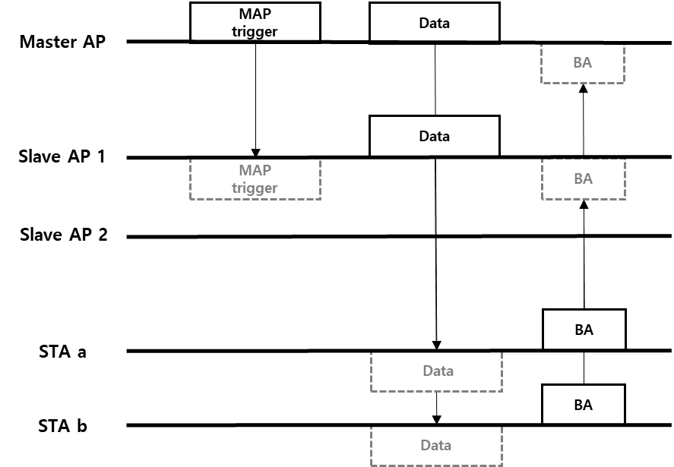
Example of
Multi-AP data transmission

Slide 13
Conclusion
We introduced a general procedure with the Multi-AP sounding, Multi-AP selection, and Multi-AP data transmission to support all types of the Multi-AP transmissions.
Detailed procedure for each scheme of the Multi-AP transmission needs further study.

Slide 14
Reference
[1] IEEE 802.11-18/1231r1, EHT draft proposed PAR, Laurent Cariou (Intel)
[2] IEEE 802.11-18/1439r0, Constrained Distributed MU-MIMO, Ron Porat (Broadcom)
[3] IEEE 802.11-18/1926r2, Terminology for AP Coordination, Sameer Vermani (Qualcomm)
[4] IEEE 802.11-18/1510r1, AP Coordinated beamforming for EHT, Hongyuan Zhang (Marvell)
[5] IEEE 802.11-18/1155r1, Multi-AP Enhancement and Multi-Band Operations, Jianhan Liu (Mediatek)
[6] IEEE 802.11-19/103r0, AP-Coordination-in-EHT, Jason Yuchen Guo (Huawei)
[7] IEEE 802.11-18/1461r1, Discussions on the PHY Features for EHT, Xiaogang Chen (Intel)
[8] IEEE 802.11-19/0071r0, Coordinated Multi-AP Transmission for EHT, Kome Otri (InterDigital)

