Slide 1
AP Coordination in EHT
Date: 2019-03-11
Authors:
Name | Affiliations | Address | Phone | email
Jason Yuchen Guo | Huawei Technologies |  |  | guoyuchen@huawei.com
Guogang Huang
Ross Jian Yu
Peter Loc

Slide 2
Introduction
There are many types of AP coordination [1-4], which can be summarized into two levels [4]
  Level 1: the data of one user is sent from a single AP → use the term Coordinated in their names
  Level 2: the data of one user is sent from multiple APs → use the term Joint in their names
For the “Coordinated” level, the following types are considered
  Coordinated BF
  Coordinated OFDMA
For the “Joint” level, the following types are considered
  Joint processing
    Multi-user case
    Single-user case
This contribution proposes a new mode of AP coordination under the “Coordinated” level: Coordinated Spatial Reuse

Slide 3
Coordinated Spatial Reuse
Coordinated spatial reuse is parallel transmission of two APs in a coordinated way
Coordinated spatial reuse can be used when BSS1 and BSS2 are “relatively far” from each other, the meaning of “relatively far” is two folds:
  Not near: interference is not so strong, nulling may not be needed, power control is enough
  Not too far: the channel state is busy (received signal power > -82dBm)
In 11ax, spatial reuse can be used in this case, but it is an uncoordinated way
  Many SR transmissions can be initiated, which makes the interference hard to control
With AP coordination in EHT, we can do it in a coordinated way, e.g., use a trigger frame to initialize the transmission
Advantage: simple, less feedback overhead comparing with co-BF; less interference comparing with SR
AP1
Control Info
AP2
Interference controlled
Power controlled
Power controlled
STA1
STA2

Slide 4
Coordinated Spatial Reuse
Furthermore, coordinated spatial reuse can be combined with coordinated OFDMA
E.g., STA1 and STA4 are near to their own APs, and far from the interfering AP, they can share the same RU/channel; STA2 and STA3 will see relatively larger interference, they can use different RUs/channels
Control Info
Coordinated spatial reuse
Coordinated OFDMA

Slide 5
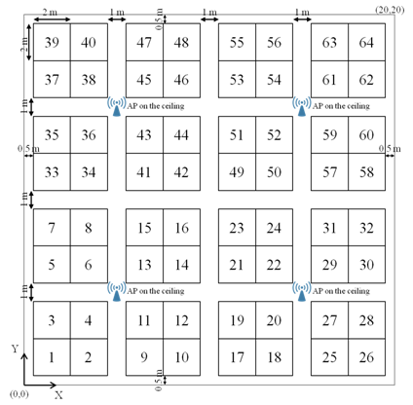
System Level Simulation
Simulation Scenario
We use the enterprise scenario defined in [5]
Simulation setting:
  Number of AP: 32
  Number of STAs per BSS: 10
  BSS Range: 20m
  Bandwidth: 20MHz @ 2.4GHz
  Traffic model: full buffer
  Packet size: 1500 bytes
  Data MCS: link adaptation
  Antenna#: AP 1, STA 1

Slide 6
Simulation Results
UL results:
  Comparing with EDCA, Coordinated SR has 14%~53% throughput gain
  Comparing with SR, Coordinated SR has up to 34% throughput gain when the number of slave APs is more than 1
  The packet loss is much lower since the interference from slave APs can be predicted
  More collaborative APs can bring more throughput gain
Throughput
Packet Loss
53%
34%
14%

Slide 7
Simulation Results
UL results:
The cell-edge throughput of Co-SR is much better than EDCA and OBSSPD
The cell-edge throughput decreases with the number of slave APs since the interference increases, but still in a controllable region
Although the SINR of the co-SR is lower, the number of parallel links is higher, which contributes to the throughput gain

Slide 8
Simulation Results
DL results:
  Comparing with EDCA and SR, Coordinated SR has 20%~27% throughput gain when the number of slave APs is more than 2
Throughput
Packet Loss
20%
27%

Slide 9
Simulation Results
DL results:
  SINR distribution

Slide 10
Conclusion
  We propose “coordinated spatial reuse” as an AP coordination mode in the “coordinated” family.
  It is an enhancement of SR under the AP coordination framework
  It can be used together with other AP coordination modes such as co-OFDMA.
  Simulation results show that more than 30% throughput gain can be obtained in the UL, and more than 20% throughput gain can be obtained in the DL.

Slide 11
Reference
[1] 11-18-1439-00-0eht-distributed-mu-mimo
[2] 11-18-1509-00-0eht-features-for-multi-ap-coordination
[3] 11-18-1510-01-0eht-ap-coordinated-beamforming-for-eht
[4] 11-18-1926-02-0eht-terminology-for-ap-coordination
[5] 11-14-0621-04-00ax-simulation-scenarios

Slide 12
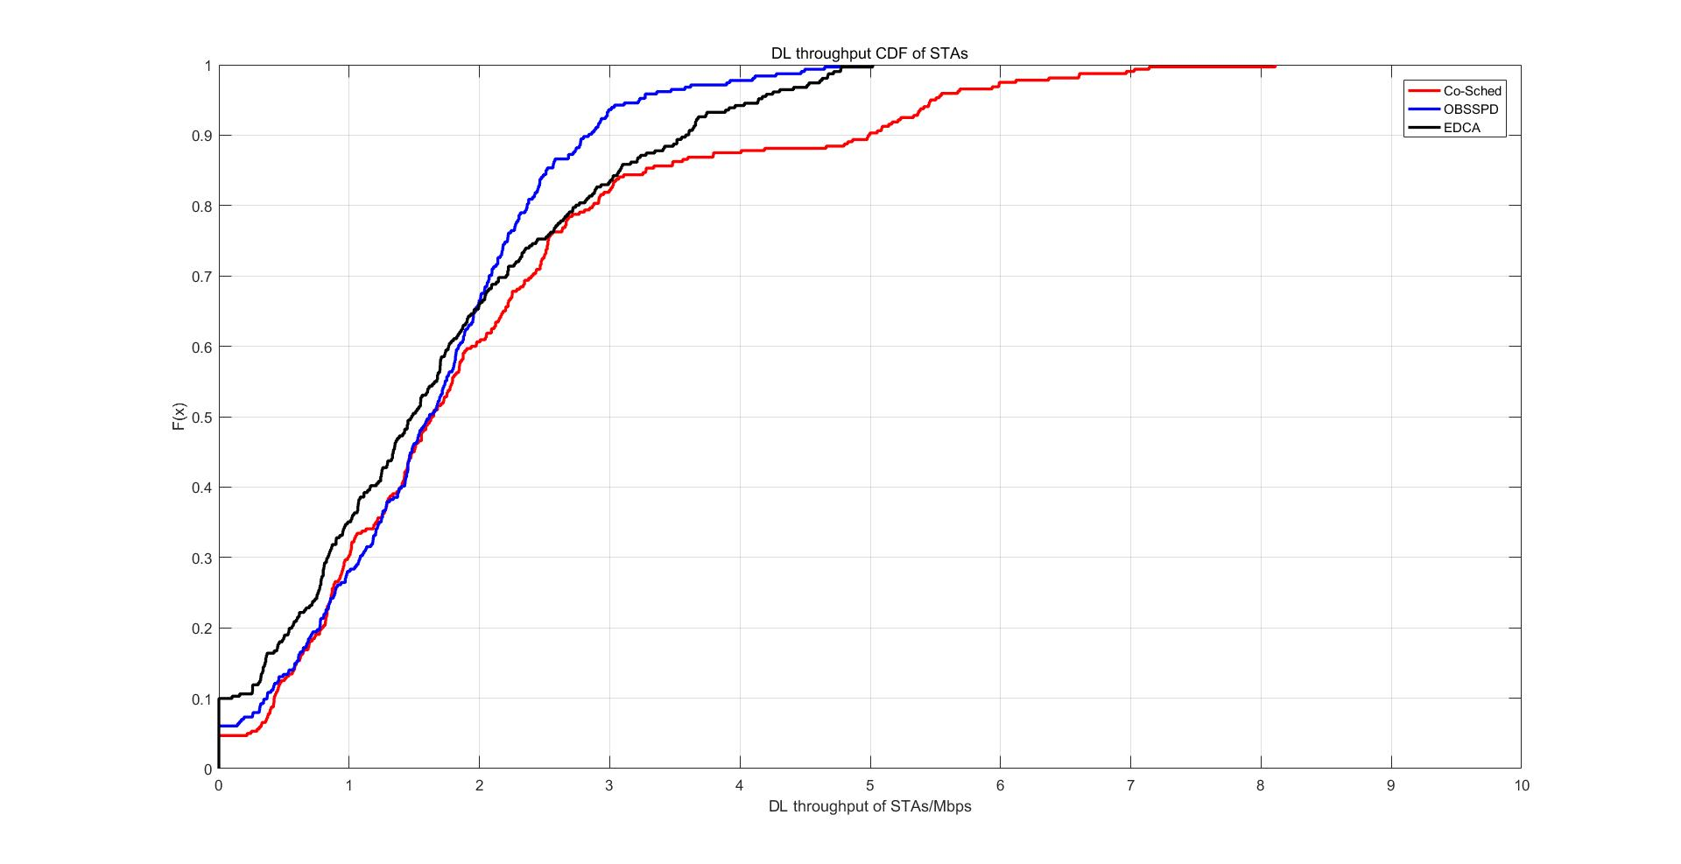
Appendix
CDF of DL throughput

