Slide 1
Comparison of Coordinated BF and Nulling with JT
Date: 2019-05-09
Authors:
Name | Affiliations | Address | Phone | email
Ron Porat | Broadcom |  |  | ron.porat@broadcom.com
Srinath Puducheri | Broadcom

Slide 2
Abstract
In contribution 19/0094, we provided performance results for JT MU-MIMO under different phase errors, and an initial estimate of the achievable residual CFO error.
In contribution 19/0384, we extended the results in 19/0094 to include asymmetrical path-loss.
In contribution 19/0401, coordinated BF and Nulling (CBF) is discussed at a high level but no simulation results are provided.
In this contribution we :
Extend the results in 19/0384 to CBF for apples-to-apples comparison of the potential performance gains assuming the same scenarios
Provide real CFO measurements results to validate the potential achievable CFO estimation accuracy

Slide 3
Coordinated Beamforming with Nulling
CBF system model: Each AP SU/MU beamforms to self-BSS clients, while simultaneously placing nulls at OBSS clients.
Transmissions across APs are assumed to be time/frequency synchronized.
CSI assumption: Each AP knows its channel to all clients (self-BSS and OBSS).
Total number of beamformed and nulled spatial directions at each AP is limited by degrees of freedom available to that AP.
Total number of simultaneous spatial streams across all BSS is limited by the size of the smallest participating AP.
Example: if all APs are 4x4, max number of simultaneous spatial streams limited to 4.
We compare CBF versus the following baseline (same as used for JT MU-MIMO simulations in 19/0384):
Each AP SU/MU beamforms to clients within its BSS without regard to OBSS clients, and only one AP transmits at a time.
Overall throughput is the average of all the per-BSS throughputs.

Slide 4
CBF simulation results: 2AP (1)
Simulation configuration is same as what was used for JT MU-MMO in contribution 19/0384 (see appendix for JT results):
All APs are 4 ant and all STAs are 2 ant, Channel 11nD 80MHz
BSS1: {AP1 <--> STA1}, BSS2: {AP2 <--> STA2, STA3}
Baseline: BSS1 Nss = [2] and BSS2 Nss = [2 1], with 50% time sharing
AP-STA relative path loss matrix:
X is varied across 10, 20dB and denotes higher path loss relative to 0dB
CBF: Both APs simultaneously transmit, with each AP transmitting Nss=2 and using additional two degrees of freedom for interference nulling. We consider two cases:
Case 1: BSS1 Nss = [2] and BSS2 Nss = [1 1]
Case 2: BSS1 Nss = [2] and BSS2 Nss = [2]. For this case, AP2 serves only one client per TX, selecting either STA2 or STA3 in a round-robin fashion.
 | AP1 | AP2
STA1 | 0 | X
STA2 | 0 | 0
STA3 | X | 0

Slide 5
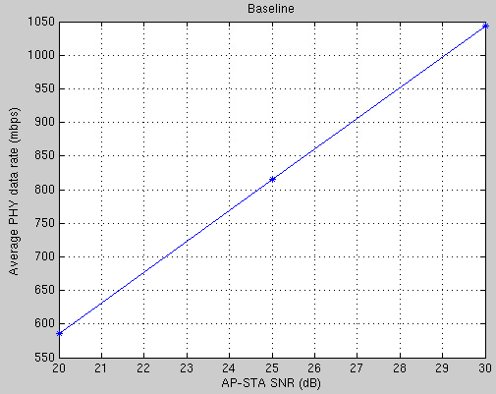
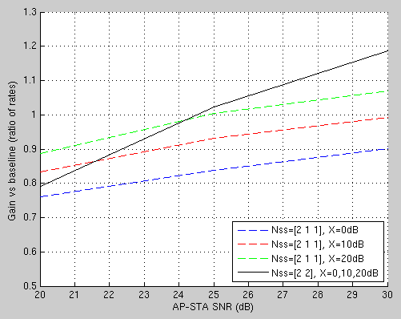
CBF simulation results: 2AP (2)
CBF worse than baseline at low SNR; shows some gains at high SNR for specific configurations and/or large relative path loss
The X-axis “AP-STA SNR” in the plots assumes X=0

Slide 6
CBF simulation results: 4AP (1)
Simulation configuration is same as what was used for JT in IEEE March 2019 contribution 384 (see appendix for JT results):
BSS1: {AP1 <--> STA1}, BSS2: {AP2 <--> STA2, STA3},
BSS3: {AP3 <--> STA4}, BSS4: {AP4 <--> STA5, STA6}
Baseline: 25% time sharing across BSS1, BSS3 Nss = [2] and BSS2, BSS4 Nss = [2 1]
AP-STA relative path loss matrix:
CBF: Each AP transmits Nss=1 to its STA, while using 3 degrees of freedom towards interference-nulling for the other 3 BSS.
BSS2 time-shares between STA2/STA3 (50%) and BSS4 time-shares between STA5/STA6 (50%)
 | AP1 | AP2 | AP3 | AP4
STA1 | 0 | 0 | X | X
STA2/STA3 | X | 0 | 0 | X
STA4 | X | X | 0 | 0
STA5/STA6 | 0 | X | X | 0

Slide 7
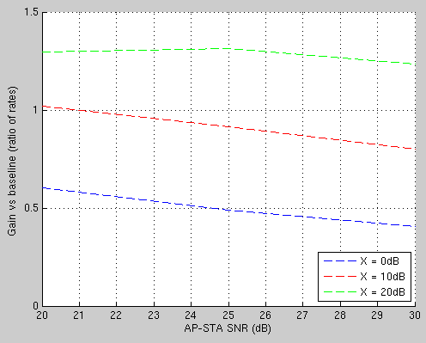
CBF simulation results: 4AP (2)
Any potential gain for CBF requires relative path loss >= 20dB

Slide 8
Discussion of results
Comparison with JT (19/0384 , see Appendix):
For the same 2AP configuration, JT can achieve ~2x gain over baseline, compared to best-case gain of ~1.2x with CBF at high SNR and high relative path loss.
For the same 4AP configuration, JT can achieve ~4x gain over baseline, compared to best-case gain of ~1.3x with CBF at high relative path loss.
In general, gains of CBF are limited by the rank of the AP itself - the same number of spatial streams could be used for own BSS transmissions.
Note in the scenarios explored the average Nss of the baseline scenario is 2.5 but for CBF we used all 4 spatial dimensions
In contrast, the gains of JT MU-MIMO can scale with the number of APs and STA.

Slide 9
CFO estimation using 11ax AP product
In contribution 19/0094, we highlighted the importance of accurate CFO estimation to minimize phase drift across APs for JT MU-MIMO.
We conducted the following experiment with a pair of 11ax chips at high SNR:
Transmitted back-to-back 11ax frames from one chip to another, with IFS = 16us and single 4x HE-LTF per frame.
Captured ADC samples on receiving chip and post-processed in SW.
Post-processing:
Estimated CFO between TX and RX chips by measuring net phase rotation on HE-LTF across neighboring packets, divided by time separation between the LTFs (=124us).
Standard-deviation of estimated CFO across 15 measurements < 10Hz
Estimated CFO able to predict actual CFO within accuracy of 10Hz.
This validates that very accurate CFO estimation across packets is possible using a real product.

Slide 10
Conclusions
CBF gain is not always guaranteed and is limited by per-AP degrees of freedom
CBF seems more suited to the case of “big” APs (e.g., >= 8 antennas) with relatively few STAs per-AP, which would allow for more spare degrees of freedom towards full nulling to 2-antenna STAs.
Very accurate CFO for JT is feasible
JT is beneficial for all AP sizes:
For small APs with insufficient degrees of freedom to support DL-MUMIMO by themselves (e.g., 2x2 APs), it provides an opportunity to pool resources and achieve greater spatial multiplexing gains.
For larger APs, it provides a path to achieve 16 spatial streams and beyond.

Slide 11
References
[19/0094] “Joint Processing MU-MIMO”, IEEE 802.11-19/0094r0
[19/0384] “Joint Processing MU-MIMO – Update”, IEEE 802.11-19/0384r0
[19/0401] “Coordinated Null Steering for EHT”, IEEE 802.11-19/0401r1

Slide 12
appendix

Slide 13
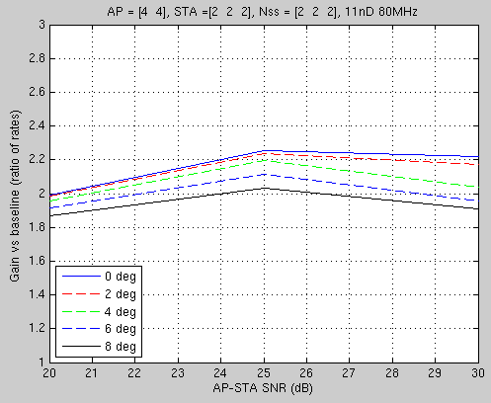
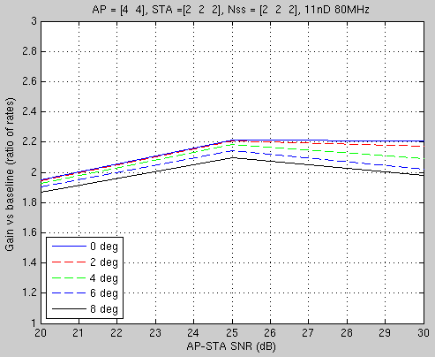
JT 2AP results
Per-AP power fixed, X=10dB
Per-AP power fixed, X=20dB
(Source: contribution 19/0384)

Slide 14
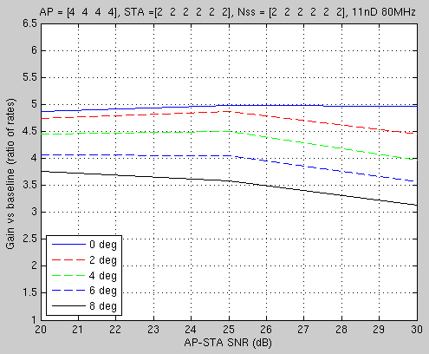
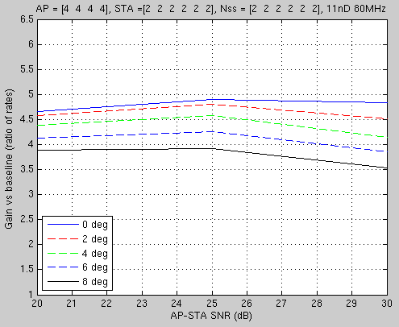
JT 4AP results
Per-AP power fixed, X=10dB
Per-AP power fixed, X=20dB
(Source: contribution 19/0384)

