Slide 1
HARQ Simulation Results
Date: 2019-05-09
Authors:
Name | Affiliations | Address | Phone | email
Ron Porat | Broadcom |  |  | ron.porat@broadcom.com
Ilan Reuven | Broadcom
Andrew Blanksby | Broadcom

Slide 2
Abstract
Provide simulation results and thoughts on HARQ

Slide 3
Simulation Methodology
11nD channel with LDPC coding
MIMO configurations studied based on practical configurations with an MMSE receiver:
  2x2 SU with BF and Nss=2
  4x2 SU with BF and Nss=2
  4x2 MU-MIMO with Nss=2 for one user and Nss=1 to another
Performance assumes CW based errors and re-transmission
HARQ CC and ARQ use all QAM sizes and current code rate combinations possible
HARQ Incremental Redundancy (IR) - assumes two re-transmissions
Two sets of results:
  MCS chosen based on known long term SNR (not instantaneous)
  MCS chosen with uniform instantaneous SNR feedback error within +/-5dB
    This is an example based on field measurements showing a difference between the reporting of SNR feedback of vendors
Alternate LDPC tone mapping between successive transmissions to capture diversity gain
Results show Goodput [bits/s/Hz/spatial stream].

Slide 4
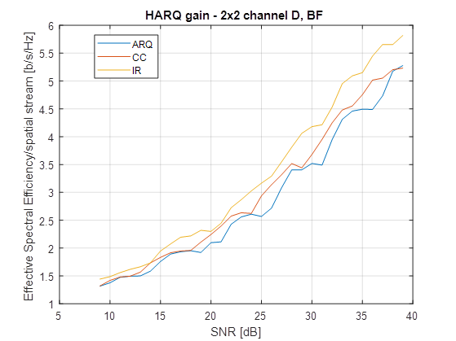
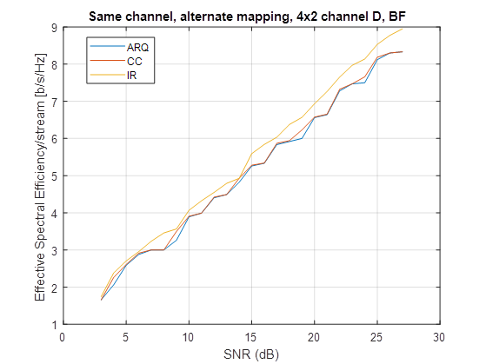
First set: SU BF Results

Slide 5
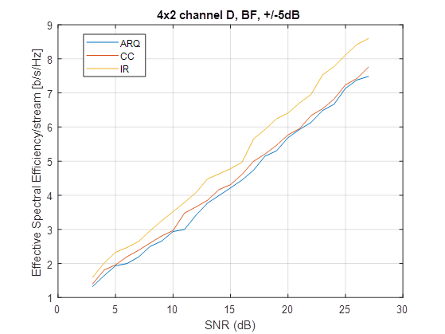
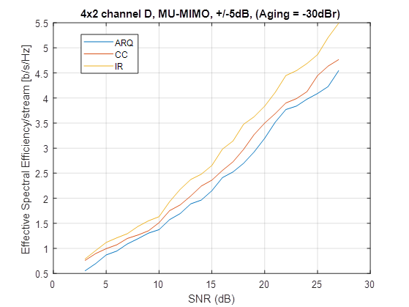
Second set: SU/MU-MIMO Results with +/-5dB SNR FB error

Slide 6
Summary of Gains
As expected the gain of HARQ depends on the MIMO configuration and increases when the Tx doesn’t have accurate knowledge of SNR or with channel aging.
Other configurations with less antennas or assuming open loop MIMO may show more gains
MIMO Configuration | Typical CC gain [dB] | Typical IR gain [dB]
SU, 2x2, BF, N_{SS} = 2 | 1 | 2-3
SU, 4x2, BF, N_{SS} = 2 | 0-0.5 | 1.5-2
SU, 4x2, BF, N_{SS} = 2, ±5dB | 0.5 | 2.5
MU-MIMO, 4x2, N_{SS} = [2,1], ±5dB, aging = -30dBr | 1 | 3-3.5

Slide 7
Summary
Based on our current results, IR with CW based feedback provide the minimum gain necessary for us to consider HARQ as a valuable technology.
Propose to continue investigating HARQ with focus on IR, CW based feedback and LDPC.

Slide 8
References
11-18-1116-00-0eht-multi-ap-harq-for-eht.pptx

