Slide 1
320MHz Channelization and Tone Plan
Date: 2019-05-12
Authors:
Name | Affiliations | Address | Phone | Email
Alice Chen | Qualcomm
Lin Yang
Bin Tian |  |  |  | btian@qti.qualcomm.com
Youhan Kim
Sameer Vermani
Steve Shellhammer
Notes:
September 2012

Slide 2
Abstract
320MHz channel bandwidth has been identified as one of the candidate features for EHT (11be)
The purpose of these slides is to discuss
Channelization of 320MHz
EHT PPDU BW modes
EHT tone plan designs, especially tone plan for 320MHz

Slide 3
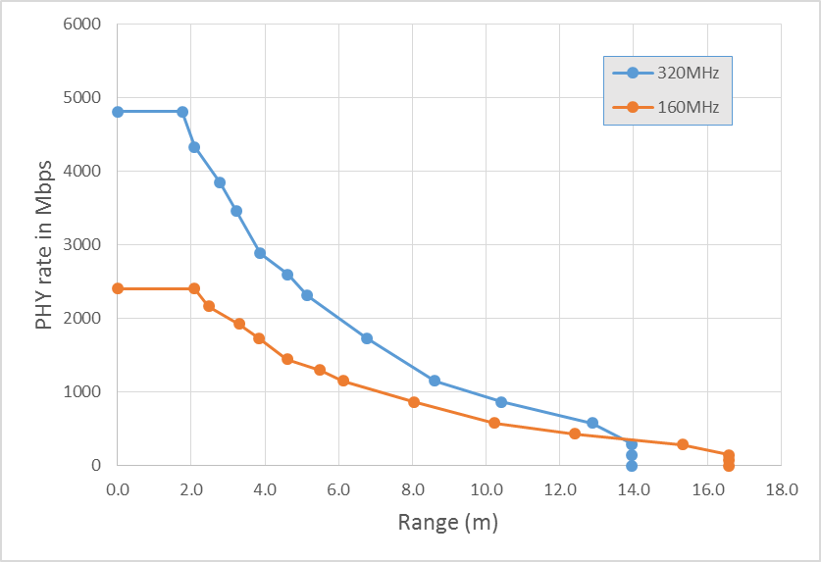
Gain from 320 MHz Channel
Double the peak throughput
Improve Rate vs Range at high PHY rates (e.g 1Gbps) due to linear BW vs log SNR trade off
2 Rx STA with 0.8us CP 11ax like tone plan | 160 (80+80) MHz | 320 (160+160) MHz
MCS9 (256 QAM) | 1.9Gbps | 3.8 Gbps
MCS11 (1024 QAM) | 2.4Gbps | 4.8 Gbps
More than 50% range improvement
on offer for many rates
4x2 TxBF
1 Gbps

Slide 4
Channelization of 320MHz and PPDU BW Modes
Channel configurations of 320MHz
Config 1: Contiguous 320MHz
Config 2: Noncontiguous 160+160MHz
Each 160 segment can be in different bands
PPDU BW Modes
Existing BW modes: 20MHz, 40MHz, 80MHz, 160MHz, 80+80MHz
New BW modes: 320MHz, 160+160MHz
160+80MHz mode may need more discussion. One option is to supported it as a partial BW mode of 160+160MHz
320MHz
160MHz
Unused SB
160MHz

Slide 5
EHT Tone Plan Design Summary
Existing BW modes (20/40/80/160/80+80MHz): Use 11ax 4x tone plans
Proposal for 320/160+160MHz BW modes uses HE160 as a building block
New BW modes: 320MHz, 160+160MHz
160+80MHz could be supported as a partial BW mode of 160+160MHz
Proposal: Use HE160 in each PHY 160MHz subband
Pros:
Preserve PHY80 boundaries and tone plan for 80MHz only devices
Be transparent to HW implementation regardless of BW mode

Slide 6
EHT 320/160+160MHz Tone Plan Proposal
HE/EHT 80MHz 4x tone plan
EHT 320/160+160MHz tone plan (examples of combinations)
Duplicate of 2 HE160
12 Edge
1
2
1
26
1
26
2
1
1
26
2
1
7
DC
13
1
2
1
26
1
2
1
1
2
11 Edge
26
26
26
26
26
26
26
26
26
26
26
26
1
26
26
26
26
26
26
26
26
26
26
26
26
2
26
2
26
26
26
26
26
13
26
2
26
2
26
26
26
26
52
2
52
1
52
52
52
52
1
52
52
7
DC
2
1
1
11 Edge
52
52
52
52
52
52
52
52
52
52
12 Edge
1
1
26
2
2
2
1
26
2
1
13
13
1
1
26
2
2
2
1
26
52
2
52
1
12 Edge
1
102+4
1
26
1
102+4
2
102+4
1
26
1
102+4
1
13
7
DC
13
1
102+4
1
26
1
102+4
2
102+4
1
26
1
102+4
1
11 Edge
12 Edge
242
242
13
7
DC
13
242
242
11 Edge
12 Edge
484
13
7
DC
13
484
11 Edge
12 Edge
996 usable tones +5 DC
11 Edge
HE80/EHT80
EHT320/160+160
SU tone plan:
12 Edge
996 + 5 subband DC
23
Null
996 + 5 subband DC
23
DC
996 + 5 subband DC
23
Null
996 + 5 subband DC
11 Edge
OFDMA tone plan examples
12 Edge
996 + 5 subband DC
23
Null
994 + 7 subband DC
23
DC
996 + 5 subband DC
23
Null
994 + 7 subband DC
11 Edge
12 Edge
994 + 7 subband DC
23
Null
996 + 5 subband DC
23
DC
994 + 7 subband DC
23
Null
994 + 7 subband DC
11 Edge

Slide 7
Straw Poll 1
Do you support adding 320MHz and 160+160MHz PPDUs to 11be?
Y
N
A

Slide 8
Straw Poll 2
Do you support the 11be uses the same subcarrier spacing for the data portion of EHT PPDU as 11ax data portion?
Y
N
A

Slide 9
Straw Poll 3
Do you support the following EHT tone plans?
Reuse 11ax tone plan for 20/40/80/160/80+80MHz
320MHz and 160+160MHz use duplicated HE160 for OFDMA tone plan
Note: puncturing design TBD. Non-OFDMA 320MHz/160+160MHz tone plan TBD
Y
N
A

Slide 10
References
[1] EHT draft proposed PAR 18/1231r6
[2] 11ax spec draft D4.0

