Slide 1
Effect of Preamble Decoding on HARQ in 802.11be
Date: 2019-03-09
Authors:

Slide 2
Abstract
In this contribution, we evaluate the effect of decoding of the preamble on 802.11be goodput with HARQ.
We also discuss some the elements that need to be addressed to specify HARQ in 802.11be.

Slide 3
Introduction
Hybrid ARQ is one of the candidate features under discussion for 802.11 EHT [1]
  HARQ combines retransmissions at the bit or symbol level before decoding to improve performance (e.g. reliability, goodput) compared with simple ARQ (used in existing 802.11) that decodes the latest retransmission (ReTx).
Its performance in 802.11 (using 802.11ax as baseline) has shown to provide some gains over simple ARQ in [2],[3],[4],[5],[6], and [7]
In [9], we evaluated the goodput performance of 802.11be with HARQ in collision-free (AWGN-impaired) and collision-dominated (interference-impaired) environments
  We also demonstrated performance gains but showed that there was a need for different strategies in collision-dominated environments.
In this contribution, we address the goodput performance of HARQ when taking preamble decoding into consideration and discuss some issues that need to be resolved for successful specification of HARQ in 802.11be.

Slide 4
HARQ Operation with Preamble Decoding
HARQ is implemented on the data portion of the packet and needs knowledge of the parameters of the packet to identify a packet that should be combined.
  The parameters are carried in the packet preamble which is usually encoded separately from the data using different transmission parameters (e.g., MCS, coding rate).
  If preamble decoding fails, then the STA cannot decode the data (or even identify that the data arrived) and, therefore, will not be able to combine the data packet.
We will investigate the goodput performance of HARQ and real preamble decoding.

Slide 5
Analysis with Preamble Decoding
Analysis of Single Packet Transmission
Pr(packet decoding fail) = Pr(SIG decoding fail) + Pr(SIG decoding success, Data decoding fail)
= Pr(SIG decoding fail) + Pr(SIG decoding success)*Pr(Data decoding fail | SIG decoding success)
= Pr(SIG decoding fail) + (1 - Pr(SIG decoding fail))*Pr(Data decoding fail | SIG decoding success)
= Pr(SIG decoding fail) (1 - Pr(Data decoding fail | SIG decoding success))
+ Pr(Data decoding fail | SIG decoding success)
Implications:
  Pr(Data decoding fail | SIG decoding success) is Pr(Data decoding fail) assuming ideal SIG detection
  At higher SNRs where SIG detection ~ ideal, there is no effect
  If Pr(Data decoding fail) >> Pr(SIG decoding fail), then there is a reduced effect
  At lower SNRs or if Pr(Data decoding fail) ~ Pr(SIG decoding fail), there is a possibility of an increase in the packet failing

Slide 6
Evaluation Metrics
Packet Error Rate (PER):
  PER = Number of failed packets / total number of unique information packets
  Does not take into account the number of retransmissions, e.g. may have HARQ with lower PER but multiple retransmissions.
Number of Transmissions (nTx):
  Average Number of transmissions till successful packet decoding (nTx)
Goodput: Successful Throughput incorporating retransmissions
  Goodput = (1-PER) x no. of bits per packet / packet duration (data only) / (nTx)
  No. of bits per packet / packet duration : Raw throughput
  NOTE: throughput does not include the preamble overhead or time spent contending for medium

Slide 7
Simulation Assumptions
Combine HARQ with link adaptation by selecting best goodput for all MCS at any SNR
Assumptions:
  802.11ax, 242 tone RU, 20 MHz, Regular GI, 4x HE-LTF, DNLOS channel
  Nt = Nr = Nss = 2, and Nt = Nr = Nss = 1;
  BCC IR HARQ (see Appendix)
  MSDU/MPDU
  Payload size:
    MCS 0~3:1500B, 100 bytes (VoIP)
  1 MPDU per PPDU
  No impairments
  Real Channel Estimation

Slide 8
Simulations
~ 2 dB difference between HARQ performance
with real and ideal preamble decoding at low SNR

Slide 9
Simulations
~ 1.5 dB difference between HARQ performance
with real and ideal preamble decoding at low SNR

Slide 10
Simulations
0 dB difference between HARQ performance with real and ideal preamble decoding

Slide 11
Analysis Results Summary
Result Summary:
  Difference in goodput performance of 802.11be with HARQ between real and ideal preamble decoding for Nss = 1, 100 bytes and Nss= 1, 1500 bytes
  No difference for Nss = 2 and 1500 bytes
Implications:
  The effect of preamble decoding on the goodput performance depends on the transmission parameters e.g. Nss and packet size
    As the probability of error (Pe) of the data increases, the effect of SIG decoding on the packet error performance decreases as discussed earlier
  There may be a need for improving the preamble decoding performance for scenarios where Pe of data is relatively low e.g. Nss = 1 or small packet sizes.

Slide 12
Hybrid ARQ as a feature for 802.11be
802.11be should support Hybrid ARQ for increased reliability, efficiency and reduced latency [1].
Potential Schemes
    Chase Combining (CC) HARQ : basic CC, CC with frequency domain interleaving [3]
    Incremental Redundancy (IR) HARQ [8]
Some issues to be resolved:
  HARQ packet identification: HARQ packets should include parameters like redundancy version, HARQ process to assist with combining.
  HARQ packet structure: HARQ design should allow for retransmissions of partial packets to prevent retransmission of the entire packet on failure
  Delay and Latency: HARQ transmission protocol design should have options to reduce delay and latency e.g. HARQ retransmission with or without waiting for ACK/NAK.
  Impairment type: HARQ transmission and feedback design should take into account the impairment type i.e. loss due to collision or due to AWGN e.g. use of ACK/NAK/COL

Slide 13
Conclusion
In this contribution, we have evaluated the effect of decoding of the preamble on the goodput performance of HARQ.
  We show that the effect of preamble decoding on the performance depends on the transmission parameters, e.g., Nss and packet size.
We also discuss some the elements that need to be addressed to specify HARQ in 802.11be.

Slide 14
References
[1] IEEE 801.11-19/244r0 EHT PAR document, Michael Montemurro (BlackBerry)
[2] IEEE 802.11-18/1979r0, HARQ performance analysis, Tianyu Wu (Samsung), Nov 2018
[3] IEEE 802.11-18/1992, HARQ Feasibility, Hongyuan Zhang (Marvell), Nov 2018
[4] IEEE 802.11-18/2031r0 BRCM, HARQ gain studies, Sindhu Verma (Broadcom), Nov. 2018
[5] IEEE 802.11-18/1963r1, Discussion on HARQ for EHT, Bo Sun (ZTE), Nov 2018
[6] IEEE 802.11-18/2029r0, HARQ in EHT, Imran Latif (Quantenna), Nov 2018
[7] IEEE 802.11-18/1955r0, HARQ for EHT - Further Information, Shimi Shilo (Huawei), Nov 2018
[8] IEEE 802.11-19/0070r0 Hybrid ARQ in Collision-Free and Collision-Dominated Environments, Kome Oteri (InterDigital), Jan 2019
.

Slide 15
Appendix

Slide 16
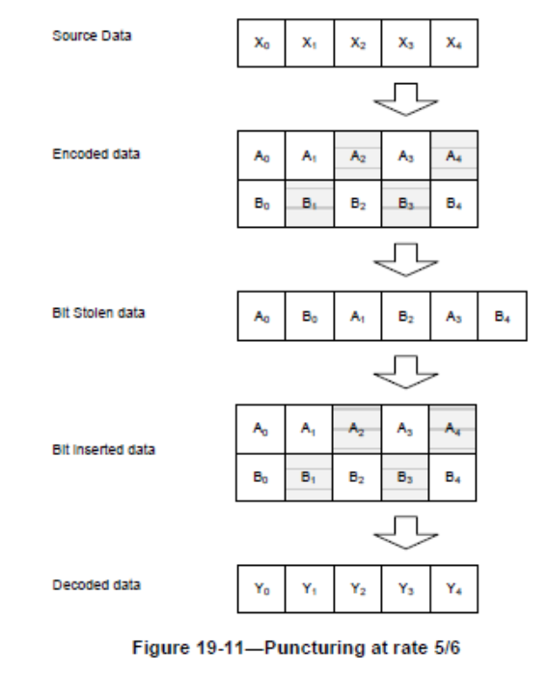
IR for BCC
BCC: change puncturing pattern (implemented)
  ½: [1 1 1 0], [1 1 0 1], [1 0 1 1], [0 1 1 1]
  ¾ : [1, 1, 1, 0, 0, 1],[1, 1, 0, 1, 1, 0],[1, 1, 1, 0, 1, 0],[1, 1, 0, 1, 0, 1]
  5/6: [1, 1, 1, 0, 0, 1, 1, 0, 0, 1],[1, 1, 1, 1, 1, 0, 0, 1, 0, 0], …

